Slide 1
GC0079 Workgroup Meeting: September 2017
Meeting name | Frequency Changes during Large System Disturbances Workgroup (GC0079)
Date of meeting | Tuesday 26th September 2017
Time | 10.30am – 4pm
Location | Energy Networks Association, London

Slide 2
Cost of RoCoF Constraint
Recap:
The presence of the RoCoF relays manifests as a constraint on the largest credible loss on the transmission system and/or the level of system inertia.
This is generally managed by curtailing the size of the largest instantaneous generation or demand loss(es) to a level where if one of them did trip, the RoCoF would be smaller than the threshold of 0.125 Hz/s.
In rare circumstances, the only available action is to increase inertia by synchronising another unit, but this involves making room for that unit when there is likely very little flexibility to do so (low demand & footroom constraint).

Slide 3
Cost of RoCoF Constraint
Forecast of future costs:
Use the same economic model as used for the Network Options Assessment (license condition C27) – Bid3:
Pan-European model
Industry approved
Based on the Future Energy Scenarios
Model process:
Normal process
Operability enhancements
Pure market dispatch
Thermal
Voltage
Loss limit
Constraints applied

Slide 4
Cost of RoCoF Constraint
Network thermal constraints.
E.g. max transfer of 3.5 GW at ‘B6’ boundary (Scotland → England)
Thermal
Voltage
Loss limit
Minimum requirement of synchronous machines in particular regions.
E.g. (table)
Unit / unit group limit
E.g. largest credible loss of a single unit or group of units* shall not cause RoCoF > 0.125Hz/s.
Both generators and demand are considered, the latter being exporting interconnectors.
*at a double-circuit risk on an intact network. There are three groups, one in the South West and two in the North East.
Zone 1 |  | Zone 2
Req. | 3.0 | Req. | 2.0
Unit A | 1.0 | Unit B | 1.0
Unit B | 1.0 | Unit D | 0.5
Unit C | 1.0 | Unit E | 0.5
Unit D | 0.5 | Unit F | 1.0
Unit E | 0.5 | Unit G | 1.0

Slide 5
Cost of RoCoF Constraint
The model re-optimises all constraints when a new constraint is added.
Thermal
Voltage
Loss limit
Constraint costs
Thermal only
Constraint costs
... + Volts
Constraint costs
... + RoCoF
The difference between these two constraint cost totals is the cost of the ‘RoCoF Constraint’

Slide 6

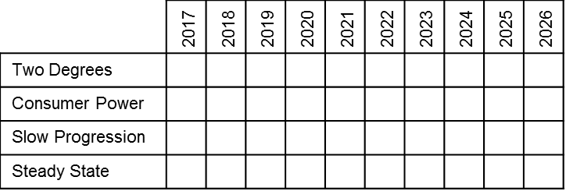
Assessment Schedule
For each Future Energy Scenario for next ten years:
RoCoF constraint costs
?
Later years might become technically or economically infeasible.

