Slide 1
Ancillary Services Information

Slide 2
External Information Sent to Service Provider
Invoice
Statement summary
Service summaries
Pivot table summary
Adjustments
Backing sheets
Spreadsheets

Slide 3
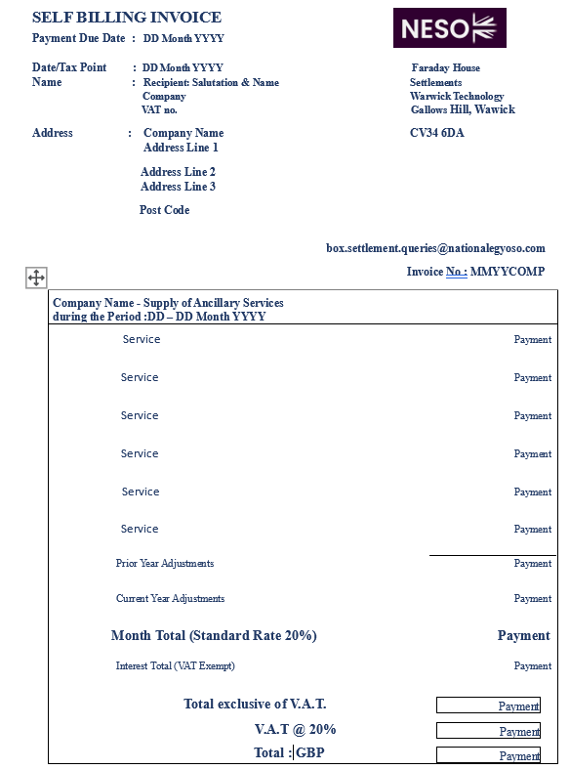
Invoice
Includes:
Company Codes
Payment Date
Invoice No
Recipient Name & Address
Payment by Service
Adjustment Information
VAT payment details
Payment Total

Slide 4
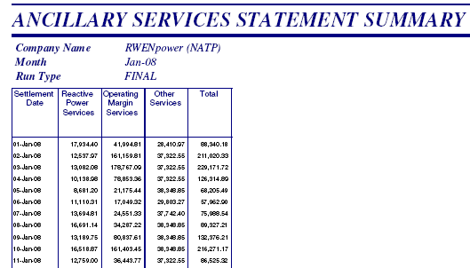
Statement Summary
Payments by service type, by day, by company

Slide 5
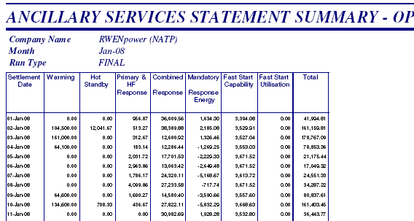
Service Summaries – Op Margin example
Payments by detailed service, by day, by company

Slide 6
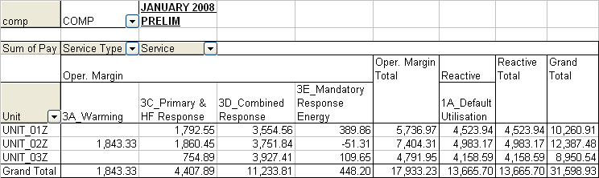
Pivot Table
Month total
By Unit
By detailed services

Slide 7
Backing Reports and Additional Information - Overview
The standard naming convention for the new backing reports and the additional information requested by service providers is as below.
NNN_COMP_MMMYY_TTTTT.CSV
Where:
NNN is a three-character code to identify the report type.
COMP is the Company Code
MMMYY is the report month and year
TTTTT is the report version e.g. PRELIM or FINAL

Slide 8

Backing Reports Description
Report Identifier | Report Name | Description | Current Report Identifier(s)
BSD | Black Start Declarations | Black Start Availability and Unavailability by Effective date and time | BSD
BSU | BM Start Up | BM Start Up and Hot Standby payments by unit/instruction | BSU
BST | Black Start Declarations | Black Start Availability and Unavailability by Settlement Period and Payment | BST
FSA | Fast Start Availability | Fast Start Availability payments by unit | FSA
FSU | Fast Start Utilisation | Fast Start Utilisation payments by unit/Instruction | FSU
HOS | Hydro Other Services | Spin Pump, Spin Gen, Pump Deload and Rapid Start payments by unit | HOS
HRA | Hydro Response Availability | Hydro Response Availability payments by unit/instruction segment | HRA
HRC | Hydro Response Commercial Imbalance | Hydro Commercial Imbalance payments/volumes by unit/SP | HRC
HRE | Hydro Response Energy | Hydro Response Energy payments/volumes by unit/SP( or part SP) | HRE
MFE | Mandatory Frequency Energy | Non Hydro Response Energy payments/volumes by unit/SP( or part SP) | MFE
MFH | Mandatory Frequency Holding | Non Hydro Response Holding payments by unit/instruction segment | MFH
RPC | Reactive Power Cost | Reactive Power Costs for default and market contracts by unit/day | RPC
RPV | Reactive Power Volume | Reactive Power Volumes for default and market contracts by unit/day | RPV
SBA | STOR BM Availability | STOR BM Availability payments by unit/SP (Note: Excludes impact of bid-offer failures during ramping periods which may reduce the availability payment) | SBA
SBU | STOR BM Utilisation | STOR BM Utilisation volumes | SBU
SNA | STOR NBM Availability | STOR NBM Availability payments by unit/SP | SNA
SNU | STOR NBM Utilisation | STOR NBM Utilisation payment and volumes | SNU

Slide 9
Additional Information Reports summary
Report identifier | Report Name | Description
ASI | Ancillary Services instructions | A list of all Ancillary Services instructions issued to BM service providers excluding Hydro Units e.g. For Frequency Response and BM Start-Up
NSD | NBM STOR declarations | A list of all NBM Week Ahead and Day Ahead Availability declarations, and the identification of rejected and excluded windows.
NSI | NBM STOR instructions | A list of all NBM STOR service call-off instructions
NSR | NBM STOR re-declarations | A list of all NBM Re-declarations of availability issued after 17:00 on the previous day.
PSI | Pumped Storage/Hydro instructions | A list of all Ancillary Service instructions issued to Hydro Units e.g. For Spin Gen and Response.

Slide 10
Summary of Data Provided
GRANULARITY OF INFORMATION
Invoice | C |  | M |  |  |  | P
Adjustments | C |  | M |  | T |  | P
Statement Summary | C |  |  | D | T |  | P
Service Summaries | C |  |  | D |  | D | P
Pivot Table |  | U | M |  |  | D | P
Backing reports /Spreadsheets |  | U |  | D |  | D |  | D
SERVICE DETAILS
PAYMENT (£)
DATA
SERVICE TYPE
COMPANY
MONTH
UNIT
DAY

