Slide 1
GSR035: System Access Reform - Changes to Enable Beneficial Outages Without Compromising System Security
Workgroup Meeting 3 , 30 March 2026
Online Meeting via Teams

Slide 2
WELCOME

Slide 3
Agenda
Topics to be discussed​ | Lead​
Objectives and Timeline​ • Walk-through of the timeline for the modification​ | Chair​
Action Log | All​
Case Studies​ | Proposer​/ NESO SME
Review Draft Legal Text | All​
Any Other Business​ | Chair​
Next Steps​ | Chair​

Slide 4

Objectives and Timeline
Ren Walker – NESO Code Administrator

Slide 5
GSR035 Proposed Timeline
Milestone​ | Date​ | Milestone​ | Date​
Modification presented to Panel​ | 05 December 2025 | Code Administrator Consultation (15 Business Days) | 05 August 2026 to 27 August 2026
Workgroup Nominations (20 Business Days holiday period)​ ​ | 22 January 2026 – 12 February 2026 | Draft Final Modification Report (DFMR) issued to Panel (5 Business Days)​ | 15 September 2026
Workgroup 1 – review proposal and legal text Workgroup 2 and 3 – refine solution, build Workgroup Consultation document and legal text Workgroup 4 – approve Workgroup Consultation document | 03 March 2026 11 March 2026 30 March 2026 13 April 2026 | Panel undertake DFMR recommendation vote ​ | 29 September 2026
Workgroup Consultation (15 Business Days)​ | 22 April 2026 to 14 May 2026 | Final Modification Report issued to Panel to check votes recorded correctly | 29 September 2026 to 05 October 2026
Workgroup 5 – review consultation feedback ad build Workgroup Report Workgroup 6 – Review Workgroup Report and vote | 29 May 2026 26 June 2026 | Final Modification Report issued to Ofgem​ | 06 October 2026
Workgroup report issued to Panel (5 Business Days)​ | 15 July 2026 | Ofgem decision ​ | TBC
Panel sign off that Workgroup Report has met its Terms of Reference​ | 29 July 2026 | Implementation Date ​ | 10 Business Days after Authority decision

Slide 6
Action Log
Ren Walker – NESO Code Administrator

Slide 7
Action Number | Workgroup Raised |  | Owner | Action | Due by | Status
01 | WG1 |  | LW | Terms of reference amendment. Submit the proposed amendment to change the word “explain” to “consider” in the TORs refence “d” to the SQSS Panel for approval. | 24/03/2026 | Propose to close
02 | WG1 |  | DN/SP | Case Studies – Prepare additional case studies for next Workgroup. Focussing on “where outages move from in securable to securable and include Scottish practices for comparison. | WG3 | Closed
03 | WG1 |  | DN/SP/NESO/TO Representatives | Clarify and document how “unacceptable overloading” is interpreted and applied in practice by NESO and the TO’s in England & Wales and Scotland. | WG3 | Open
04 | WG1 |  | All WG Members | Legal Text Review - ensuring correct references and alignment. | WG3 | Closed

Slide 8
Action Number | Workgroup Raised |  | Owner | Action | Due by | Status
07 | WG2 |  | DN/SP | Case studies to be updated with clause-by-clause SQSS walkthroughs. | WG3 | Closed
08 | WG2 |  | DN/SP | Engagement with ‘Affected Users’ request to explicitly define and document this in reports and slides. | WG3 | Closed
09 | WG2 |  | DN/SP | Impact of Proposed changes on Safety and Asset Protection: Clarification requested on who is responsible for safety and how this interacts with SQSS. | WG3 | Closed
10 | WG2 |  | DN/SP | Relationship between chapter 5.4 changes and chapters 2 & 4. Concern that any changes made to 5.4 will impact Chapter 2 and 4 of the SQSS. Request for this link to be fully assessed. | WG3 | Closed
11 | WG2 |  | DN | Need for clearer problem definition: Clarify this before amending legal text. | WG3 | Open
12 | WG2 |  | DN | Purpose and scope of 5.11 (risk-based approach) Request to revisit the rationale before reviewing legal text drafting. | WG3 | Closed

Slide 9
Terms of Reference
Workgroup Term of Reference
Consider the governance arrangements for the risk based methodology as this need to be documented, open and transparent. The governance needs to be such that any affected stakeholder is able to influence the development and application of the methodology. The workgroup should explicitly consider whether the risk based methodology should form part of the SQSS.
b) Clearly state the key assumptions and principles associated with the risk based methodology.
c) Engage with all potentially affected stakeholders.
d) Consider the rationale and benefits associated with the balance between short term increase in risk to stakeholders and the longer term benefits associated with the connection of projects associated with the transition to a low carbon economy.
e) Consider whether a risk based methodology should be associated with outages other than those to facilitate the implementation of the Clean Power 2030 Action Plan e.g. normal maintenance and asset replacement outages.
f) Consider whether the risk based methodology should be applied across all four seasons or just during winter, as implied by the modification proposal.
g) Consider the most appropriate place for the methodology to be documented, so that it is open and transparent.
h) Consider the requirement for a Grid Code modification such that there is an obligation for all relevant parties to provide the required data to undertake the risk assessment, engage in the risk assessment process, share the results from application of the methodology and agree to its findings. Consideration should be given to the process where the impacted party does not agree with the outcome of the risk assessment. The party responsible for applying the methodology should also be codified.
Consider the number of occasions per annum when the new arrangements are expected to be applied and the relaxations implemented, to form a view of the potential benefits.
j) Consider whether the risk based approach should be applied to high impact / low probability events only, or whether a risk based approach could / should be applied to low impact / high probability events.
k) Quantify or provide examples of the change in risk to customer supplies arising from the implementation of a risk based approach compared to a deterministic approach.
l) Consider the current risk assessment process applied in Scotland and whether it, in its current or modified form could be applied in England and Wales.

Slide 10
CASE Studies GSR-035
30 March 2025

Slide 11
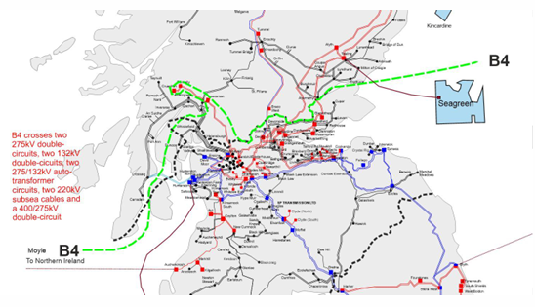
Case Study 1 – Scotland (Constraint)
The scenario analysis a north-to-south power flow along the B4 boundary.
This is a high-cost boundary.
ETYS publication
Notes:
It is important to note that the 132kV network is still part of the transmission system in Scotland.
Assessments carried out identified that cascading the circuit does not cause widespread disturbance on the network.
If the TO does not agree to the cascade, the outage would need to be sanctioned.

Slide 12
A detailed analysis of the boundary outage determined that the most critical fault is a double circuit (DC) trip which overloads a circuit on the 132kV network. (SQSS 5.3.3)
From SQSS
“5.3 The onshore transmission system shall be operated under prevailing system conditions so that for the secured event on the onshore transmission system of a fault outage of:
5.3.1 a double circuit overhead line;
there shall not be any of the following:
5.3.3 a loss of supply capacity greater than 1500 MW;“
Notes:
5.3 The onshore transmission system shall be operated under prevailing system conditions so that for the secured event on the onshore transmission system of a fault outage of:
5.3.1 a double circuit overhead line; or
5.3.2 a section of busbar or mesh corner,
there shall not be any of the following:
5.3.3 a loss of supply capacity greater than 1500 MW;
5.3.4 unacceptable frequency conditions;
5.3.5 unacceptable voltage conditions affecting one or more Grid Supply Points for which the total group demand is greater than 1500 MW;
5.3.6 system instability of one or more generating units connected to the supergrid; or
5.3.7 Unacceptable Sub-Synchronous Oscillations.

Slide 13
A detailed analysis of the boundary outage determined that the most critical fault is a double circuit (DC) trip which overloads a circuit on the 132kV network. (SQSS 5.3.3)
There are no mitigating actions that can be taken post fault to reduce the overloads whilst keeping the same constraint limit.
The overload on the circuit is approx. 130% - 150% of its PFC rating and has a STR rating of approx. 108% to 115% of its PFC.
It was identified that cascade tripping this circuit does not cause widespread disturbance on the network. No impact to DNO, TOs or generators were seen.
By cascading and instead securing for the subsequent fault, the constraint limit can be increased by 300MW – 350MW.
As the excessive overload was successfully managed without resulting in any noncompliance with the referenced SQSS clauses, the outage was permitted to proceed.
The unavailability of the cascade would incur significant boundary cost.
Notes:
5.3 The onshore transmission system shall be operated under prevailing system conditions so that for the secured event on the onshore transmission system of a fault outage of:
5.3.1 a double circuit overhead line; or
5.3.2 a section of busbar or mesh corner,
there shall not be any of the following:
5.3.3 a loss of supply capacity greater than 1500 MW;
5.3.4 unacceptable frequency conditions;
5.3.5 unacceptable voltage conditions affecting one or more Grid Supply Points for which the total group demand is greater than 1500 MW;
5.3.6 system instability of one or more generating units connected to the supergrid; or
5.3.7 Unacceptable Sub-Synchronous Oscillations.

Slide 14
Case Study 2 – Scotland
The scenario analysis an outage request in the Northwest of Scotland.
The substation consist of three SGTs and several MIS circuits.
In this scenario, an outage on two SGTs and a circuit was considered.
A fault on the double circuit in the region leads to overloading of the remaining SGT between 108% - 120% of its STR rating and 130% -150% of its PFC rating.
Although the SQSS does not contain specific clauses requiring us to secure for the aforementioned DC, as a prudent system operator, NESO will implement these security measures to avoid incurring costly balancing actions.
The overload would continue during the fault because the O/C protection threshold was not met.
Without an agreement for cascade tripping the remaining SGT, the outage would not have been able to proceed as it would lead to operability challenges on the network.
Alternatively, the SGT would need to be taken pre-fault which reduces demand security.
Notes:
O/C protection threshold was not met
Challenges in taking the required drops as the generator effectiveness is low and would require significant amount of MW drops.
5.3 The onshore transmission system shall be operated under prevailing system
conditions so that for the secured event on the onshore transmission system of a fault outage of:
5.3.1 a double circuit overhead line; or
5.3.2 a section of busbar or mesh corner,
there shall not be any of the following:
5.3.3 a loss of supply capacity greater than 1500 MW;
5.3.4 unacceptable frequency conditions;
5.3.5 unacceptable voltage conditions affecting one or more Grid Supply Points for which the total group demand is greater than 1500 MW;
5.3.6 system instability of one or more generating units connected to the supergrid; or
5.3.7 Unacceptable Sub-Synchronous Oscillations.

Slide 15
Case Study 3 – E&W
Thermal and voltage analysis was carried out for a Mesh corner (MC) outage request in Southwest of England.
This outage was required to address long standing voltage issues by installing required equipment.
If a MC fault were to occur at the substation, unacceptable voltage (as per table 6.4 of the SQSS) were detected at the surrounding GSPs.
Therefore, the condition of SQSS clause 5.4.4 is breached based on 5.4.2. which would not allow the outage to proceed.
From SQSS:
“The onshore transmission system shall be operated under prevailing system conditions so that for the secured event on the supergrid of a fault outage of:
5.4.2 a section of busbar or mesh corner in NGET’s transmission system,
there shall not be:
5.4.4 unacceptable voltage conditions in NGET’s transmission system.“
Notes:
The onshore transmission system shall be operated under prevailing system conditions so that for the secured event on the supergrid of a fault outage of:
5.4.1 a double circuit overhead line where any part of either circuit is in NGET’s transmission system; or
5.4.2 a section of busbar or mesh corner in NGET’s transmission system,
there shall not be:
5.4.3 unacceptable overloading of primary transmission equipment in NGET’s transmission system;
5.4.4 unacceptable voltage conditions in NGET’s transmission system.

Slide 16
Case Study 3 – E&W
From the 5.11.3 proposal, the MC fault might be ignored based on probabilistic assessment and if there is no widespread disturbance on the transmission network.
NESO would also engage with all affected users* review system risks and mitigations
If the above conditions are met, this would mean that if the fault were to occur in real time
the affected GSPs would be disconnected from the network
the DNO possibly losing demand/generators.
Though there is a short-term risk associated with this request, it would lead to long term system security as the above issues would have been mitigated
*only users connected to the transmission network (TO, DNO, Generators, DCC). NESO would not engage with users connected to the distribution network.
Notes:
The onshore transmission system shall be operated under prevailing system conditions so that for the secured event on the supergrid of a fault outage of:
5.4.1 a double circuit overhead line where any part of either circuit is in NGET’s transmission system; or
5.4.2 a section of busbar or mesh corner in NGET’s transmission system,
there shall not be:
5.4.3 unacceptable overloading of primary transmission equipment in NGET’s transmission system;
5.4.4 unacceptable voltage conditions in NGET’s transmission system.

Slide 17
Case Study 4 – E&W (Constraint)
The scenario examines south to north power flows where there is a circuit outage in Northeast of England.
The assessment identified that the most severe trip scenario as DC fault, which overloads an adjacent circuit, which in turn limits the constraint. (SQSS 5.4.3)
From SQSS
“The onshore transmission system shall be operated under prevailing system conditions so that for the secured event on the supergrid of a fault outage of:
5.4.1 a double circuit overhead line where any part of either circuit is in NGET’s transmission system;
there shall not be:
5.4.3 unacceptable overloading of primary transmission equipment in NGET’s transmission system;”
Notes:
From the 5.11.3 proposal, checks will be carried out to see the probability of this DC fault occurring and that there is no widespread disturbance on the transmission network.
The onshore transmission system shall be operated under prevailing system conditions so that for the secured event on the supergrid of a fault outage of:
5.4.1 a double circuit overhead line where any part of either circuit is in NGET’s transmission system; or
5.4.2 a section of busbar or mesh corner in NGET’s transmission system,
there shall not be:
5.4.3 unacceptable overloading of primary transmission equipment in NGET’s transmission system;
5.4.4 unacceptable voltage conditions in NGET’s transmission system.

Slide 18
Case Study 4 – E&W (Constraint)
The scenario examines south to north power flows where there is a circuit outage in Northeast of England.
The assessment identified that the most severe trip scenario as DC fault, which overloads an adjacent circuit, which in turn limits the constraint. (SQSS 5.4.3)
Cascade tripping of the overloaded circuit was studied – no widespread disturbance on the network was observed.
No impact on DNO and generators were identified in this region due to the cascade tripping of the overloaded circuit.
Cascading the overloaded circuit when the DC fault occurs would allow for an increase in the constraint limit of around 600 MW.
Notes:
From the 5.11.3 proposal, checks will be carried out to see the probability of this DC fault occurring and that there is no widespread disturbance on the transmission network.
The onshore transmission system shall be operated under prevailing system conditions so that for the secured event on the supergrid of a fault outage of:
5.4.1 a double circuit overhead line where any part of either circuit is in NGET’s transmission system; or
5.4.2 a section of busbar or mesh corner in NGET’s transmission system,
there shall not be:
5.4.3 unacceptable overloading of primary transmission equipment in NGET’s transmission system;
5.4.4 unacceptable voltage conditions in NGET’s transmission system.

Slide 19
Questions?

Slide 20
Legal text and Process Implementation

Slide 21
Rationale/proposed statement GSR 035
To support a more flexible and efficient operational planning framework while preserving the integrity of Article 5, the introduction of a new clause 5.11.3 is proposed as the most effective and proportionate solution. Clause 5.11.3 would establish a clearly defined mechanism for allowing limited, exceptional relaxation of operational criteria where there is demonstrable system or consumer benefit. Crucially, this flexibility would only be granted following a structured and transparent risk‑assessment process, ensuring that any deviation from standard requirements is justified, controlled, and auditable.
This approach enables the system to accommodate occasional, well‑supported opportunities without exposing the network to routine or unmanaged risk. It is also consistent with previous SQSS developments—specifically the introduction of clause 5.11.2 under the Frequency Risk and Control Report (FRCR) arrangements, which similarly enabled additional flexibility without weakening core standards.

Slide 22
Rationale/proposed statement GSR 035 contd.
In parallel, complementary enhancements to the STCP framework could strengthen the practical application of clause 5.11.3. In particular, a new provision would allow Transmission Owners to initiate the risk‑assessment process in situations where an outage would ordinarily be rejected under standard criteria but where a flexible approach could offer clear benefit. Providing TOs with this formal route would improve early identification of viable opportunities, enhance coordination between parties, and ensure that all instances of flexibility are managed through a consistent governance structure.
Overall, the combination of clause 5.11.3 within the SQSS and targeted STCP updates offers a balanced, robust, and future‑proof solution. It maintains Article 5 as the enduring security benchmark while introducing a controlled, evidence‑based pathway for exceptional flexibility where it delivers value.”

Slide 23
GSR 035 Legal Text
Impact to sections 5.3 and 5.4
Clause 5.11.3 - Exceptions to section 5.3 and 5.4

Slide 24
5.3 The onshore transmission system shall be operated under prevailing system conditions so that for the secured event on the onshore transmission system of a fault outage of:
5.3.1 a double circuit overhead line; or
5.3.2 a section of busbar or mesh corner,
there shall not be any of the following:
5.3.3 a loss of supply capacity greater than 1500 MW; 5.3.4 unacceptable frequency conditions;
5.3.5 unacceptable voltage conditions affecting one or more Grid Supply Points for which the total group demand is greater than 1500 MW;
5.3.6 system instability of one or more generating units connected to the supergrid; or
5.3.7 Unacceptable Sub-Synchronous Oscillations.
.

Slide 25
5.4 The onshore transmission system shall be operated under prevailing system
conditions so that for the secured event on the supergrid of a fault outage of:
5.4.1 a double circuit overhead line where any part of either circuit is in
NGET’s transmission system; or
5.4.2 a section of busbar or mesh corner in NGET’s transmission system,
there shall not be:
5.4.3 unacceptable overloading of primary transmission equipment in NGET’s transmission system;
5.4.4 unacceptable voltage conditions in NGET’s transmission system.

Slide 26
Proposed Legal Text
5.11 Exceptions to the criteria in paragraphs 5.1 to 5.7 and 5.9 may be required:
5.11.1 where variations to the connection designs as per paragraphs 3.12 to 3.15 have been agreed; or
5.11.2 in relation to 5.1.7 and 5.3.4 only, based on the outcome of an assessment conducted in accordance with
the Frequency Risk and Control Report.
5.11.3
In relation to 5.3 and 5.4, only if identified by a robust assessment process that is approved by the Authority, and only for the background conditions and duration identified by such process, for specific secured events which if secured would have an impact on a transmission licensee’s ability to complete their planned construction works or on the operational costs arising from these works that is significantly disproportionate to the risks arising from not securing them over a specific period of time, or where securing such event would unduly reduce the security of supply for one or more demand groups.

Slide 27
Process Framework
SQSS change approval – Defines the ‘What’
Risk Assessment Template /Process agreed via a technical workshop – NESO/TOs/stakeholders – Defines the ‘How’
Process framework approved by Authority – Process will be part of the Network Access Plan(NAP) process – Defines the ‘How’
New STCP modification to codify the NESO/TO interaction on the initiation of the application of this process.

Slide 28
Process Implementation
TOs identify a qualifying Outage that could be assessed based on initial strategic assessment after initial outage rejection/anticipated rejection or
NESO identify potential outage candidate after offline studies and discuss with relevant TOs for agreement
Outage is assessed under agreed risk assessment criteria
Risk assessment approved or rejected
Yearly report to Ofgem by NESO/TOs led NESO on the application of this process.

Slide 29
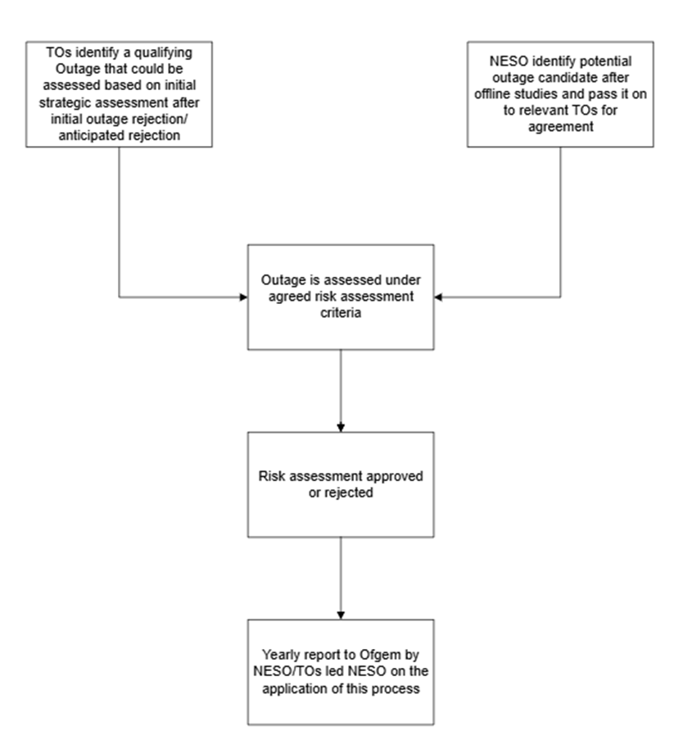
Process Map

Slide 30
Any Other Business
Ren Walker – NESO Code Administrator

Slide 31
Next Steps
Ren Walker – NESO Code Administrator

