Slide 1
Public
RESP Methodology
Areas for further development
Spatial Context for Gas and Biomethane
06 March 2026, 10am - 11:30am
Nick Smith, RESP Technical Delivery Manager
Faith Natukunda, RESP Senior Technical Delivery Manager
Jonny Sadler, RESP Engagement and Communications Manager

Slide 2
Agenda
  Welcome (5 mins) – Jonny Sadler
  Presentation (15 mins) - Nick Smith
  Plenary Q&A (10 mins) - Jonny Sadler chairing with Nick Smith and Faith Natukunda
  Breakout workshops (35 mins)
  Feedback & discussion (20 mins) - nominated participant or facilitator to feed back
  Next steps (5 mins) - Jonny Sadler
Notes:
Housekeeping - Transcription will be on but notes will not be shared publicly

Slide 3

Session aims
Public
NESO presents our updated proposals
NESO answers any clarification questions
Attendees provide feedback on our proposals

Slide 4

RESP Methodology areas for further development - web page
Public
New feedback window open: RESP Methodology - areas for further development | National Energy System Operator

Slide 5
Spatial Context for Gas and Biomethane
Public
15 mins
Presentation - Nick Smith

Slide 6
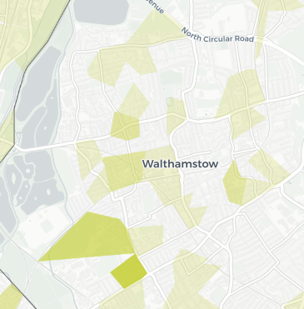
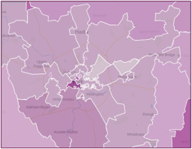
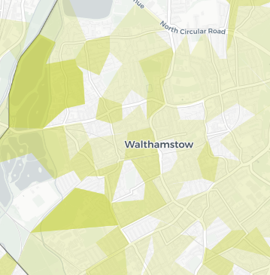
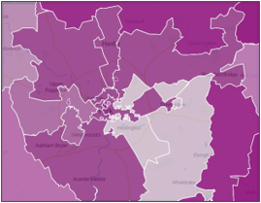
Reminder: What is Spatial Context?
Public
The Spatial Context is a key geospatial component of the RESP. It provides a whole energy visualisation based on RESP Pathways through an accessible digital mapping tool and will use both geographical and network asset views to allow users to interrogate system needs spatially and temporally, including where potential constraints may emerge.
Spatial Context Vision
Geographic View
Network Asset View
2050
2050
2030
2030

Slide 7
Spatial Context
Public
Areas of further work have focused on integration of Gas and Biomethane into Spatial Context.
Areas of Further Work
 | Topic | Proposed changes from draft methodology
1 | Gas (Demand) | NESO proposes: Gas Distribution Networks (GDNs) utilise RESP Pathways and RESP Consistent Planning Assumptions (CPAs) to model peak gas demand (weather corrected) across their networks, supporting the proactive identification of system needs and acting as an input to specification of Strategic Investment Need.
2 | Biomethane (Supply) | NESO proposes: GDNs utilise RESP Pathways and RESP CPAs to model the interaction between projected biomethane supply and periods of minimum demand across their networks, supporting the proactive identification of system needs and acting as an input to specification of Strategic Investment Need.
3 | Network Asset Granularity | NESO proposes: For the Geographic View - Visualise supply and demand related outputs for Spatial Context using the same granularity as RESP Pathways outputs (LSOA/Data Zone/MSOA etc). For the Network Asset View - Visualise supply and demand related outputs for Spatial Context gas network within Medium Pressure zones.

Slide 8
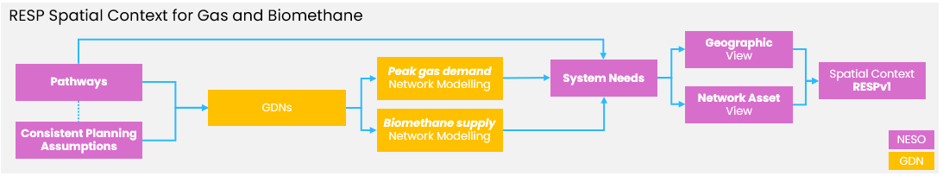
Public
Areas of Further Work
The below diagram sets out an indicative process flow for coordinating data between NESO and GDNs for the purposes of developing Spatial Context.
NESO’s proposed approach has been developed to support the identification of system needs where proactive intervention may be required and to act as an input into the identification of Strategic Investment Needs across the gas distribution networks

Slide 9


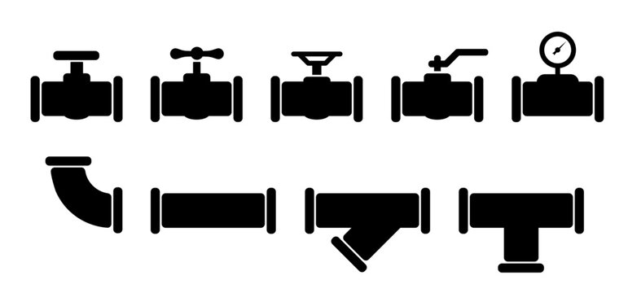



Gas (Demand)
Public
For gas demand, RESP Spatial Context will focus on modelling peak gas demand across the gas distribution networks
What we heard:
NESO’s initial approach focused on mapping future gas demand across all gas distribution networks to provide a spatial view of how gas demand could change over time.
Many stakeholders commented that whilst this view was welcomed, the detail provided within the draft Methodology was limited, making it hard to conclude how this would work in practice and how its value would be assessed.
NESO Proposes:
GDNs utilise RESP Pathways and RESP Consistent Planning Assumptions (CPAs) to model peak gas demand (weather corrected) across their networks
NTS
85 bar → 38 bar
High Pressure
38 bar > 7 bar
Intermediate Pressure
7 bar > 2 bar
Medium Pressure
2 bar > 75 mbar
Low Pressure
75 mbar >
NTS
Gas Demand
Large industrial loads
Large industrial loads
Industrial & commercial loads
Domestic and small commercial
Notes:
Supporting the identification of system needs where proactive intervention may be required
Supporting the identification of Strategic Investment Needs across the gas distribution networks (note the final decision of how areas of Strategic Investment Need are implemented within network planning processes and price control mechanisms remaining with Ofgem through its regulatory and policy frameworks.)
NESO will continue to collaborate with GDNs to develop the necessary peak gas demand network modelling methodology for Spatial Context, noting that NESO’s proposal for GDNs to utilise RESP Pathways and CPAs within Spatial Context to model peak gas demand does not supersede or replace these existing methodologies and responsibilities.

Slide 10
Biomethane (Supply)
Public
For biomethane supply, RESP Spatial Context will focus on the interaction between projected biomethane supply and periods of minimum demand across the networks
What we heard:
NESO’s initial approach for biomethane focused on mapping future biomethane injections into the gas distribution network.
Similarly to Gas demand, many stakeholders commented that whilst this view was welcomed, the detail provided within the draft methodology was limited, making it difficult to conclude how this would work in practice and how value of this approach would be assessed.
NESO Proposes:
GDNs utilise RESP Pathways and RESP CPAs to model the interaction between projected biomethane supply and periods of minimum demand across their networks, supporting the proactive identification of system needs and acting as an input to specification of Strategic Investment Need.
NTS
85 bar → 38 bar
High Pressure
38 bar > 7 bar
Intermediate Pressure
7 bar > 2 bar
Medium Pressure
2 bar > 75 mbar
Low Pressure
75 mbar >
NTS
Biomethane Supply
Very Large biomethane plants
Large biomethane plants
Medium and small biomethane plants
Notes:
Biomethane is typically supplied onto gas distribution networks under firm injection profiles, resulting in limited flexibility to adjust supply to meet changes in demand. This can result in network constraints during periods of seasonal minimum demand and may prevent biomethane producers from being able to inject their supplies onto the local gas distribution network.
Facilitating an increasingly proactive approach to identification of system needs where biomethane connection enquiries may emerge.
NESO considers that GDNs are best placed to model the interaction between projected biomethane supply against projected minimum demand across their networks following provision of RESP Pathway outputs and Consistent Planning Assumptions.

Slide 11
Network Asset Granularity
Public
Medium Pressure entry assets are at the interface between medium and intermediate/high pressure, a granularity allowing stakeholders to interrogate gas network changes over time
What we heard:
NESO’s initial approach for visualising gas network data did not present a decision on the granularity of network asset to be modelled against.
NESO Proposes:
NESO proposes that GDNs model the required supply and demand related outputs for Spatial Context at their Medium Pressure Entry Assets.
NTS
85 bar → 38 bar
High Pressure
38 bar > 7 bar
Intermediate Pressure
7 bar > 2 bar
Medium Pressure
2 bar > 75 mbar
Low Pressure
75 mbar >
NTS
NESO’s proposed approach for integrating gas and biomethane into Spatial Context provides a strategic, pathway-aligned view to support proactive investment planning and whole system coordination. This approach does not guarantee network capacity for stakeholders and will not replace the requirement for detailed network analysis conducted by GDNs.
GDNs will still need to individually assess customer connection enquiries, identifying actual available capacity and reinforcement needs based on bespoke connection details such as:
The exact entry connection point
Distance from existing network assets
Local technical parameters of the gas distribution network.
Notes:
Medium Pressure entry assets operate at the interface between the medium (below 2 bar) and the intermediate/high pressure (above 2 bar) gas distribution systems. Modelling the RESP Pathways data at this asset granularity will enable stakeholders to interrogate how gas network capacities may change over time. This includes identification of system needs across RESP Regions and Nations where further strategic investment may be required.
Throughout the development of the proposed approach, NESO evaluated the value of providing a network-based view at higher asset granularities across the gas distribution network. GDNs indicated that it may be valuable to present a view at the Local Transmission System (LTS) level, comprising of the above 7 bar network.
NESO acknowledges some of the benefits associated with this view, including a reduction in the volume of data modelling; however, our proposed approach provides added value by enabling stakeholders to visualise biomethane connections at the pressure tier connections are typically made, as well as how gas networks may change at a fine granularity within each RESP region and nation. The approach closely aligns with the level of asset granularity being developed in parallel by Electricity Distribution Networks Operators (DNOs) when modelling Peak Electricity Demand at Primary Substations.

Slide 12
Plenary Q&A
Public
10 mins
Jonny Sadler, Nick Smith, Faith Natukunda

Slide 13
Breakout Workshops
Public
35 mins
Jonny Sadler

Slide 14
Breakout Room Structure
Public
We’ll cover three questions in 35 mins:
Do you agree with NESO’s proposal for visualising peak demand to identify areas of system need within Spatial Context?
Do you agree with NESO’s proposal for visualising biomethane supply to identify areas of system need within Spatial Context?
Do you agree with NESO’s proposal to visualise the gas distribution network asset view at Medium Pressure Entry Assets for biomethane supply and gas demand?
Housekeeping:
Mics on, and cameras too if you want
Transcription will be on, but notes will not be published

Slide 15
Breakout Room Guide
Public
Per question:
2 mins - Intros
3 mins (x3) - Everyone writes their responses to each question in Mural
7 mins (x3) – Group discussion on the feedback given
3 mins - To review and vote on the response they consider most important (You each have 1 vote per question)
Notes:
Guidance for facilitators:
Keep discussion focused on evidence and outcomes
Capture:
Suggested changes
Risks or unintended consequences
Dependencies or assumptions needing review

Slide 16

Car park
Public
Used by participants to capture items outside of today's session scope
Points will be considered when drafting other sections of the methodology.

Slide 17
Feedback & discussion
Public
20 mins
All

Slide 18
Feedback & Discussion (20 mins)
Public
  Once the breakout sessions have ended:
  Voting results will be displayed from Mural
  Chair will highlight most voted points
  Open discussion on key themes
Notes:
Guidance for facilitators:
Keep discussion focused on evidence and outcomes
Capture:
Suggested changes
Risks or unintended consequences
Dependencies or assumptions needing review

Slide 19
Next steps
Public
5 mins
Jonny Sadler

Slide 20
How to respond
Public
Please submit your responses by 11.59pm on 16 March 2026
Please submit your response via the Qualtrics platform: https://nationalgrideso.fra1.qualtrics.com/jfe/form/SV_8pJAMkj82VNpEyi
If you are not able to submit via Qualtrics, please let us know at box.resp@neso.energy by 9 March 2026, at the latest.
Responses are saved as you progress through the form, so you don't have to complete all questions at once. Please note that they are only saved when you go to the next page of the survey.
You will be able to download a copy of your responses as a PDF at the end.
FAQs are published on the RESP Methodology consultation section of the NESO website
If you have any questions, please email: box.resp@neso.energy
Notes:
This slide shows how to respond to the consultation
In terms of the FAQ: We’ll attempt to answer all questions received during the webinars and add them to the 'RESP Methodology Consultation FAQs' on the NESO website. The FAQs are updated every two weeks, so please check regularly.
If you have a question, please review the consultation document first, as it contains all core information. If your question isn’t covered in the document or FAQs, email box.consultations.resp@neso.energy. Thank you.

