Slide 1
Monitoring & Reducing Excessive Pricing in Balancing Reserve
16th February 2026

Slide 2
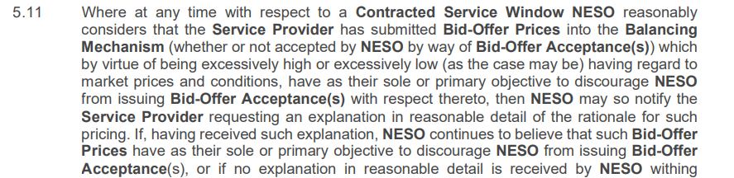
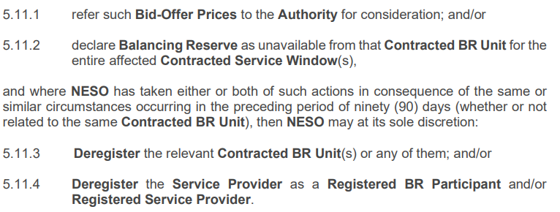
BR Service Terms Clause 5.11
NESO will begin enforcing this clause from 2nd March 2026

Slide 3
Performance Monitoring
Excessive pricing
The formula
For the purpose of monitoring, our tool considers whether a unit bid/offer price submitted is excessively high/low when compared to the calculated statistical threshold value for the relevant fuel category in a particular settlement period.
The Price Threshold Formula we apply (which NESO reserves the right to review periodically) is as follows:
The BM Bid Price Threshold Formula is:
= Median BM Bid (for the relevant SP and unit fuel category) - 3 * the Standard Deviation (for the relevant SP and unit fuel category)
The BM Offer Price Threshold Formula is:
= Median BM Offer Price (for the relevant SP and unit fuel category) + 3 * the Standard Deviation (for the relevant SP and unit fuel category)
NESO has implemented the Excessive Pricing Service Term clause, drawing on insights gained from other Balancing Services. It seeks to ensure that BR units remain available through contracted periods and do not intentionally deter NESO from dispatch by submitting excessively high or low pricing
Note: These formulas are used to define the thresholds that help NESO assess whether the BM Bid Price or BM Offer Price may be excessively high or excessively low, pursuant to Paragraph 5.11 of the BR Service Terms.
BM- Balancing Mechanism, SP- Settlement period

Slide 4
“Excessive Pricing” – Process flow
Stage One - Flagging potential pricing anomalies / outliers
Stage Two – Assessment
Stage Three – Provider explanation
Stage Four – Identifying mitigating and aggravating factors
Possible sanctions
Review
Possible sanctions
No action
No availability fee for affected service window
Refer to Ofgem (via Market Monitoring team)
If same or similar facts in preceding 90 days (same or different asset), then also:
  Deregister relevant asset on SMP from affected service
  Deregister provider on SMP from affected service
  Deregister provider on SMP for all services
Price threshold formula to identify potential anomalies/outliers which are taken into stage two
Provider explanation sought and considered- If NESO considers sole or primary motivation was to discourage despatch, then taken into stage four.
Consideration of market conditions and other relevant circumstances (example unplanned/planned BM EDL OR EDT + EDL outages, wider BM scarcity) to identify any potential legitimate justifications- if none, or in doubt, then taken into stage three
Mitigating factors include first ‘offence’, minor divergence from acceptable pricing range, cooperative with NESO, having efficient corrective actions in place, self-reporting and having resilient processes in place.
Aggravating factors include repetitive or persistent non-compliance, significant divergence from the acceptable pricing range, delays in taking corrective action, failure to implement a resilient/ robust process, aggravating actions or failure to act in a timely manner after becoming aware of the breach either before or during NESO’s investigation
Review

Slide 5
Detailed example 6a : Excessive Pricing
NESO Assessment
Stages | Detail
Stage One - Flagging potential pricing anomalies / outliers | Price Threshold Formula results is £215.96 Offer price is greater than threshold, stage 2 assessment is required
Stage Two – Assessment | Consideration of market conditions and other relevant circumstances. Day Ahead Nordpool Price = £330.07 Average Intraday price = £977.92 Peak BM Price = £5,750 On the 8th January 2025, a day of tight margins, average Intraday price was higher than the BM offer price of £400. Which can be understood as Provider A was pricing accordingly to market conditions. No further assessment is required.
Context
Provider A – Unit X wins a Positive Balancing Reserve Contract for the 08 Jan 2025
Settlement Period 33
BM Offer price: £400
Technology type: Battery
Note: the provided example and values are purely illustrative and should not be considered factually accurate
Outcome → No action

Slide 6
Detailed example 6b : Excessive Pricing
NESO Assessment
Stages | Detail
Stage One - Flagging potential pricing anomalies / outliers | Price Threshold Formula results is £414.44 Offer price is greater than threshold.
Stage Two – Assessment | Consideration of market conditions and other relevant circumstances. Day Ahead Nordpool Price = £104.42 Average Intraday price = £103.16 Peak BM Price = £144.9 Provider B offer pricing exceeded market prices. No unplanned/planned EDL BM outages observed that could have impede provider to adjust MIL/MEL to reflect unavailability.
Stage Three – Provider explanation | Provider B declared that BM price was used to discourage BOA.
Stage Four – Identifying mitigating and aggravating factors | This was the first offence from Provider B and after becoming aware of the failure provider has put corrective action
Context
Provider B – Unit Y wins a Positive Balancing Reserve Contract for the 9th Jan 2025
Settlement Period 31
BM Offer price: £9,999
Technology type: OCGT
Note: the provided example and values are purely illustrative and should not be considered factually accurate
Outcome → No availability fee for affected service window.
Incident recorded in case of further breaches

Slide 7
Q&A
Any questions raised but not answered during the session will be answered in a Q&A document which we will aim to share later this week.
For any further questions that arise after the session, please contact the Balancing Services Performance Monitoring team at box.balancingservicesmonitoring@neso.energy

