Slide 1
C9 Annual Review
13 November 2025

Slide 2
Agenda
As part of NESO’s annual review process, we are preparing to consult on changes to these statements for 2026/27 and invite feedback from stakeholders across the sector.
This session will provide:
1. An overview of the review and consultation process
2. Insight into the initial changes being proposed
3. Guidance on how to engage with the consultation process and next steps
4. Q&A

Slide 3
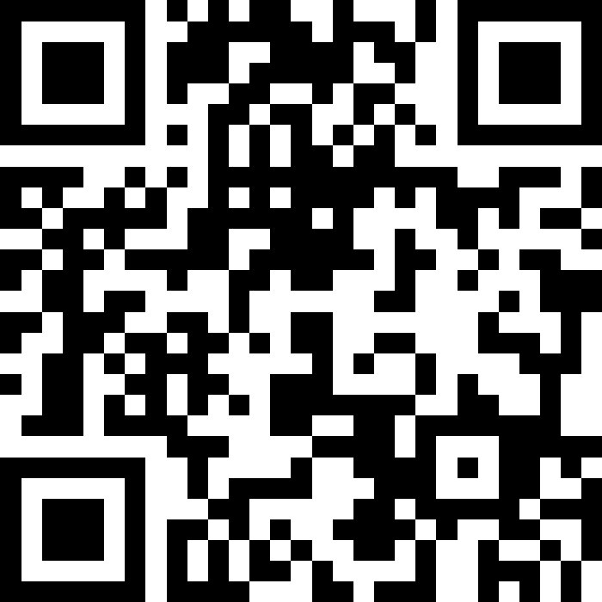
Housekeeping
slido #3200343
Cameras and mics off for attendees
Questions to be asked through Slido #3200343

Slide 4
Overview of the C9 Review Process
#3200343

Slide 5
C9 Annual Process
#3200343
The Electricity System Operator Licence Condition C9 "Procurement and use of balancing services" sets out the obligation on NESO to publish and annually review five statements addressing the procurement and use of balancing services.
The five statements are:
The Procurement Guidelines Statement (PGS)
The Balancing Principles Statement (BPS)
System Management Action Flagging Methodology (SMAF)
Applicable Balancing Service Adjustment Data Methodology Statement (ABSVD)
The Balancing Services Adjustment Data Methodology Statement (BSAD)
The current versions of the statements and consultations are published on the C9 NESO website page.

Slide 6
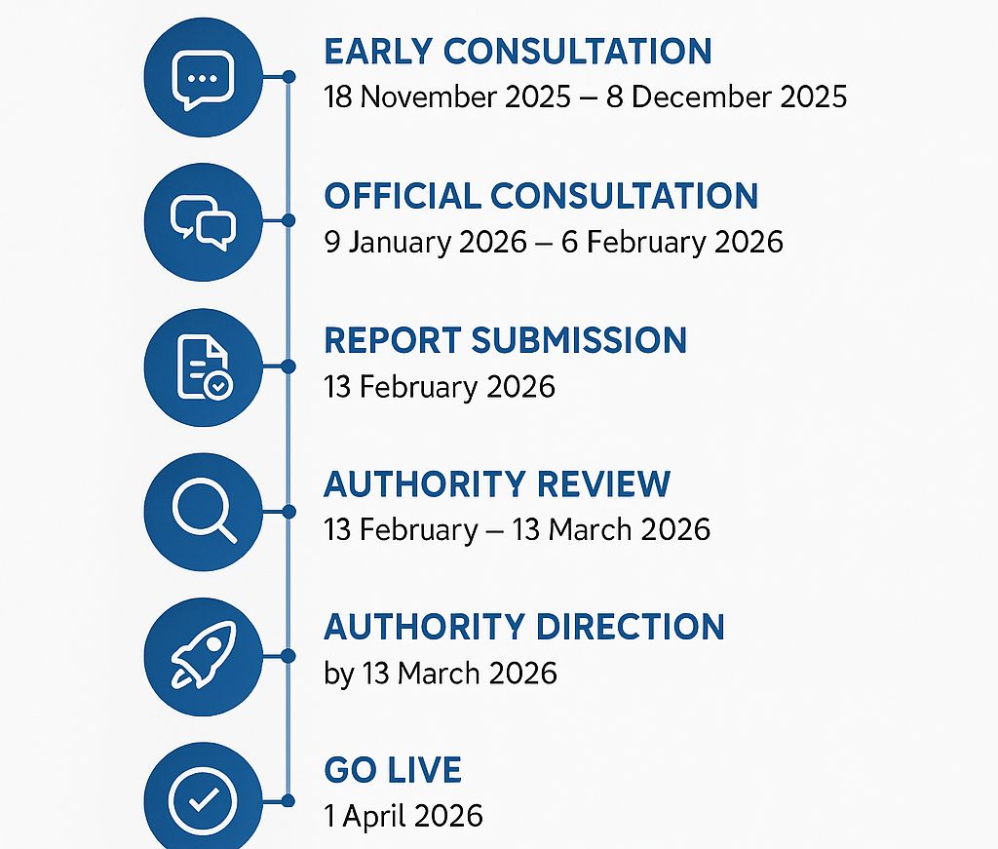
C9 Review timeline
#3200343
In accordance with Standard Condition C9 of the ESO License, we are conducting an annual review of all licence statements, as part of this review we have proposed changes to the five statements which we invite all industry parties to provide feedback on.
The proposed changes being consulted on would be for statements effective from 01 April 2026 until 31 March 2027.
Today’s webinar is an informal part of this process.

Slide 7
Early view of proposed changes
slido #3200343

Slide 8
Early view on changes summary
slido #3200343
This informal stage of the C9 process allows for further changes based on industry feedback and ongoing review.
Overview of changes/themes:
Key updates for Balancing Services across C9 statements
Key changes to the ABSVD and BSAD statements
Please note, detail on the full set of changes proposed will be set out within the informal and official consultation and are subject to change following industry feedback and further review.

Slide 9
Demand Flexibility Service (DFS)
slido #3200343
For more information and to keep up to date with DFS:
Webpage: DFS Webpage
Contact: demandflexibility@neso.energy
Upcoming engagement:
We are looking to procure the service both upwards and downwards
Subject to Article 18 and updated derogation approval, the service will be procured at any time in a day, up to a maximum of twelve hours ahead of the start of any Service Requirement window
Existing derogation for DFS to continue until March 2027.
We will be seeking an update derogation based on the live consultation changes and alignment with Clean Power 30 and bi-directional capability.
Resulting updates to DFS settlement report
Demand Flexibility Service Article 18 Consultation Response Form

Slide 10
Static Firm Frequency Response (SFFR)
slido #3200343
For more information and to keep up to date with Static FFR:
Webpage: Static FFR
Contact: Commercial.operation@neso.energy
Upcoming engagement:
November 2025 EBR Article 18 T&C’s consultation process
Reform of the Static service will take place in 2026 which will include the following proposed changes:
Changing the trigger level at which units respond to 49.65Hz or to a level required by NESO
Lowering the Auction minimum bid size to 01.MW
Lowering the minimum Unit size to 01.MW

Slide 11
Slow Reserve
#3200343
For more information and to keep up to date with SR:
Webpage: Slow Reserve
Contact: Commercial.operation@neso.energy
Upcoming engagement: Webinar 6th November
EBR Article 18 Approved by Ofgem in October 2025. New service to launch March 2026 and will replace STOR
STOR scheduled to hard stop on the 30 March 2026 and Slow Reserve to take over on 31 March.
Full details are published in our updated SR Transition plan

Slide 12
Reactive Power
#3200343
For more information and to keep up to date with Reactive Power updates:
Webpage: Reactive Power
Contact: commercial.operation@nationalenergyso.com
Long Term (Y-4) Reactive Power Market
  The long-term market is now business as usual with tenders being run when a requirement is identified, under the Network Services programme
  The Long-term 2029 tender was launched in March 2025 as a simultaneous procurement process seeking services from 2029 onwards.
Mid Term (Y-1)
  Recommended Mid-Term market for implementation
  Market to be launched subject to the identification of a requirement, with Mid-Term being chosen as optimal procurement route
Short Term (D-1)
  Further analysis is required to determine the value of a day ahead service
  Will update industry in due course

Slide 13
Reactive Power
#3200343
For more information and to keep up to date with Reactive Power updates:
Webpage: Reactive Power
Contact: commercial.operation@nationalenergyso.com
Obligatory Reactive Power Service (ORPS)
  New compensation methodology for the ORPS
  Industry Webinar held 25 Sept 2025.
  Final proposal will go through CUSC Code modification process.

Slide 14
Demand for Constraints
#3200343
For more information and to keep up to date with Demand for Constraints updates:
Webpage: Constraints Collaboration Project
Contact: box.market.dev@neso.energy
Engagement: CCP Webinar 5th November 2025
As part of the Constraints Collaboration Project (CCP), NESO is developing Demand for Constraints, a long-term contract whereby NESO can ask a demand source to increase its consumption of electricity at times of constraints, helping to reduce curtailment costs and volume.
NESO is still considering how this service would fit within the C9 landscape.
We aim to provide further details during the C9 consultation period ahead of the planned service launch in 2026.
Additional information will be shared in upcoming CCP webinars.

Slide 15
ABSVD/ BSAD Statement Transformation
#3200343
Key updates includes:
Clearer signposting to:
  Relevant BSC rules & definitions
  Roles & Responsibilities within the process between NESO & Elexon
  Where relevant data can be viewed
  Where the related queries can be addressed
Removal of any Imbalance calculation references in order to align better to the scope & purpose of the document
Provision of ABSVD to Elexon process is unchanged
In response to feedback from previous consultations and queries and to be well aligned with our Licence, methodology documents have been updated with the aim to streamline and simplify methodology documentation.

Slide 16
Next steps – engaging with the consultation process
#3200343

Slide 17
How to respond to the consultations
#3200343
Contact details
To receive updates relating to the C9 timeline or notification of consultation publications please register to the Balancing Service mailing list on our NESO website.
For any help or further questions please contact box.EFTConsultations@neso.energy
We welcome all industry parties to provide their views to the proposed changes for the upcoming informal and official C9 consultation.
Upon publication, all documentation will be published on the C9 Webpage.
Responses to be sent to box.EFTConsultations@neso.energy
Upcoming consultation publications:
Publication | Start Date | End Date
Informal consultation | 18 November 2025 | 17:00 08 December 2025
Official consultation | 09 January 2026 | 17:00 06 February 2026

Slide 18
Slido Q&A
#3200343

Slide 19
Thank you for listening.
slido #3200343
For any help or follow up questions please contact box.EFTConsultations@neso.energy

