Slide 1
GC0182:
Metering Polarity
Workgroup 3, 25 November 2025
Online Meeting via Teams

Slide 2
WELCOME

Slide 3
Agenda
Topics to be discussed​ | Lead​
Introductions​ | Chair​
Objectives and Timeline​ | Chair​
Actions Log Review | Chair​
Proposer presentation​ | Proposer​
Proposed Implementation Plan | NESO Representative
Workgroup Consultation Document Review
Any Other Business Timeline Review | Chair​
Next Steps​ | Chair​

Slide 4

Workgroup Responsibilities and Membership
Prisca Evans – NESO Code Administrator

Slide 5
Expectations of a Workgroup Member
Contribute to the discussion
Be respectful of each other’s opinions
Language and Conduct to be consistent with the values of equality and diversity
Do not share commercially sensitive information
Be prepared - Review Papers and Reports ahead of meetings
Complete actions in a timely manner
Keep to agreed scope
Email communications to/cc’ing the .box email
Your Roles
Help refine/develop the solution(s)
Bring forward alternatives as early as possible
Vote on whether or not to proceed with requests for Alternatives
Vote on whether the solution(s) better facilitate the Code Objectives

Slide 6
Workgroup Membership
Role​ | Name​ | Company​
Proposer | Thomas Goss | NESO
Workgroup Member | Hao Guo | NESO
Workgroup Member | Garth Graham | SSE Generation
Workgroup Member | Alan Creighton | Northern Powergrid
Workgroup Member | Andrew Allan | RWE
Workgroup Member | Harry Burns | EDF
Workgroup Member | Alan Convery | SP Transmission
Authority Representative | Paul Drew | OFGEM

Slide 7
Workgroup Membership
Role​ | Name​ | Company​
Workgroup Member | Roger Carter | Transmission Investment
Observer | Rhiannon Whitty | NESO
Observer | Angie Gwozdz | NESO
Observer | Aman Sharma | NESO
Observer | Elena Fry | NESO
Observer | Rebecca Coan | NESO
Observer | Pritesh Patel | NESO

Slide 8
Objectives and Timeline
Prisca Evans – NESO Code Administrator

Slide 9
Timeline for GC0182 as of 15 September 2025
Milestone​ | Date​ | Milestone​ | Date​
Modification presented to Panel​ | 24/07/25 | Code Administrator Consultation | 29/05/26 - 29/06/26
Workgroup Nominations (15 business days)​ | 29/07/25 - 18/08/25 | Draft Final Modification Report (DFMR) issued to Panel (5 business days)​ | 22/07/26
Workgroups 1, 2 and 3 | 15/09/25 20/10/25 25/11/25 | Panel undertake DFMR recommendation vote ​ | 30/07/26
Workgroup Consultation (21 business days)​ | 09/12/25 - 09/01/26 | Final Modification Report issued to Panel to check votes recorded correctly | 31/07/26 - 10/08/26
Workgroups 4, 5 and 6 | 20/01/26 04/03/26 14/04/26 | Final Modification Report issued to Ofgem ​ | 11/08/26
Workgroup report issued to Panel | 13/05/26 | Ofgem decision needed by | TBC
Panel sign off that Workgroup Report has met its Terms of Reference​ | 21/05/26 | Implementation Date ​ | TBC

Slide 10
Action Log Review
Prisca Evans – NESO Code Administrator

Slide 11
Action Log Review
Action | Owner | Status Update
4) Propose a clear and consistent implementation date for the new requirements, ensuring alignment across all relevant documents. | TG/PP | Needs to be a clear internal process(SCADA, Ops metering team). Contracts team - to discuss Mod is coming in and warn users of. Meet with compliance/contracts team. Draft Appendix F5- needs updating and added to new offers
5) Review and suggest a streamlined approach for implementing compliance via the BCA, considering whether to use only the electrical standards and BCA or also include CCs/ECCs. | TG/PP | Follow up required as Antony would like to include CCs/ECCs
6) Update the Legal Text as discussed, including clarifying references to operational notifications | HG | Updated the wording but needs further work

Slide 12
Action Log Review
Action | Owner | Status
7) Confirm the relevant section of the ECC refers specifically to limited operation notification (LON) or applies more broadly, to ensure the legal text aligns with the correct operational notification sequence (EON, ION, LON). | HG | Updated the wording but needs further work
8) Confirm in what capacity STC Panel member joining the Workgroup | TG | See above
9)Find out the technical difficulty of implementing the changes, i.e. is it a matter of connecting 2 wires one way or the other upon installing a meter. | TG | Detailed Response is on Slide 18

Slide 13
Action Log Review
Action | Owner | Status
10) Consider, the need for a guidance note on the installation of operational metering for non-participants | PP | AG units, VLP units. To make sure these units have the same Appendix amended. PP to reach out to L.H.

Slide 14
Proposer Presentation
Thomas Goss – NESO

Slide 15
Update on Questions from WG2
  After the standard is in place, how easy is it to change the metering polarity around if it is incorrect and what is the cost?
  [NESO Update] Please refer to slides on cost to fix incorrect meter polarity. NESO is not currently looking to retroactively implement this standard and only request new meters and connections to comply and set up the metering correctly from the start which should make it easier and less costly.
  What will be the date of implementation?
  [NESO Update] Because we do not know how long it will take for OFGEM to approve the modification, a blank date is used for now which will be updated to an agreed date after OFGEM approval.
  How will we implement the dates?
  [NESO Update] NESO have decided, for new connections, the implementation date will be based on the Completion Date (which can be found in Appendix J of the Connection Agreements) and new clause in ECC6.5.6.4 will be added to specify the requirement.
  For existing connections, the implementation date will be based on when the GB Code Users install or upgrade the operational metering and new clause will be added to CC6.5.6 to specify the requirement. Note that the offshore networks are usually built by the Generators and subsequently transferred to OFTO after the Completion date. Therefore, the Generators will likely be responsible for making sure the meter polarity complies to the standard.

Slide 16
Update on Questions from WG2
  How will non-BM participants comply to the standard as they are not bound to the Grid Code or Connection Agreements?
  [NESO Update] For Non BMUs the changes will be reflected in the service terms of the service provided. This will not be captured under the Grid Code. The only exception is Licence Exempt Embedded Medium Power Stations (50 - 100MMW Embedded Generators in England and Wales which apply for Licence Exemption) where we have to place the obligation on the DNO and the DNO then place the obligation on the Generator.
  Do we need to define what changes to Operational Metering means?
  [NESO Update] For installation of new operational metering it is straightforward. However, in terms of changes/upgrades to operational metering, NESO does not have a list of all the types of changes that can be made and might need to consult the GB Code Users.
  Will the STC Panel member be an Observer or Member in the Workgroup?
  [NESO Update] The STC Panel member(s) will be Observer for this Grid Code Mod Workgroup. There is a concurrent STC Mod CM0105 and there will be an STCP Workgroup. At present this has been agreed by the STC panel to move to the Work Group stage.
Notes:
For non BM Participation we cannot do anything because we have no relationship with them. The only exception is Licence Exempt Embedded Medium Power Stations (50 - 100MMW Embedded Generators in England and Wales which apply for Licence Exemption) where we have to place the obligation on the DNO and the DNO then place the obligation on the Generator.

Slide 17
Power Flow Metering Polarity – Example Cost to Fix
  The User is responsible to ensure the polarity is correct.
  The wire connections from CT/VT units are physical connections to the meters and once commissioned they should not be changed. The meters are contained within a cubicle that is sealed with access only allowed by authorised personnel.
  The process effectively ensures the correct value and direction of power flow is reported by the metering equipment to Elexon and any user. There can be massive financial issues if this data is incorrect.
  When the metering is in service the primary circuit is also in service. If there is a need to change polarity post commissioning there is considerable re-work that involves a number of parties to not only conduct re-wiring but more critically re-configure the software. It is this step that counts towards the majority of costs to the User.
  Cost to fix the meter polarity issue (based on TO data)
  (1) BAU activity: no cost
  (2) Software re-config and wiring changes are required on site: £4,000 / meter
  (3) New equipment needs to be ordered and replaced on site: £21,000 / meter
  (4) Meter points with 4G requirements needs to be ordered and replaced: £98,524 / meter
  Additional Cost for OFTO is £100,000 / site
Notes:
In order to fix the meters we need to understand what is required and how much this could cost. I have mention how we were viewing the 818 total meters as 402 meters provided by TOs and Generators and 416 meters provided by OFTOs, we are viewing them separately as there are different costs incurred when dealing with the Offshore stations. We received some data from TOs which separated the costs into 4 different fix types. A fix may be included as part of BAU activity which would come at no cost, if a fix required software reconfiguration or wiring changes this could come to £4000 per metre. In some cases new equipment is required so for standard equipment to be ordered and replaced on site would come to £21,000 per meter, if the equipment required was more specialised such as with 4G, the costs are closer to £100,000 per meter.
The OFTO costs were provided to us as per site rather than per meter and were given at £100,000 per site. The 416 meters we identified are spread across 45 sites.

Slide 18
Proposed Implementation Plan
Hao Guo – NESO

Slide 19
Grid Code Mod – Proposed Implementation Plan Stage 1
  Stage 1: Only update the Connection Agreements (e.g. BCA/BEGA/BELLA/LEEMPS/Offshore etc) - to add Metering Polarity Standard and requirement
  (1.1) To add Metering Polarity Standard to Connection Agreements, for example BCA Appendix F5/OF5 (in the case of LEEMPS, Appendix E) as a new schedule.
  Once Grid Code Mod is approved, it will be removed and included into the Electrical Standard documents (Annex to Grid Code General Conditions).
  We also considered whether we would need to bring Response Services, MW Dispatch, DER etc on board this Mod but as these are under separate contracts or specified by the DNO's it will not be necessary.
Electrical Standard – Metering Polarity Standard for Power Flow Data

Slide 20
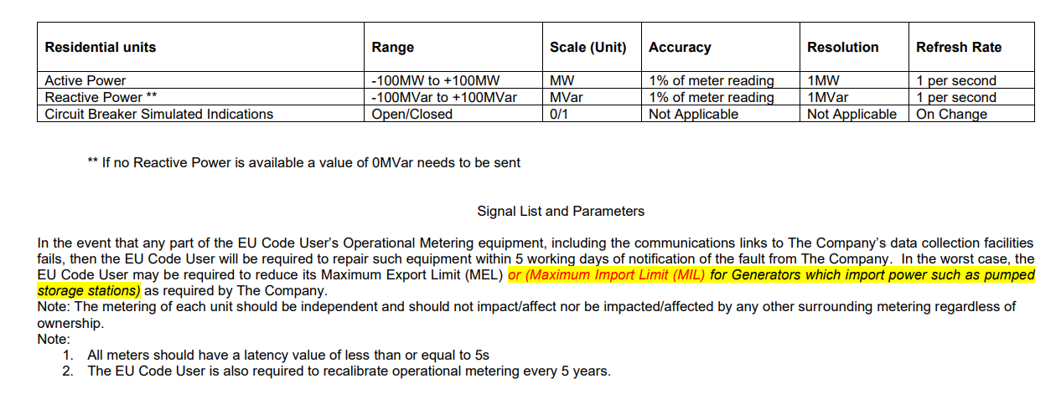
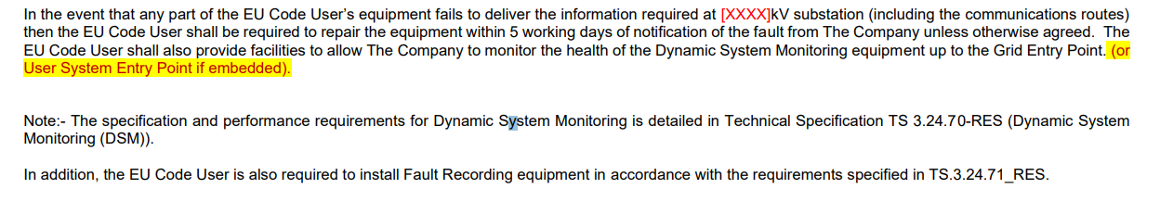
Grid Code Mod – Proposed Implementation Plan Stage 1
  Stage 1: Only update the Connection Agreements (e.g. BCA/BEGA/BELLA/LEEMPS/Offshore) - to add Metering Polarity Standard and requirement
  (1.2) To add requirement to Connection Agreements, for example BCA Appendix F5/OF5 – Schedule 2 & 3
  BCA Appendix F5/OF5 – Schedule 2
  BCA Appendix F5/OF5 – Schedule 3
3. All meters shall follow the Metering Polarity Standard for Power Flow Data as specified in BCA Appendix F5/OF5 new schedule.
All meters shall follow the Metering Polarity Standard for Power Flow Data as specified in BCA Appendix F5/OF5 new schedule.

Slide 21
Grid Code Mod – Proposed Implementation Plan Stage 1
  Stage 1: ONCC Process with reference to Connection Agreements
Operational Notification & Compliance Checklist (ONCC)
Connection Agreements
  Metering Polarity Standard with diagram and text will be added to Connection Agreements, for example BCA Appendix F5/OF5 as a new schedule
  Connection Agreements (e.g. BCA Appendix F5/OF5 Schedule 2 and 3) will be modified to request that “all meters shall follow the Metering Polarity Standard for Power Flow Data as specified in the Connection Agreements”.
  NESO ONCC process will request evidence of user’s equipment compliance for Op Metering and the checklist will refer to Connection Agreements (e.g. BCA Appendix F5/OF5 Schedule 2 and Schedule 3)
  NESO Compliance team request NESO Op Metering team to do the check

Slide 22
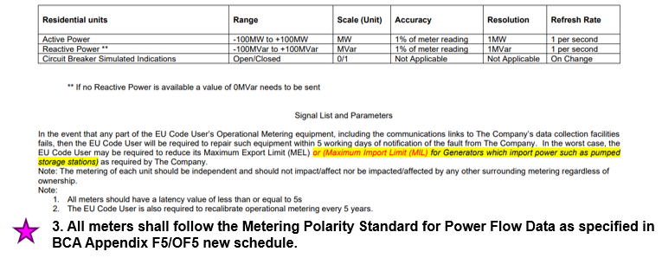
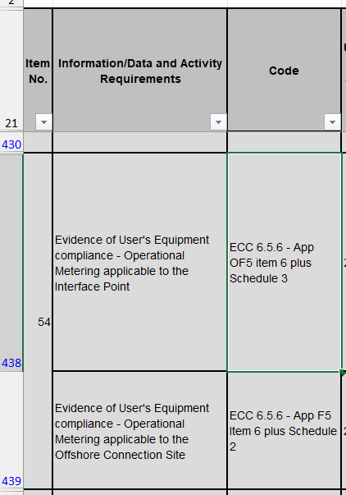
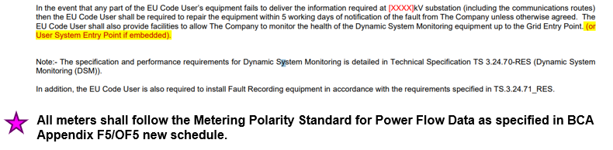
Grid Code Mod – Proposed Implementation Plan Stage 1
  Stage 1: ONCC Process with reference to Connection Agreements
Operational Notification & Compliance Checklist (ONCC)
Connection Agreements,
e.g. BCA Appendix F5/OF5
  Appx. F5 & OF5 Schedule 2
  Appx. F5 & OF5 Schedule 3

Slide 23
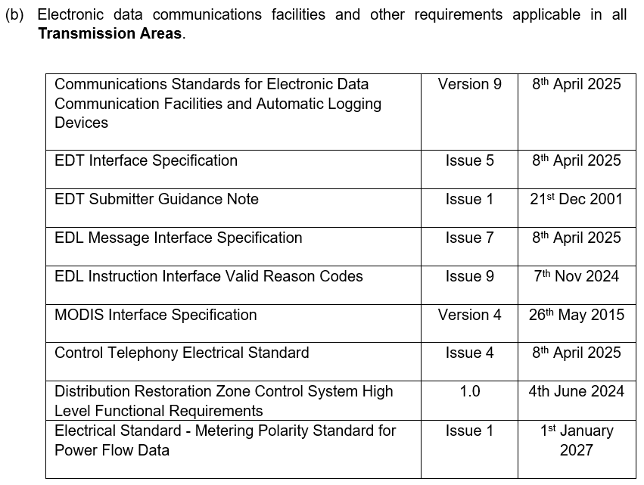
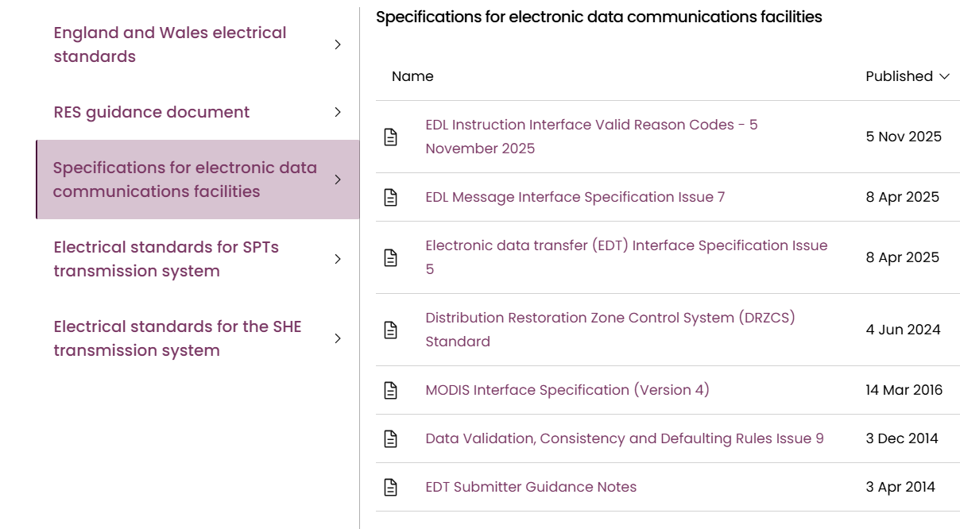
Grid Code Mod – Proposed Implementation Plan Stage 2
  Stage 2: Update both Grid Code and Connection Agreements - to publish Metering Polarity Standard as a new Electrical Standard and add reference and New CC and ECC to Grid Code; to remove Metering Polarity Standard from Connection Agreements and modify the requirements
  (2.1) To publish Metering Polarity Standard as a new Electrical Standard and add reference in Section (b) of Annex to Grid Code General Conditions.
Electrical Standard Website
Metering Polarity Standard for Power Flow Data

Slide 24
Grid Code Mod – Proposed Implementation Plan Stage 2
  Stage 2: Update both Grid Code and Connection Agreements - to publish Metering Polarity Standard as a new Electrical Standard and add reference and New CC and ECC to Grid Code; to remove Metering Polarity Standard from Connection Agreements and modify the requirements
  (2.2) To add New CC and ECC Clause to Grid Code
  CC6.5.6 (f) Where a GB Code User installs or upgrades its operational metering on or after DD/MM/YYYY, the User shall be required to satisfy the requirements of the Metering Polarity Standard for Power Flow Data. The detailed specifications for this standard are listed as an Electrical Standard in Annex (b) of the General Conditions. The GB Code User shall provide the list of metering points being installed or upgraded to The Company and these metering points will be checked and validated by The Company and agreed with the GB Code User.
    ECC6.5.6.4 (f) Where an EU Code User whose Completion Date is on or after DD/MM/YYYY the EU Code User shall be required to satisfy the requirements of the Metering Polarity Standard for Power Flow Data. The detailed specifications for this standard are listed as an Electrical Standard in Annex (b) of the General Conditions. The EU Code User shall provide the list of metering points being installed or upgraded to The Company. In the event of a new connection, the metering points will be checked and validated by The Company and agreed with the EU Code User prior to issue of Interim Operation Notification.

Slide 25
Grid Code Mod – Proposed Implementation Plan Stage 2
  Stage 2: Update both Grid Code and Connection Agreements – to publish Metering Polarity Standard as a new Electrical Standard and add reference and New CC and ECC clauses to Grid Code; to remove Metering Polarity Standard from Connection Agreements and modify the requirements
  (2.3) To modify requirements in Connection Agreements, for example BCA Appendix F5 & OF5 Schedule 2 and 3
  BCA Appendix F5 & OF5 – Schedule 2
  BCA Appendix F5 & OF5 – Schedule 3
3. All meters shall follow the Electrical Standard - Metering Polarity Standard for Power Flow Data as listed in Section (b) of Annex to Grid Code General Conditions.
All meters shall follow the Electrical Standard - Metering Polarity Standard for Power Flow Data as listed in Section (b) of Annex to Grid Code General Conditions.

Slide 26
Grid Code Mod – Proposed Implementation Plan Stage 2
  Stage 2: ONCC Process with reference to both Connection Agreements and Grid Code
Operational Notification & Compliance Checklist (ONCC)
Grid Code
Connection Agreements
  Publish Electrical Standard – Metering Polarity Standard for Power Flow Data on NESO Grid Code website.
  Add reference to Electrical Standard – Metering Polarity Standard for Power Flow Data to Section (b) of Annex to Grid Code General Conditions.
  New CC 6.5.6 (f) and ECC6.5.6.4 (f) clauses to specify from when the User needs to follow the Metering Polarity Standard
  Connection Agreements (e.g. BCA Appendix F5 Item 13 and Appendix OF5 Item 134) already request User’s Operational Metering to comply with Grid Code CC 6.5.6 and ECC 6.5.6
  Connection Requirement (e.g. BCA Appendix F5/OF5 Schedule 2 and 3) will be modified to request that “all meters shall follow the Electrical Standard - Metering Polarity Standard for Power Flow Data as listed in Section (b) of Annex to Grid Code General Conditions.”
  NESO ONCC process will request evidence of user’s equipment compliance for Op Metering and the checklist will refer to Connection Agreements (e.g. BCA Appendix F5/OF5 Schedule 2 and Schedule 3)
  NESO Compliance team request NESO Op Metering team to do the check

Slide 27
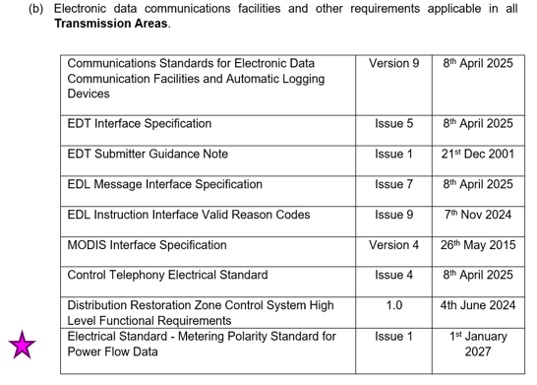
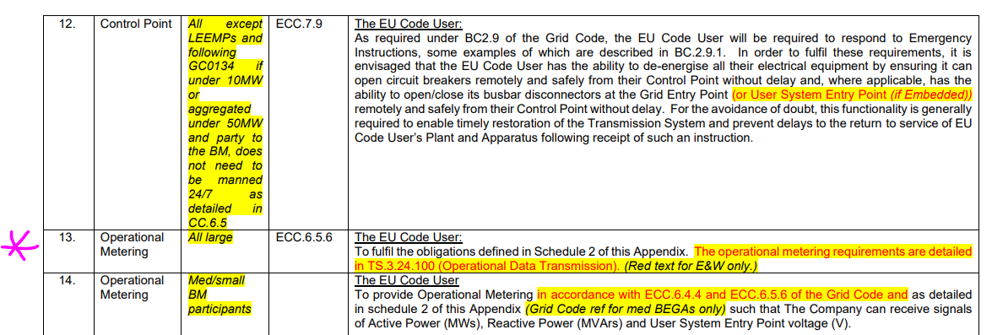
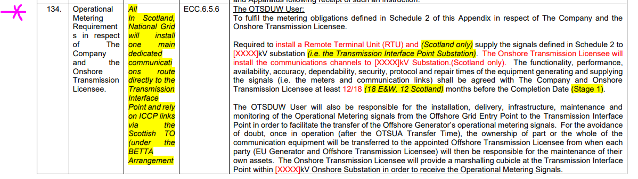
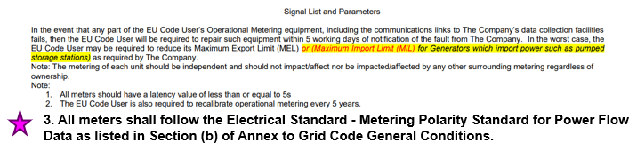
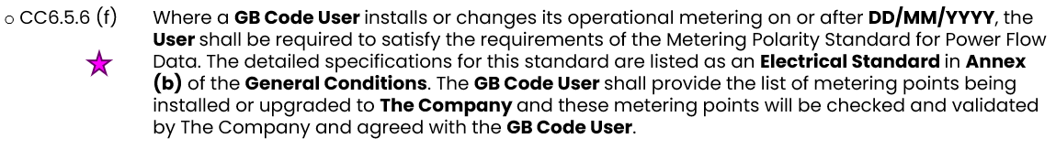
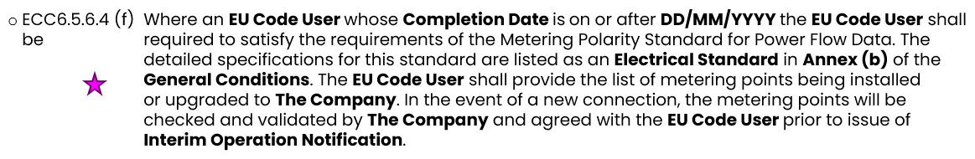
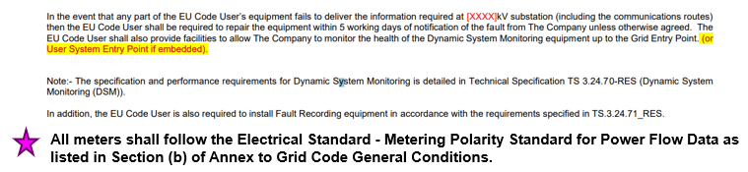
Grid Code Mod – Proposed Implementation Plan Stage 2
  Stage 2: ONCC Process with reference to both Connection Agreements and Grid Code
Connection Agreements, e.g. BCA Appendix F5 /OF5
Operational Notification & Compliance Checklist (ONCC)
Grid Code
  General Condition GC.A.A ANNEX (b)
  Appx. F5 Item 13
  Appx. OF5 Item 134
  Appx. F5 & OF5 Schedule 2
  New CC6.5.6 (f)
  New ECC6.5.6.4 (f)
  Appx. F5 & OF5 Schedule 3
Notes:
It is worth stating that we have begun a Mod with the STC team and the STC Panel have agreed that it should progress to the Work group stage.

Slide 28
Questions?

Slide 29
Any Other Business
Prisca Evans – NESO Code Administrator

Slide 30
Next Steps
Prisca Evans – NESO Code Administrator

