Slide 1
Transmission Charging Methodologies Forum and CUSC Issues Steering Group
6 November 2025

Slide 2
Agenda
1 | Introduction, meeting objectives and review of previous actions - Alastair Owen, NESO | 10:00 - 10:10
2 | CMP462: Provision for Alternate Panel Members, Niall Coyle, NESO | 10:10 - 10:30
3 | Isolated MITS nodes, Andrew Dudkowsky, NESO | 10:30 - 11:00
4 | Amending BSC Change Process for Changes Affecting NCER T&Cs, Alex Curtis, NESO | 11:00 – 11:20
5 | Storage Sub-group update, Dan Arrowsmith, NESO | 11:20 – 11:30
6 | Code Administrator update, Catia Gomes, Code Administrator NESO | 11:30 – 11:45
7 | AOB and Meeting Close - Alastair Owen, NESO | 11:45 – 12:15

Slide 3
TCMF Objective and Expectations
Objective
Develop ideas, understand impacts to industry and modification content discussion, related to the Charging and Connection matters.
Anyone can bring an agenda item (not just the NESO!).
Expectations
Explain acronyms and context of the update or change.
Be respectful of each other’s opinions and polite when providing feedback and asking questions
Contribute to the discussion
Language and Conduct to be consistent with the values of equality and diversity
Keep to agreed scope

Slide 4
Review of previous action
ID | Month | Description | Owner | Notes | Target Date | Status
24-12​ | July​ | Post implementation analysis of CMP376: Inclusion of Queue Management process within the CUSC.​ | DA​ | NESO will reopen this action in April 2025, as that will be 12 months after CMP376 was included in contract terms. | Pending formed queue | On Hold
24-14​ | October​ | Data post CMP376 implementation on the TEC register around projects moving forward, backward or staying the same.​ | DA​ | ​ | Pending formed queue | On Hold
24-15 | May | Consider how to report meaningful connections data following the recent 'Pause' in connections reform activity. | JS | Whilst there is a pause in the new connection data being shared at TCMF, JS to consider how data can be made more accessible to Industry | Pending formed queue | On Hold
24-16 | Sept | TNUoS Tariffs 5 Year View Updates | NE | NESO to provide quarterly updates on the progress of the STC modification. | TBC | Ongoing

Slide 5
CMP462:
Provision for Alternate Panel Members
Niall Coyle, NESO

Slide 6
What is the issue?
The 2025 CUSC Panel Election did not result in the election of Alternate Members for the CUSC Panel, as sufficient nominations were not received during the Elections Process.
The election resulted in the nomination of the minimum of 7 Panel Members, therefore no Alternate Members were elected.
Alternate Members are an important part of a fully operational and functioning CUSC Panel as they replace Panel Members when they are unable to attend CUSC Panel meetings. For quoracy purposes, six Panel Members are required to hold a quorate Panel meeting
Why Change?
There have currently been 28 CUSC Panel meetings in 2025 so far.
Without Alternate Panel Members, the risk of meetings being inquorate increases significantly, meaning that a substantial number of scheduled meetings could fail to proceed effectively.
This would not only inhibit progress of CUSC Modification Proposals and other critical Panel business but also create ongoing uncertainty and disruption for industry parties who rely on timely and robust governance procedures.

Slide 7
Proposed Solution
We propose to introduce provision within CUSC Annex 8A for the Code Administrator to run an expedited Alternate Election Process where the CUSC Election Process has not resulted in the election of Alternate Panel Members.
This annex already details an Alternate Election Process to be followed on the resignation of an Alternate Member, or promotion of an Alternate Member to replace a resigning Panel member. This solution would extend this provision to cover the scenario where a lack of nominations results in no Alternate panel members being elected.
The solution also clarifies the timetable for an expedited process to be followed, with a minimum 1 week each for nominations and voting.

Slide 8
Legal Text
The draft legal text contains the addition of a new clause to Paragraph 8A.2.2.5:
“Where the election has resulted in zero (0) Alternate Members, Alternate Members shall be elected in accordance with the Alternate Election Process as set out in Paragraph 8A.4.4.”
8A.4.4 has been amended to include the scenario where the election process has not resulted in the election of Alternate Members:
“Where there are no Alternate Members in office following an election, as set out in 8A.2.2.5, Alternate Members shall be elected in accordance with Paragraphs 8A.2, 8A.3 and subject to the following paragraphs 8A.4.4.3 to 8A.4.4.5 (inclusive) (the “Alternate Election Process”).”
8A.4.4.5 has been amended to set out the minimum timelines for the expedited Alternate Election Process:
    “The timetable for the Alternate Election Process shall be expedited and the Code Administrator shall prepare a timetable accordingly,. setting out:
    (a) the date by which nominations of candidates are to be received, which shall not be less than one (1) week after the timetable is circulated;
    (b) the date by which the Code Administrator shall circulate a list of candidates and voting papers;
    (c) the date by which voting papers are to be submitted, which shall not be less than one (1) week after the date for circulating voting papers;
    (d) the date by which the results of the election will be made known.”

Slide 9
Timeline
Modification Stage | Date
Modification presented to Panel | 31 October 2025
Ofgem grant Urgency | 05 November 2025 (by 5pm)
Code Administrator Consultation (10 Business Days) | 06 November – 20 November 2025
Draft Final Modification Report (DFMR) issued to Panel (5 Business Days) | 04 December 2025
Panel undertake DFMR recommendation vote | 12 December 2025
Final Modification Report issued to Panel to check votes recorded correctly | 12 December 2025
Final Modification Report issued to Ofgem | 12 December 2025
Ofgem Decision | TBC
Implementation Date | 5 Business Days following Authority Decision

Slide 10
Isolated MITS nodes
Andrew Dudkowsky, NESO

Slide 11
MITS
CUSC 14.15.33 defines MITS nodes as:
  Connections with more than 4 transmission circuits connecting at the site.
  Grid Supply Point connections with 2 or more transmission circuits connecting at the site.

Slide 12
Features of MITS nodes
TNUoS Charging
  Connections to MITS nodes – No local circuit charges.
  Connections to non-MITS nodes – Local circuit charges to cover the cost to connect to the MITS.
  Generally, connecting to a MITS node will be cheaper than connecting to a non-MITS node.
MITS nodes may become isolated from the wider MITS
  However, as the transmission network develops, this status may not be permanent.

Slide 13
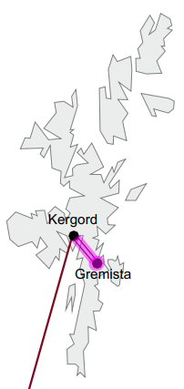
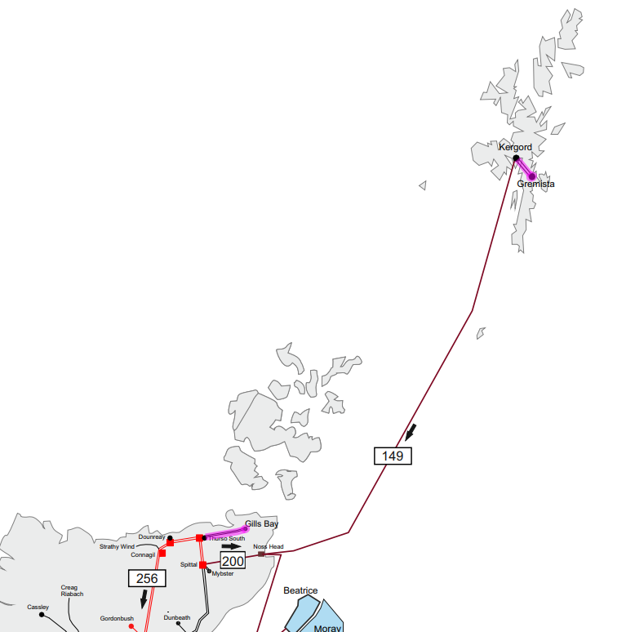
Defect
Shetland 27/28
  Kergord non-MITS node.
    Connects to MITS node via HVDC link to mainland.
    Local circuit charges includes cost of HVDC link.
  Gremista MITS node and GSP.
    Double circuit to Kergord
  Mossy Hill (not shown) between Gremista and Kergord but close to Gremista.
Generator connections to Gremista pay no local circuit charges, although the power flow to mainland is dependent on non-MITS node.

Slide 14
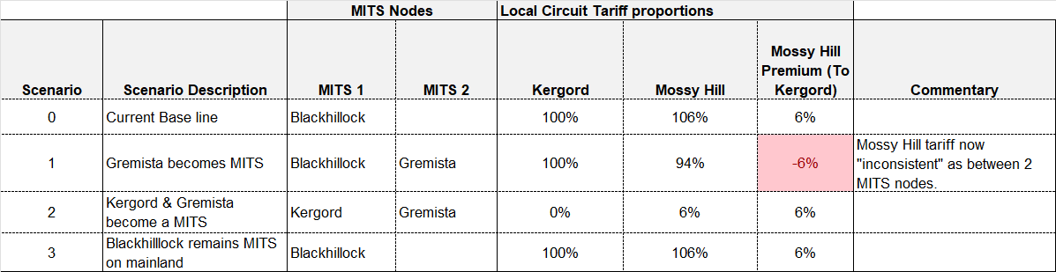
TNUoS Local Circuit Tariff impacts
Shetland has a number of generators and will see Gremista become a MITS node due to GSP
In scenario 1 a LCT “discount” at Mossy Hill as it is connected between 2 MITS nodes – generation flow goes both ways
All other scenarios keep the Mossy Hill premia in place
Mossy Hill – New Generator between Gremista and Kergord.
Blackhillock - On Scottish mainland part of the mainland MITS

Slide 15
Proposal (for discussion)
Change TNUoS calculation rather than definition of MITS
Charge TNUoS as-if the MITS node was a non-MITS node.
"When an isolated MITS node connects to the wider MITS network through a non-MITS node, it will be treated as a non-MITS node for the purpose of TNUoS charging.”
  The wider flow will always be from the isolated MITS node to the wider MITS network.

Slide 16
Project Scope – Amending BSC Change Process for Changes
Affecting NCER T&Cs
Alex Curtis - NESO

Slide 17
Project Scope – Amending BSC Change Process for Changes
Affecting NCER T&Cs
The Electricity Balancing Guideline (EBGL) and the Network Code on Electricity Emergency and Restoration (NCER) were assimilated into UK law by the European Union (Withdrawal) Act 2018 following the UK-EU transition period
These Terms and Conditions are legally binding, and changes to them must follow a specific change process laid out in the NCER
Unlike the EBGL, the NCER does not have an explicit provision to allow the delegation of tasks by NESO
This has significant implications where specific provisions of the Balancing and Settlement Code (BSC) constitute the NCER Terms and Conditions
Currently NESO must carry out the NCER-prescribed amendment steps directly, either jointly or in parallel with Elexon conducting the BSC change process . This causes multiple issues such as
  Lack of delegation means that NESO must be directly involved at each stage of the change process
  When NCER Terms and Conditions are mapped to the BSC, the amendments require NESO and Elexon to act jointly or in parallel, adding complexity & duplication
  Incompatibility with BSC processes such as Authority-led Significant Code Reviews
Notes:
Hi my name is alex curtis working in the commercial codes team in NESO working with Steve Baker on this mod. I have only just recently picked up this mod in the past two weeks and as your aware he is not working due to illness so I am diving into support. I will do what I can to help answer peoples questions and also have Tony Johnstone here with me to help with any questions you may have as I get up to speed on this topic. But please bear with us as we work through this proposal form. Secondly apologies that the slides changed as well yesterday pm, this is due to the same issue so wanted here to give you more detail on the scope , problem and proposed solutions , ehnce the change.
so diving into the project scope, read the slide verbatim

Slide 18
The Proposed Solution
This Modification proposes to incorporate the NCER change process within the BSC Modification Procedures, specifically where the approved Terms and Conditions for System Defence and System Restoration Service Providers under Article 4(4) are mapped to BSC provisions. This dual approach could ensure that both NCER and BSC processes are aligned
Suggested steps in the process are:
Initial Impact assessment – Elexon will assess for any BSC mod if there is any impact to the NCER
TSO Confirmation and Engagement – If there is, NESO to confirm if amendment is necessary and attend Panel
Stakeholder Involvement – NESO to participate in the workgroup to meet NCER obligations
Parallel Consultations – at the report phase NESO to publish a parallel NCER consultation
Consideration of responses - NESO and Elexon to jointly consider consultation responses, providing views and publish a consolidated conclusions
Dual Submission to Ofgem; NESO will submit the Modification to Ofgem for approval of the NCER T&C changes whilst Elexon submits the modification to Ofgem on the BSC. Ofgem to approve both concurrently
There is an alternative proposal as well, which is based on the existing similarities between NCER and EBGL articles both addressing the aggregation of balancing services. It could be interpreted that the aggregation of defence services is already covered in EBGL and so governed under modification P392
Also provision relating to the aggregation of demand response services for defence are included in the Grid Code not the BSC, so therefore no aggregations arrangements exist for restoration, and such should they be incorporated, they would be added into Grid Code not the BSC
Notes:
This mod proposes to incorporate the NCER change process into the BSC mod process specifically around the T&Cs for System defence and system restoration service provider, so aligning the NCER and BSC processes
Suggested steps are
Initial Impact assessment – Elexon will assess for any BSC mod if there is any impact to the NCER
TSO Confirmation and Engagement – If there is, NESO to confirm if amendment is necessary and attend Panel
Stakeholder Involvement – NESO to participate in the workgroup to meet NCER obligations
Parallel Consultations – at the report phase NESO to publish a parallel NCER consultation
Consideration of responses - NESO and Elexon to jointly consider consultation responses, providing views and publish a consolidated conclusions
Dual Submission to Ofgem; NESO will submit the Modification to Ofgem for approval of the NCER T&C changes whilst Elexon submits the modification to Ofgem on the BSC. Ofgem to approve both concurrently
There would need to be a new Annex created to map out the NCER T&Cs to the relevant BSC provision adding to the existing Annex 2 for EBGL. This will giving legislative distinction whilst preserving BSC governance over the impacted provisisons and ensure compliance with EU retained law

Slide 19
Any Questions?
The ask is if your interested in this BSC mod please do get in touch with Elexon
You can join the Workgroup as a voting member, a non-voting member or be added to the Workgroup mailing list. To sign-up, please fill out this form: https://www.elexon.co.uk/change/modifications/modification-workgroups/modification-and-issue-workgroup-sign-up/
Further information on P501 can be found on the P501 page of Elexons website. https://www.elexon.co.uk/bsc/mod-proposal/p501/
If you have any questions, or would like to discuss the Modification further, please contact Architi Batra on 020 7380 4124 or at bsc.change@elexon.co.uk
Notes:
So the ask is if this topic interests you please do get in contact with Elexon to join the work group via the details below, any questions?

Slide 20
Storage sub-group update
Dan Arrowsmith - NESO

Slide 21
Code Administrator Update
Catia Gomes - Code Administrator NESO

Slide 22
Key Updates since last TCMF
New Modifications / Nominations
Decisions
CMP461 ‘Rectifications to Legal Text following various implementations’ raised on 16 October 2025
CMP448 ‘Introducing a Progression Commitment Fee to the Gate 2 Connections Queue​’ amendment to timetable received on 19 September.
CMP444 ‘Introducing a cap and floor to wider generation TNUoS charges’ on 23 October the Authority rejected this modification.
CMP462 ‘Provision for Alternate Panel Members’ urgent modification raised on 24 October 2025
CMP463 ‘Stabilising the Specific Onshore Expansion Factors from 1st April 2026’ urgent raised on 31 October 2025.

Slide 23
Key Updates since last TCMF
Implementations
None.

Slide 24
Authority Expected Decision Date
Modification | FMR submitted | Expected Decision Date
Review’​CMP315 ’TNUoS Review of the expansion constant and the elements of the transmission system charged for’ and CMP375 ‘Enduring Expansion Constant & Expansion Factor Review’​ | 07 February 2024​ | TBC pending update on REMA (previously 07 February 2025)​
CMP316 ‘TNUoS Charging Methodology for Co-located Generation’ | 08 August 2025 | 10 November 2025 (previously October 2025)
CMP330 & CMP374 ‘Allowing new Transmission Connected parties to build Connection Assets greater than 2km in length and Extending contestability for Transmission Connections’​ | 10 August 2023​ | TBC subject to CMP414 send back ​
CMP344: Clarification of Transmission Licensee revenue recovery and the treatment of revenue adjustments in the Charging Methodology | 09 July 2025 | 10 November 2025 (previously October 2025)
CMP397 ‘Consequential changes required to CUSC Exhibits B and D to reflect CMP316 (Co-Located Generation Sites)’​ | 12 June 2024​ | 10 November 2025 (previously October 2025)
CMP432 ‘Improve “Locational Onshore Security Factor” for TNUoS Wider Tariffs’ | 15 May 2025 | November 2025 (previously October 2025)
CMP447 ‘Removal of designated strategic works from cancellation charges/securitisation’ | 21 October 2025 | November 2025
CMP448 ‘Introducing a Progression Commitment Fee to the Gate 2 Connections Queue​’ | 14 July 2025 | November 2025
The Authority’s publication on decisions can be found on their website below:
https://www.ofgem.gov.uk/publications/code-modificationmodification-proposals-ofgem-decision-expected-publication-dates-timetable

Slide 25
Key Consultations in November
Workgroup Consultations
Appeals Window
Code Administrator Consultations
CMP461 ‘Rectifications to Legal Text following various implementations’ opens 10 November and closes 01 December.
None.
CMP462 ‘Provision for Alternate Panel Members’ opens 06 November and closes 20 December..

Slide 26
Useful Links
Ofgem’s expected decision dates/ date they intend to publish an impact assessment or consultation, for code modifications that are with them for decision are available here
Updates on all Modifications are available on the Modification Tracker here
The latest CUSC Panel Headline Report and prioritisation stack are available here
If you would like to receive updates from the Code Administrator on CUSC modifications, please join the distribution list here

Slide 27
CUSC 2025 - Panel dates
 | Panel Dates | Papers Day | Modification Submission Date | (TCMF) CUSC Development Forum
December | 13 | 5 | 28 November | 21 November (cancelled)
January | 31 | 23 | 16 | 9
February | 28 | 20 | 13 | 6
March | 28 | 20 | 13 | 6
May (April’s Panel) | 02 | 24 April | 15 April | 10 April (cancelled)
May | 23 | 15 | 8 | 8
June | 27 | 19 | 12 | 5
July | 25 | 17 | 10 | 3 (cancelled)
August | 22 | 14 | 7 | 7
September | 26 | 18 | 11 | 4
October | 31 | 23 | 16 | 2
November | 28 | 20 | 13 | 6
December | 12 | 4 | 16 | 20 November

Slide 28
Your CUSC Panel representatives
Industry is represented at CUSC Panel by representatives, who would love your input. Their contact details can be found here.
Panel members represent their industry segments at Panel; the more input they have, the more your voice can be heard.
Anthony Pygram | Independent Panel Chair |  | Lauren Jauss | Panel Member
Catia Gomes | Panel Secretary and Code Administrator Representative |  | Shane Cracknell | Panel Member
Ren Walker | Panel Technical Secretary |  | Camille Gilsenan | NESO Representative
Andrew Enzor | Panel Member |  | Daniel Arrowsmith | NESO Representative
Binoy Dharsi | Panel Member |  | Andy Pace | Consumer Panel Representative
Garth Graham | Panel Member |  | Rashmi Radhakrishnan | BSC Representative
Joe Colebrook | Panel Member |  | Nadir Hafeez | Ofgem Representative
Kyran Hanks | Panel Member |  | Harriet Harmon | Ofgem Representative

Slide 29
AOB and meeting close

Slide 30
Active X Controls in T and T Model
Nick Everitt, NESO

Slide 31
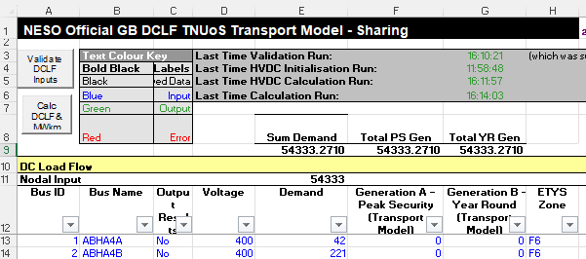
Problem Statement
ActiveX controls are being disabled by default by Microsoft 365 and Office 2024 due to security concerns^{1.}
This will result in the Transport and Tariff (T and T) model being rendered unusable by several parties.
ActiveX controls are currently in the Transport tab (pictured) and Tariff calculation.
Extract from Public 2026/27 5 Year Tariff Model
¹ActiveX controls are disabled by default in Microsoft 365 and Office 2024 - Microsoft Support

Slide 32
Change Proposal
Approach
Next Steps
Draft November T and T model onwards will move to using “Form Controls” as an alternative to the “ActiveX controls”.
We invite external parties to participate in testing the new version of the T and T model, to help confirm the changes are compatible with their systems.
No change to the layout or interaction with the model.
If interested, please contact us at TNUoS.queries@neso.energy

Slide 33
STCP Changes
November 2025

Slide 34
STCP Issues Update
Onshore Transmission Owners
Use of Substitute Data
Additional Data
Improved Transparency
Offshore Transmission Owners
1. Timing of Submissions
Notes:
Onshore Transmission Owners
1. STCP24-1 only allows the use of substitute data in the case where no data has been received from the TOs for TNUOS Tariffs
Detail In instances where alternative data would provide an improved “Best View” for use in TNUoS Tariff forecasts, NESO is currently unable to use alternative source without onshore TO agreement or through a derogation.
Example; RIIO-ET3 Draft Determinations vs January 2025 Revenue Submissions
Proposal - Amended STCP24-1 to allow latitude for NESO to use alternative data source if deemed necessary to provide Best View for industry.
Proposed wording similar to STCP 14-1
2. STCP24-1 requires submission of revenue forecasts for the Financial Year Y+1 and following Five Financial Years from Y+2 onwards
Detail Industry request longer-term projections of TNUoS Tariffs for Financial Modelling.
However, any forecasts beyond FY + 5 are beyond the scope of STCP24-1, and are provided by onshore TOs by exception only.
Example; for NESO (formally National Grid ESO) 10 Year Projection of TNUoS Tariffs, long-range revenue forecasts were set to be 2% inflation YoY, as no alternative data was available.
Proposal: Amended STCP24-1 to require longer range forecasts on an [Annual?] basis
3.2 and 3.3 to be amended to request a [8/10/25?] year projection
2. Also on additional Data, we have been talking about the possibility of whether a single number is appropriate as the revenue number from onshore TO,s particularly in a price control change year like what tariffs are for this year this year, maybe a high low range would be appropriate.
In the 5 year view we tried to do sensitivities around different onshore TO revenue numbers as ultimately until the Ofgem final determinations are made its hard to put a single value on these.
There are also other factors that the TO’s ma be considering within a year that mean that a central and high and low numbers would be appropriate for the submissions used, obviously for Final we would still need a single fixed value.
3. Frequent feedback from industry on the allowed revenues has been requiring additional information on drivers in allowed revenue forecasts and other changes.
NESO acting as a go-between for the onshore Transmission Owners and
We are currently looking at different options for this and will discuss it with the onshore TO’s in the coming weeks
Offshore Transmission Owners
Relatively simple issue compared to the above, the timings of the OFTO submissions (25th Jan or day after if it falls on a weekend) is very close to the deadline for us publishing final tariffs. Its common that some of the OFTO’s use the whole of that deadline, so we often receive data close to midnight on the final day. This makes it very tough on the team to do due diligence on the data and integrate it into tariffs and do the necessary checks before we publish, We have discussed the timing of this with contacts at Ofgem and its challenging to bring those dates earlier so the we are posing the question on what impact it would have on industry if final TNUoS tariffs were pushed back 1 week. Just to be clear, we are not proposing this change for the tariffs to be published this January, barring any serious issues we are committed to publishing by the end of January 2026. This idea is for future years, as the number of Oftos grows and will grow further in the coming years, this timetable gets ever more challenging.

Slide 35
Next Steps
Continue work with NESO codes team on proposal template
Onshore Transmission Owner engagement
Feedback on impact of pushing TNUoS Final tariffs back 1 week
Feedback on any ideas for improved transparency
Come back to TCMF in Jan with more detailed information
Feedback to TNUoS.queries@neso.energy

Slide 36
TCMF: CMP​463
Stabilising the Specific Onshore Expansion Factors from 1st April 2026
Damian Clough

Slide 37
Overview
The Price Control from April 2026 has led to large (41%), unexpected increases in Specific Onshore Expansion Factors.
This modification seeks to hold those Specific Expansion Factors, for 2026/27 onwards, at 2025/26 levels, similar to the CMP353 approach, ahead of a larger more fundamental review of TNUoS (by Ofgem).

Slide 38
Changes to the current, individually calculated, SEF as of latest TNUoS 5 year forecast
Table 1
Network | TO Region | Bus 1 | Bus 2 | Link Type | Link specific expansion factor: | Link specific expansion factor: RIIO-T3 | Link specific RIIO-T3 vs RIIO-T2
 |  |  |  |  | RIIO-T2
Western Bootstrap | SP | FLIB40 | HUNE40 | HVDC | 4.66 | 6.55 | 141%
Caithness Moray bootstrap | SSE | BLHI20 | SPIT20 | HVDC | 14.69 | 20.67 | 141%
Shetland Link | SSE | KERG20 | BLHI20 | Cable | 8.7 | 12.24 | 141%
Western Isles | SSE | DOUN20 | FINS20 | Cable | 16.26 | 22.88 | 141%
Eastern bootstrap | SP | BRNX4A | HAWP4A | HVDC | 11.01 | 15.49 | 141%
Eastern bootstrap | SSE | PEHE40 | DRAX40 | HVDC | 6.7 | 9.42 | 141%

Slide 39
Background
Latest NESO forecast of TNUoS tariffs for 2026/27 indicated a large uplift of 41% in Specific Expansion Factors (SEF).
This is based on using new RIIO-T3 Price Control financial treatments.
This uplift would cause very large detrimental impacts to some Users and relatively large impacts on others in ways that Users could not have reasonably expected and cannot usefully respond to.

Slide 40
Justification for this modification
Justification for this modification and design of the solution is based on the same principle as CMP353, which Ofgem previously approved, with their rationale that:
  “Such unexpected changes in charges are, in our view, detrimental to competition”.

Slide 41
Next Steps
A simple Modification.
Value of SEFs (from 2025/26) already exist – just using them for 2026/27 (and future years till Ofgem TNUoS review).
No fundamental change to Transport & Tariff Modelling.
Seeking urgency to have in place for end January 2026 final tariffs publication.
Straight to Code Admin Consultation .

