Slide 1
Connections Reform: Complaints process
Public
4 September 2025

Slide 2

Public
100% of all application validations are now complete thanks to fast customer responses.
Thank you to all our customers, network colleagues and wider industry for the patience, understanding and tenacity.
NESO0409

Slide 3
Key numbers
Public
1815 applications to the NESO window (1547 to Gate 2)
181 applications completed in the final day
4500 queries answered
100% of validation requests complete

Slide 4

Timelines

Slide 5

Timelines
Public
We understand how important it is for customers to have certainty around timelines:
We are very conscious of knock-on impacts and taking time to fully assess and properly understand the true magnitude of the impact on other projects and programmes.
Given the importance of this information, we won’t rush the timeline assessment and aim to publish new dates as soon as possible.

Slide 6
Initial checks

Slide 7
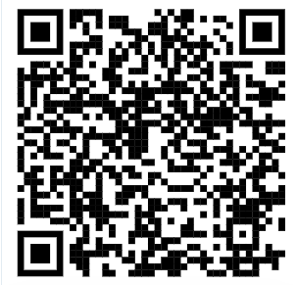
Initial checks
Public
Following submission, we undertake initial checks to confirm that your application meets the required criteria. These checks cover:
General documentation (i.e. do documents open)
Land and Planning readiness documentation
Original Red Line Boundary
Queue formation checks for LDES
Strategic alignment – e.g checks on applications for Protections
Further information on initial checks can be found in sections 8.5 – 8.8 of the Gate 2 Criteria Methodology

Slide 8
Initial checks
Public
Communications to customers about initial checks are under way
We expect 60% of all customers will have heard by next Monday
We know you need these results as soon as practical, and we have teams working over the weekend to get information to you
We are seeing good quality of evidence with a high rate of projects moving directly to the next stage
Where we see projects needed resubmission, we have extra auditing in place to quality review our checks

Slide 9
Resubmission following initial checks

Slide 10
Resubmission
Public
A 4-day resubmission process will follow initial checks
If your project passes initial checks, you will receive confirmation via email.
If your project fails any checks, you will receive an email with detailed feedback and clear instructions for the resubmission process. This will include the reasons for failure and a reminder of the pass criteria to help you resubmit confidently.
Resubmissions will be handled via a secure document upload, and you will have four days to complete this process. NESO teams will be on standby to support with query resolution and document handling. We encourage you to raise any queries promptly during this period.

Slide 11
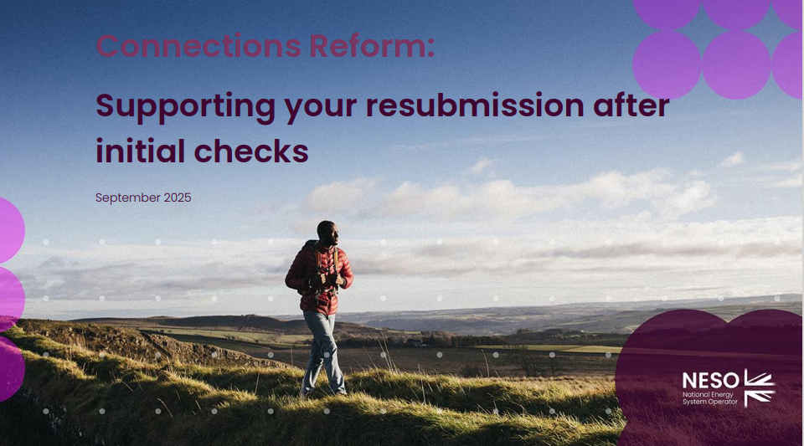
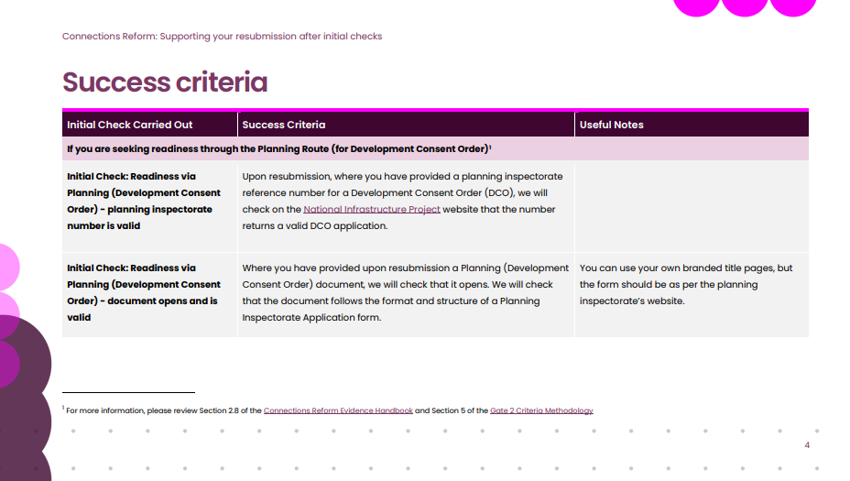
Consolidated resubmission support
Public
We will email this document to you if you need to resubmit. It contains no new information, but consolidates useful details to help you.

Slide 12
Complaints process

Slide 13
Supporting Your Concerns
Public
NESO is currently supporting your queries, escalations and complaints
Query
Escalation
Formal complaint to NESO
CUSC and wider industry complaints process
BAU process raised on any topic at any time
Independent of NESO
Directly relating to formal decisions (i.e initial check decisions).
Expedited process that offers a route back into G2tWQ)
Notes:
we should update on the validations process and some of the wider noise.

Slide 14
Complaints Process Overview
Public
To support customers, we have introduced a new faster complaints procedure enabling customers to raise a complaint, or disagreement about final outcomes. This faster process allow us to get any customers back into the queue if NESO made an error.
Please help us help you by acting quickly and direct complaints through the portal or via the dedicated form that will accompany all final decision information. This gives us the best chance to resolve things..
If you disagree with our outcome and you believe we have made an error, you will be able to raise a complaint.
This is an additional process administered by NESO to help get you back into the process quickly if your complaint is upheld. You will have two clear working days to raise a complaint.
If you still disagree with the outcome of our complaints process you will be able to raise a dispute via other industry channels but this process will not be fast enough to impact G2TWQ.
Notes:
This is an opportunity for you to flag to us if you feel that an error has been made by NESO during the initial checks process.

Slide 15

#
Public
What NESO will review
We will review: Complaints which relate to how NESO has executed the submissions and initial checks process. And, claims that NESO’s treatment of an application has negatively impacted the outcome
We will not review: Complaints relating to either the process set out in the NESO methodologies, and/or complaints received after two full days of final initial checks decision
Each complaint will be owned by an impartial case manager within NESO, who has had no prior involvement in the checks process. They will also undergo impartial legal review by an external party
If a customer disagrees with the complaint outcome, they may escalate via the Connection and Use of System Code (CUSC). This will be via the case owner using a template

Slide 16
Reminder -Feedback
Public
#
Listening to feedback, we are now using Slido to capture your thoughts. Please only put your hand up when you are called on to speak
The route for specific queries to be responded to has not changed- please use the portal or email box.connectionsreform@neso.energy
We will not respond to each question on Slido individually (We will respond to those most upvoted in the webinar)

Slide 17
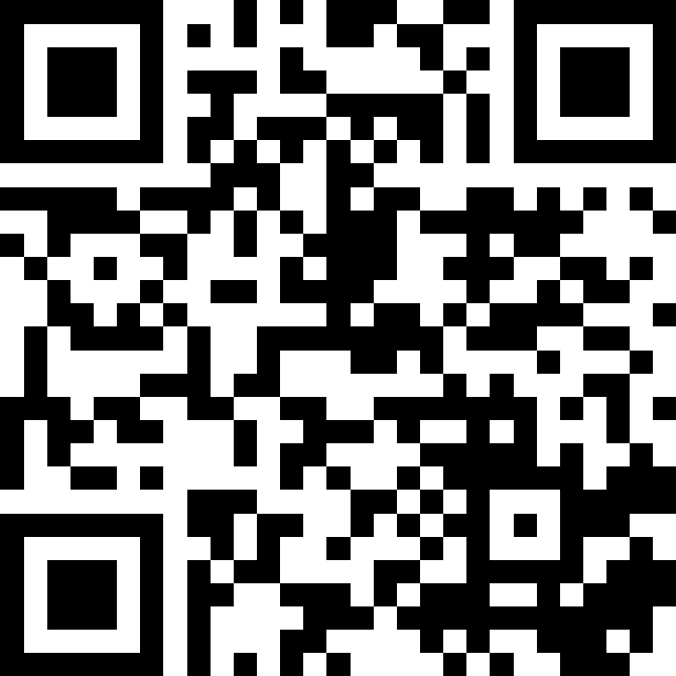
Slido Q&A
Public
We will now take Slido Q&A for the remainder of the session.
#NESO0409
We kindly request that do you do not raise project specific questions and that you keep your question constructive and relevant to the content we have shared today.

Slide 18
Thank you
Public

Slide 19
Key stats: Friday 22 August 2025 (12:00)
18th July | 713
1st August | 387
15th August | 202
99% of possible upper limit of projects have logged into the portal​.
93% of the projects that have logged into the portal have submitted and a large proportion of those in draft are in the latter stage of the process.
Expected projects in scope
Not logged in yet
11
~1800
Draft
18th July | 754
1st August | 653
15th August | 431
121
1789
Gate 2
18th July | 233
1st August | 617
15th August | 992
Logged into portal
1431
18th July | 1087
1st August | 1413
15th August | 1598
Gate 1
18th July | 100
1st August | 143
15th August | 175
237
Total queries received | Total queries in progress | Total queries closed
4560 | 61 | 4499

Slide 20
Overview
We will do whatever it takes to get everyone who wants to submit through the process.
What we will cover today:
What “no application left stranded means in practice”
Data remediation
Initial checks
Slido code:
#NESO2608

Slide 21
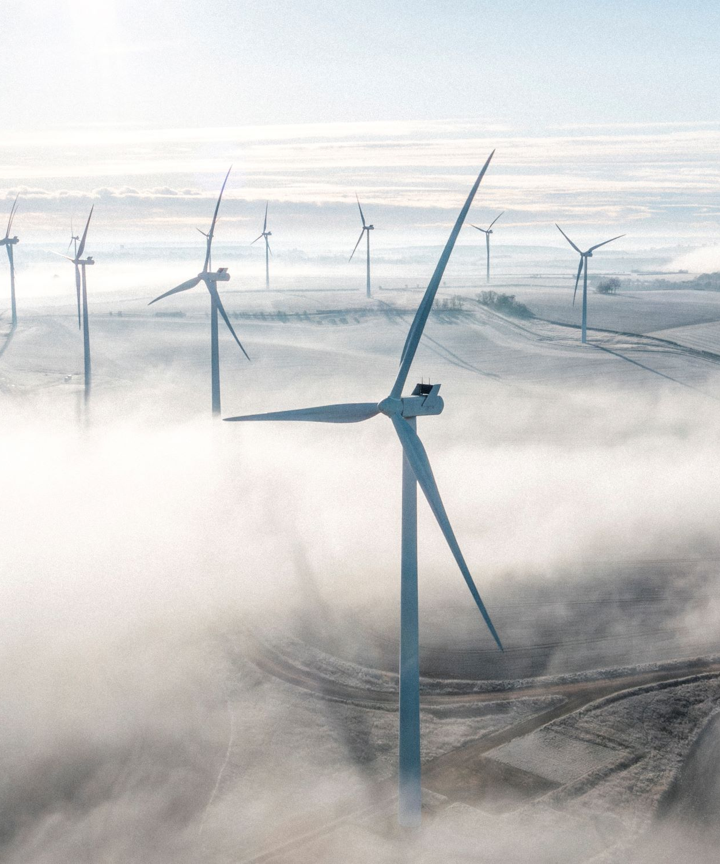
Deadline today
Public
By 23:59 tonight you must have
Submitted your application (and validation requests if eligible)
OR
Told us of the change you need to make to your application to submit
If you meet the criteria above you are treated as submitted
Notes:
Accurate
Reflective
Complete

Slide 22



Validation Process
Public
If you submitted before 11 August at 23:59 and raised a validation request
For many customers in the validation process we are or have written to you to ask you to make edits directly to your application.
This is to ensure your application is accurate, a clear reflection of your wishes and complete.
In the interest of fairness, we can only allow changes that were requested as part of your Validation Process and communicated to us before 23:59 on 26 August.
.

Slide 23
Validation Process
Public
If you submitted before 11 August at 23:59 and raised a validation request
If you wish to make changes – log in, make required edits, and press submit
If you no longer wish to make changes – you still need to log in and press submit
Please make edits as soon as you are able so we can progress your application to initial checks.
We are here to help, and if we have not seen an edited submission from you this week, we will contact you to assist you in progressing your application.

Slide 24
Validation Process
Public
If you submitted before 11 August at 23:59 and raised a validation request
If we have not contacted you to ask you to make changes directly it is because:
The change you have requested must be done in the NESO side of the system, we will contact you when this is complete
The change you have requested is complex, so our teams will call you and walk with you through the changes

Slide 25
No application left stranded: what does it mean in practice

Slide 26
No application left stranded
Public
What does it mean in practice?
As we approach the closure of the submission window, we are aware that a small number of customers are still experiencing issues.
NESO has committed that no application will be left stranded, and we stand firmly by this commitment.
For customers who have been actively trying to submit their application and have a raised a query explaining the issues via the reform .box or portal
  We will recognise these application as meeting the deadline and will continue to support them through to completion, even if this occurs after the deadline.

Slide 27
In conversation with us
Public
If you are currently progressing an application and have raised a query about an issue preventing submission
Our teams are proactively reaching out to you.
We aim to resolve all matters before the window closes.
If we are unable to do so, we will honour your application as submitted within the window and recognise your best endeavours to summit.

Slide 28
Not yet contacted us
Public
If you are progressing an application and have an issue that is preventing submission but have not raised a query about a portal or data issue
You must raise a query as soon as possible.
In the interest of fairness, if you miss the submission deadline without raising a query about the issue that is preventing submission, we will not be able to accept your application.

Slide 29
Top tip

Slide 30
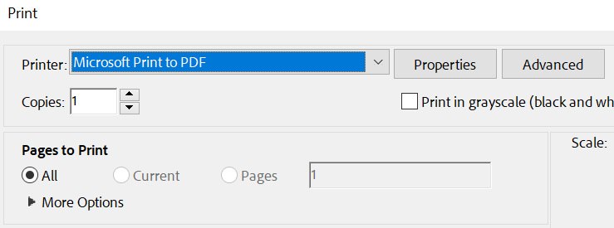

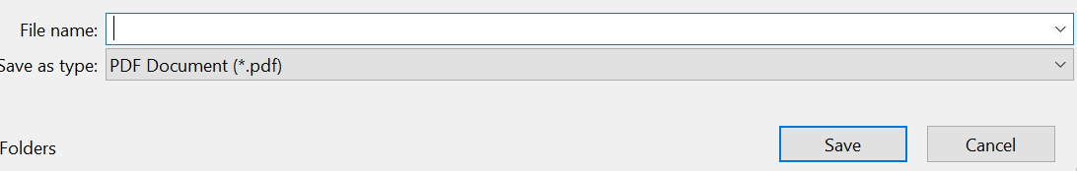
PDF top tip
Public
For customers having issues with File upload errors with PDF’s, one way to fix it is to print to PDF and save it.
Open the file in Adobe
Click the Print icon
Then in the printer section select Microsoft Print to PDF
Click Print
Click Print
Select the File name and save
Select the File name and save
Then this file would need uploading to the portal and that will resolve the issue and allows you to upload the PDF.

Slide 31
Overview
Our shared objective is to ensure that the connections queue is reordered fairly and efficiently. It is essential that projects can submit their application before the evidence submission window closes.
We’ve listened carefully to your feedback and worked hard to respond. You asked for clearer guidance, better functionality, and stronger support and we’ve acted. On Monday we issued 10 working days’ notice that the NESO Connections Reform evidence window will close on Tuesday 26 August at 23:59.
If you have yet to submit, we want to reassure you: Our evidence collection process will not be the reason any project is unsuccessful. We will do whatever it takes to get everyone who wants to submit through the process.
Slido code:
#NESO2208

Slide 32


Initial Checks
Public
NESO has given five working days’ notice ahead of the first communications about the results of initial checks as part of the Connections Reform process. It does not mean that your individual project’s check results will be available in 5 days.
The five days started at 00:01 Wednesday 20 August. This means the first possible date customers will receive any results of the initial checks on their evidence submissions will be Thursday 28 August. Some customers will be informed on 28 August and others will be notified later.
As a reminder, this is the point in the process when customers will be told if they have passed or failed the initial checks. In the event of any failures, customers will be invited to resubmit evidence to rectify any failed checks.
.

Slide 33

Updates to PDF download
Public
We know how important accuracy in the PDF download function is for both validation and record keeping.
The functionality is working for most and we have seen 369 validations using the PDF review.
Since last week we have updated the following functionality:
Customers are now able to see the list of documents they have submitted at the end of the downloaded
Fixed the issue where customers with multiple original redline boundary entries had duplicate longitude and latitude values displayed in the PDF
To note: For upload issues try ‘Print to PDF’ and saving the document it works for most customers

Slide 34
Protected TEC value for Hybrid sites
Public
Please tell us the total protected capacity of each technology
It is the installed capacity that is protected rather than the TEC.
For a hybrid, we will use the lower of the TEC or installed capacity when allocating projects against permitted capacity, so we need to know the protected installed capacity.

Slide 35
Validation update
Public
Some customers are awaiting validation updates.
We will be contacting customers on a case-by-case basis with additional information or confirmation of validation.

Slide 36
No application left stranded
Public
We are proactively calling customers with outstanding queries to walk them through the portal and support resolution up to the point of submission.
If our team contacts you, please make the most of our time together by keeping the conversation focused on progressing your submission.
We want to reassure you that if we are in an active dialogue with you because you have raised queries or a validation request, we will continue contact you on a case-by-case basis to continue to support you even if matters are not fully resolved by 23:59 26 August.

Slide 37
Validation
Public
From Tuesday 12 August 2025, a new validation process will be open for the customers who submitted prior to 23:59 on Monday 11 August 2025.
We have implemented an easy-to-use functionality into the portal for this process and tomorrow’s webinar will focus on this.
Only customers who submitted prior to 23:59 on Monday 11 August 2025 are eligible to validate their evidence. This is to ensure the same, fair, process is afforded to those submitting later.
Those who have not yet submitted should take care not to submit until they are confident of their answers. Please note that when you submit the application or validation, this will be the final submission opportunity.
In addition, all customers regardless of when they submit, will have the opportunity to download their submission in a PDF form for their records.
We know some customers used different workarounds to submit their evidence via the Portal due to functionality issues and data mismatches. We have committed that anyone who submitted early will have the opportunity to check, confirm and change their submission.
We emailed validation guidance to all customers on Tuesday 12 August

Slide 38
Validation signatory clarification
Public
Customers have asked whether a different authorised user can provide the signature required for validation
Preferred Approach: The same signatory used in the original submission should also be used for validation.
Exceptions: We understand that some validations may already have been submitted, and that the holiday period may make it difficult for some customers to use the original signatory.
In such cases, an alternative authorised signatory may be used if they meet the criteria:
The signature must be used in the same context as on the Readiness Declaration.
If the entity is a registered company, the signatory should be a director.
If the entity is not registered, the signatory should be someone authorised to sign on its behalf.

Slide 39
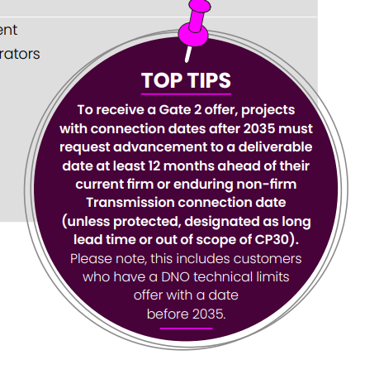
Handbook Changes
Public
Removed the timeline as it was misleading and reflected the changed this made to table and figure numbers
Updated the deadline
Added a small clarification point on page 27 the words in backets show here

Slide 40
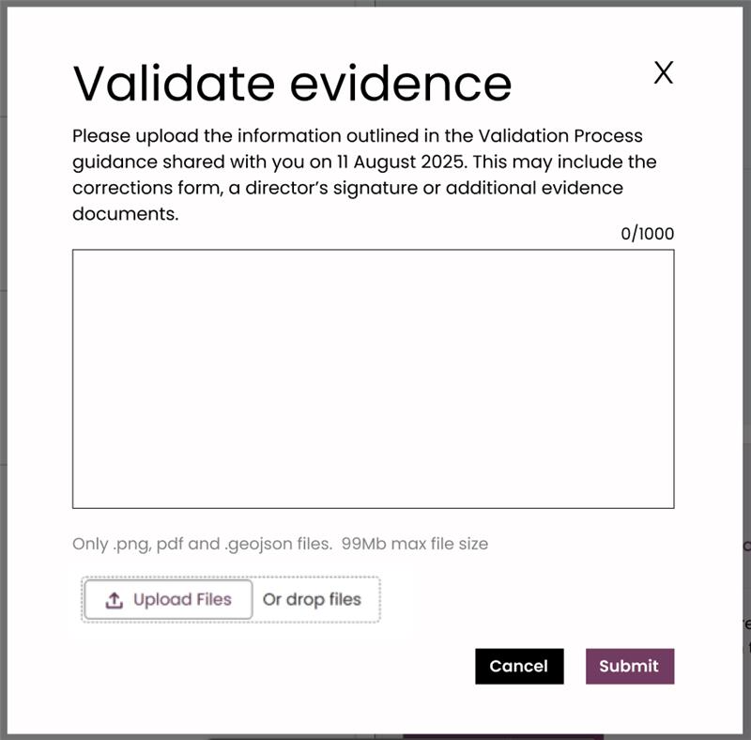
Validation
Public
Clarity on validation with no changes
I confirm I have reviewed my evidence and have no changes.
If customers are satisfied with their application, they should use the validation button on the Portal (see screenshot) to confirm they have no changes by using the text box.
Type into the box a statement such as:
“I confirm I have reviewed my evidence and have no changes.”
Then press submit.

Slide 41
Archive old slides

Slide 42
Mod App Reminder
Public
Currently there are approximately 180 applications missing relevant mod apps.
Not every submission needs a mod app, but if you do you must act now.
Please submit these as soon as you are able.
Your readiness declaration is not complete without it.

Slide 43
#NESO1108
Public
Overview
Our shared objective is to ensure that the connections queue is reordered fairly and efficiently. It is essential that projects can submit their application before the evidence submission window closes.
We’ve listened carefully to your feedback and worked hard to respond. You asked for clearer guidance, better functionality, and stronger support and we’ve acted. Yesterday we issued 10 working days’ notice that the NESO Connections Reform evidence window will close on Tuesday 26 August at 23:59.
If you have yet to submit, we want to reassure you: Our evidence collection process will not be the reason any project is unsuccessful. We will do whatever it takes to get everyone who wants to submit through the process.

Slide 44

Timings – Initial Checks
Public
Our 5-day notice for initial check communications signals the start of communications for all customer.
It does not mean that your individual project’s check results will be available in 5 days.
For example, if we issue the notice on Wednesday 20 August, initial check results will begin to be shared no earlier than 29 August. That’s when the first customers will hear from us, but your own update may come after that date.
.

Slide 45
Validation
Public
Three routes – route one
Confirm: If customers are satisfied with their application, they should use the validation button on the Portal (see screenshot below) to confirm they have no changes by using the text box
Notes:
f customers are satisfied with their application, they should use the validation button on the Portal (see screenshot below) to confirm they have no changes by using the text box

Slide 46
Reminder -Feedback
#NESO0708
Update new code
Public
Listening to feedback, we are now using Slido to capture your thoughts. Please only put your hand up when you are called on to speak.
The route for specific queries to be responded to has not changed- please use the portal or email the box.connectionsreform@neso.energy
We will not respond to each question on slido individually (We will respond to those most upvoted in the webinar)
We are using your feedback from these webinars to support prioritisation of portal development where possible
All insights taken from Slido questions are allowing us to develop and updates the FAQs

Slide 47
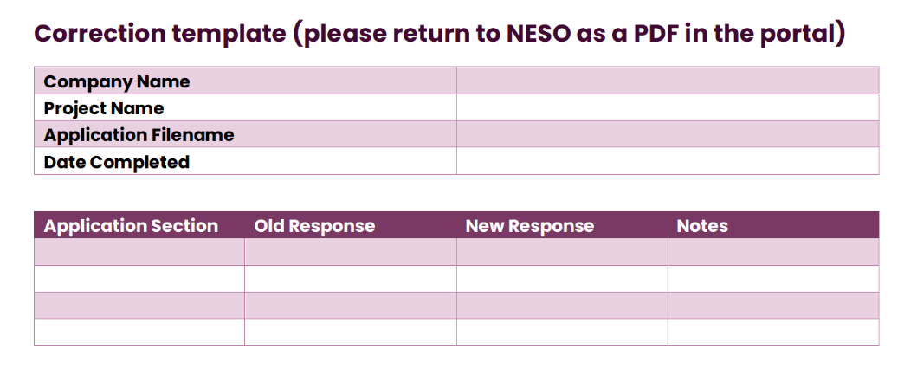
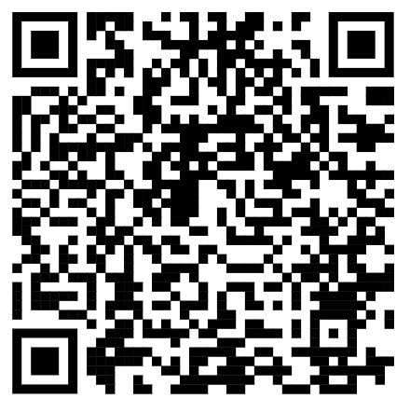
Validation
Public
Three routes – route two
You’ll find a link to this form and text in the guidance we emailed all portal users yesterday and in the Connections Reform Essentials Document online
Correct: Customers must notify us of any amendments they wish to make to their submission. If customers want to make changes to their original application and know what new or additional evidence is required, they should inform us what they are changing in the ‘validate evidence’ text box and complete the designated form and download the final content in PDF format.
An authorised signature is also required. Please use the template text below, saved as a PDF of a Word document, to accompany the signature.
1 [authorised signature...] confirm we have reviewed and, with the updated evidence, certify we have validated our information submitted as part of the connections reform process. [Signature] [Name] [Position] [Company] [Date]
Notes:
A authorised signature is also required. Please use the template text below, saved as a PDF of a Word document, to accompany the signature

Slide 48
Validation
Public
Three routes – route three
Correct: We recognise that some customers may want to make a change to their original application but may be uncertain about how to do so or what additional evidence is required.
,Please use the ‘evidence validation’ function to outline the nature of the changes you intend to make. A member of our team will then contact you to provide tailored support.
Our triage team is available to ensure you are directed to the appropriate assistance.
Please note we can only support you with the process and cannot advise you on your readiness or strategic alignment approach.
Notes:
We recognise that some customers may want to make a change to their original application but may be uncertain about how to do so or what additional evidence is required. This may be due to recent updates to the Portal that have affected the type of evidence originally provided. Connections Reform: Customer Guidance Essentials UPDATED 11 If this applies to you, please use the ‘evidence validation’ function (see screenshot above) to outline the nature of the changes you intend to make. A member of our team will then contact you to provide tailored support. Our triage team is available to ensure you are directed to the appropriate assistance. Please note we can only support you with the process and cannot advise you on your readiness or strategic alignment approach.

Slide 49

Communications Approach
Public
We’re committed to clear, consistent, and proactive communication as we continue to improve the portal experience.
Daily Calls: We will hold daily calls to provide updates on data, issues, and progress
System Walkthroughs: Where key journey issues are identified, we’ll run focused walkthroughs to support resolution
Weekly Updates: You’ll receive weekly summaries with the latest status of the portal and key developments
Our goal is to keep you informed, supported, and confident throughout the submission process.
Notes:
Commit to our comms approach going forward and timing of next call (I think we’re committing to a daily call incl. data and issues updates, and commitment to run system ‘walk throughs’ where key journey issues are identified. We will communicate with you on a weekly basis, providing timely updates on the status of the portal

Slide 50
What if I don’t validate?
Public
If a customer chooses not to validate their evidence before 23:59 on Tuesday 26 August 2025, we will proceed to check previously submitted evidence.

Slide 51
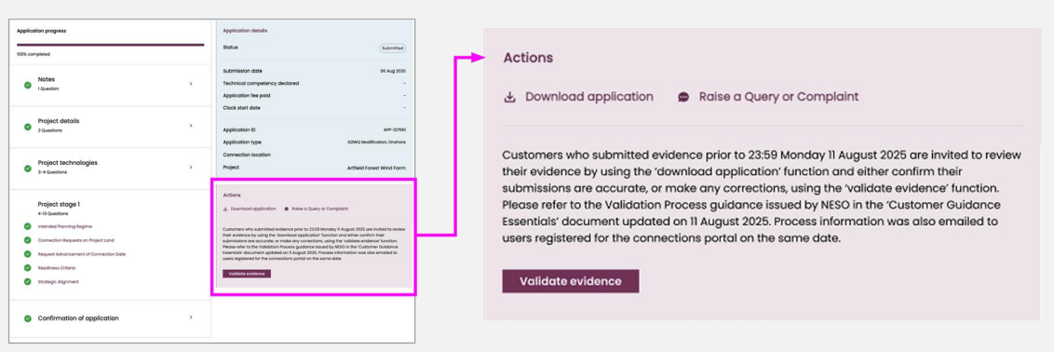
Validation
Public
First stages
Eligibility: Those customers who submitted evidence between 00:01 on Tuesday 8 July 2025 and 23:59 on Monday 11 August 2025 will be welcome to participate in the validation process.
Verify: Customers are encouraged to carefully review their submission for accuracy. If, when you reflect on changes to the portal, you want to change your submission due to a workaround you used when submitting, you are now invited to do so
Download: Customers can download their evidence submission
Notes:
Customers will be invited to download their evidence submission

Slide 52
Validation
Public
We know some customers used different workarounds to submit their evidence via the Portal due to functionality issues and data mismatches. We have committed that anyone who submitted early will have the opportunity to check, confirm and change their submission.
From Tuesday 12 August 2025, a new validation process will be open for the customers who submitted prior to 23:59 on Monday 11 August 2025.
We have implemented an easy-to-use functionality into the portal for this process and tomorrow’s webinar will focus on this.
Only customers who submitted prior to 23:59 on Monday 11 August 2025 are eligible to validate their evidence. This is to ensure the same, fair, process is afforded to those submitting later.
Those who have not yet submitted should take care not to submit until they are confident of their answers. Please note that when you submit the application or validation, this will be the final submission opportunity.
In addition, all customers regardless of when they submit, will have the opportunity to download their submission in a PDF form for their records.
We are emailing validation guidance to all customers today

Slide 53
What we are asking of you
Public
Please do not resubmit emails / queries
Please continue to log in and submit evidence. Do not wait until closer to the deadline.
If you have already raised a query with us, please be assured my team is working on it and will be in touch. You do not need to raise it again.
Use the box.connectionsreform@neso.energy email or use the Connections Reform Portal to raise any new problems that you experience.
Please continue to refer to the guidance and FAQs on our website which we will continue to update.

Slide 54
Looping back: queries we took away
#NESO2807
Public
Query | Update
Grouped these together based on a couple of questions raised regarding latitude and longitude in the last couple of webinars | A fix was deployed Saturday to allow customer to complete this part of the process
When will we have a walk through of the Mod App process
When will those who are due a refund from a transitional offer receive this
What is the process for those companies who are not VAT registered (for example an SPV) relating to uploading company invoices

Slide 55
PDF Files Guidance
#NESO3107
Public
✅ Use Clean File Names
Avoid special characters (e.g. %, &, #, @) in filenames.
Stick to letters, numbers, underscores (_) and hyphens (-) only.
📁 Minimise File Path Length
Store files in a location with a short path before uploading.
Long paths can cause upload errors or delays.
🖨️ Flatten Your PDFs
Use “Print to PDF” on Windows or macOS to create flat, static files.
Avoid PDFs with embedded layers, forms, or dynamic content.
📌 Portal Compatibility
Only PDF format is accepted for uploads.
Excel or other formats will be rejected by the portal
🕒 Submit Early
Portal issues and query backlogs may delay uploads.
Submit well before the deadline to allow time for corrections

Slide 56
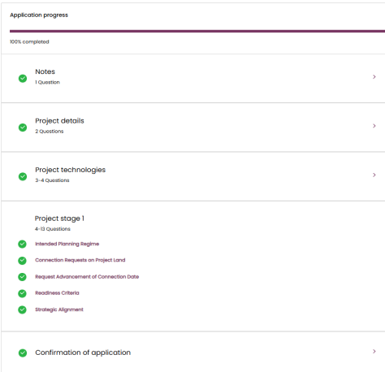
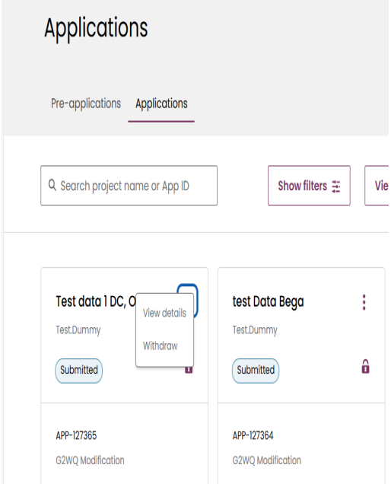
How to review my submission
#NESO3107
Public
Once the application is submitted, we can go back and view the details of the application.
You can see the different sections marked green and going into any of the sections will be in read only mode as the application is already submitted. You are able to take note of what was submitted and download the files that were attached.

Slide 57
Tracking queries
Public
#NESO0708
All open queries will have received an email last Friday to confirm that we are working to resolve their issue
If you have an unresolved query and have not received an email to confirm we are working on it, please email or raise a case on the portal with the header EXISTING ISSUE and the eight digit case number e.g. 00091234

Slide 58

Resolved: Key Portal functionality
#NESO0708
Public
14 August 2025
PDF Download updates - Further improvements made to PDF download to update labels, consistent formatting and additional data points included in the relevant sections.
12 August 2025
PDF Download - Further improvements made to PDF download to include DCO section and clarification of Milestone M7.
Validation function - Validation function now open for all customers who submitted before 23:59 11 August.
07 August 2025
Submit Button Issues- Resolved a number of issues where the submit button was incorrectly enabled/disabled meaning customers were unable to submit their applications as planned.
Confirm Minimum Acreage guidance - Updated guidance given around minimum acreage questions to make it clearer and easier for customers to understand.
06 August 2025
Progress bar percentage - Resolved an issue where the percentage complete on an application was not reflecting the amount a customer had completed. This has been rectified to show customers the amount remaining on their application.
05 August 2025
CCGT and other dispatchable technologies - resolved issue for customers who had CCGT and other dispatchable technologies and were unable to save the values for installed capacity.
Dispatchable Technologies - fixed issues with dispatchable technologies not displaying correctly in the technology section
Strategic alignment - resolved issue where technologies were not showing correctly in the strategic alignment section
G2WQ Banner - G2WQ banner updated to reflect latest information.

Slide 59
Upcoming releases*
#NESO0708​
Public
Project Technologies green tick error
Resolved an issue where the green tick was showing for Project Technologies without the section being completed
Technology category for strategic alignment missing
Resolved an issue on the Technology page where the customer could not see the default technology category for strategic alignment for their demand project so was unable to proceed. This issue was blocking several customers completing their submissions
Displaying banner only for applicable projects
Improvements made to the eligibility banner to not display where there are no active projects. Modify contract button will also be disabled for this case
Run-of-river Hydro Technology type
On the 'Input TEC/Developer Capacity and Refine Technology Type for Queue Formation' page, customers are now able to enter their installed capacity where their technology is 'Run-of-river Hydro'
Gate 1 notification email
Resolved an issue where 'null' was appearing instead of the required values in the email customers received
Strategic Alignment Dispatchable technologies
Resolved an issue with technology definitions for "Unabated Gas" and "Low Carbon Dispatchable Power" allowing customers to be mapped to the correct CP30 technology
Completed applications showing in draft
Resolved an issue where completed applications were still showing in draft when their submissions were complete. These will now be shown as submitted
*Subject to testing

Slide 60
Novation
#NESO0608
Public
We are getting a lot of requests for novation.
Evidence should be submitted by the contracted legal entity, so it is important that your contract is in the name of the correct entity.
If there is to be a change in the entity this will require a novation, a legal ownership transfer of a project via a sealed deed.
On average it can take a week to novate a project if all parties act swiftly.
It can take longer than a week if any parties delay their review and signature process.
Please request novation by Friday 8 August 2025.
We urge all customers to check their details in the portal ASAP to confirm if they need a novation, and if they do, they must contact us immediately with “novation” in the subject header.
We will endeavour to process any requests for novation that come in after Friday 8 August, however we cannot guarantee these will be processed in time for you to submit evidence for connections reform due to the timescale of novation.
Not sure we need this one ant more

Slide 61
Validation process walk through

Slide 62
Email security
Public
We confirm
noreply-connections@nationalenergyso.com
is a valid no reply box from NESO and can be added to your safe senders list

Slide 63
Submission Process
Public
Slide 2: Submission Process
  Briefly explain what customers need to submit and when.
  Highlight any deadlines or key actions.
  Keep the language plain and direct.
Suggest using the no one left stranded messaging

Slide 64
Building blocks for giving notice
Public
#NESO0708
Ensure that everyone who wants to is able to submit
Known data and known portal issues addressed
Ability for those who have already submitted to review and amend before the window closes
Resource and process in place to give additional support where required
Remediation process

Slide 65

Definitions
Public
A clear working day means that no matter the time we email you, the ‘clock’ starts at 00:01 the next working day.
So, if we email you on Friday at 11am about the results of your checks, your four working days start on Monday at 00:01 and finish on Thursday at 23:59.
Please note: Monday 25 August 2025 is a bank holiday in England and Wales and is classed as a non-working day for all customers for the purposes of this announcement.

Slide 66
Validation – First stages
Public
Eligibility: Those customers who submitted evidence between 00:01 on Tuesday 8 July 2025 and 23:59 on Monday 11 August 2025 will be welcome to participate in the validation process.
Verify: Customers are encouraged to carefully review their submission for accuracy. If, when you reflect on changes to the portal, you want to change your submission due to a workaround you used when submitting, you are now invited to do so.
Download: Customers can download their evidence submission.
Notes:
Customers will be invited to download their evidence submission

Slide 67
Validation
Public
Three routes – route two
Correct: Customers must notify us of any amendments they wish to make to their submission. If customers want to make changes to their original application and know what new or additional evidence is required, they should inform us what they are changing in the ‘validate evidence’ text box and complete the designated form and download the final content in PDF format.
You’ll find a link to this form and text in the guidance we emailed all portal users yesterday and in the Connections Reform Essentials Document online
An authorised signature is also required. Please use the template text, saved as a PDF of a Word document, to accompany the signature.
1 [authorised signature...] confirm we have reviewed and, with the updated evidence, certify we have validated our information submitted as part of the connections reform process. [Signature] [Name] [Position] [Company] [Date]

Slide 68
Validation
Public
Three routes – route three
Correct: We recognise that some customers may want to make a change to their original application but may be uncertain about how to do so or what additional evidence is required.
Please use the ‘evidence validation’ function to outline the nature of the changes you intend to make. A member of our team will then contact you to provide tailored support.
Our triage team is available to ensure you are directed to the appropriate assistance.
Please note we can only support you with the process and cannot advise you on your readiness or strategic alignment approach.
Notes:
We recognise that some customers may want to make a change to their original application but may be uncertain about how to do so or what additional evidence is required. This may be due to recent updates to the Portal that have affected the type of evidence originally provided. Connections Reform: Customer Guidance Essentials UPDATED 11 If this applies to you, please use the ‘evidence validation’ function (see screenshot above) to outline the nature of the changes you intend to make. A member of our team will then contact you to provide tailored support. Our triage team is available to ensure you are directed to the appropriate assistance. Please note we can only support you with the process and cannot advise you on your readiness or strategic alignment approach.

Slide 69
What if I don’t validate?
Public
If a customer chooses not to validate their evidence before 23:59 on Tuesday 26 August 2025, we will proceed to check previously submitted evidence.
Notes:
If a customer chooses not to validate their evidence before 23:59 on Tuesday 26 August 2025, we will proceed to check previously submitted evidenc

Slide 70
Checks Process
Public
If the result of the initial checking process is that a customer has failed any initial checks, the following process will begin:
Stage 1
Stage 2
Stage 3
Customers will have four clear working days from notification to resubmit evidence relating to the checks using the Portal.
Once we receive resubmission, we will respond to customers within four working days with a final decision.
If customers disagree, they will have the opportunity to participate in our new expedited complaints process, outlined on the next page.
If they have any questions during those four days, we encourage them to contact us straight away so we can clarify what is needed.
We will give five working days’ notice before we begin the first communication to customers about the results of initial checks. Some customers may hear as soon as the five days’ notice passes, and some may hear a little later.
Notes:
If the result of the initial checking process is that a customer has failed any initial checks, the following process will begin:
1. Stage 1: Customers will have four clear working days from notification to resubmit evidence relating to the checks using the Portal. If they have any questions during those four days, we encourage them to contact us straight away so we can clarify what is needed.
2. Stage 2: Once we receive resubmission, we will respond to customers within four working days with a final decision.
3. Stage 3: If customers disagree, they will have the opportunity to participate in our new expedited complaints process, outlined on the next page.

Slide 71
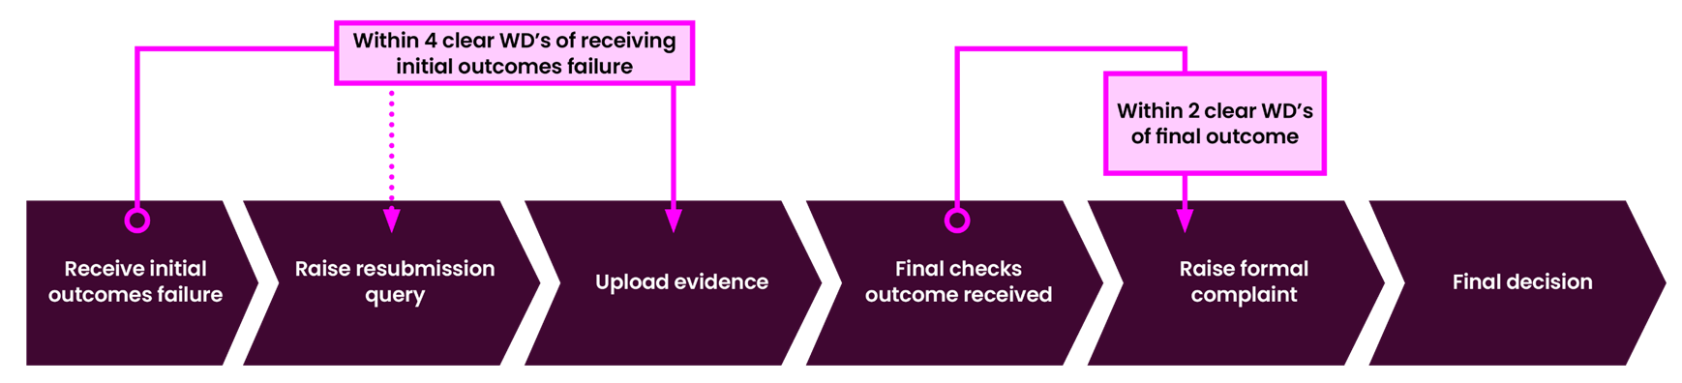
Checks and Complaints Timings
Public

