Slide 1

Tracing the Oscillations – A Few Pieces of the Puzzle
Yunjie Gu¹, Slava Maslennikov², Shahil Shah³
1. Imperial College London, 2. ISO-NE, 3. NREL

Slide 2
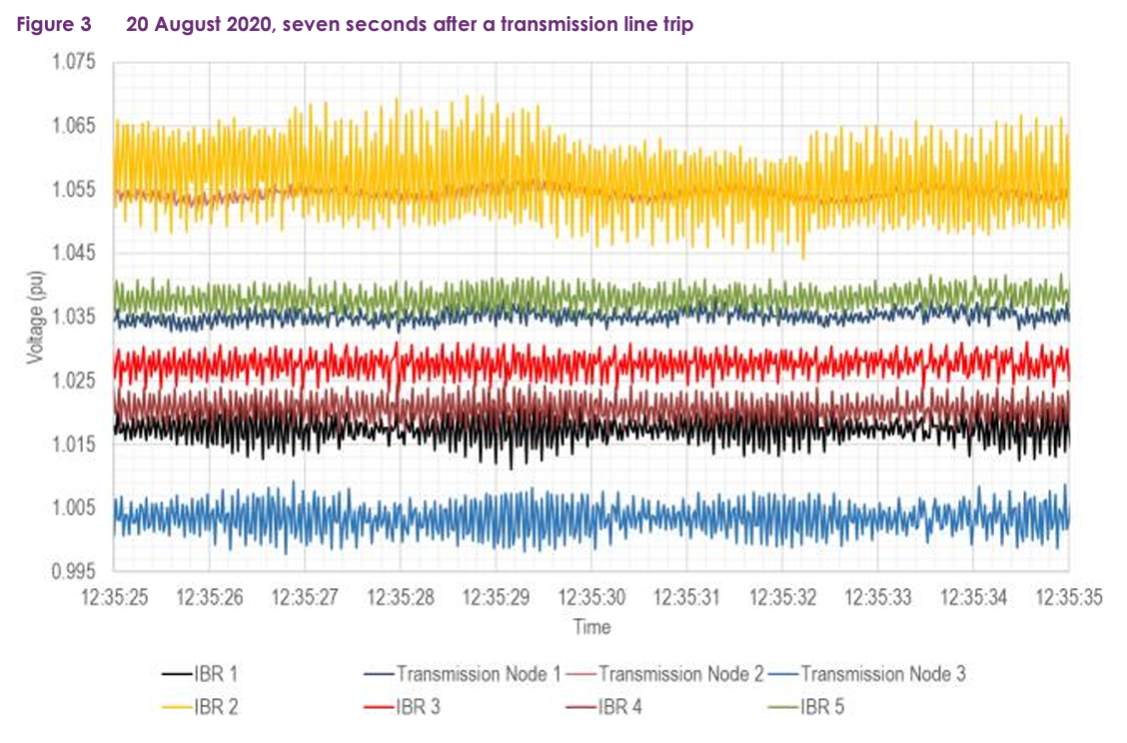
Mysterious Oscillations
The sub-synchronous oscillations seem to be intermittent and occurring both with and without any apparent disturbance in the WMZ or surrounding region.
The frequency of oscillations is mostly around 17-19 Hz (RMS).
The oscillations have been identified as contained in the north-west of Victoria and specifically around the Red Cliffs and Wemen area, likely involving the following solar plants: Wemen, Bannerton, Karadoc, Yatpool & Kiamal.
Based on instances when the response of these solar plants was analysed, the Q and V response from the solar plants were sometimes in-phase and sometimes out-of-phase.
The system operator replicated the oscillation in their EMT simulation models, after two years.
Impedance analysis has found the source of oscillations to be an underdamped mode in few IBRs and creation of system mode by few IBRs.
Sub-synchronous Oscillations in West Murray Zone (WMZ), Australia, since 2019. Source: High level summary of WMZ – Subsynchronous Oscillations.

Slide 3
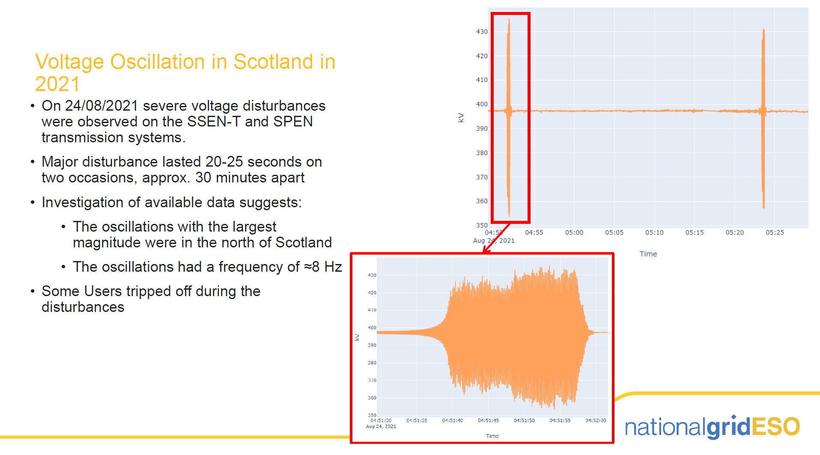
Mysterious Oscillations

Slide 4
Forced Oscillation or Free (Natural) Oscillation?
Forced Oscillations:
System is stable (eigen value of A has negative real part)
Oscillation is driven by periodic external input u, caused by failed components or load fluctuations
Common in synchronous-generator-based power systems, where mechanical components fail (steam valve, turbine blades…)
The origin of forced oscillations are the external input, and the mitigation scheme is to remove the external input (by repairing a failed component)
Im
Re
Free Oscillations:
System is unstable (eigen value of A has negative real part)
Oscillation is driven by interactions among states without external inputs
Common in inverter-based-systems (electronics do not easily fail but may create control interactions)
The origin of free oscillations are self-amplifying interactions between states, and the mitigation scheme is to damp the interactions (by tuning control)
Im
Re

Slide 5
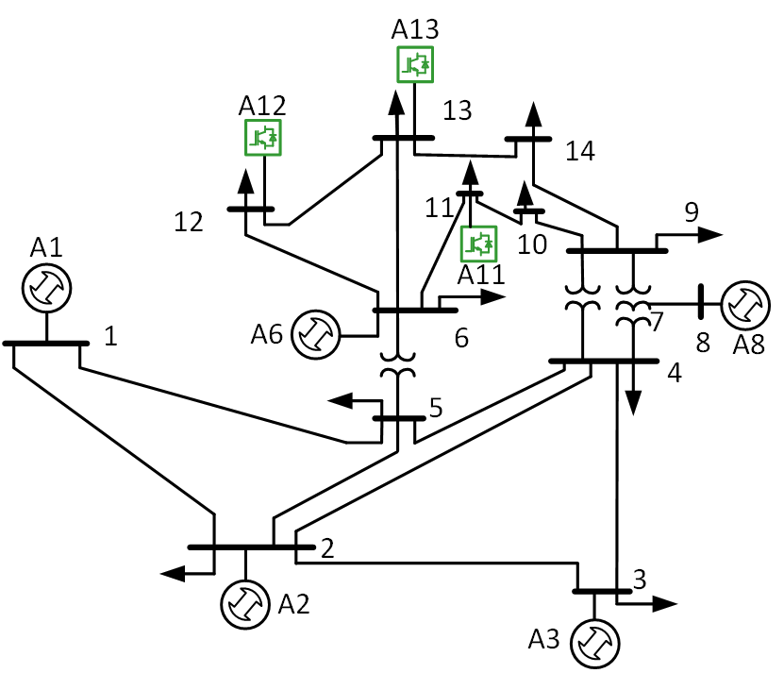
Forced Oscillation or Free (Natural) Oscillation?
Weak Grid
Oscillation
Some Free Oscillations are Misunderstood as Forced:
A typical case is IBR-weak grid oscillations, which is induced by a single IBR but is propagated to other nodes in the grid.
From the whole-system point of view, it is free oscillation; only for the system excluding the unstable IBR, it is forced oscillation.
Mid-Ground Between Forced and Free: Pink Oscillations
As the operating point shifts, the eigenvalue moves towards unstable.
Before becoming complete unstable, the eigenvalue becomes very underdamped, which induces pink oscillation, that is, oscillation excited by ambient noise (like load fluctuations).
Pink oscillation is forced oscillation but should be mitigated as free oscillation, because it is impossible to remove ambient noise.
Pink Oscillation
Im
Operating point shift
Re

Slide 6
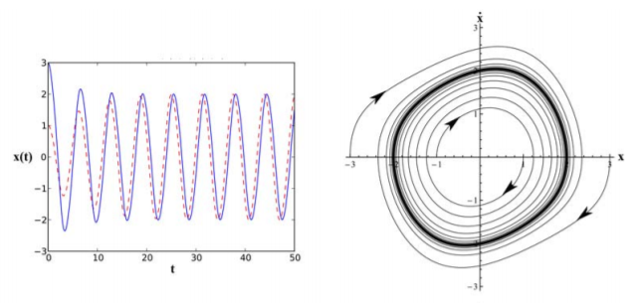
Limit Cycles in Free Oscillations
Free oscillations should “explode” in theory, but in practice, they are constrained to some amplitude, which is called limit cycles.
Oscillation “settles” at the point where the positive and negative damping is balanced
Linear negative damping
Non-linear positive damping that increases with the magnitude of oscillation due to “saturation”

Slide 7
What is Required for a Tracing Method?
Morality
To set up a moral standard for good and bad behaviours in terms of system stability
To index and rank the moral merit (good or bad) of different components
Effectiveness
To identify the effective component to mitigate or excite a particular oscillation
To index and rank the effectiveness of components in oscillation mitigation
Are Morality and Effectiveness always aligned?
Is “taming the bad guys” always the most effective solution to mitigate oscillation?

Slide 8
Oscillation Tracing Methods
Data-Driven
(Model Free)
Data-Led
(Data + Blackbox Model)
Model-Driven
(White-Box State-Space Model)
Energy-Based Method
Phase Compass Plot
Impedance Sensitivity
State Sensitivity
Real-Time Operation,
Post-Event Analysis
Planning, Pre-Event Screening

Slide 9
Energy Based Method
Two principles for a meaningful energy flow
Conservation: the net energy flows into every bus in the network must be zero.
Consistency: the flows are associated with energy functions H that are consistent across all plants.
where H is energy storage, F is flow, and d is dissipation
Dissipation of energy (d) governs the stability of the system, which is observable from energy flow (F).
Morality is achieved by distinguishing the source (bad) and sink (good) of energy flow. Effectiveness?

Slide 10
Different Definitions of Energy Flow
Dissipation Energy Flow (DEF, original form) [1,2]
Oscillation Power Flow [3]
Definition
Interpretation | Mechanical dissipation
Equivalence | Damping torque coefficient
Applicability | Angle and torsional oscillation
Definition
Interpretation | Electrical dissipation
Equivalence | Resistance
Applicability | Electromagnetic oscillation
[1] Maslennikov, S., Wang, B. and Litvinov, E., 2017. Dissipating energy flow method for locating the source of sustained oscillations. International Journal of Electrical Power & Energy Systems, 88, pp.55-62.
[2] Chen, L., Min, Y. and Hu, W., 2012. An energy-based method for location of power system oscillation source. IEEE Transactions on Power Systems, 28(2), pp.828-836.
[3] Xie, X., Zhan, Y., Shair, J., Ka, Z. and Chang, X., 2019. Identifying the source of subsynchronous control interaction via wide-area monitoring of sub/super-synchronous power flows. IEEE Transactions on Power Delivery, 35(5), pp.2177-2185.

Slide 11
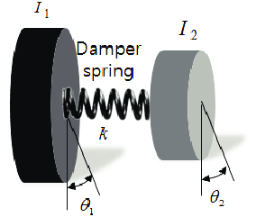
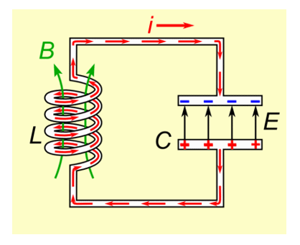
Dissipation vs. Passivity vs. Damping
In control theory, dissipation = passivity
In power engineering, passivity refers to electrical dissipation (positive resistance)
Dissipation contributes to damping only if they are consistent
  Mechanical dissipation contributes to the damping of angle swing and torsional resonance
  Electrical dissipation contributes to the damping of electromagnetic resonance
Torsional resonance: damped by mechanical dissipation (positive torque coefficient)
Electromagnetic resonance: damped by electrical dissipation (positive resistance)

Slide 12
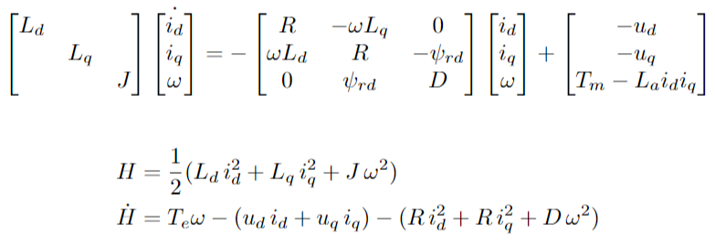
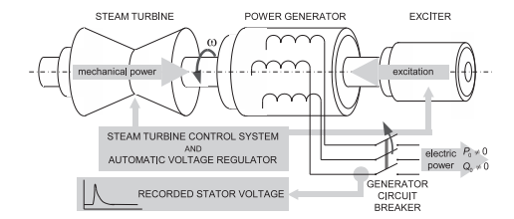
Side Note: Total vs. Incremental Energy Flow
State equation of synchronous generator
Energy storage and flow
Energy flow at mechanical port
Dissipation
Energy flow at electrical port
Total energy flow is consistent but is not useful.
For example, a synchronous generator is a source of total energy, but is a sink of oscillation energy (positive damping torque).
We are more interested in the oscillation energy (incremental energy) on top of the base energy flow.
Total Energy
Oscillation Energy

Slide 13
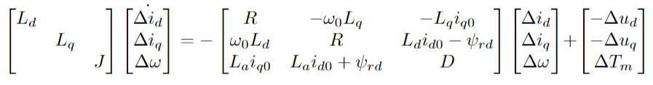
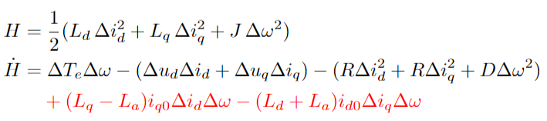
Side Note: Incremental Energy
Incremental state equation of synchronous machine
Incremental energy storage and flow
Energy flow at mechanical port
Dissipation
Energy flow at electrical port
Additional energy flow
The additional energy in the incremental system breaks the conservation of the physical system, making the definition of a meaningful incremental energy flow difficult.

Slide 14
DEF vs. Phase Compass Plot
P_{d} is proportional to the dc component of DEF.
The phase compass plot method is DEF method transformed to the frequency domain.

Slide 15
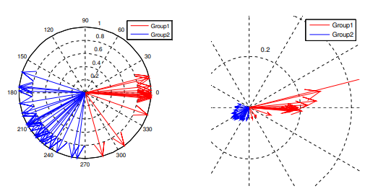
Phase Compass Plot vs. Mode Shape
Phase compass plot can display the phase distribution of multiple buses to identify the pathway of interaction for an inter-area mode. It is essentially the mode shape of the measured states.

Slide 16
Sensitivity Analysis: A Generic Way for Oscillation Tracing
The different definitions of energy flow all have their successful cases, but none universal.
The applicability of energy flow is up to its consistency with damping.
Sensitivity analysis directly investigates damping itself (the real part of the eigenvalue) and is therefore generic.
Sensitivity analysis does not distinguish sources (bad) and sinks (good): effective but not necessarily moral.
More importantly, sensitivity analysis requires a state-space model, which is not available.
Im
stabilising
destabilising
Re
In energy flow, the left side is source and the right side is sink of oscillation.
In sensitivity analysis, left and right has equal participation: sensitivity analysis is effective but not moral.
Participation factor: sensitivity of oscillation modes to states
Source
Sink

Slide 17
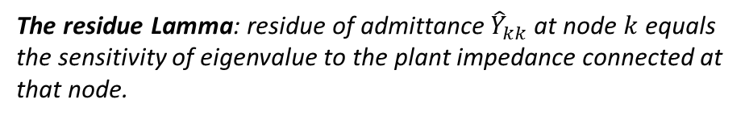
Port-Based Sensitivity: Impedance Participation Factor
Port
Residue
Plant 1
Eigenvalue
The residue Lamma: residue of admittance ${\hat{Y}}_{kk}$at node $k$ equals the sensitivity of eigenvalue to the plant impedance connected at that node.
Plant k
Network
……
The residue Lamma yields the impedance participation factor
Plant N

Slide 18
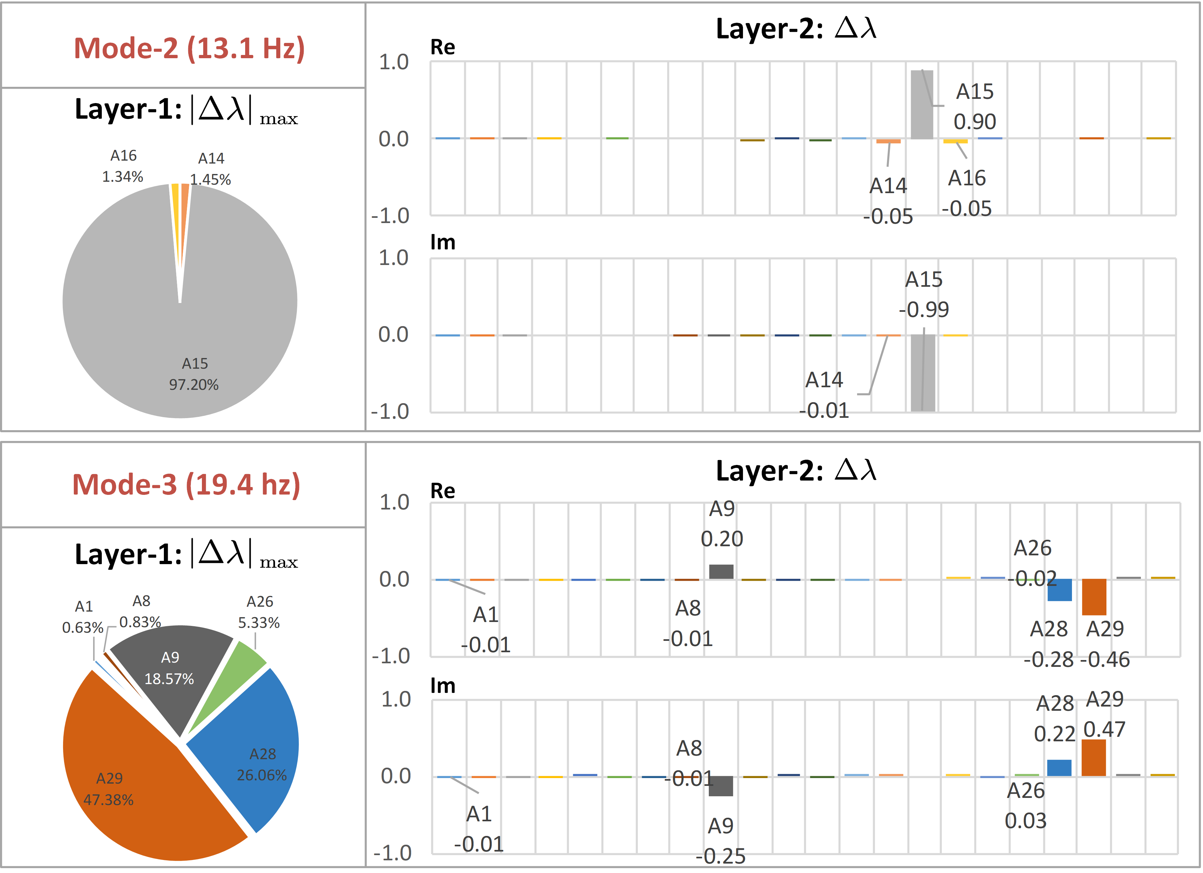
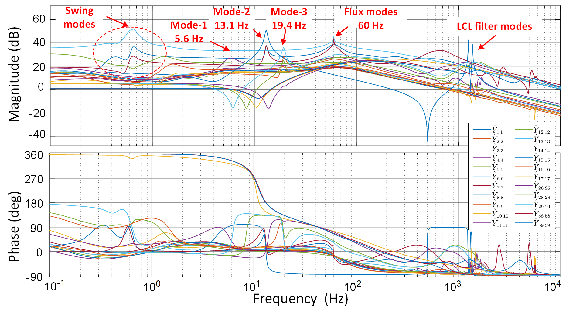
Impedance-Based Oscillation Tracing
1: Effectiveness
2: Morality
System-Wide Impedance Scan
Identifying mode and impedance sensitivity from data
Zhu, Y., Gu, Y., Green, T.C., 2021. Participation analysis in impedance models: The grey-box approach for power system stability. IEEE Transactions on Power Systems.
Ranking of effectiveness (Layer 1) and morality (Layer 2) in oscillation damping from impedance sensitivity analysis

Slide 19
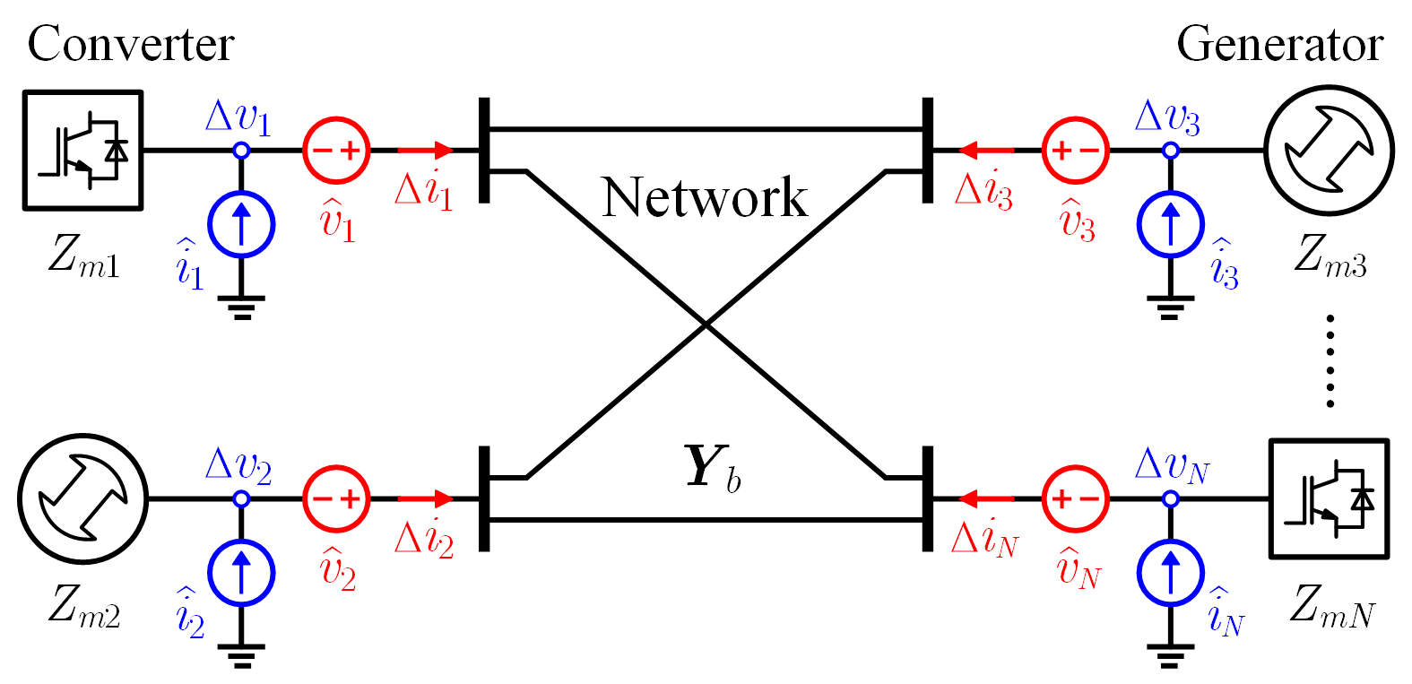
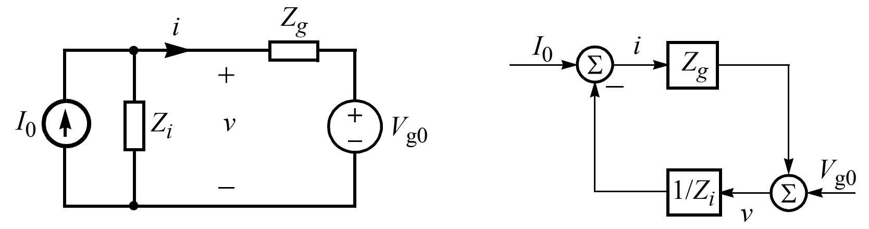
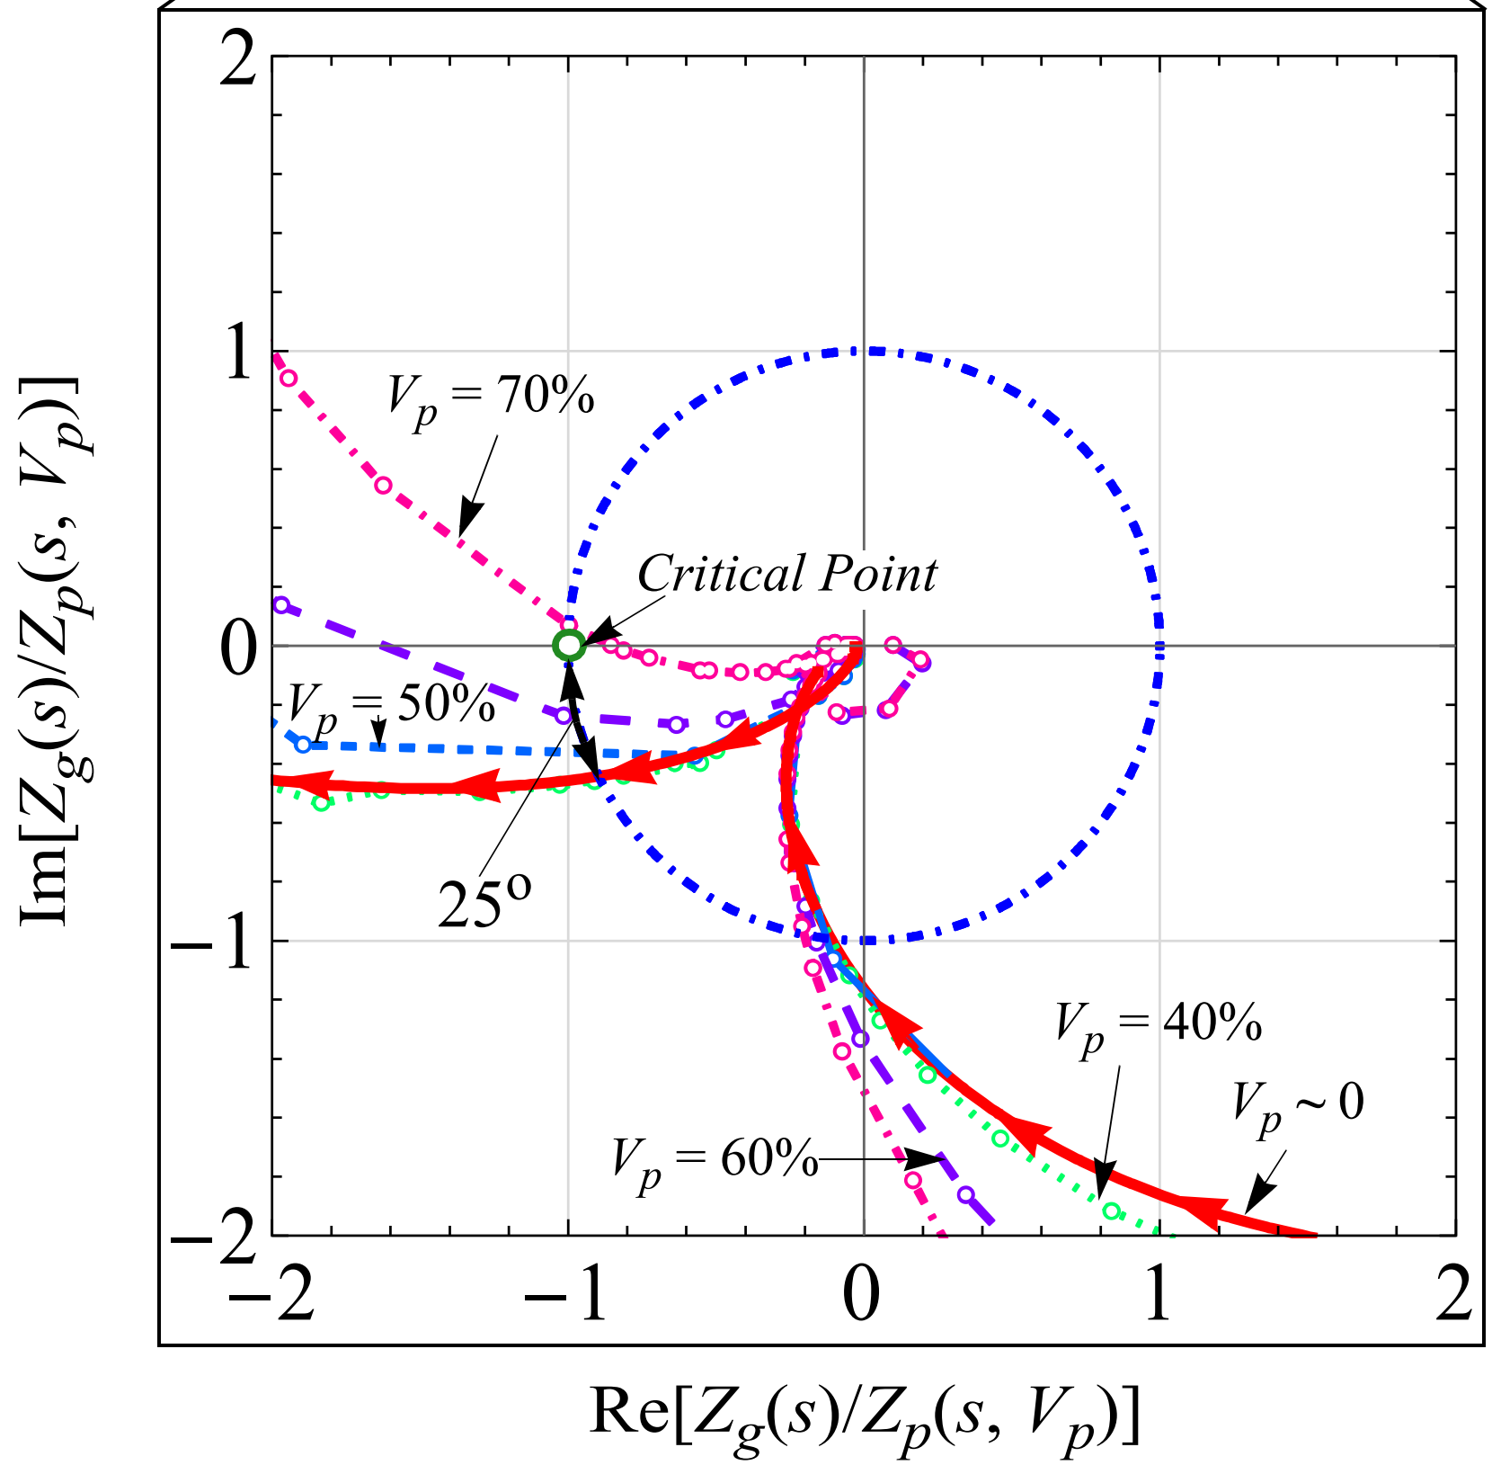
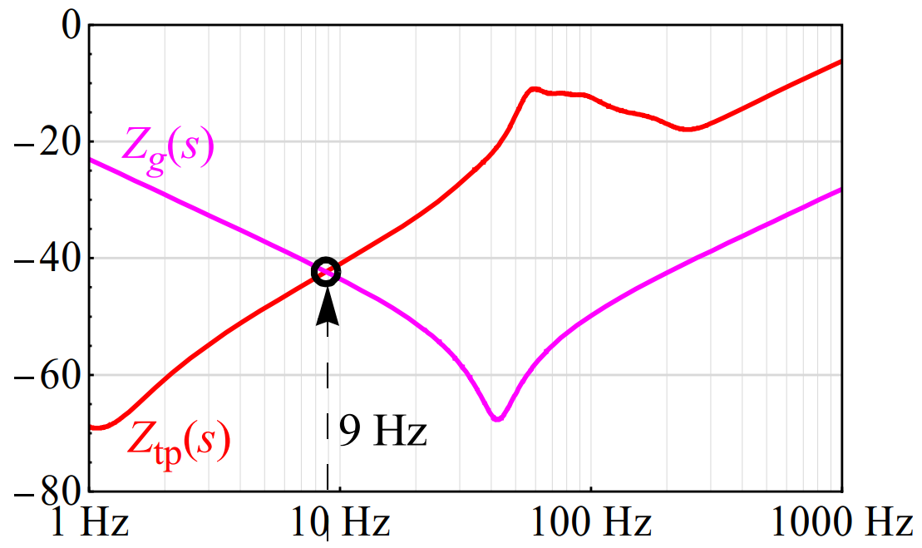
Relationship with Impedance Nyquist Criterion
Split into the plant under investigation (Z_{i}) and the grid (Z_{g})
Apply Nyquist Criterion on Z_{g}/Z_{i} loop gain.

Slide 20
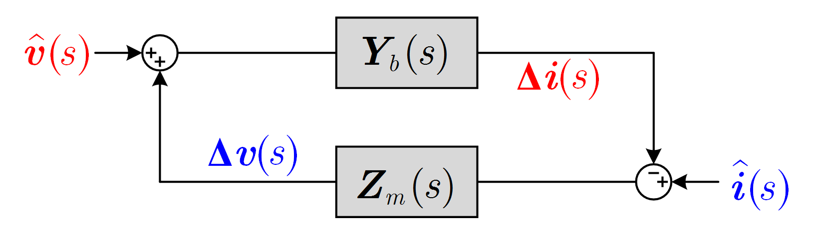
Relationship with Impedance Nyquist Criterion
Split into the plant under investigation (Z_{i}) and the grid (Z_{g})
Apply Nyquist Criterion on open-loop gain Z_{g}/Z_{i}.
Split into plants (Z_{m}) and the network (Y_{b}) and apply sensitivity analysis on the closed-loop system (I+Y_{b} Z_{m})⁻¹ Y_{m}

Slide 21
Accelerated System-Wide Impedance Scan
Step 1: Identify IBRs and their operation conditions that are suspected to have significant role in the observed oscillations.
Step 2, SMIB IBR Scan: Perform impedance scans at IBRs in SMIB (single machine infinite bus) format
  Identify internal resonance modes of IBRs and evaluate their ability to operate stably with grids of different strength conditions (SCR, X/R)
Step 3, Wide Area Network Scan: Perform impedance scans of the grid at the terminal of an IBR using wide-area network EMT model
  Identify oscillation modes in the grid and contribution of the IBR to its damping
  Repeat this step as needed at other IBRs

Slide 22
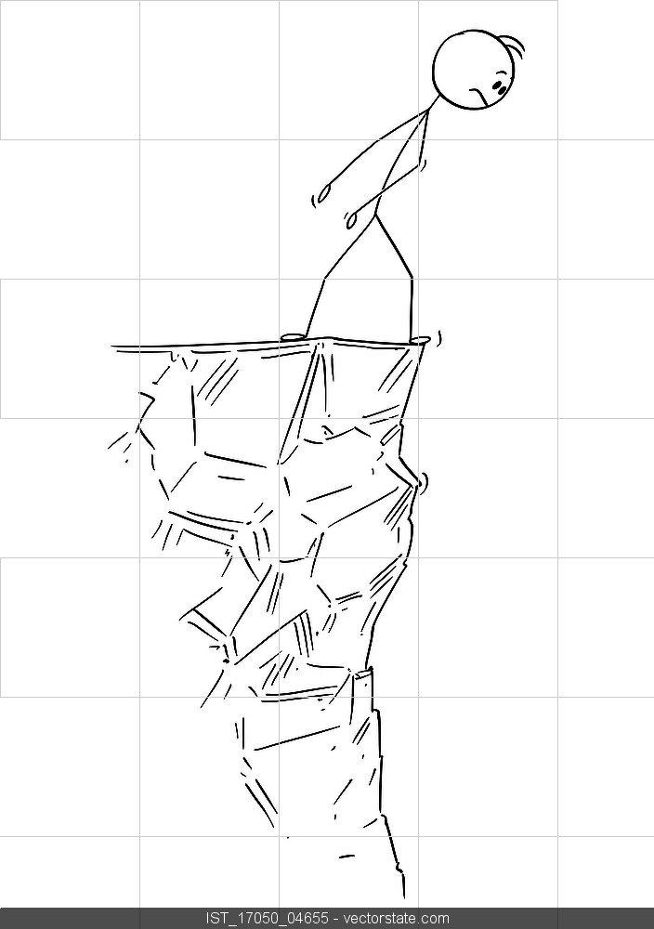

Reversed Impedance-Based Stability Criterion
Usual Approach
Reversed Approach
Will the connection of a plant make the system stable/unstable?
IBR 4
IBR 3
IBR 3
IBR 4
IBR 2
IBR 2
IBR n
IBR 1
IBR n
IBR 1
Will the removal of a specific plant make the system stable/unstable?
Shah, S., Yan, W., Koralewicz, P., Mendiola, E. and Gevorgian, V., 2022. A reversed impedance-based stability criterion for IBR grids.

Slide 23
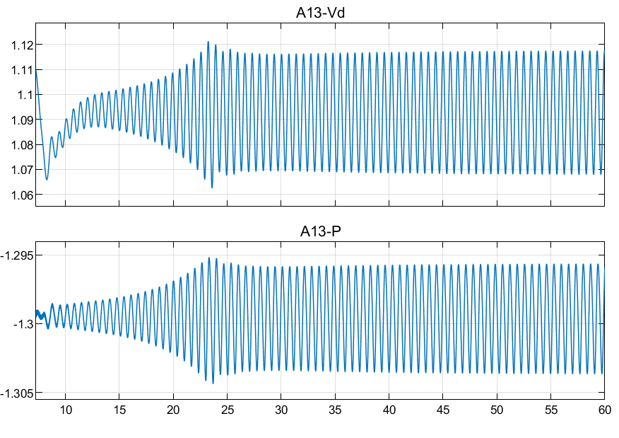
Case Study: a Weak System with 1.5 Hz Oscillation
1.5 Hz free oscillation

Slide 24
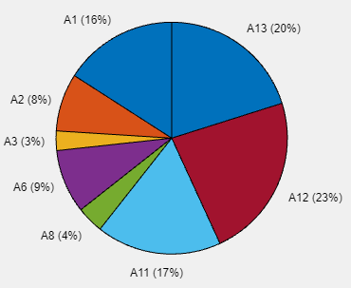
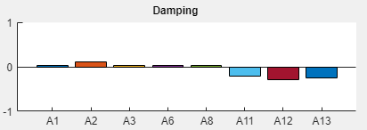
Impedance-Based Tracing
Impedance Participation Factor: Layer 1
Impedance Participation Factor: Layer 2
From the impedance-sensitivity analysis, we see
IBRs (A11, A12, A13) excite the oscillation
Generators (A1,A2,A3,A6,A8) damp the oscillation

Slide 25
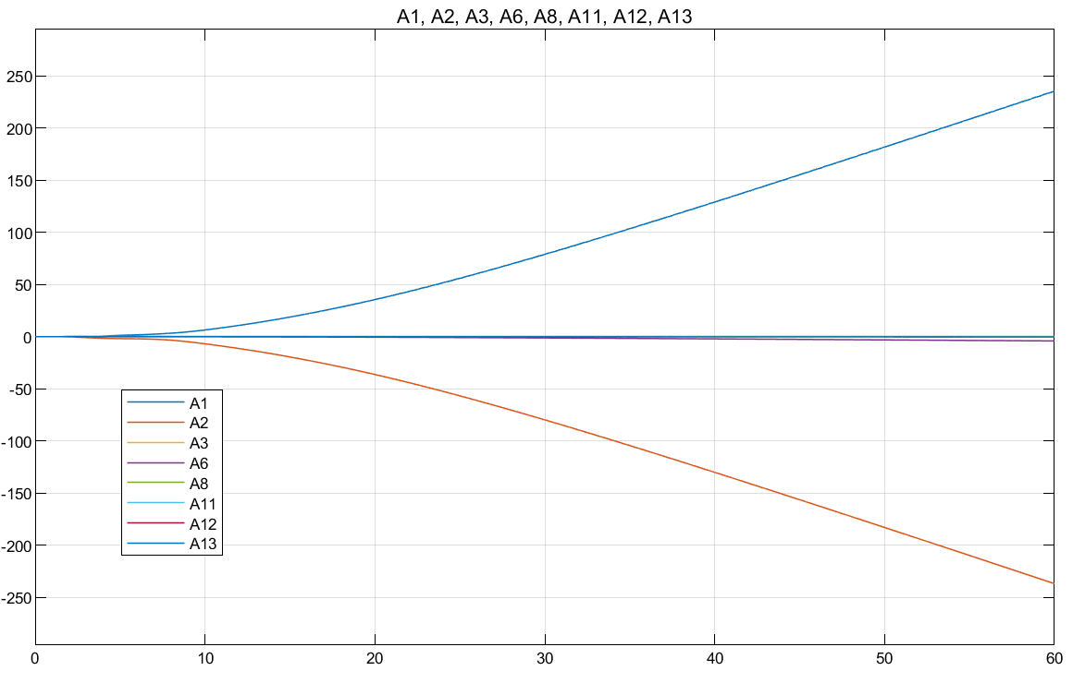
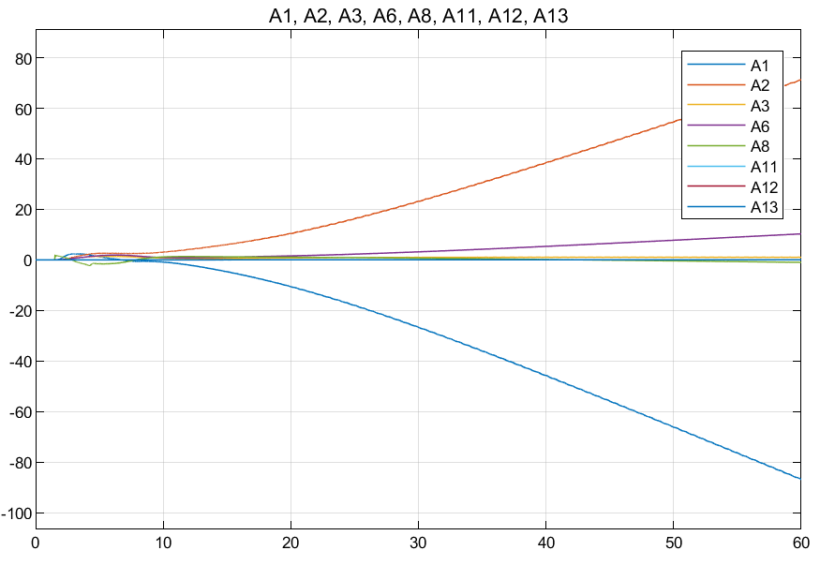
Energy-Based Tracing
DEF (conventional)
DEF (modified)
A1 (SG)
A2 (SG)
A1 (SG)
A2 (SG)
False indication
False indication

Slide 26
Relationships of Oscillation Tracing Methods
Energy-Based Method
Frequency Domain
Phase Compass Plot
Impedance Sensitivity
State Sensitivity
Right Eigenvector (Mode Shape)
Port
Left-Right Eigenvector

Slide 27
Relationships of Oscillation Tracing Methods
Energy-Based Method
Frequency Domain
Phase Compass Plot
Impedance Sensitivity
State Sensitivity
Right Eigenvector (Mode Shape)
Port
Left-Right Eigenvector
Moral but not always Effective | Effective or Moral | Effective but not always Moral
Merit

Slide 28
Relationships of Oscillation Tracing Methods
Energy-Based Method
Frequency Domain
Phase Compass Plot
Impedance Sensitivity
State Sensitivity
Right Eigenvector (Mode Shape)
Port
Left-Right Eigenvector
Data | Data + Blackbox Model | White-Box Model
Input

Slide 29
Relationships of Oscillation Tracing Methods
Energy-Based Method
Frequency Domain
Phase Compass Plot
Impedance Sensitivity
State Sensitivity
Right Eigenvector (Mode Shape)
Port
Left-Right Eigenvector
Real-Time and Post-Event | Pre-Event and Offline, with possible extension to Online and Real-Time
Use Case

Slide 30
Data Quality: Sampling Rate
The sampling rate of the data must be at least twice the oscillation frequency. Is this enough?
From the test on commercial PMU with 50Hz sampling rate, significant phase delay is observed from 10Hz.
For DEF-like method, the phase delay is not a problem if the delay for different signals (e.g. power and frequency) are uniform.
For phase compass plot method, the pathway of interaction analysis may be compromised by non-uniform phase delay of the PMUs from different vendors.
Dynamic System Monitoring (DSM) offer much higher sampling rates (several kHz) than PMUs, but DSM data is not synchronised. Is synchronisation necessary?

Slide 31
Data Quality: Synchronisation
Only phase compass plot method, used for interaction pathway study, need globally synchronised data (GPS).
The globally synchronisation also implies that the phase delays of PMUs at different buses are uniform up to the oscillation frequency.
DEF-like methods need locally synchronised data (e.g. power and frequency on the same bus).
Impedance participation factor is currently used for offline study based on EMT models. If it is taken online (digital-twin), it might or might not need synchronised data (depending on how the system is probed).
PMU on distribution network is synchronised but may also suffer from phase differences due to load flow.
Clear specification of measurement devices is needed to make the data useful.

Slide 32
Success Stories

Slide 33
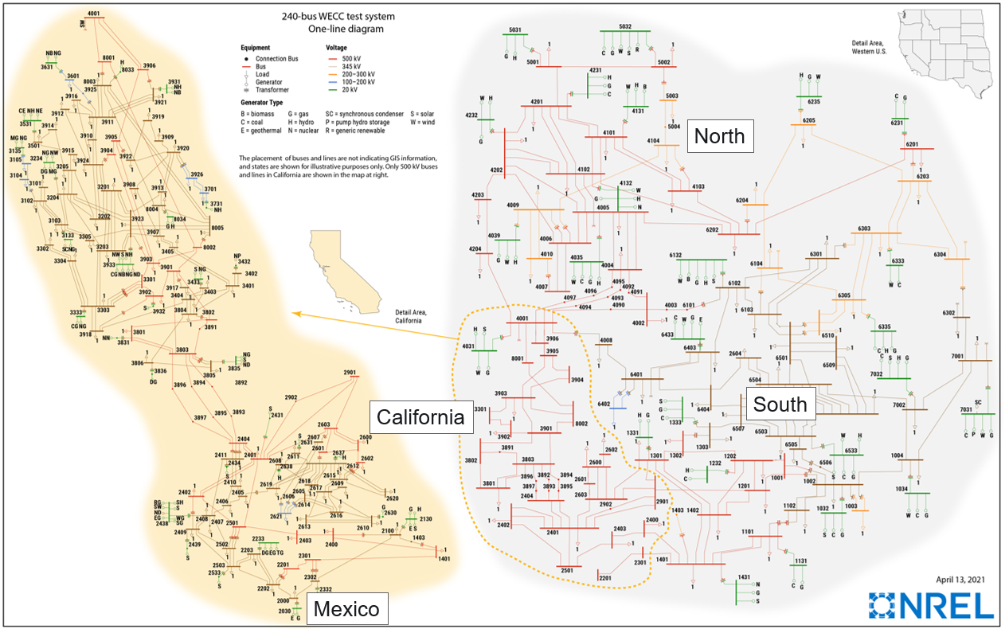
2021 IEEE/NASPI Oscillation Source Location Contest*
Objective: help to identify tools for practical use
Test system : NREL’s 240-bus WECC model
  13 realistic test cases of traditional oscillations
  Participation: 60 sign-ups, 21 submissions
  OSL methods utilized:
Group # | Description
1 | Energy-based methods (DEF, Transient energy,…)
2 | Oscillation shape and magnitude (Phase relation at the onset, Magnitude of oscillation, Mode shape)
3 | Machine Learning and Model-based analytics (ML pattern recognition, Spectral estimate, …)
4 | Cross Power Spectra Density (energy-based approach is the core)
* http://web.eecs.utk.edu/~kaisun/Oscillation/2021Contest/

Slide 34
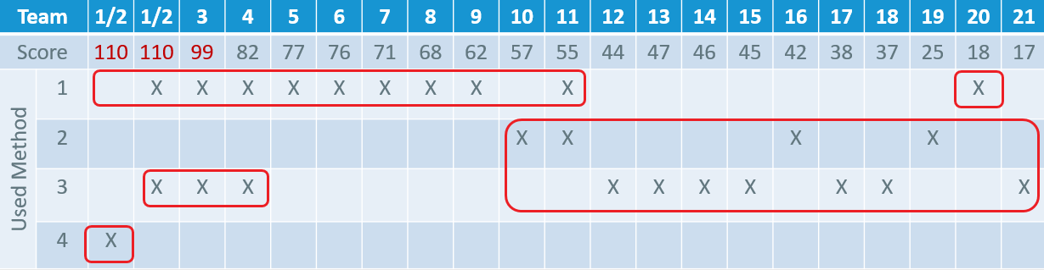
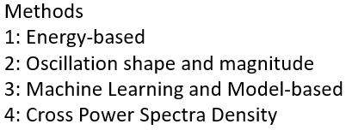
Conclusions Based on Results
Details of implementation could be critical
Energy-based methods are most efficient
Complementary use of ML and Model-based method seems to be beneficial
ML and Model-based method are less efficient

Slide 35
OSL Success Stories: Traditional Oscillations
Where | Method | Description
ISO New England (USA) | Energy-based | On-line use since 2017
Power System Operation Corporation (India) | Energy-based | On-line use since 2022
RTDMS by EPG (USA). Commercial product | Energy-based* | Deployed in many utilities but not much information on success stories
Phasorpoint by GE (USA). Commercial product | Phase compass plot | Deployed in many utilities but not much information on success stories
* Reduced version of energy function implemented in frequency domain

Slide 36
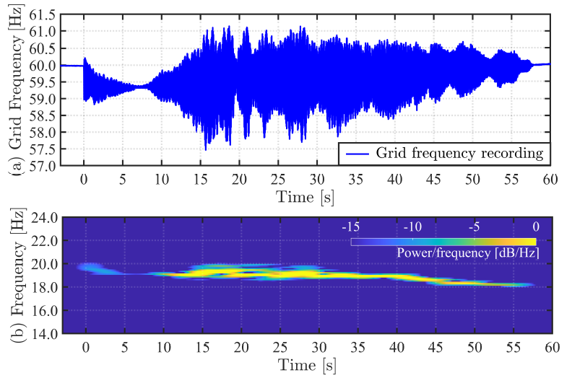
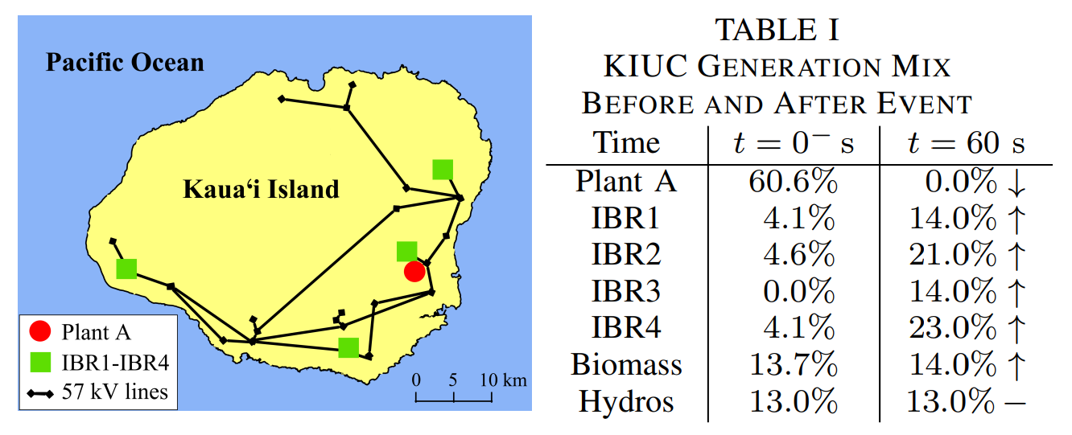
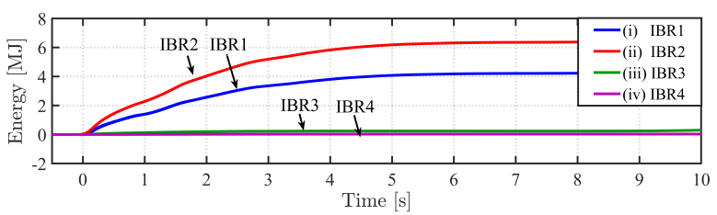
OSL Success Stories: IBR-based Oscillations
November 21, 2021, Kaua‘i Island Power System 18–20 Hz Oscillations
Identification of oscillation sources with the DEF method
Source: https://arxiv.org/pdf/2301.05781.pdf

Slide 37
Analysis with Impedance Method
Impedance with (*) and without (o) the Y Plant
Nyquist Plot of determinant of [I + Z_{netw}(s)/Z_{plant}(s)]⁻¹
Analysis Result:
    An underdamped resonance mode at 23 Hz is identified
    The mode is unstable without the Y plant
    The Y plant holds the system stable

Slide 38
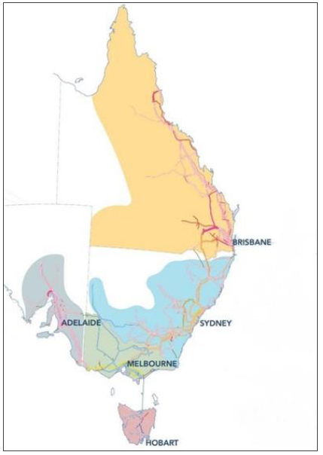
OSL Success Stories: AEMO
11/7/2023 event of 6Hz and 20/9/2023 event of 17 Hz, IBR-related oscillations
AEMO has obtained a cost-free license of the OSLp software from ISO-NE and benchmarked the algorithm against several simulated and real events
In EMT simulations, a SSCI event was induced, and measurements recorded by ‘virtual’ PMUs
For real events, live PMU data from all available PMUs were utilized
OSLp software, utilizing the DEF method, has correctly traced the source of oscillation for both simulated and actual events
Source: AEMO

Slide 39
Impedance Scan of Australian Grid from IBR-1
IBR-2 and IBR-3 are disabled; IBR-2 and IBR-3 operate at low-risk condition; IBR-2 operates at high-risk condition and IBR-3 is disabled; IBR-2 and IBR-3 operate at high-risk condition

Slide 40
OSL Test Case Library*
Contains sets of PMU data for testing OSL methods for traditional oscillations
  Simulation cases based on WECC 179-bus model
  Field-measured cases
  IEEE-NASPI contest cases and data set-ups for simulation in 240-bus WECC system
Creation similar test cases for IBR-based oscillations could be beneficial for benchmarking OSL methods
  Models with multiple IBRs
  Cases covering all types of oscillations
* http://web.eecs.utk.edu/~kaisun/Oscillation/

Slide 41
Conclusions
The effectiveness energy-based tracing method is subject to the consistency between dissipation and damping. This means that different definitions of energy flow are needed to match the types of oscillations.
New definitions of energy flow need to be investigated to adapt to the behaviours of IBRs.
The impedance-sensitivity-base tracing method is rather generic but still need black-box EMT model. Extensive to digital-twin being considered.
Attention is needed on data quality: sampling rate, filtering delay, synchronisation.

Slide 42

Thank You!

