Slide 1
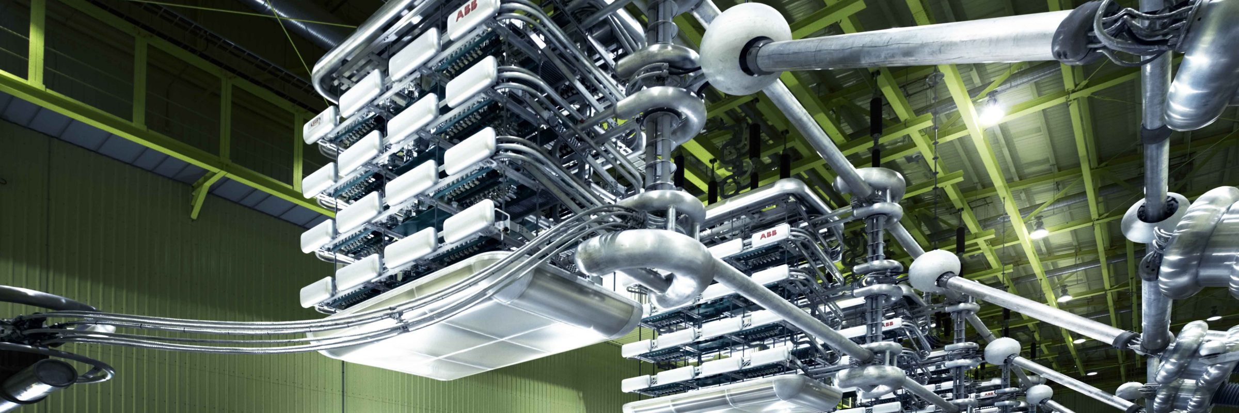
Data-led Oscillation Monitoring and Early Warning
Dr Yunjie Gu, Lecturer in Power Systems
Imperial College London

Slide 2
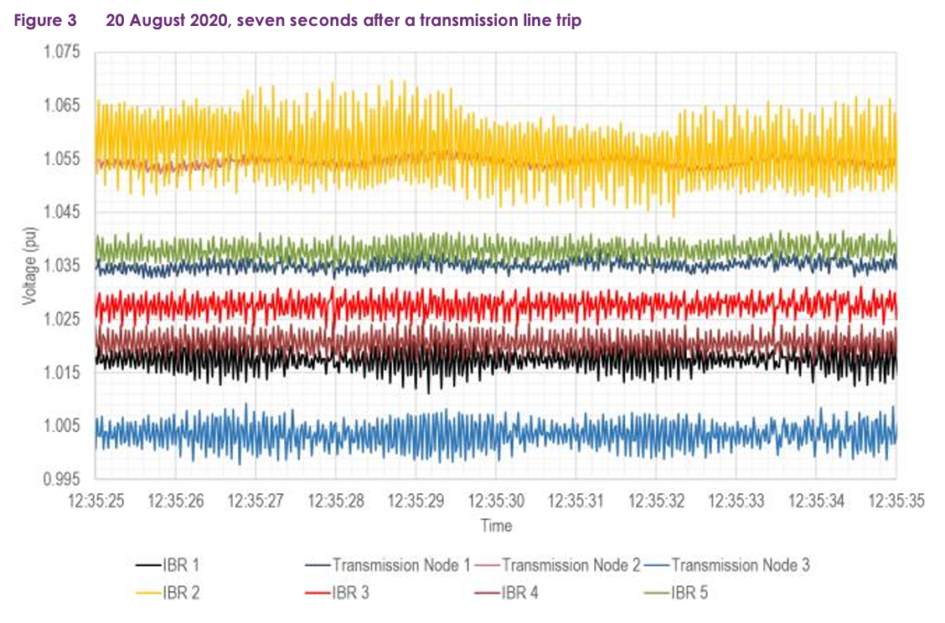
AEMO Oscillations
The sub-synchronous oscillations seem to be intermittent and occurring both with and without any apparent disturbance in the WMZ or surrounding region.
The frequency of oscillations is mostly around 17-19 Hz (RMS).
The oscillations have been identified as contained in the north-west of Victoria and specifically around the Red Cliffs and Wemen area, likely involving the following solar plants: Wemen, Bannerton, Karadoc, Yatpool & Kiamal.
Based on instances when the response of these solar plants was analysed, the Q and V response from the solar plants were sometimes in-phase and sometimes out-of-phase.
The system operator replicated the oscillation in their EMT simulation models, after two years.
Sub-synchronous Oscillations in West Murray Zone (WMZ), Australia, since 2019. Source: High level summary of WMZ – Subsynchronous Oscillations.

Slide 3
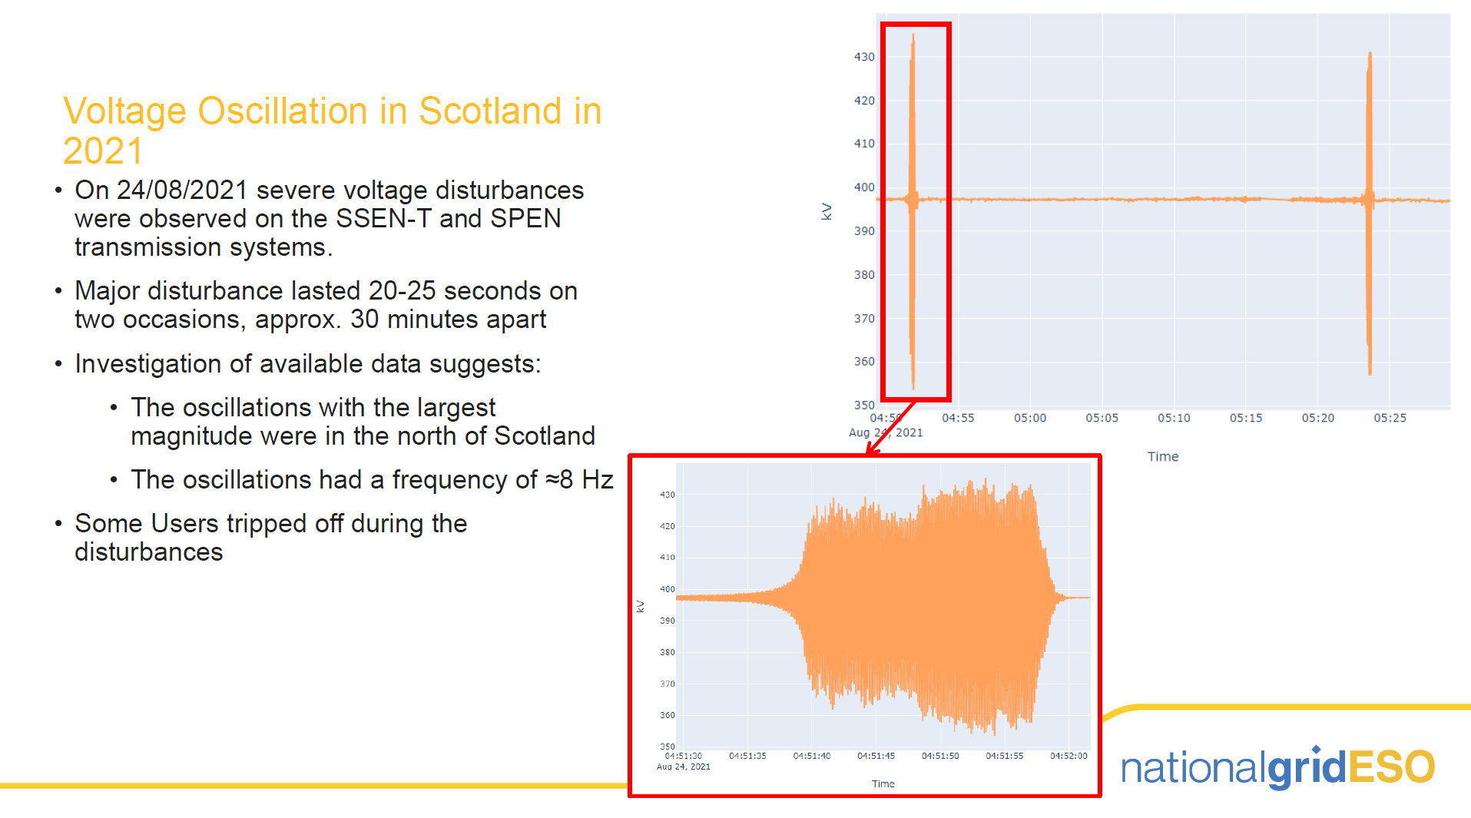
Scotland Oscillations

Slide 4
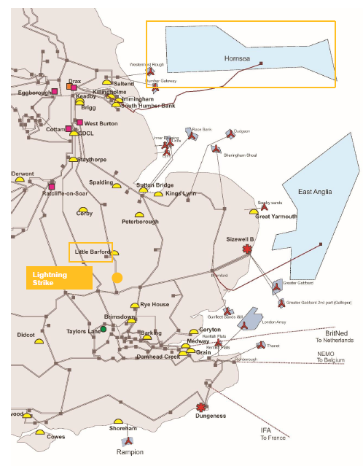
Hornsea Oscillations

Slide 5
Hornsea Oscillations
Before the Hornsea wind farm de-loading, there was an under-damped voltage oscillation

Slide 6
Defence Lines for Oscillations
Planning: identify the strength and weakness of the network and perform connection planning accordingly
Pre-Event: provide predictions and early warnings of oscillations before they actually occur
Post-Event: identify the origins of oscillations and deploy mitigation actions to prevent them from happening again
This work is supported by National Grid ESO via Network Innovation Allowance projects “Data-Driven Online Monitoring and Early Warning For GB System Stability” (DOME) and “Strength to Connect”

Slide 7
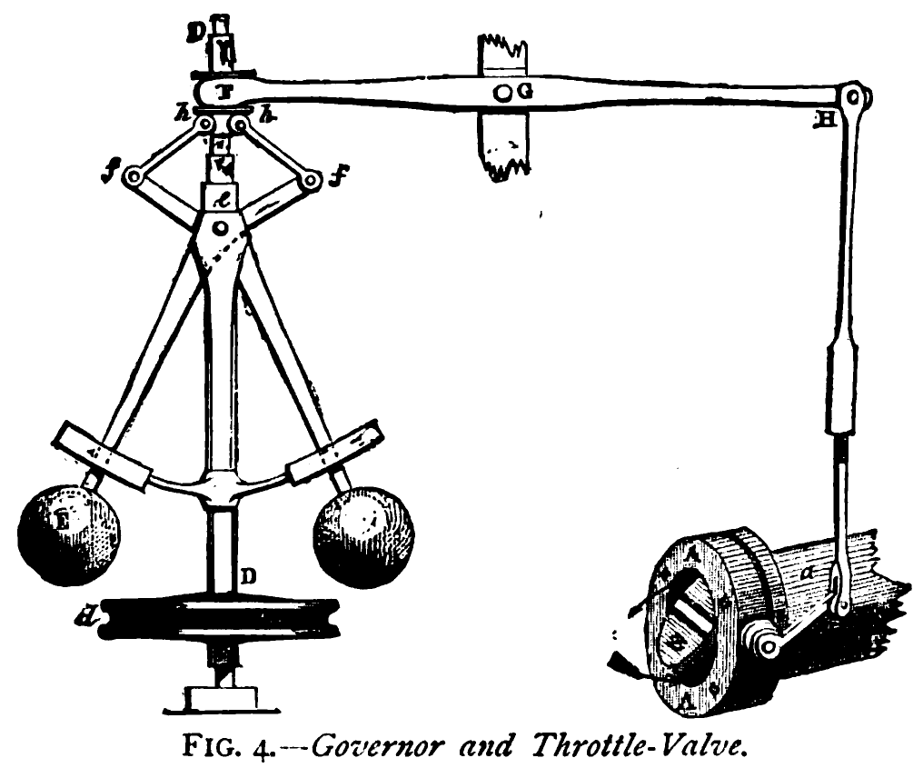
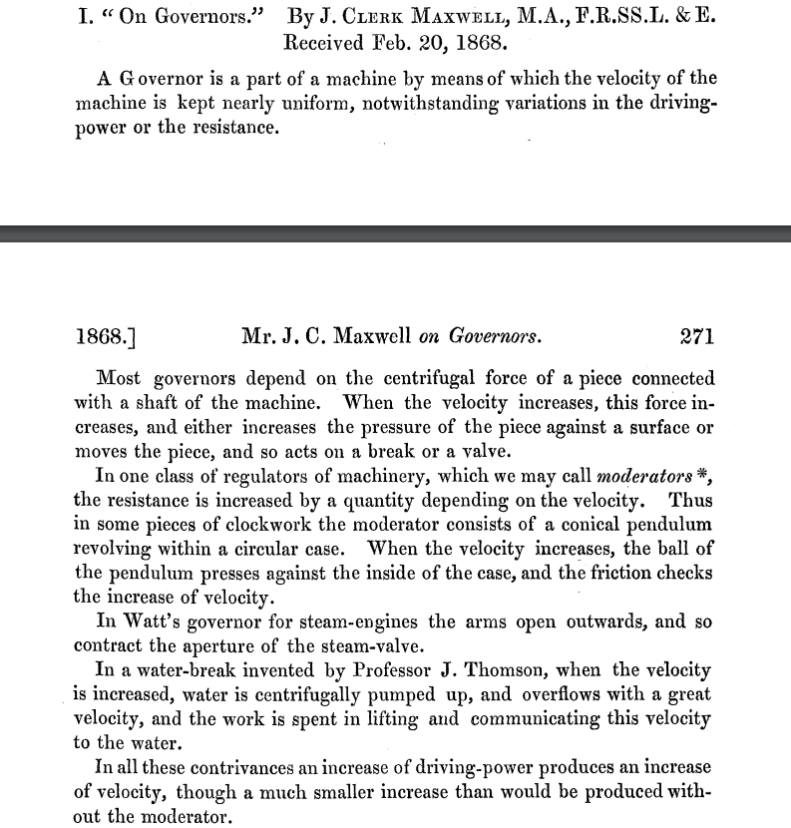
The Eigenvalue Approach
The stability of linear system
is determined by

Slide 8
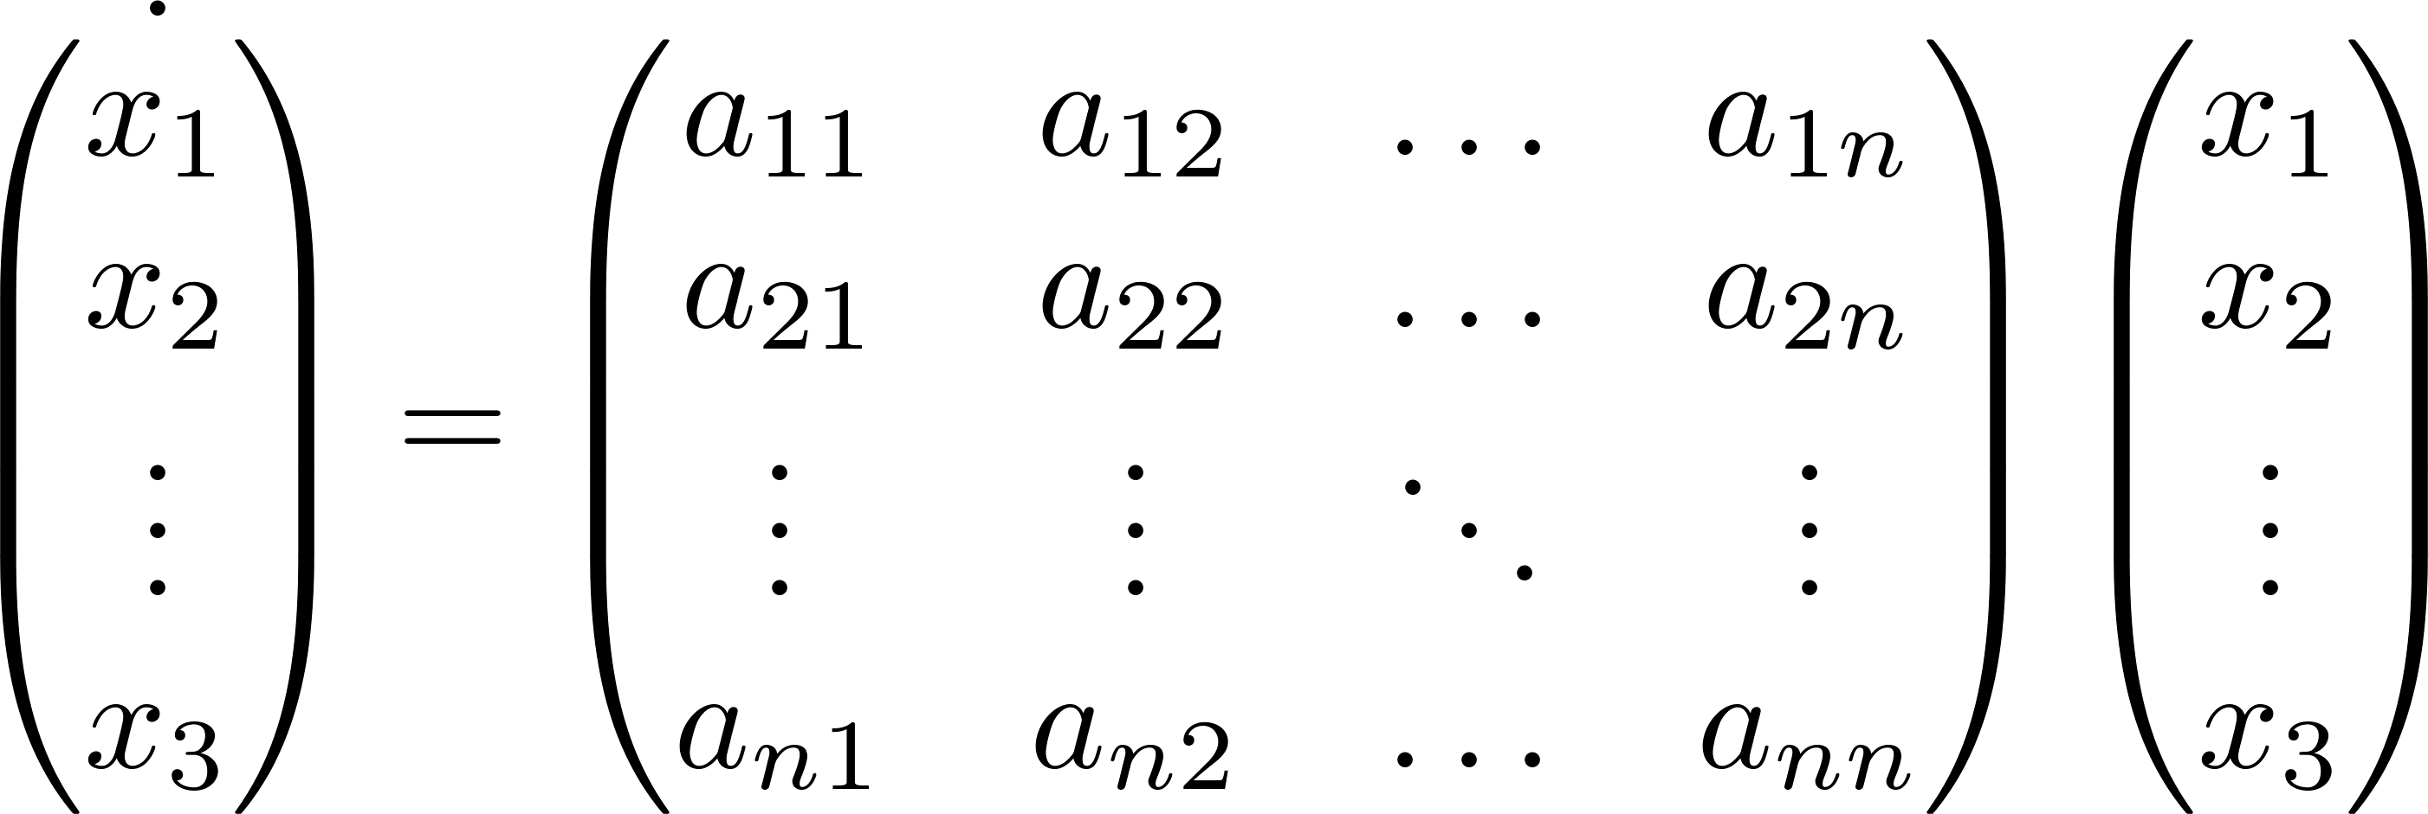
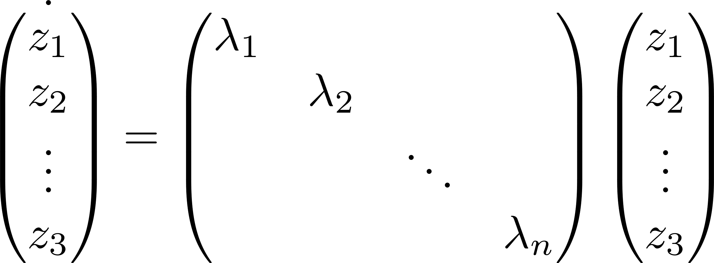
State Sensitivity: Participation Factor
Participation factor: sensitivity of an oscillation mode to a state
Pagola, F.L.; Perez-Arriaga, I.J.; Verghese, George C. (1989). "On sensitivities, residues and participations: Applications to oscillatory stability analysis and control". IEEE Transactions on Power Systems.

Slide 9
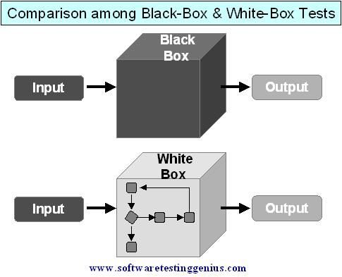
Model? We don’t have a good one
Sensitivity (participation factor) analysis is a powerful tool to understand oscillations,
only if we have a good (white-box) model.
The first generation of inverter-based resources (IBRs) do not provide models at all.
Newer IBRs are obliged to provide model, but in a black-box form (compiled executables).

Slide 10
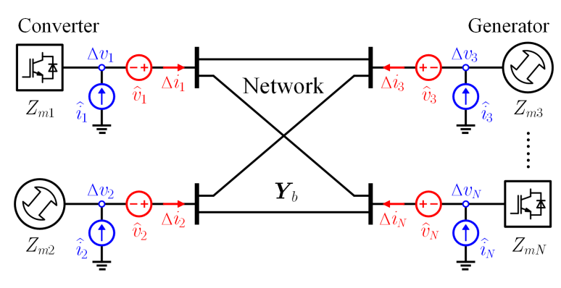
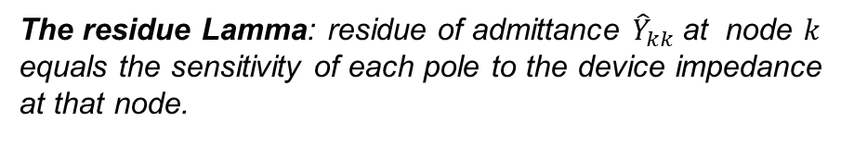
Port-Based Sensitivity: Impedance Participation Factor
Residue
Pole/Eigenvalue
The residue Lamma: residue of admittance ${\hat{Y}}_{kk}$at node $k$ equals the sensitivity of each pole to the device impedance at that node.
: impedance of device connected at bus k
From the residue Lamma, we define an “impedance participation factor”
: admittance of whole-system seen at bus k

Slide 11

Admittance Participation Factor
Residue
Pole/Eigenvalue
The residue Lamma: residue of impedance ${\hat{Z}}_{kk}$at node $k$ equals the sensitivity of each pole to the device admittance at that node.
: admittance of device connected at bus k
From the residue Lamma, we define an “admittance participation factor”
: impedance of whole-system seen at bus k

Slide 12
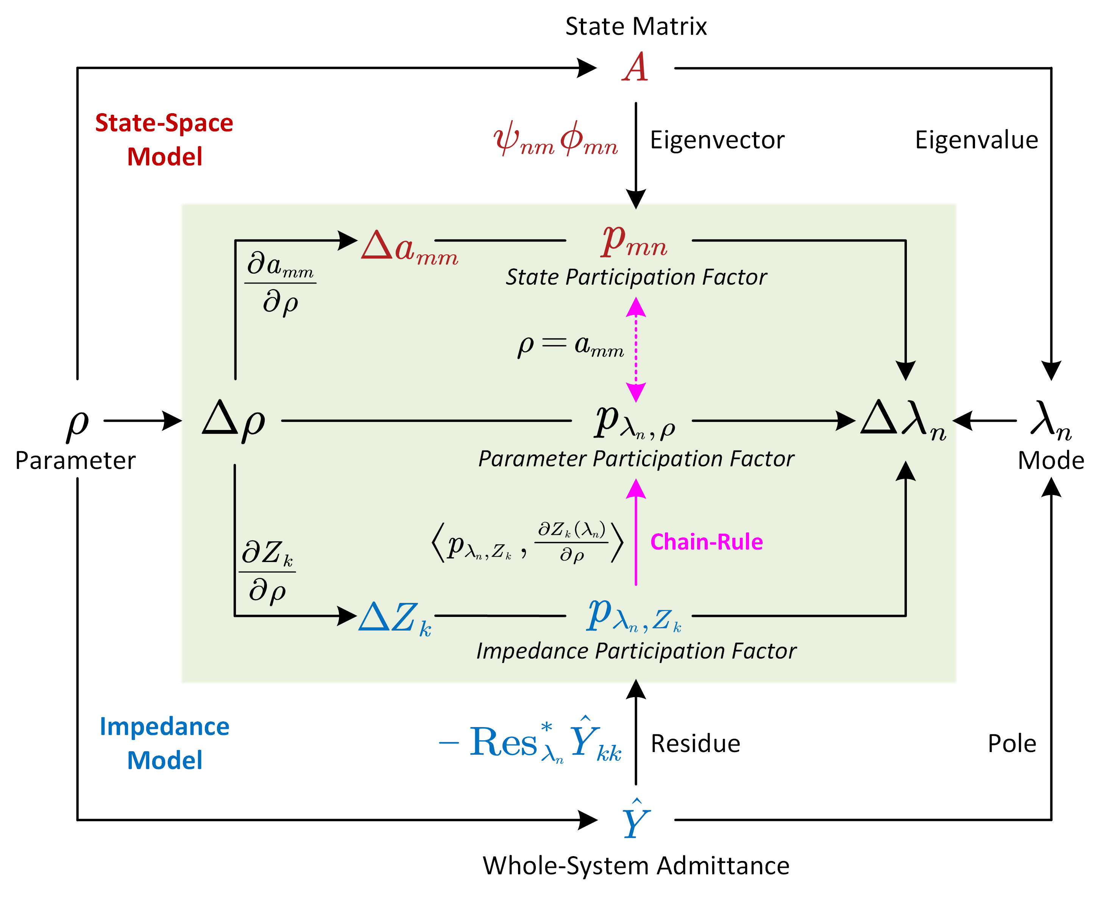
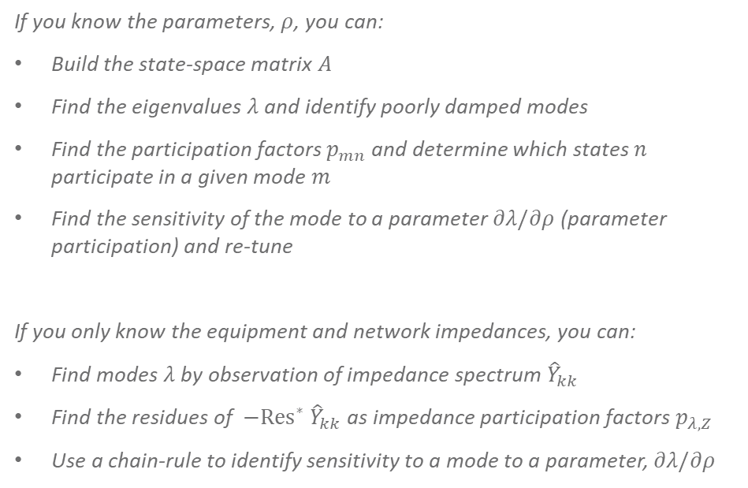
Unified Sensitivity Relationships
If you know the parameters, $ρ$, you can:
Build the state-space matrix $A$
Find the eigenvalues $λ$ and identify poorly damped modes
Find the participation factors $p_{mn}$ and determine which states $n$ participate in a given mode $m$
Find the sensitivity of the mode to a parameter $∂λ/∂ρ$ (parameter participation) and re-tune
If you only know the equipment and network impedances, you can:
Find modes $λ$ by observation of impedance spectrum ${\hat{Y}}_{kk}$
Find the residues of $−Res^{∗} {\hat{Y}}_{kk}$as impedance participation factors $p_{λ, Z}$
Use a chain-rule to identify sensitivity to a mode to a parameter, $∂λ/∂ρ$

Slide 13
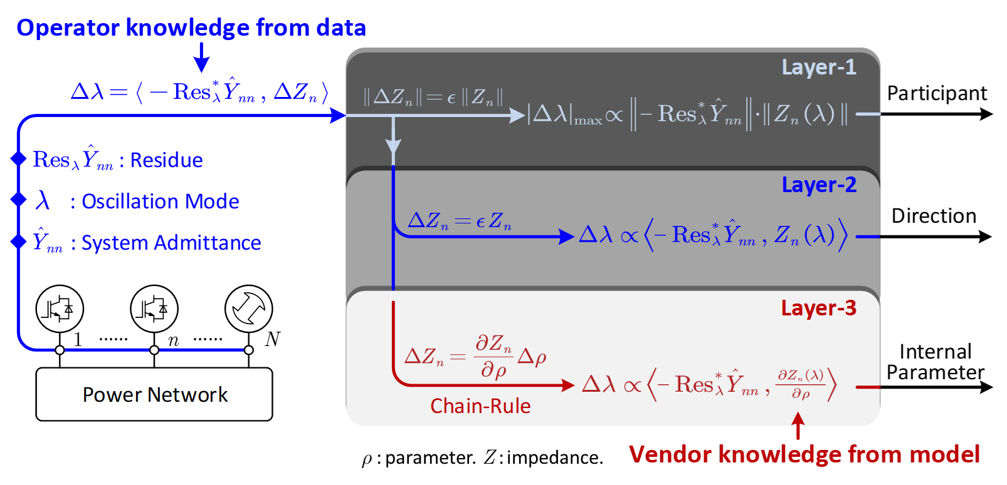
The Grey-Box Approach

Slide 14
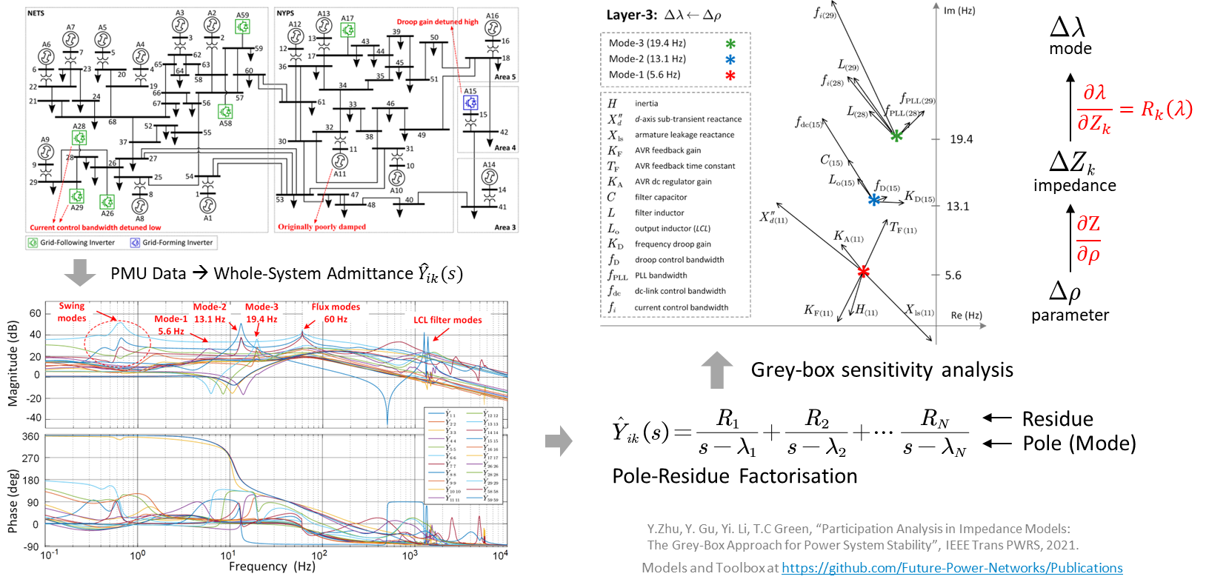
Case Study: Modified IEEE 68 Bus System

Slide 15
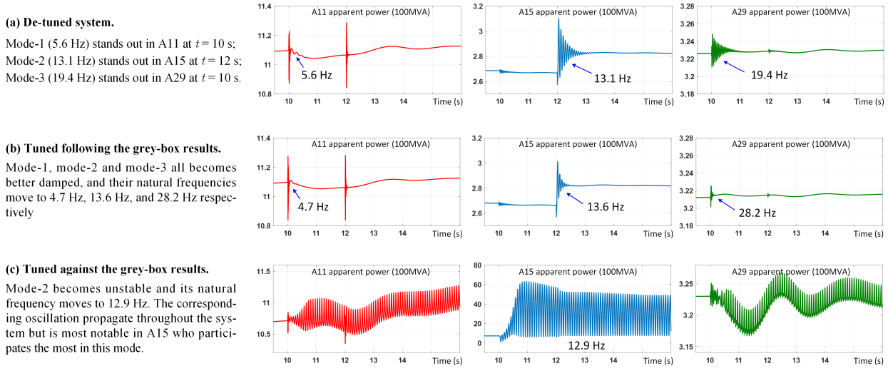
Case Study: Modified IEEE 68 Bus System

Slide 16
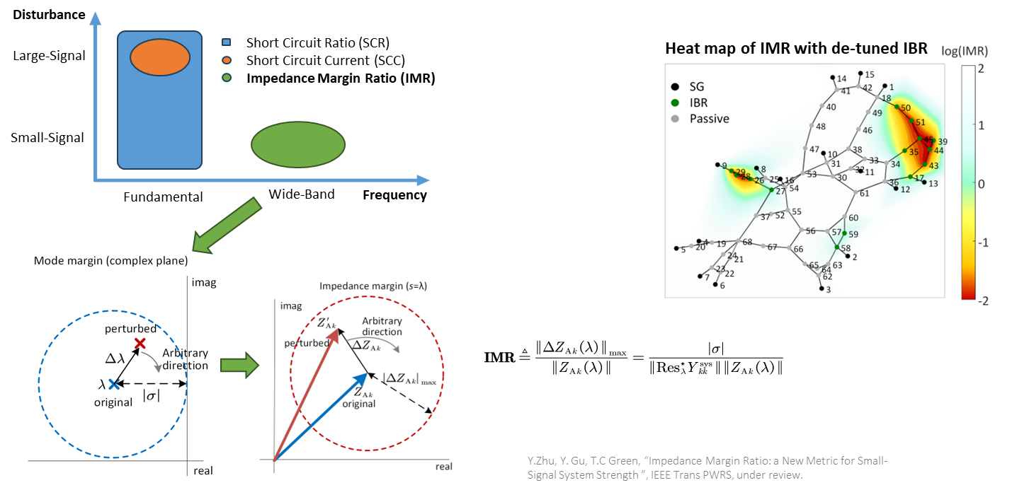
Impedance Margin Ratio: New Index of System Strength

Slide 17
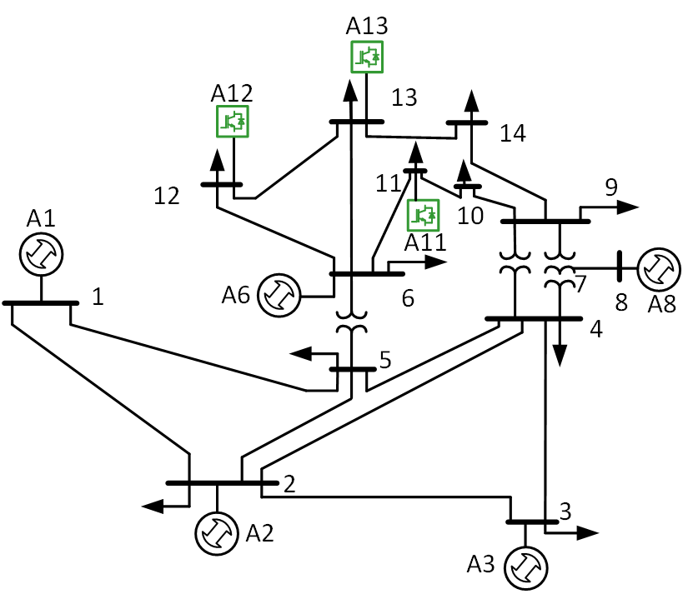
Dissipating Energy Flow (DEF)
DEF: Dissipation Energy Flow
DEF indicates the flow of “damping power” in the system.
The sign of the dc component of DEF indicates contribution to damping.
Positive DEF indicates sources of oscillation, and negative DEF indicates sinks of damping.
DEF was proposed in [1] and applied to the New England system in [2], with 100% accuracy.
DEF can be fully calculated from PMU data: model free.
Sink
Source
[1] Chen, L., Min, Y. and Hu, W., 2012. An energy-based method for location of power system oscillation source. IEEE Transactions on Power Systems, 28(2), pp.828-836.
[2] Maslennikov, S., Wang, B. and Litvinov, E., 2017. Dissipating energy flow method for locating the source of sustained oscillations. International Journal of Electrical Power & Energy Systems, 88, pp.55-62.

Slide 18
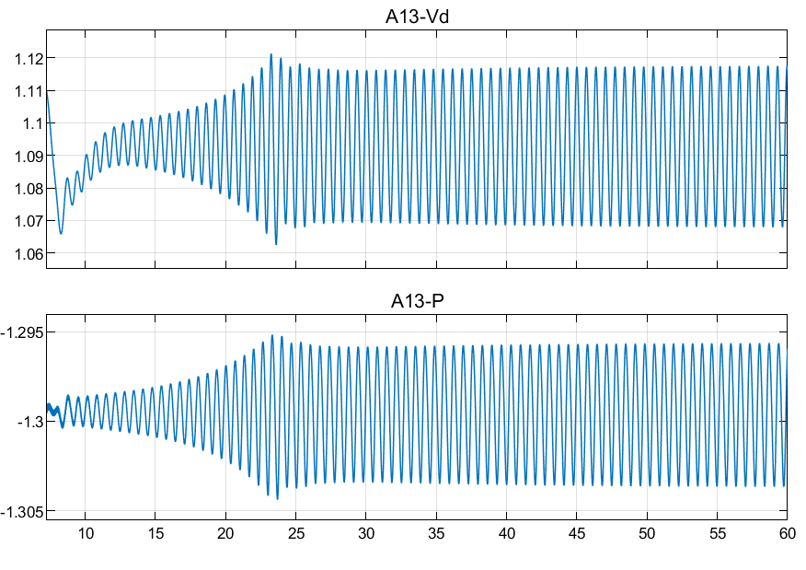
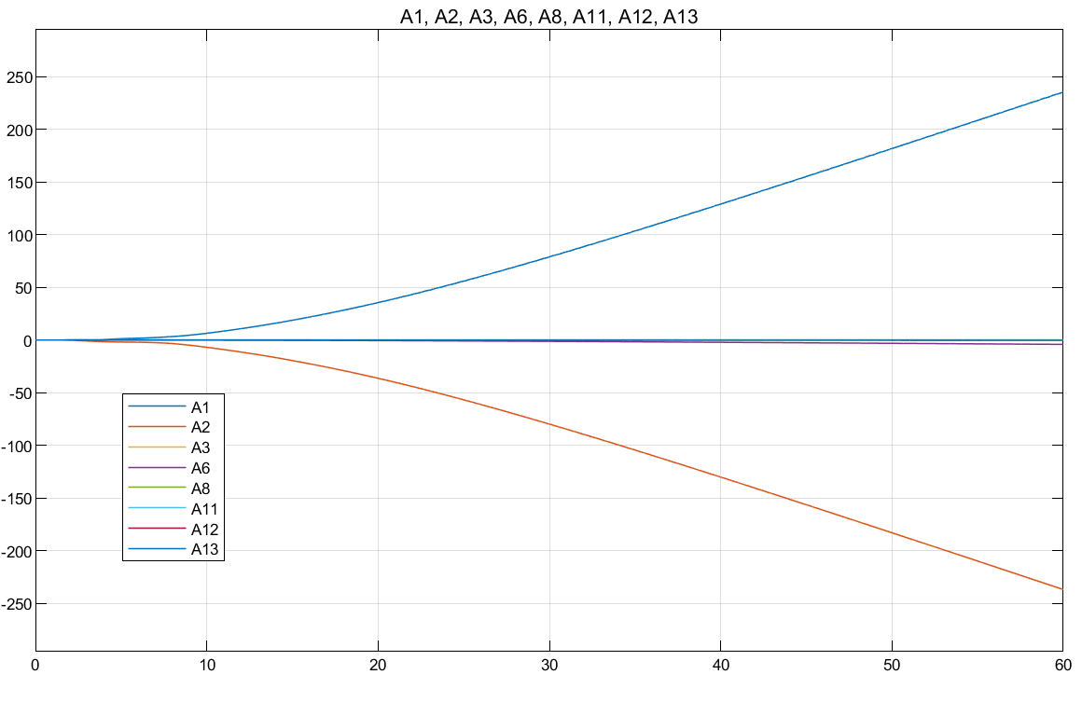
DEF may fail for IBRs
1.5 Hz weak-grid oscillation
“weak grid”
DEF measured at all buses
A1 (SG)
A2 (SG)
Oscillation is induced by IBRs, but DEF points towards synchronous generators (SGs)

Slide 19
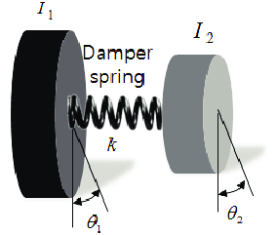
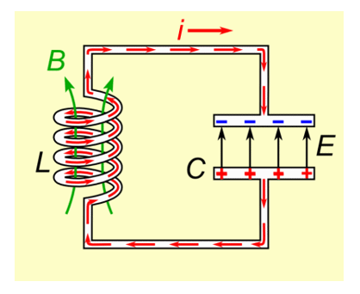
Dissipation v.s. Damping
Dissipation: the rate of energy loss (time derivative of the energy function)
Damping: the rate of oscillation decay (real part of eigenvalue)
Dissipation contributes to damping only if they are consistent
  Mechanical dissipation contributes to the damping of angle swing and torsional resonance
  Electrical dissipation contributes to the damping of electromagnetic resonance
Torsional resonance: damped by mechanical dissipation (positive torque coefficient)
Electromagnetic resonance: damped by electrical dissipation (positive resistance)

Slide 20
Can we adapt DEF to inverters?
Name | Abbreviation | Definition
Original DEF | DEF
Complex DEF [1] | cDEF
Dual DEF [2] | dDEF
Sub/Super-Synchronous DEF [3] | sDEF
Multiple attempts have been made to modify DEF to make it work for IBRs. They all succeed in some cases but not in all cases.
[1] L Fan, Z Wang, Z Miao, S Maslennikov, Oscillation Source Detection for Inverter-Based Resources via Dissipative Energy Flow, TechRxiv
[2] PG Estevez, Complex dissipating energy flow method for forced oscillation source location, IEEE Trans Power Systems.
[3] X Xie, Y Zhan, J Shair, Z Ka, X Chang, Identifying the source of subsynchronous control interaction via wide-area monitoring of sub/super-synchronous power flows, IEEE Trans Power Delivery.

Slide 21
The unified DEF: uDEF
W is to be specified to make uDEF consistent with damping

Slide 22
uDEF covers all existing DEFs
Existing DEF | Definition | Equivalent W
DEF
cDEF
dDEF
sDEF

Slide 23
uDEF covers all possible DEF
Derivative on currents? Not needed.
Higher order derivatives? Not needed.
Other signals (ΔP, ΔQ, Δθ, Δω)? Equivalent.

Slide 24
uDEF v.s. Damping
uDEF is precisely consistent with damping if W is consistent with the admittance participations factors

Slide 25
Case Studies
IEEE 14 Bus System
IEEE 7 Bus System
Case 1: Voltage Oscillation (18.8Hz)
Voltage control gain of IBRs at bus 4 & 7 tuned high.
Case 2: Weak Grid Oscillation (1.5Hz)
Power of IBRs at buses 11-13 tuned high
Case 3: Current-PLL Oscillation (8.8Hz)
Current loop of IBRs at buses 11-13 tuned low

Slide 26
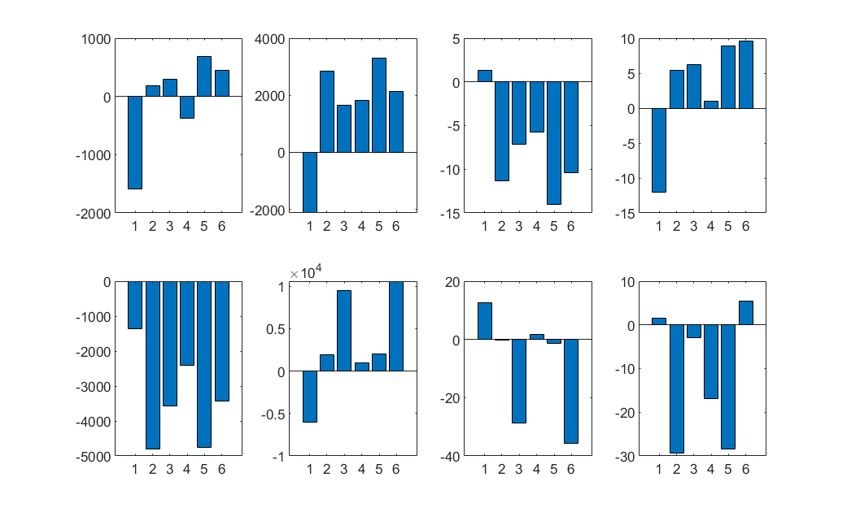
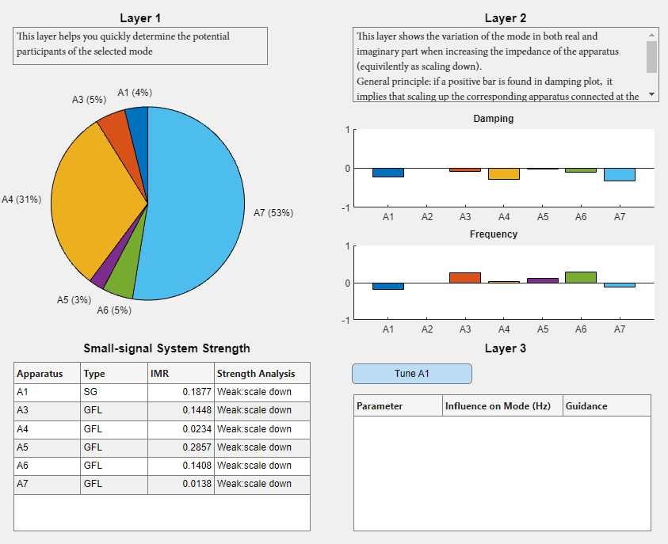
Case 1: Voltage Oscillation
Ground truth from sensitivity analysis
Eight components of uDEF
1 3 4 5 6 7
1 3 4 5 6 7
1 3 4 5 6 7
1 3 4 5 6 7
1 3 4 5 6 7
1 3 4 5 6 7
1 3 4 5 6 7
1 3 4 5 6 7
Two uDEF components give approximately correct indications

Slide 27
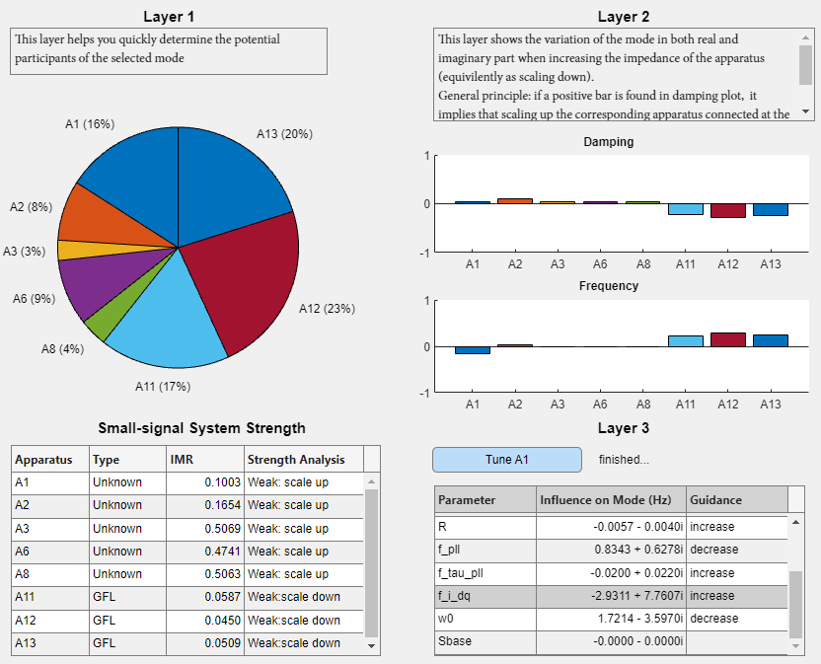
Case 2: Weak Grid Oscillation
Ground truth from sensitivity analysis
Eight components of uDEF
1 2 3 6 8 11 12 13
1 2 3 6 8 11 12 13
1 2 3 6 8 11 12 13
1 2 3 6 8 11 12 13
1 2 3 6 8 11 12 13
1 2 3 6 8 11 12 13
1 2 3 6 8 11 12 13
1 2 3 6 8 11 12 13
Only one uDEF component gives approximately correct indications

Slide 28
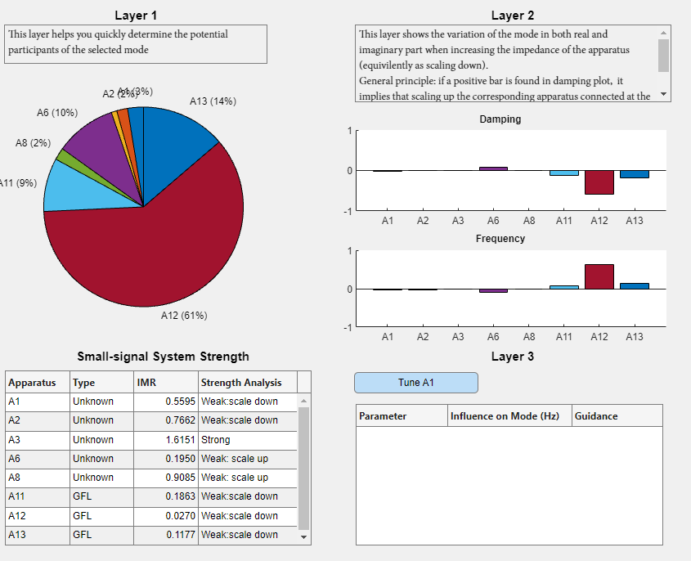
Case 3: Current-PLL Oscillation
Ground truth from sensitivity analysis
Eight components of uDEF
1 2 3 6 8 11 12 13
1 2 3 6 8 11 12 13
1 2 3 6 8 11 12 13
1 2 3 6 8 11 12 13
1 2 3 6 8 11 12 13
1 2 3 6 8 11 12 13
1 2 3 6 8 11 12 13
1 2 3 6 8 11 12 13
1 2 3 6 8 11 12 13
1 2 3 6 8 11 12 13
All of the eight uDEF components give approximately correct indications (subject to signs)

Slide 29
Takeaway from case studies
The three cases cover a wide range of IBR induced oscillations, involving different control loops and occurring at different frequencies.
The best specifications of uDEF is different for different types of oscillations.
It is encouraging that for all the cases we have studied, one component of uDEF stands out as being correct throughout the cases.
Is there any reasons or just a coincidence?
The uDEF that works for all three cases

Slide 30
Conclusions
Impedance Participation Factor: Pre-event
Black-box models or real system
Port Sensitivity
Impedance Margin Ratio: Planning
Black-box models or real system
Unified Dissipating Energy Flow: Post-event
Completely model free

