Slide 1
CMP453:
To Bill BSUoS on a net basis at BSC Trading Units
Workgroup 1, 25 June 2025
Online Meeting via Teams

Slide 2
WELCOME

Slide 3
Agenda
Topics to be discussed​ | Lead​
Introductions​ | Chair​
Code Modification Process Overview ​ • Workgroup Responsibilities​ • Workgroup Alternatives and Workgroup Vote​ | Chair​
Objectives and Timeline​ • Walk-through of the timeline for the modification​ | Chair​
Review Terms of Reference​ | All​
Proposer presentation​ | Proposer​
Legal Text Update | NESO Representative
Agree Terms of Reference​ | All​
Workgroup Consultation Discussion | All​
Any Other Business​ | Chair​
Next Steps​ | Chair​

Slide 4

Modification Process
Prisca Evans – NESO Code Administrator

Slide 5






Code Modification Process Overview
Talk to us
Raise a mod
Refine solution
Consult
Decision
Implement
Forums
Panels
Workgroups
(Workgroup Consultations)
Ofgem/Panel

Slide 6

Refine Solution
Workgroups
If the proposed solution requires further input from industry in order to develop the solution, a Workgroup will be set up. ​​
​The Workgroup will:​
  further refine the solution, in their discussions and by holding a Workgroup Consultation​
  Consider other solutions, and may raise Alternative Modifications to be considered alongside the Original Modification​
  Have a Workgroup Vote so views of the Workgroup members can be expressed in the Workgroup Report which is presented to Panel

Slide 7

Consult
Code Administrator Consultation
The Code Administrator runs a consultation on the final solution(s), to gather final views from industry before a decision is made on the modification.​
After this, the modification report is voted on by Panel who also give their views on the solution.

Slide 8

Decision
Dependent on the Governance Route that was decided by Panel when the modification was raised​
Standard Governance: Ofgem makes the decision on whether or not the modification is implemented ​
Self-Governance: Panel makes the decision on whether or not the modification is implemented​
  an appeals window is opened for 15 days following the Final Self Governance Modification Report being published

Slide 9

Implement
The Code Administrator implements the final change which was decided by the Panel / Ofgem on the agreed date.

Slide 10
Workgroup Responsibilities and Membership
Prisca Evans – NESO Code Administrator

Slide 11
Expectations of a Workgroup Member
Contribute to the discussion
Be respectful of each other’s opinions
Language and Conduct to be consistent with the values of equality and diversity
Do not share commercially sensitive information
Be prepared - Review Papers and Reports ahead of meetings
Complete actions in a timely manner
Keep to agreed scope
Email communications to/cc’ing the .box email
Your Roles
Help refine/develop the solution(s)
Bring forward alternatives as early as possible
Vote on whether or not to proceed with requests for Alternatives
Vote on whether the solution(s) better facilitate the Code Objectives

Slide 12
Workgroup Membership
Role​ | Name​ | Company​
Proposer | Matthew Foster | Triton Power
Workgroup Member | Andrew Dudkowsky | NESO
Observer | Lisa Waters | Waters Wye
Workgroup Member | Damian Clough | SSE
Workgroup Member | Karl Mayron | Drax Energy Solutions Limited
Workgroup Member | George Major | Smart Grid Consultancy (SGC)
Observer | Robert Malone | Phillips 66 Ltd
Observer | Iain Ewing | SEE Transmission
Authority Representative | Ellie Brundrett | OFGEM

Slide 13
Workgroup Alternatives and Workgroup Vote
Prisca Evans – NESO Code Administrator

Slide 14
What is the Alternative Request?
What is an Alternative Request? The formal starting point for a Workgroup Alternative Modification to be developed which can be raised up until the Workgroup Vote. ​
​
What do I need to include in my Alternative Request form? The requirements are the same for a Modification Proposal you need to articulate in writing:​
- a description (in reasonable but not excessive detail) of the issue or defect which the proposal seeks to address compared to the current proposed solution(s);​
- the reasons why the you believe that the proposed alternative request would better facilitate the Applicable Objectives compared with the current proposed solution(s) together with background information; ​
- where possible, an indication of those parts of the Code which would need amending in order to give effect to (and/or would otherwise be affected by) the proposed alterative request and an indication of the impacts of those amendments or effects; and​
- where possible, an indication of the impact of the proposed alterative request on relevant computer systems and processes.​
​
How do Alternative Requests become formal Workgroup Alternative Modifications? The Workgroup will carry out a Vote on Alternatives Requests. If the majority of the Workgroup members or the Workgroup Chair believe the Alternative Request will better facilitate the Applicable Objectives than the current proposed solution(s), the Workgroup will develop it as a Workgroup Alternative Modification.​
​
Who develops the legal text for Workgroup Alternative Modifications? NESO will assist Proposers and Workgroups with the production of draft legal text once a clear solution has been developed to support discussion and understanding of the Workgroup Alternative Modifications.

Slide 15
Can I vote? And What is the Alternative Vote?
To participate in any votes, Workgroup members need to have attended at least 50% of meetings. The vote shall be decided by simple majority of those present at the meeting at which the vote takes place (whether in person or by teleconference)
Stage 1 – Alternative Vote
Vote on whether Workgroup Alternative Requests should become Workgroup Alternative CUSC Modifications.
The Alternative vote is carried out to identify the level of Workgroup support there is for any potential alternative options that have been brought forward by either any member of the Workgroup OR an Industry Participant as part of the Workgroup Consultation.
Should the majority of the Workgroup OR the Chair believe that the potential alternative solution may better facilitate the CUSC objectives than the Original then the potential alternative will be fully developed by the Workgroup with legal text to form a Workgroup Alternative CUSC modification (WACM) and submitted to the Panel and Authority alongside the Original solution for the Panel Recommendation vote and the Authority decision.

Slide 16
Can I vote? And What is the Alternative Vote?
To participate in any votes, Workgroup members need to have attended at least 50% of meetings. The vote shall be decided by simple majority of those present at the meeting at which the vote takes place (whether in person or by teleconference)
Stage 2 – Workgroup Vote
2a) Assess the original and Workgroup Alternative (if there are any) against the relevant Applicable Objectives compared to the baseline (the current code)
2b) Vote on which of the options is best.
Alternate Requests cannot be raised after the Stage 2 – Workgroup Vote

Slide 17
Objectives and Timeline
Prisca Evans – NESO Code Administrator

Slide 18
Timeline for CMP453 as of 19 June 2025
Milestone​ | Date​ | Milestone​ | Date​
Modification presented to Panel​ | 23/05/25 | Code Administrator Consultation | 29/09/25 - 17/10/25
Workgroup Nominations (15 business days)​ | 23/05/25 - 13/06/25 | Draft Final Modification Report (DFMR) issued to Panel (5 business days)​ | 23/10/25
Workgroups 1 and 2 | 25/06/25 09/07/25 | Panel undertake DFMR recommendation vote ​ | 31/10/25
Workgroup Consultation (21 business days)​ | 11/07/25 – 1/08/25 | Final Modification Report issued to Panel to check votes recorded correctly | 03/11/25
Workgroups 4 and 5 | 11/08/25 27/08/25 | Final Modification Report issued to Ofgem ​ | 11/11/25
Workgroup report issued to Panel | 18/09/25 | Ofgem decision needed by | TBC
Panel sign off that Workgroup Report has met its Terms of Reference​ | 26/09/25 | Implementation Date ​ | 01/04/26

Slide 19
Terms of Reference Discussion (Live)
Prisca Evans – NESO Code Administrator

Slide 20
Terms of Reference
Workgroup Terms of Reference | Workgroup Consultation Questions | Workgroup thoughts
Consider EBR implications
Consider whether CMP453 proposed solution is consistent with the principles that were recommended for the charging of BSUoS under the Balancing Services Charges Task Force and as reflected in the solution derived under modification proposal CMP333
Consider the practicalities of making physical configuration changes to a site to meet to the intent of CMP453

Slide 21
Proposer Presentation
Matthew Foster – Triton Power

Slide 22




CMP453 To bill BSUoS on a net basis at BSC trading units

Slide 23
The issue
BSUoS is now billed to sites with final demand on a gross basis
Customers forming a BSC Trading Unit are therefore charged BSUoS when net flows at the site are export
A Trading Unit recognises that the impact on the system is the net sum of demand and supply at the point of connection
Energy imbalance is calculated this way …
… And so should BSUoS be
Where a demand Balancing Mechanism Unit (BMU) forms part of a transmission connected Trading Unit, BSUoS will be billed on a net basis, i.e. when the site is importing it will pay BSUoS, but when it is exporting it will not

Slide 24
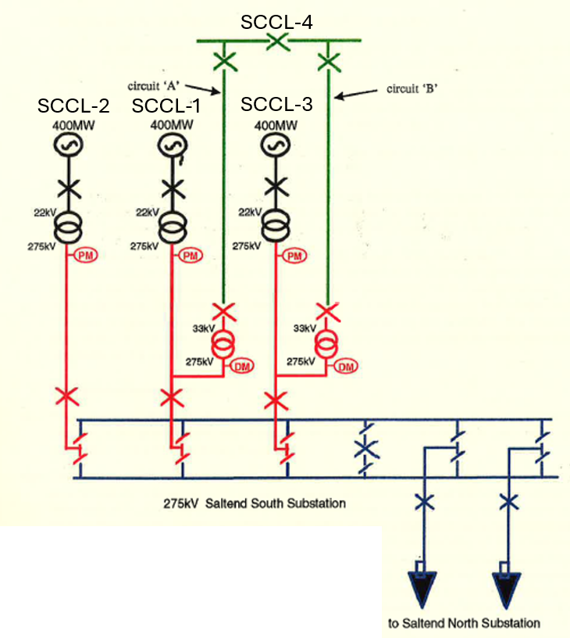
Metering configuration
SCCL 1 to 3 generation
SCCL 4 demand
If the generators are running the power
loops only briefly onto the TO by virtue
of the wiring
The wiring could change, but that is
unnecessary cost
Customers BSUoS charges are not cost reflective

Slide 25
Legal Text Update
Andrew Dudkowsky – NESO Representative

Slide 26
Changes to legal text – Section 14.30.3
All Users excluding those Users with valid Declarations, Interconnectors and Virtual Lead Parties are liable for Balancing Services Use of System charges based on their Final Demand in each Settlement Day. Where the BMU is directly connected to the National Electricity Transmission System and forms part of a Trading Unit, BSUoS will be charged based on the net imports of the Trading Unit.

Slide 27
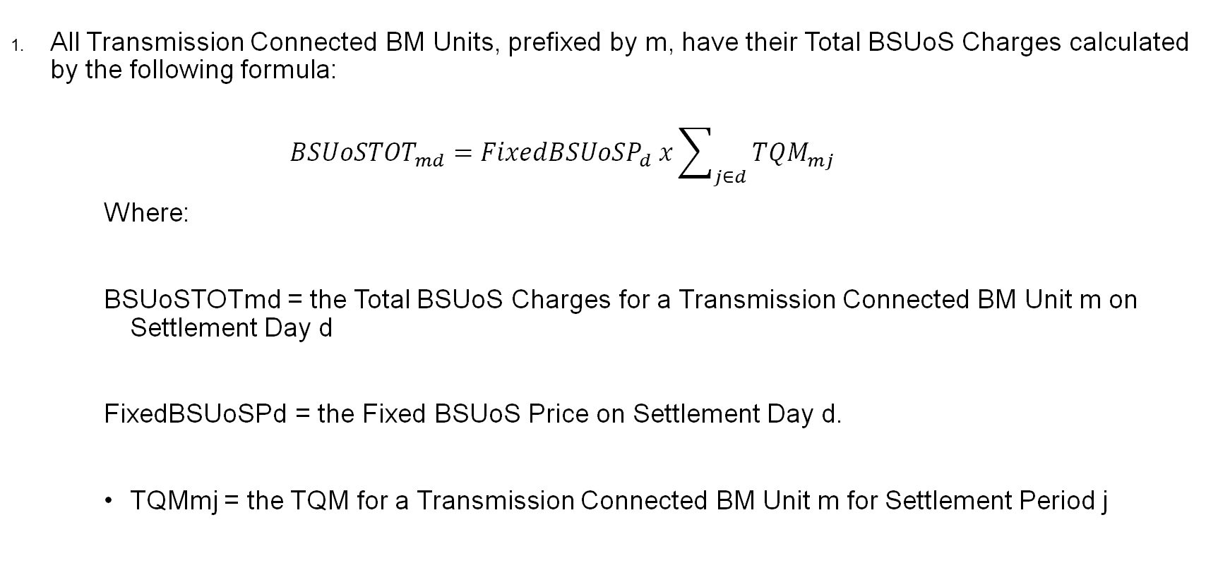
Current BSUoS charging statement – 14.31.11
All Transmission Connected BM Units, prefixed by m, have their Total BSUoS Charges calculated by the following formula:
$${BSUoSTOT}_{md}={FixedBSUoSP}_{d} x\sum_{j∈d}{{TQM}_{mj}}$$
Where:
BSUoSTOTmd = the Total BSUoS Charges for a Transmission Connected BM Unit m on Settlement Day d
FixedBSUoSPd = the Fixed BSUoS Price on Settlement Day d.
TQMmj = the TQM for a Transmission Connected BM Unit m for Settlement Period j

Slide 28
Changes to legal text - Glossary
Transmission Connected Final Demand BM Unit Metered Volume | TQM | MWh | The BM Unit Metered Volume for Final Demand with a Bilateral Agreement with The Company, exclusive of export volumes, which is multiplied by the TLM and (in case of directly connected BMU Units only) the TUM
Trading Unit Final Demand | TUFD | MWh | The aggregate (across all directly connected Final Demand BM Units within the Trading Unit) of the BM Unit Metered Volume, exclusive of export volumes
Trading Unit Chargeable Volume | TUCV | MWh | In respect of a Trading Unit, the lower of: (i) TUFD; and (ii) The aggregate (across all directly connected BM Units within the Trading Unit) of the BM Unit Metered Volume, inclusive of export volumes; provided that if such value is negative, TUCV shall be zero.
Trading Unit Multiplier | TUM |  | For all directly connected BM Units within a Trading Unit, the TUM is: (i) If TUFD =0, then TUM = 0; else (ii) TUM = TUCV / TUFD.

Slide 29
Worked example 1
Assume one final demand BM Unit, with metered volume:-
  BMU Z – 30MW
Assume a single generator with a metered volume
  BMU A – 20MW
TUFD (Trading Unit Final Demand) = 30MW
TUCV (Trading Unit Chargeable Volume) = 10MW
TUM (Trading Unit Multiplier) = 0.333
BSU oS - BMU Z 10MW

Slide 30
Worked example 2
Assume two final demand BM Units, with metered volumes:-
  BMU Y – 20MW
  BMU Z – 30MW
Assume a single generator with a metered volume
  BMU A – 20MW
TUFD (Trading Unit Final Demand) = 50MW
TUCV (Trading Unit Chargeable Volume) = 30MW
TUM (Trading Unit Multiplier) = 0.6
BSU oS - BMU Y 12MW ; BMU Z 18MW

Slide 31
Agree Terms of Reference (Live)
All

Slide 32
Workgroup Consultation Discussion
All

Slide 33
Any Other Business
Prisca Evans – NESO Code Administrator

Slide 34
Next Steps
Prisca Evans – NESO Code Administrator

