Slide 1
Agenda- Glasgow
Time | Activity
9.00 - 9.45 | Registration and Arrival
10.00 - 10.45 | Welcome and Strategic updates
10.45 - 11.00 | Break
11.00 - 12.00 | Breakout 1
12.00 - 12.45 | Lunch
12.45 - 1.45 | Breakout 2
1.45 - 2.30 | Break and Marketplace
2.30 - 3.30 | Breakout 3
3.30 - 4.15 | Q&A and Close

Slide 2
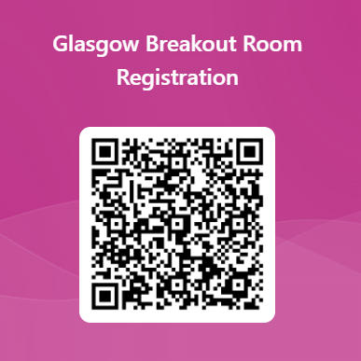
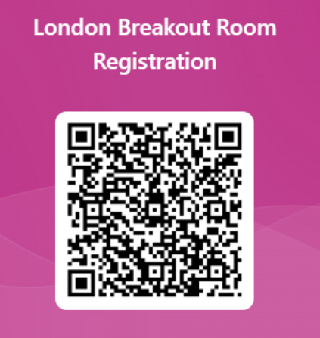
Breakout room options
Balancing Services*
Locational Signals in Reformed Electricity Markets**
Future of Gas Markets***
Consumer Led Flexibility for Clean Power 2030
Whole Energy Market Strategy
* There are 2 opportunities to attend the Balancing Services breakout session.
** There are 3 opportunities to attend the Locational Signals in Reformed Electricity Markets breakout session.
*** There are 2 separate sessions for Future of Gas Markets. The second session will be a continuation of the first session, but attendance at the first session is not necessary into order to attend the second session.
You can select a maximum of 3 sessions to attend through the day.
Sign up for breakout rooms by scanning here:

