Slide 1
CMP445: Pro-rating first year TNUoS for Generators
Workgroup 2, 20 May 2025
Online Meeting via Teams

Slide 2
WELCOME

Slide 3
Agenda
Topics to be discussed​ | Lead​
Introduction | Chair​
Timeline | Chair​
Outstanding Actions Updates to Actions 3 and 5 provided in slide pack | Chair​
Legal Text Review | All​
Workgroup Consultation – Initial Discussion | Proposer​
Terms of Reference Discussion (Live) | All​
Agree Terms of Reference​ | All​
Next Steps​ | Chair​

Slide 4
Expectations of a Workgroup Member
Contribute to the discussion
Be respectful of each other’s opinions
Language and Conduct to be consistent with the values of equality and diversity
Do not share commercially sensitive information
Be prepared - Review Papers and Reports ahead of meetings
Complete actions in a timely manner
Keep to agreed scope
Email communications to/cc’ing the .box email
Your Roles
Help refine/develop the solution(s)
Bring forward alternatives as early as possible
Vote on whether or not to proceed with requests for Alternatives
Vote on whether the solution(s) better facilitate the Code Objectives

Slide 5
Workgroup Membership
Role​ | Name​ | Company​
Proposer​ | ​Angus Armstrong | ​Ocean Winds
Workgroup Member​ | ​Sean Nugent | ​NESO
Workgroup Member​ | Stephen Dale | NESO
Workgroup Member​ | ​Graham Pannell | ​BayWa r.e.
Workgroup Member​ | ​Thibaut Cheret | ​Offshore Energy UK
Workgroup Member​ | ​Ryan Ward | ​ScottishPower Renewables
Workgroup Member​ | Garth Graham | SSE Generation
Workgroup Member​ | Archie Campbell | Zenobe Energy Limited
Workgroup Member​ | Alan Kelly | Corio Generation
Authority Representative​ | ​Louis Sandiford | ​Ofgem

Slide 6
What is the Alternative Request?
What is an Alternative Request? The formal starting point for a Workgroup Alternative Modification to be developed which can be raised up until the Workgroup Vote. ​ ​
What do I need to include in my Alternative Request form? The requirements are the same for a Modification Proposal you need to articulate in writing:​ - a description (in reasonable but not excessive detail) of the issue or defect which the proposal seeks to address compared to the current proposed solution(s);​ - the reasons why the you believe that the proposed alternative request would better facilitate the Applicable Objectives compared with the current proposed solution(s) together with background information; ​ - where possible, an indication of those parts of the Code which would need amending in order to give effect to (and/or would otherwise be affected by) the proposed alterative request and an indication of the impacts of those amendments or effects; and​ - where possible, an indication of the impact of the proposed alterative request on relevant computer systems and processes.​ ​
How do Alternative Requests become formal Workgroup Alternative Modifications? The Workgroup will carry out a Vote on Alternatives Requests. If the majority of the Workgroup members or the Workgroup Chair believe the Alternative Request will better facilitate the Applicable Objectives than the current proposed solution(s), the Workgroup will develop it as a Workgroup Alternative Modification.​
​
Who develops the legal text for Workgroup Alternative Modifications? NESO will assist Proposers and Workgroups with the production of draft legal text once a clear solution has been developed to support discussion and understanding of the Workgroup Alternative Modifications.

Slide 7
Timeline for CMP445 as of 20 May 2025
Milestone​ | Date​ | Milestone​ | Date​
Modification presented to Panel​ | 29 November 2024 | Code Administrator Consultation | 9 March 2026 to 30 March 2026
Workgroup Nominations (15 business days)​ | 1 April 2025 to 17 April 2025 | Draft Final Modification Report (DFMR) issued to Panel (5 business days)​ | 17 April 2026
Workgroups 1 to 3 | 29 April 2025 – Initial discussion 20 May 2025 – Consider Legal Text and action updates 18 July 2025 – Discuss Workgroup Consultation and check ToR met | Panel undertake DFMR recommendation vote ​ | 24 April 2026
Workgroup Consultation (21 business days)​ | 25 July 2025 to 22 August 2025 | Final Modification Report issued to Panel to check votes recorded correctly | 24 April 2026 to 1 May 2026
Workgroups 4-8 | 8 September 2025 – Review Workgroup Consultation feedback 6 October 2025 – Review Workgroup Report and Legal Text 3 November 2025 – Review Workgroup Report and Legal Text 1 December 2025 - Finalise Workgroup Report and Legal Text 29 December 2025 – Close off any outstanding actions and Workgroup vote | Final Modification Report issued to Ofgem ​ | 1 May 2026
Workgroup report issued to Panel | 20 February 2025 | Ofgem decision needed by | 30 September 2026
Panel sign off that Workgroup Report has met its Terms of Reference​ | 27 February 2025 | Implementation Date ​ | 01 April 2027

Slide 8
Outstanding Actions
Action number | Workgroup Raised | Owner | Action | Comment | Status
1 | WG1 | KH | Amend Terms of Reference c) to include consideration of increases in TEC and d) to include the consideration of over-recovery. | New ToR to be shared with the CUSC Panel for approval in May. | To close
2 | WG1 | SN/SD | Draft the legal text for the modification and share it with work group members for review. | We have the draft legal text from the Proposer, and this is being reviewed by NESO legal. NESO SMEs to reflect the legal text on the latest CUSC baseline. | Open
3 | WG1 | SN/SD | Provide further information on the cash flow and money trail related to asset connection and revenue recovery. | We have spoken with NESO revenue and believe we have a HL view of the charging model and payments to TO's. We intend to get this validated by the TO's to confirm our understanding. Action update provided in the slide pack. | Open
4 | WG1 | SN/SD | Check for any interaction with this modification on the STC. | This has been raised with the NESO technical Team. | Open
5 | WG1 | SN/SD | Review CUSC Section 3 for any interaction relating to invoicing and reconciliations from this modification which would require a consequential CUSC non-charging modification being raised. | The Commercial codes team have done an initial review and believe there is likely a consequential modification required to amend some wording in Section 3 to align with the proposal. Action update provided in the slide pack. | Open

Slide 9

Cash Flow and Revenue Recovery (Action 3)
Steve Dale – NESO Representative

Slide 10
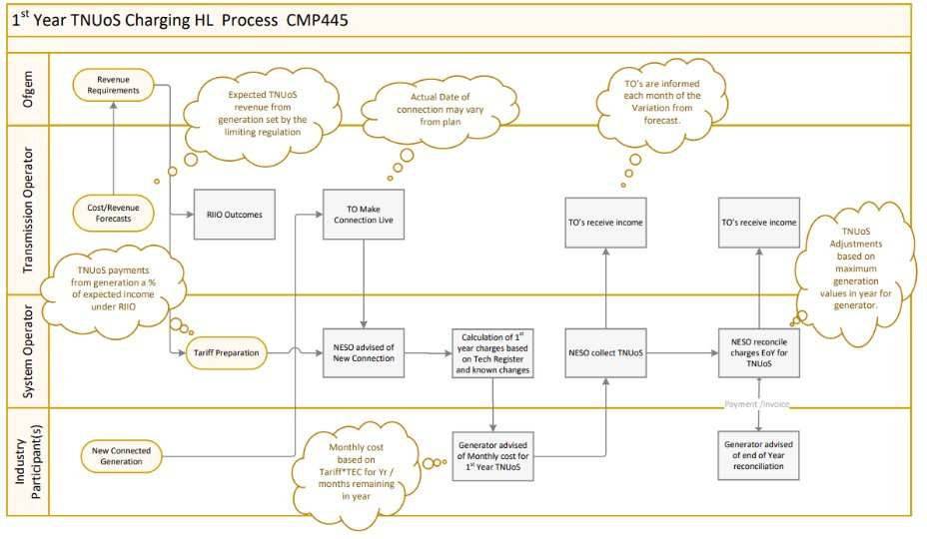

Slide 11
Action 5 Update
NESO Representative

Slide 12
Action 5 (Update)
CMP445 raised as charging mod, affects Section 14
CUSC section 3.10.5 requires a new mod for TEC monthly profile
Twin mod needed to address changes in both Section 14 and 3.10.5
CUSC section 3.9.1 relevant to CMP445, no changes needed
Generation Reconciliation (3.13.2 and 3.13.3) looks fine, no changes needed
Securities posting (3.9.4) looks fine, no changes needed
We welcome any other Workgroup members thoughts and comments.

Slide 13
Legal Text Review
Kat Higby – NESO Code Administrator

Slide 14
Proposer’s Legal Text
The Proposer considers that the drafting proposal can utilise equivalent drafting for Connection Charges already in the CUSC:
“The Transmission Network Use of System Generation Charges in the Financial Year in which the Charging Date occurs shall be apportioned as follows:- For each complete calendar month from the Charging Date to the end of the Financial Year in which the Charging Date occurs the User shall be liable to pay one twelfth of the annual Transmission Network Use of System Generation Charges and for each part of a calendar month the User shall be liable to pay to The Company one twelfth of the Transmission Network Use of System Generation Charges, prorated by a factor determined by the number of days for which the User is liable divided by the total number of days in such calendar month.”

Slide 15
Workgroup Consultation – Initial Discussion
Kat Higby – NESO Code Administrator

Slide 16
Standard Workgroup Consultation Questions
Do you believe that the Original Proposal and/or any potential alternatives better facilitate the Applicable Objectives versus the current baseline?
Do you support the proposed implementation approach?
Do you have any other comments?
Do you wish to raise a Workgroup Consultation Alternative request for the Workgroup to consider?
Does the draft legal text satisfy the intent of the modification?
Do you agree with the Workgroup’s assessment that the modification does not impact the European Electricity Balancing Regulation (EBR) Article 18 terms and conditions held within the Code?
Specific Workgroup Consultation Questions
When composing the specific questions, it is important to focus on what the Workgroup will do the output of the questions as well as phrasing them in a way to maximise theming.

Slide 17
Terms of Reference Discussion (Live)
Kat Higby – NESO Code Administrator

Slide 18
Terms of Reference
Workgroup Terms of Reference | Workgroup Consultation Questions | Workgroup thoughts
a) Consider EBR implications | Question 6
b) Consider applicability to negative charging zones given the different charging basis for those users – ie based on actual output in months November to February | Damian to draft a question.
c) Consider whether the solution should also be applied to users who reduce or increase TEC within year, such as when closing a generating station | Do you believe a similar solution should be applied to operational users who reduce their TEC to zero, such as when closing a generating station? please explain your rationale.
d) Consider the timing of the recovery of any over or under-recovery in charging year t[0] – is it to be recovered in charging year t[0] (via a ‘mid-year tariff change?) or t[+1] or t[+2]? | Should under-recovery be treated differently?
e) Consider from which class or classes of User the recovery should be made by: (i) generators only, (ii) demand only or (iii) both generation and demand

Slide 19
Any Other Business
Kat Higby – NESO Code Administrator

Slide 20
Next Steps
Kat Higby – NESO Code Administrator

