Slide 1
Markets forum Q&A
April 2025

Slide 2
Agenda
Pre read ahead of Live Q&A session
Markets Roadmap 2025
Service update
Demand Side Flexibility Routes to Markets Review
REMA (Review of Electricity Market Arrangements)

Slide 3

Ask your questions
Ahead of the forum | On the day
Email us @ Markets Engagement or Slido code #MFAPR25 | Please use the ‘raise hand’ function in the Teams webinar or Slido code #MFAPR25

Slide 4
Markets Roadmap

Slide 5

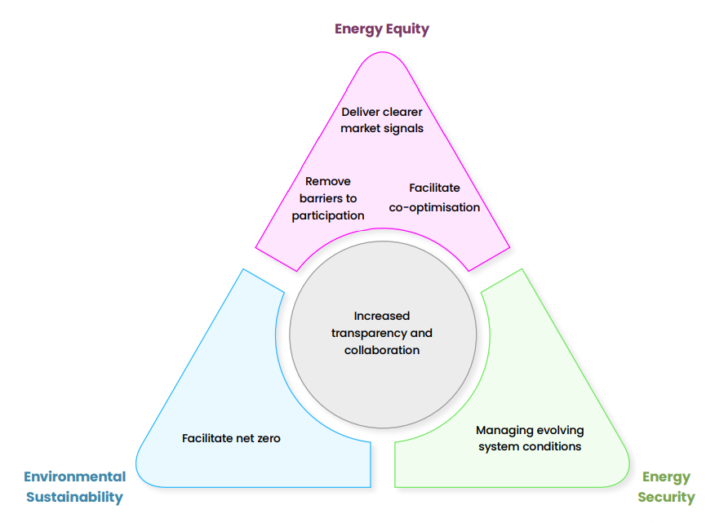
Markets Roadmap 2025
Overview
In March 2025, we published the first version of our electricity Markets Roadmap as NESO.
This year, we published alongside the Operability Strategy Report which outlines some of the typical system conditions we may reasonably expect in a decarbonised electricity system.
NESO’s electricity Markets Roadmap:
  Gives stakeholders confidence in our market design decisions
  Presents a co-ordinated view of market reforms in a consistent, accessible form
  Provides strategic direction for NESO markets reflecting CP30 & sector-wide decarbonisation
Markets Roadmap 2025
The 2025 iteration remains focussed on the electricity markets which NESO owns and operates.
The energy trilemma continues to highlight the importance of NESO balancing services reform as we transition to a decarbonised, secure, affordable electricity system.

Slide 6
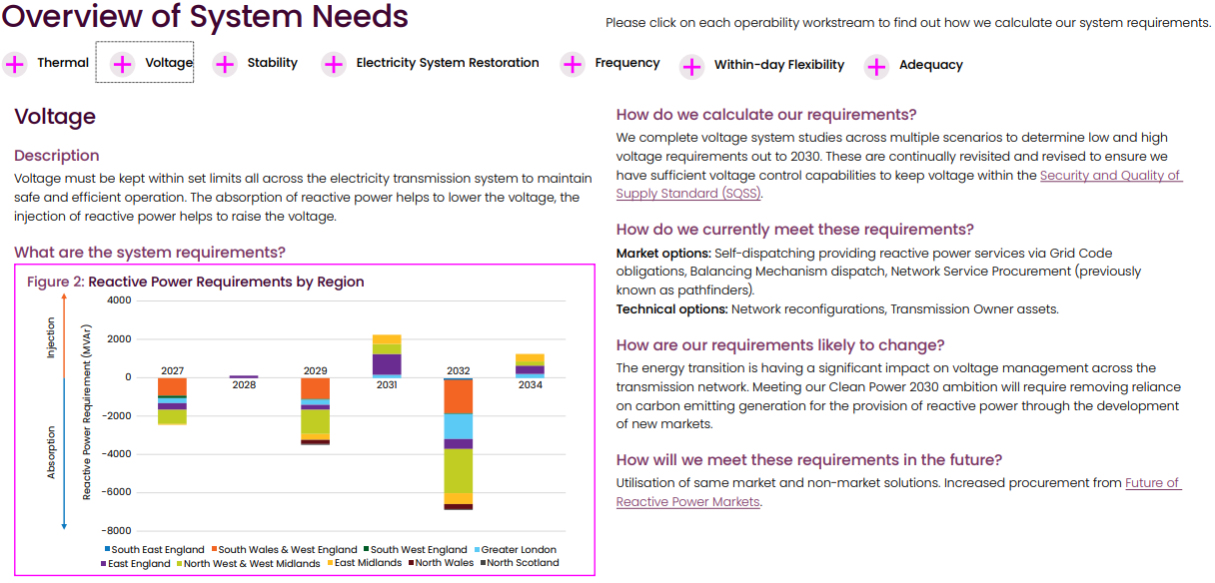
Markets Roadmap seeks to provide clarity to stakeholders on market reforms & system needs
We continue to influence and implement market reform both in the short-term and as part of more fundamental reform via the Review of Electricity Market Arrangements (REMA) programme.
Improving dispatch efficiency to aid transparency and build trust
Enabling flexibility in light of new Government targets
Supporting REMA programme to advise & implement long-term reform
Short-term
Medium-term
Long-term
Acting on stakeholder feedback, we have also included a new section in the report which pulls together information on system requirements.
We hope that this provides further clarity on how big the system operability requirements are, what drives them, how we expect them to change in the future, and the primary routes to market we foresee being used to meet them.

Slide 7
A snapshot of each Markets Roadmap chapter
Chapter | Key market reforms
Balancing Mechanism | In the short-term, we are working to improve our dispatch efficiency, develop ancillary services markets to reduce non-energy actions in the BM, and reform systems to improve integration of energy-limited and smaller, flexible assets. Longer-term BM reforms will be developed in accordance with market/policy reform via REMA.
Within-day flexibility | Enabling flexibility is vital for the achieving Clean Power by 2030. In 2024, we published our Enabling Demand Side Flexibility & Routes to Market reports which set out our ambitions to grow flexibility in NESO markets. We are also collaborating on the Low Carbon Flexibility Roadmap with DESNZ & Ofgem.
Response | Our primary focus for market reform is to explore both within-day and locational procurement of response services. We are also seeking to improve existing services through applying ABSVD for non-BMUs and exploring the potential for stacking/co-optimisation of response and reserve products together.
Reserve | In 2025, we will be supplementing the first release of Quick Reserve with a second release which will enable non-BM participation. We are also launching our new Slow Reserve service and planning to explore similar themes to response in terms of locational/within-day procurement.
Stability | We are seeking to procure 15GVA.s inertia in the second delivery year of the Mid-term Stability Market and have also recently launched a new long-term tender seeking to procure stability, voltage and restoration services for delivery from 2029 onwards.
Voltage | We have progressed design work on the Mid-term Reactive Power Market which will provide an opportunity to access additional reactive power capability via a transparent, competitive process. The Long-term 2029 Tender seeking to procure stability, voltage and restoration services has also recently launched.
Thermal | The Constraints Collaboration Project continues to explore potential options to reduce thermal constraint costs ahead of future network build and potential wholesale reform. Meanwhile we are making continuous improvements to existing services such as Local Constraints Market and MW Dispatch to facilitate competition from distributed energy resources.
Restoration | Code modifications and the introduction of the Electricity System Restoration Standard have increased the resilience and provided further guidance about the restoration of national demand in the event of a partial or total system shutdown.

Slide 8
Service update

Slide 9
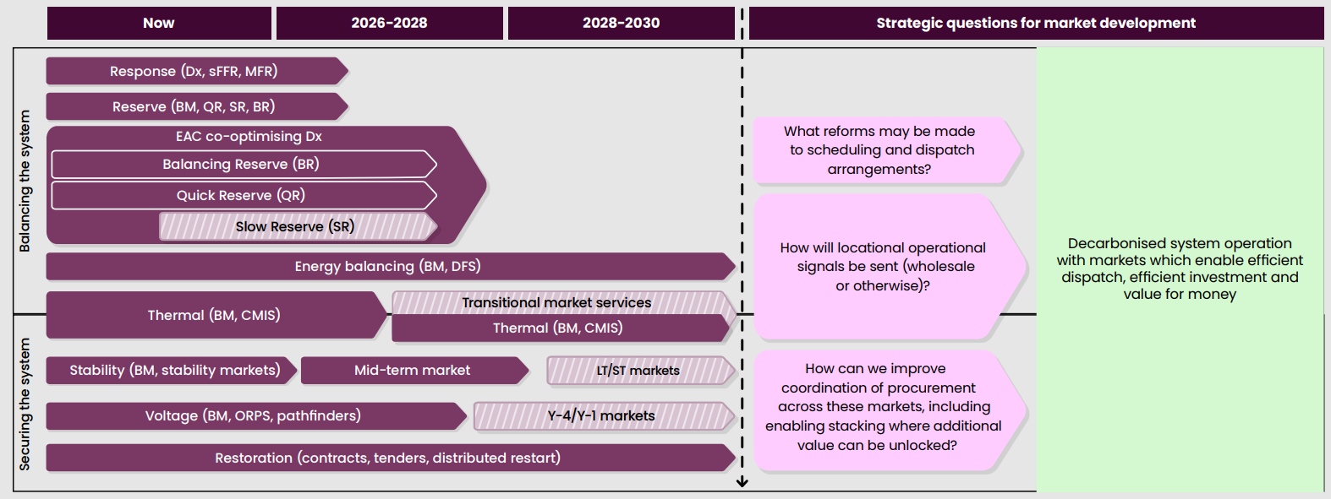
Service update
Please see a high-level forward look of our electricity market development. Join us at our Summer forum where we will run breakout rooms to enable deep dives in some of these topics.

Slide 10

We would really value your feedback on the latest publication and how it can be improved in future
We want to continue to review and evolve Markets Roadmap to ensure it meets stakeholder expectations and provides valuable insights to industry.
The Markets Forum Q&A on 28th April provides an opportunity for you to ask questions on the content of the electricity Markets Roadmap or the purpose it is designed to fulfil.
We would also appreciate any additional feedback on the Markets Roadmap publication itself and how we can improve it in future. Please fill out our MS Forms.

Slide 11
Demand Side Flexibility Routes to Markets Review
Stage 3

Slide 12
Demand Side Flexibility Routes to Market Review – Stage 3
Overview
The NESO Routes to Market Review for Demand Side Flexibility seeks to remove barriers for demand side flexibility in our markets.
Stage 1 and Stage 2 of the review were undertaken in 2024 and focused on barrier identification and prioritisation.
The Stage 3 report focuses on communicating our approach to removing barriers and associated timelines.
Our barrier removal commitments will also be captured in the upcoming DESNZ, Ofgem and NESO Low Carbon Flexibility Roadmap.
The plan on the following slide shows a snapshot of the full report, that provides further details on activities and sets out our overarching approach and next steps.
Stage 1: Engage industry on archetypes & barriers
(May ‘24)
Stage 2:
Publish barriers & prioritisation approach
(December ‘24)
Stage 3:
Communicate approach to tackle barriers & timelines
(April ‘25)

Slide 13
Barrier removal programme plan
External activities
 |  | 2025 |  |  |  | 2026 |  |  |  | 2027
 |  | Q1 | Q2 | Q3 | Q4 | Q1 | Q2 | Q3 | Q4 | Q1 | Q2 | Q3 | Q4
Onboarding | B15 Registration
 | B15 Registration
 | B11.2 Flexible & ANM connections
Procurement & Dispatch | B10.1 , B10.2 Sub 1 MW & non integer
 | B13 Aggregated BMU location
 | B18 Dispatch flexibility rules
 | B12 Skip rates
 | B4 Static response metering
 | B11.1 DNO DTU limits
Settlement | B9 Imbalance & compensation
Metering & Baselines | B1.1, 1.2 BM Ops metering
 | B2 Smart meter data access
 | B5 Measuring Instrument Regs
 | B14 Static resp. EFA blocks
 | B7.2 Cros Service Baselines
BM SMP migration
Continuous improvement of onboarding & registration systems, processes & information
Flexibility Market Asset Registration (FMAR) design and development
ANM & flex connections methodology & policy
Sub 1MW & non integer options assessment
Detailed design & implementation subject to outcome of Options Assessment. Implementation will be over several months & years, in line with relevant IT system & process changes, Code changes & service consultations
Assessment of locational assignment of aggregated BMUs
Dispatch flexibility rules review
Balancing Reserve consultation
DSR “Skip Rate” reporting
Ongoing Skip Rate programme activities
Static response analysis & design
Static response impact assessment
Static response reform implementation
Short term DTU approach agreed with DNOs
Market Facilitator and RESP coordination, Primacy implementation
Issue 114 and Code changes
Independent Review of BM Ops metering
Smart meter data access options assessment
MIR consultation
Static response analysis & design
Static response impact assessment
ENA/MF Baselining Technical Working Group

Slide 14



We really value your feedback & engagement
We will be hosting a webinar on the 12th May from 1 – 3pm, to present the Stage 3 report, and provide an update on how we plan to engage with stakeholders on a quarterly basis.
Register for the webinar here Microsoft Virtual Events Powered by Teams
We also welcome 1 to 1 discussions and written feedback so please reach out to the team at flexibilitystrategy@nationalenergyso.com
We will also be including commitments to remove barriers for demand side flexibility in NESO markets as part of the DESNZ, Ofgem and NESO Low Carbon Flexibility Roadmap, to be published this summer.

Slide 15
REMA

Slide 16
NESO has continued to advise government on its Review of Electricity Market Arrangements
REMA is a Government-led programme to identify and assess potential reforms to existing market arrangements. REMA will evolve GB’s market arrangements to be fit for purpose for clean power in 2030 and beyond.
NESO is a formal delivery partner in the programme. As such, we have continuously advised government on:
Dispatch and Balancing design
Cross-border trading and operability
Investment support and operability
Constraint management
Reform implementation planning

Slide 17


The REMA programme remains on track to deliver in
line with timelines provided in the Autumn Update
REMA timeline
Mid-2025
Policy development phase concludes
CfD Allocation Round 7
Further information:
Review of electricity market arrangements - GOV.UK
Government’s distribution list. Contact:
remamailbox@energysecurity.gov.uk

Slide 18
Thank you
We look forward to you joining our Q&A session next week

Slide 19
Reminder: Please ask your questions
Ahead of the forum | On the day
Email us @ Markets Engagement or Slido code #MFAPR25 | Please use the ‘raise hand’ function in the Teams webinar or Slido code #MFAPR25

