Slide 1
NESO
Future of Registration Webinar
Slido code #2728574
You have been joined in listen only mode with your camera turned off
Live captioning is available in Microsoft Teams
Click on the 3 dots icon / ‘More’
Click ‘Turn on live captions’
20 February 2025

Slide 2
Introduction | Sli.do code #2728574
Slido code #2728574
To ask questions live go to Sli.do event code # 2728574
  Ask your questions as early as possible as this will help us to provide more live answers.
  Please provide your name or organisation. This is a webinar for industry participants therefore questions from unidentified parties will not be answered live. If you have reasons to remain anonymous to the wider forum, please use the email options below.
  Questions will be answered in the upvoted order whenever possible. We will take questions from further down the list when: the answer is not ready, we need to take the question away or the topic is outside of the scope of this webinar.
  Sli.do will remain open until 12:00, even if the webinar closes earlier, to provide the maximum opportunity for you to ask questions. After that please use the email option below.
  All questions will be recorded and published. Questions which are not answered on the day will also be included, with answers, with the slide pack and webinar recording at: Balancing Mechanism Wider Access | National Energy System Operator
  Ask questions anytime whether for inclusion in the forum or individual response at: .box.bmu.registration@nationalenergyso.com

Slide 3
Contents
Slido code #2728574
What has changed?
How we need you to support the transition?
What support and resources will be available for this?
Your questions answered

Slide 4
What's been delivered and what's next
14th Feb
Code Deployment - Completed
17th to 26th Feb
Data Migration
1. Commence data migration all BM & NBMU except interconnectors & supplier Base units from old CRM to SMP after following a complete due diligence of data sanity
28th Feb
Complete BM registration delivery
1. Complete the BM registration delivery including, code, Data migration, & data flow to downstream to live BM systems
2. To complete the new BM registration SMP has also migrated enabler data (Trading Agent, Trading Agent Version, Control Point, Control Point version, BM Station) on SMP production
2. All loaded data will be exposed to market providers and NESO downstream systems
1. Salesforce code with BM registration except interconnectors & supplier Base units has been successfully deployed into production

Slide 5
Registration Process
Single Sign-on
User registration
Access SMP
Company Registration
Register company in SMP
Unit & Asset Registration
Register Units
Register Assets
Align Asset to Units
Align assets to unit
Unit Submission
Unit submitted for registration
BM & Service Prequalification
Prequalify for the service
Complete Service specific parameters
No change in the BM Registration process
Manual BM registration process will move to SMP.
BM Registration data will now be visible to users through their access to SMP enabling self-service
This puts the data back in providers hand whilst still ensuring that the BM Reg team retains the gate keeper role ensuring compliance.
Note: units must be BM compliant before entering into balancing Services

Slide 6
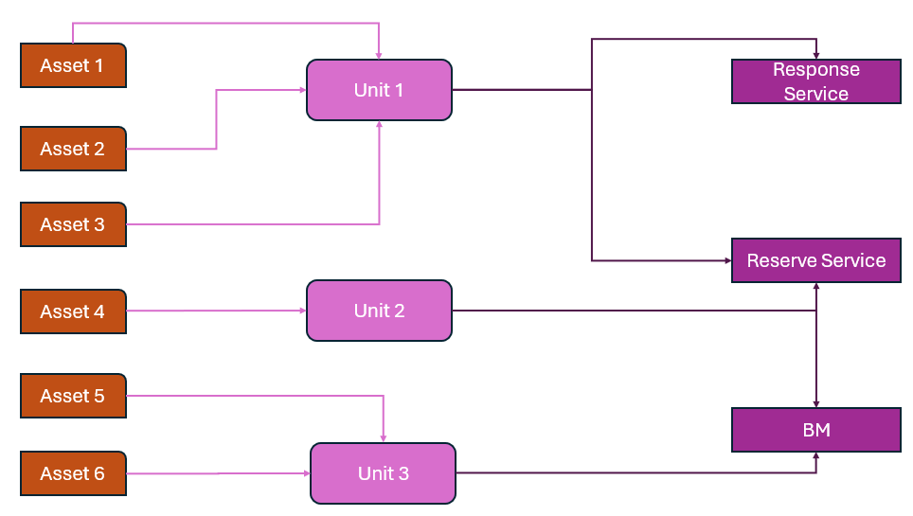
Assets & Units in
SMP
Asset can be aligned to one unit or multiple units at the same time
Multiple assets aligned to one unit will make an aggregated unit
Unit can participate in one Service as well as multiple services at the same time
Note: changes to asset alignment may require NESO action before becoming effective

Slide 7
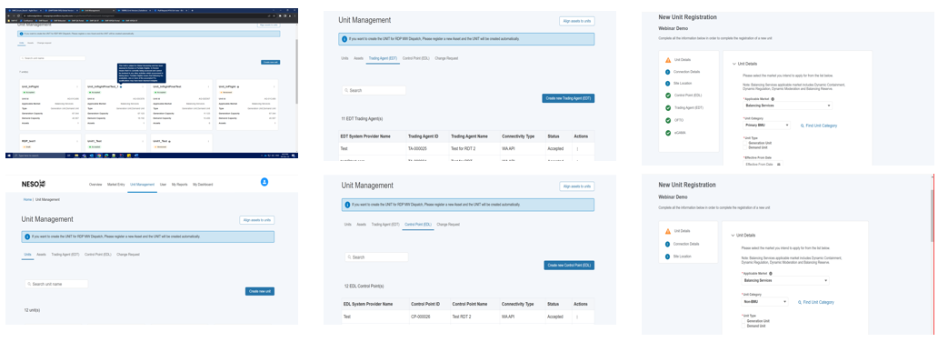
What's changed in SMP
SMP landing/home page remains the same
New section of EDL (Control Point) & EDT (Trading Agent) added under Unit Management tile
Providers can register EDL (Control Point) & EDT (Trading Agent) through SMP
New Unit registration flow will add more section for the Primary, Secondary, & Additional Supplier Category
There is no change in the Non-BMU registration in SMP
Two new sections BSC Registration & BM Registration documents are added under the Company overview section
SMP Portal
SMP Guide & Videos

Slide 8
Coming Up…
Q1 25/26
Interconnectors, Supplier Base units & SMPAPIs
Q3 25/26
Enhancements to BM registration
1. Onboard Interconnector Cable registration on SMP
Q4 25/26
Explore Automation and User feedback
2. Extending SMP APIs to allow registration of aggregated BMUs made up of multiple assets automatically with control point & trading agent data
1. SMP will onboard registration of Interconnector users & Supplier base units
1. Explore more automation opportunities i.e. a potential to connect directly with Elexon
3. Enabling versioning of units whenever there is a change in capacity to keep track of the unit history
2. Opportunity to enhance process based on external and internal user feedback

Slide 9
How do we need you to support the transition?
What support and resources will be available for this?
Slido code #2728574

Slide 10
Timeline of changes and activities
NESO support for SMP Users will include:
Registration team and account manager calls
Daily drop-in surgeries
Monthly share and listen
Update webinars
Slido code #2728574
Complete BM Registration delivery
14 Feb
20 Feb
1 Mar
28 Mar
31 Mar
3 April
Customers
NESO
Create new user accounts
Confirm BMU data is accurate, complete and up-to-date
Confirm other unit data is accurate, complete and up-to-date
Support new users
check transferred data
Support users to confirm BMU data
Support users to confirm other asset data data
Update and test key data flows
check transferred data
BM Registration Process and active BMU data starts transfer to SMP
Other units’ data transferred to SMP
Update webinar
Update webinar

Slide 11
What this means for you, our customers, and for NESO
Slido code #2728574
Do you have assets registered for BM &/or Balancing Services?
No
Yes
These changes will not affect you yet.
14-16 February: BMU registration data moved to SMP
From 17 February:
New registrations contact Registrations Team
BM Registrations data held in SMP
From 31 March: all new registrations completed in SMP
1 to 31 March:
Check the data for each of your BMU is accurate, complete and up-to-date

Slide 12
Next steps
Slido code #2728574
By 1 March:
  Registration and SMP teams will complete quality checks on active BMU data migrated to SMP
  SMP Team will complete next SMP release (scheduled for 28 February)
  Registration and Contract teams will contact SMP Users with more information about the validation activities to be completed in March
By 31 March:
  SMP Users to validate migrated data and notify Registration team of changes needed to ensure they are correct and complete.
  We will support SMP Users (see next slide)
  Registration and SMP teams will prepare remaining legacy data for migration (Interconnector and Supplier BMU data scheduled for migration from 28 March).
Please note: registration requirements have changed over time and also differ between BM and non-BM.
This means, depending on the length of time a unit has been registered and the type of registration, we may need you to provide additional information about a unit.

Slide 13

How we will support you and what resources will be available for this
Slido code #2728574
Single Markets Platform team:
Show and Listen
Webpage (Market Information tab) Single Markets Platform | National Energy System Operator
Registrations:
Daily drop in surgeries
.box.bmu.registration@nationalenergyso.com
Balancing Mechanism Wider Access | National Energy System Operator
SBMU Virtual Lead Party Registrations:
commercial.operation@nationalenergyso.com
Balancing Mechanism Wider Access | National Energy System Operator

Slide 14

Your questions from Slido
Slido code #2728574

Slide 15


Audience Q&A
ⓘ Start presenting to display the audience questions on this slide.

Slide 16
Thank you for joining us
Reminders:
Slido is open until 12:00
Next SMP Show & Listen: 27 February & 27 March
Next update Webinar: 20 March
Requests:
If you have not already registered to receive updates and webinar invitations, please contact: .box.bmu.registration@nationalenergyso.com

