Slide 1



Diversified Flexible Queue Management
Show and Tell
Strategic Innovation Fund Show and Tell – 14th June 2023

Slide 2
Contents
Section | Topic | Presenter
01 | Introductions and Problem Statement | NPg
02 | Diversified Flexible Queue Management – Summary of work undertaken and key outcomes | WSP
03 | Dissemination and Engagement | NPg
04 | Conclusions, Q&A and close | NPg

Slide 3
Introductions and Problem Statement

Slide 4
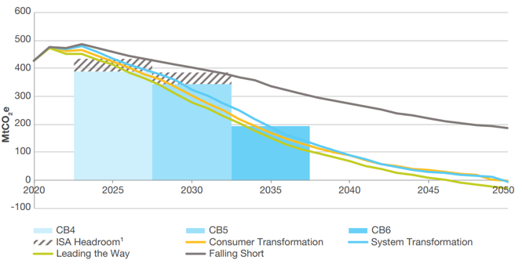
Transformation to Net-Zero
To meet Net Zero there is a need to produce more renewable electricity and increased need for electricity for transport and heat
Connection of new Generation and Demand to a network relies on available capacity
How do we ensure that the characteristics of the forms of Generation and Demand are taken into account for maximum utilisation of the existing network in tandem with building new capacity?
27 years to net zero
Source: FES in Five July 2022

Slide 5
Diversified Flexible Queue Management
Traditionally when considering a distribution grid connection application for generators, the DNO will attribute capacity on it’s network to the maximum output power from each generator.
5 MVA Building Integrated and Ground Mounted Solar Photovoltaics (PV) (Inverter)
3 MVA Wind Farm (Inverter)
4MVA Battery Electrical Energy Storage (BESS)
Total Generation Capacity 20MVA
8 MVA
Gas Turbine
Before
Diagrams not to scale
Notes:
This project investigates how optimising network operations in conjunction with the adaptive management of connection assets we could provide real-time capacity monitoring
We explore the technical innovations that enable available renewable, storage and demand side response (DSR) resources via integrated, faster and more efficient connection to the network considering renewable resources natural diversity and the dispatchable flexibility services they may provide
We investigate the value of using existing and enhanced network data to enable NPg and NGESO to identify congestion, track the status and capabilities of its connection queue and a provide a streamlined process for identifying solutions to actively manage the queue to bring innovative and flexible resources on stream more quickly and cheaply

Slide 6
Diversified Flexible Queue Management
But if we take into account via a ‘diversity factor’ of some of the technical attributes of the technologies and the nature of the resources that they require …
5 MVA Building Integrated and Ground Mounted Solar Photovoltaics (PV) (Inverter)
Potential free capacity using a 0.4 PV Diversity Factor
PV (Inverter)
3 MVA Wind Farm (Inverter)
Potential free capacity using a 0.33 Wind Diversity Factor (Inverter)
Wind Farm (Inverter)
4MVA Battery Electrical Energy Storage (BESS)
Total Generation Capacity 20MVA
Potential all free capacity using a 1 BESS Diversity factor
8 MVA
Gas Turbine
8 MVA
Gas Turbine
Before
Consider diversity
Diagrams not to scale
Notes:
This project investigates how optimising network operations in conjunction with the adaptive management of connection assets we could provide real-time capacity monitoring
We explore the technical innovations that enable available renewable, storage and demand side response (DSR) resources via integrated, faster and more efficient connection to the network considering renewable resources natural diversity and the dispatchable flexibility services they may provide
We investigate the value of using existing and enhanced network data to enable NPg and NGESO to identify congestion, track the status and capabilities of its connection queue and a provide a streamlined process for identifying solutions to actively manage the queue to bring innovative and flexible resources on stream more quickly and cheaply

Slide 7
Diversified Flexible Queue Management
Does this diversity approach unlock the potential for additional capacity?
5 MVA Building Integrated and Ground Mounted Solar Photovoltaics (PV) (Inverter)
Potential free capacity using a 0.4 PV Diversity Factor
Potential free capacity unlocked to make way for additional connections to the network
Available capacity?
PV (Inverter)
3 MVA Wind Farm (Inverter)
Potential free capacity using a 0.33 Wind Diversity Factor (Inverter)
Wind Farm (Inverter)
4MVA Battery Electrical Energy Storage (BESS)
2 MVA PV (Inverter)
Total Generation Capacity 20MVA
Potential all free capacity using a 1 BESS Diversity factor
1 MVA Wind Farm (Inverter)
8 MVA
Gas Turbine
8 MVA
Gas Turbine
8 MVA
Gas Turbine
Reserved Capacity 11MVA
Before
Consider diversity
After diversity
Diagrams not to scale
Notes:
This project investigates how optimising network operations in conjunction with the adaptive management of connection assets we could provide real-time capacity monitoring
We explore the technical innovations that enable available renewable, storage and demand side response (DSR) resources via integrated, faster and more efficient connection to the network considering renewable resources natural diversity and the dispatchable flexibility services they may provide
We investigate the value of using existing and enhanced network data to enable NPg and NGESO to identify congestion, track the status and capabilities of its connection queue and a provide a streamlined process for identifying solutions to actively manage the queue to bring innovative and flexible resources on stream more quickly and cheaply

Slide 8
Diversified Flexible Queue Management
Summary of work undertaken and key outcomes

Slide 9
Project Structure
WP1.
WP2.
WP3.
Problem Definition and Quantification
Regulatory Barriers and Opportunities
Use Case Development and Benefits Analysis
Screen the network
Quantify the capacity enabled through diversity
Review of existing technical and commercial arrangements.
Stakeholder Engagement
Shortlist Grid Supply Points (GSPs – the ESO/NGET-DNO interface) for use case development
Analysis of benefits

Slide 10
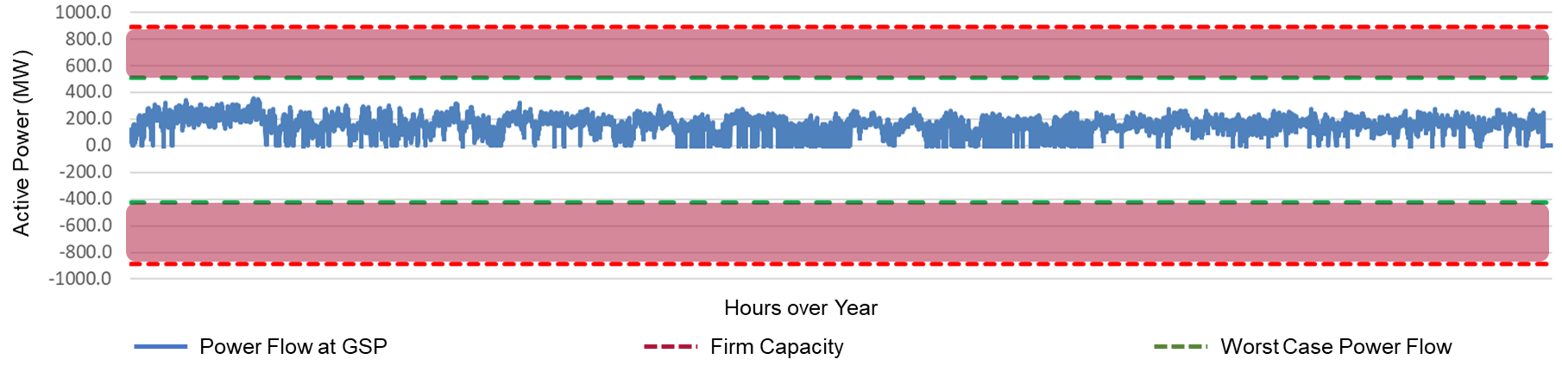
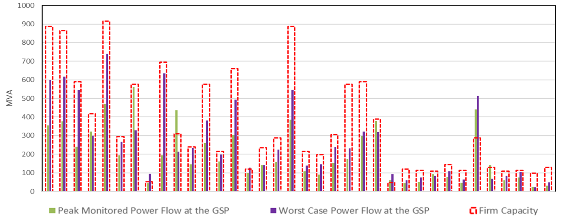
WP1 Problem Definition and Quantification
Two hypothesis developed and verified
    Dynamic headroom can enable higher hosting capacity.
    Generation composition mix can support effective utilisation of dynamic headroom.
  GSP Screening
    40 GSPs within NPg License area screened.
    Dynamic Headroom at GSPs quantified.
Power flow at a single GSP
Dynamic Headroom Analysis

Slide 11
WP2 Regulatory Barriers and Opportunities
NGESO 5 Point Plan
Security and Quality of Supply Standard
TEC Amnesty
Access SCR
Bilateral Embedded Generation Capacity
Distribution Operation Codes
Connection and Use of System Code
A wide range of policy and network initiatives and regulations for queue management across distribution and transmission reviewed and assessed
Initiatives and Regulations

Slide 12
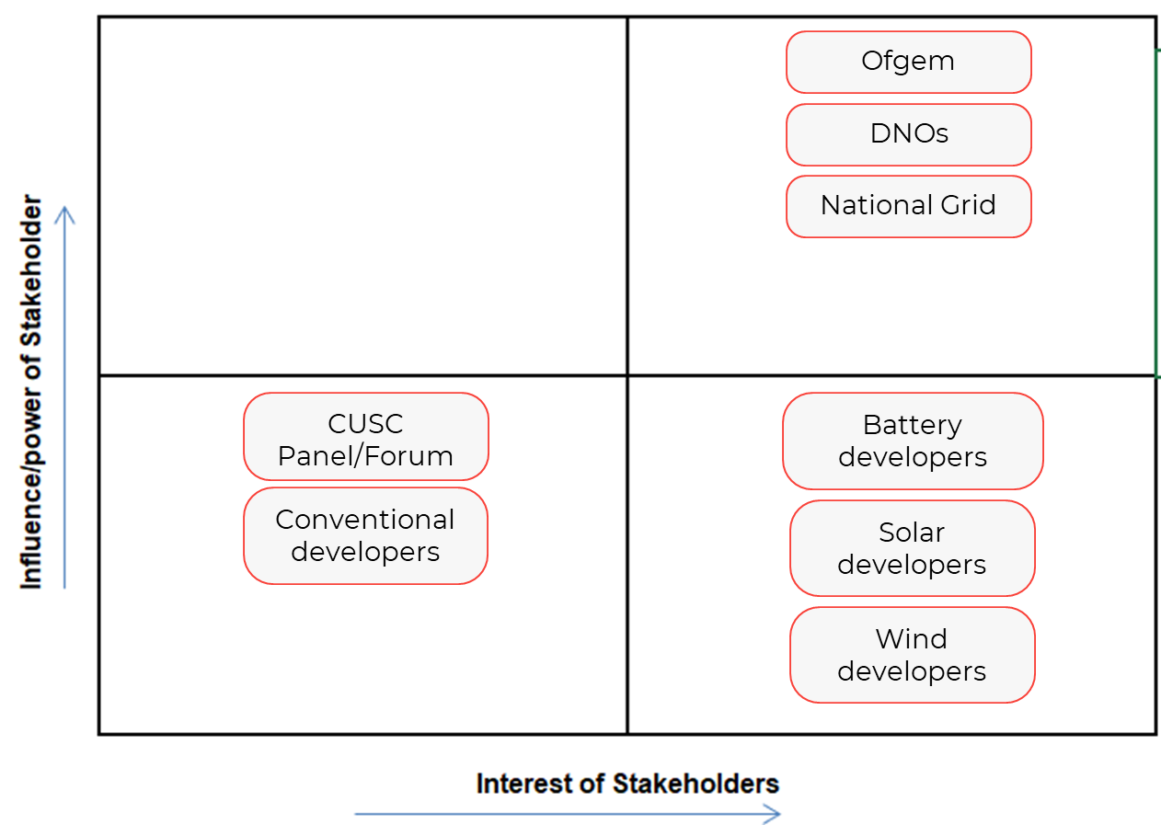
WP2 Regulatory Barriers and Opportunities
Stakeholder engagement
A wide range of initiatives and regulations for queue management across distribution and transmission assessed.
Stakeholders were assessed based on their likely interest in and influence over the outcomes of this work
Influence of Stakeholders

Slide 13
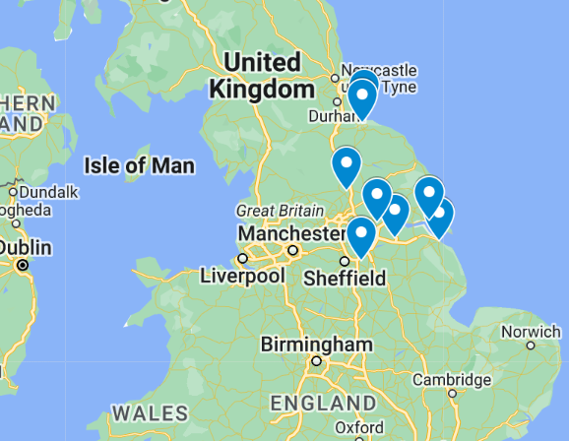
WP3 Use Case Development and Benefit Analysis
  8 GSPs have been identified as priority use cases for further evaluation
    Keadby
    Grimsby West
    Saltend North
    Knaresborough
    Thurcroft
    Hartmoor
    Saltholme
    Camblesforth
  Wider network constraints to be taken into account.

Slide 14
Alpha phase objectives
Leveraging Load Diversity
Data-Driven Management
Identification and definition of solutions to get connected quicker
Establish validated methods of incorporating diversity in connections processes
Assess diversity of customer loads and the flexibility of their assets
Cost benefit analysis of the network test cases and respective solutions
Consider network risks
Connection Queues
Faster and Efficient Connections
Explore the impact to Connection Queue timelines
Proposals for deployment options for feasible solutions
Application and dissemination of findings
Consultation with all stakeholders including policy makers
Notes:
This approach can offset customer connections by utilising their load flexibility, leading to local network benefits and allowing customers to move earlier in the connection queue. It maximizes the use of existing network resources and reduces congestion, ultimately improving service for customers and supporting the transition to a net-zero future.
By harnessing network data, this project aims to identify the actual and potential capacity on the network. This will enable faster connections for customers, as well as help mitigate congestion and optimise network operations. It plays a crucial role in facilitating the integration of renewable energy, storage, and demand side response resources, supporting the transition to a net-zero energy system.

Slide 15
Dissemination and Engagement

Slide 16
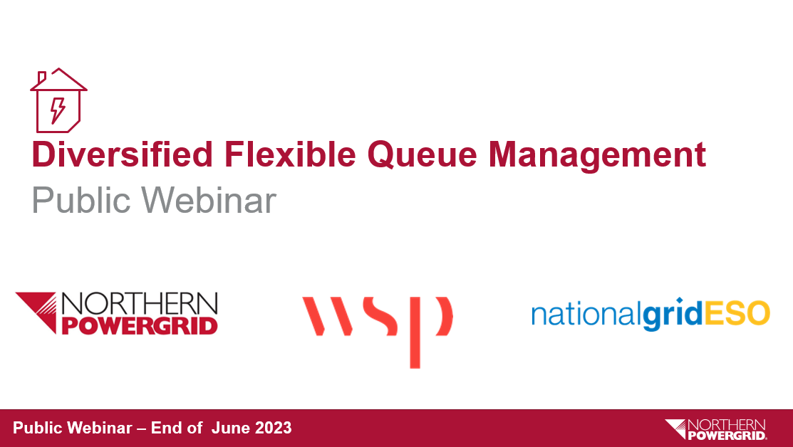
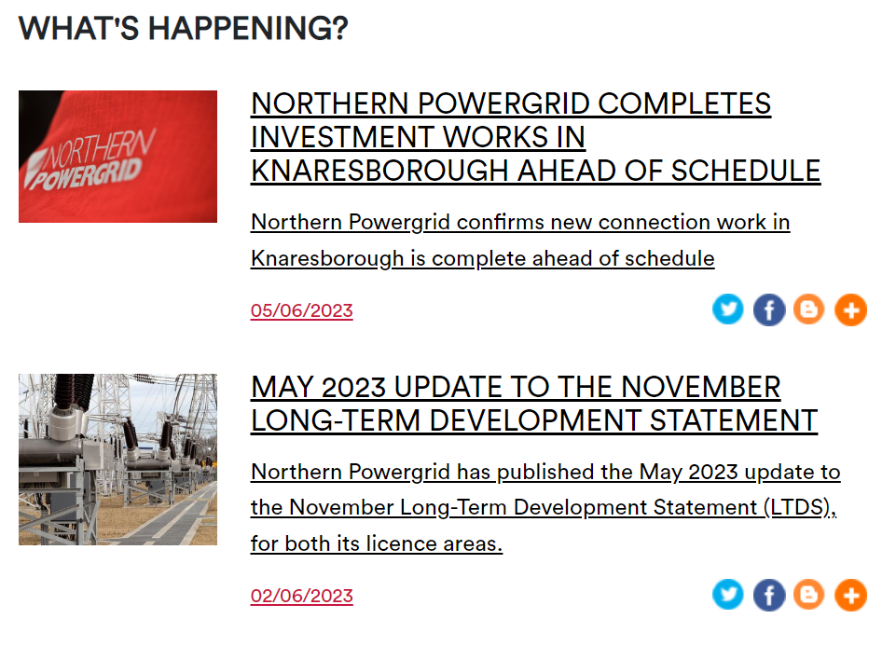
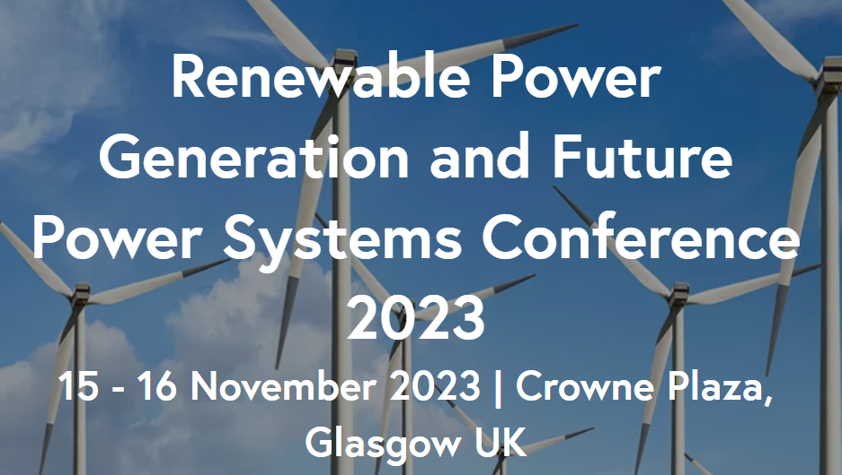
Dissemination and Engagement
Webinar
Media Release
Conference Paper
LinkedIn Posts
Conference Paper
“Diversified Flexible Queue Management:
Analysis of Great Britain Distribution Network Hosting Capacity with Diversification of Generation and Demand”
Industry and public webinar to disseminate findings to wider audience
Northern Powergrid and partners’ channels

Slide 17
Conclusions, Q&A and Close

Slide 18
Conclusions and Next Steps
Enabling higher penetration of renewable energy at pace to ensure transition to Net-Zero requires a change to connections queue management
The discovery phase has shown promising connection timescale benefits from taking diversification into consideration for both generation and demand
Next steps:
  Verification of assumptions and models using real world network and asset data
  Establishment of cost benefits
  Refining methodology for incorporating diversification of resources for unlocking dynamic headroom

Slide 19
Thank you
Contacts:
NPg: flexibility@northernpowergrid.com
WSP: mazher.syed@wsp.com
ESO: innovation@nationalgrideso.com

Slide 21
Diversified Flexible Queue Management
If a customer in the connection queue can offset connect customers, providing a local network benefit by using their load flexibly to create further diversity, this might enable them to move earlier in the queue.
Queue | Project | Status
No reinforcement required
1 | A | On track
2 | B | On track
3 | C | On track
4 | D | On track
Reinforcement required
5 | E | On track
6 | F (Flexibility) | On track
7 | G | On track
Queue | Project | Status
No reinforcement required
1 | A | On track
2 | B | On track
3 | C | On track
4 | D | On track
5 | F (Flexibility) | On track
6 | E | On track
Reinforcement required
7 | G | On track

