Slide 1




Electricity System Restoration Competitive Procurement Webinar
27th September 2022
Northern region tenders
Alex Unitt
This session will be recorded
Please remain on mute during the presentations
Type in your questions in the chat box
Please refrain from asking questions that may identify you as a current Electricity System Restoration (ESR) Service Provider

Slide 2
Alex Unitt
Presenters
Roop Phull, Senior Restoration Contracts Manager
Alex Unitt, Restoration Contracts Manager
Vitor Soares, Restoration and Resilience Manager
Paul Obanor, Restoration Engineer (North West and Scotland)
Xiaolei Cai, Restoration Engineer (North East)

Slide 3
Purpose of the webinar
Alex Unitt
Provide an overview of the tender process for electricity system restoration (ESR) services in 2022
Highlight key changes from previous restoration tenders
Invite feedback from interested service providers to improve the proposed process
Take early questions about the process and requirements to enter this service
Update you on where we are with the other tender rounds launched this year
We encourage you to ask us questions and provide your feedback now, and afterwards
“It is our commitment to work collaboratively with our stakeholders to respond to the changing energy landscape and incrementally evolve our process and restoration strategy to include newer technologies as their contribution to restoration is proven, to reduce the risk to end consumers”

Slide 4

Session agenda
Alex Unitt
  Tender plan for Northern region
  DNO licensed areas included
  Proposed changes
  Tender market inc. Distributed ReStart
  Technical requirements
  Tender process
  Technical assessment criteria
  Recap 2022 Tenders
  Q & A

Slide 5
1. What we are doing for the Northern region
Roop Phull
Continuing with our commitment to move towards a more competitive and transparent procurement approach
Removing barriers to market entry for new providers
Introducing more technology types for restoration services
  As before, launching a competitive tender bid for restoration service providers
  As a minimum we will procure to maintain our existing capability in the region, plus any additional requirements to meet the new restoration standard (ESRS)
  Launch campaign in October 2022, service go-live November 2025 and contract expiry October 2030
Request for EOI
Invitation to Tender
Feasibility Study - Stage 1
Feasibility Study - Stage 2
Tender Evaluation
Contract
Award
Build / Install
Service Delivery
17 Oct 2022
19 Dec 2022
Dec 2022-Feb 2023
April 2023
Jan - Mar 2024
April 2024
April 2024
Nov 2025
Deadline
11 Nov 2022
Deadline
24 Feb 2023
Deadline
19 Jan 2024

Slide 6
2. Areas included in this tender
Roop Phull
DNO area for:
Scottish Power Energy Networks – Mersey side, Cheshire, North Wales
Electricity North West Limited – North West
Northern Power Grid – North East
Scottish and Southern Energy – North Scotland
Scottish Power Energy Networks – Central and South Scotland
If you do not know who your DNO is you can find out who it is on the Energy Networks Association website and search by postcode

Slide 7
3. Proposed changes
Roop Phull
Innovation meets BAU Distribution Restoration to supplement existing process and help meet ESRS requirements
More routes to market Service providers can choose to tender for: Full service requirements, or as an ‘Anchor Generator’, or as a ‘Top-up Service’ (for both Tx or Dx assets)
Reduced technical requirements ‘Availability’ reduced from ≥90% to ≥80% and ‘Block Loading size’ from ≥ 20MW to ≥ 15MW Final tender evaluation weightings changed from 70:30 to 50:50
Following stakeholder feedback FS2 moved from 6 to 9 months allowing more time to complete study and build time increased by extra 6 months

Slide 8
4. Tender market for Northern region
Roop Phull
Regional requirement = [Demand vs Generation]
Existing generation includes Hydro, CCGTs and Interconnectors
Potential for more wind generation, battery storage and biomass providers 10-100MW range
Why is this service of any benefit to you?
Open to transmission and distribution connected energy resources
Five-year restoration service contract
Funding provided for FS2, capital contributions and availability fee
Your plant can still provide other balancing services
Service only required in the event of a partial or full blackout situation

Slide 9
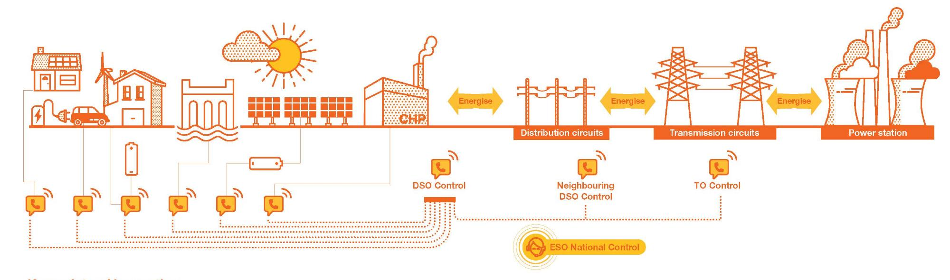
Roop Phull
What is Distributed ReStart?
Innovation project
3.5 year Network Innovation Competition (NIC) partnership: NGESO, SPEN, TNEI
Technical, organisational and procurement service designs have been delivered
Final year focused on demonstration
Objective
Use DER to energise the distribution and transmission system to compliment and expand on existing Restoration procedures.
The project will design and demonstrate the technical capability, organisational capability and functional route to market for this service.
Expected Benefits
Future proof restoration through using DER, increasing the diversity of providers
Expected savings of £115M by 2050 through enhanced competition
Save up to 810,000 tonnes CO₂ through avoiding warming of conventional generation
Website: https://www.nationalgrideso.com/future-energy/projects/distributed-restart
Reports: https://www.nationalgrideso.com/future-energy/projects/distributed-restart/key-documents

Slide 10
What services do we need from DER to achieve a DRZ
Roop Phull
  The total requirements for each DRZ will be site specific (depending on the scope of the DRZ and capability of DER within), but will consist of the following:
Service | Requirement | Description | Potential providers
Anchor generator (or power park) | Essential | Only one anchor generator is required per power island. Self-start and provide a controlled voltage source, able to energise the network to reach the next resource. | Synchronous generator, or other technology with required capability. A single point of connection is required with the DNO network.
Fast MW Control | Potential | May be required to supplement technical capability of anchor generator for example enhance block loading. | Battery, loadbank, flywheel, generator, others.
Inertia | Potential | Increase frequency stability of the DRZ and/or/ allow greater demand blocks to be picked up. | Synchronous generator, synchronous compensator (an inherent response is required without any measurement delays), others.
Frequency control | Potential | May be required to support the anchor generator to maintain frequency parameters during normal operation. | Synchronous generator, converter based sources with appropriate control, others.
Voltage control | Potential | May be required to enhance the MVAr capability of the DRZ to expand the island/energise to a higher voltage. | Wind farm, solar, battery, synchronous gen, Statcom, SVC, others.
Short circuit level | Potential | Increase the DRZ fault level. Facilitate protection operation at higher voltage levels or converter DER to connect | Synchronous generator, synchronous compensator, others.
Energy (MWh) | Potential | Enhance capability of the DRZ to restore demand above the capacity of the anchor generator. This could come from other any other gens on the island. (May be schedulable or intermittent.) | Schedulable MW - Synchronous generator (additional to the anchor), Intermittent resources (constrained and controlled by a set point),demand side management, others.

Slide 11
5. Technical Requirements
Paul Obanor
Primary Restoration Service Providers
Anchor Generator (Dx)
Top-up Service (Dx)
Top-up Service
Time to Connect ≤ 2h​​
Service Availability ≥ 80%​​
Voltage Regulation​​: Existent
Frequency Regulation​​: Existent
Resilience of Supply:​​
- Service ≥ 10h​​
- Auxiliary Unit(s) ≥ 72h​​
Block Loading Size ≥ 10MW (TBC with local DNOs)​​
Reactive capability ≥ 100MVAr Leading​​
Sequential Start-ups ≥ 3
Short Circuit Level
Inertia Value ≥ 400 MVAs
Time to Connect ≤ 8h​​
Service Availability ≥ 80%​​
Voltage Regulation
Frequency Regulation​​
Resilience of Supply:​​
- Service ≥ 72h up to 120h​​
- Auxiliary Unit(s) ≥ 120h​​
Block Loading Size ≥ 2MW​​
Reactive capability 0.95 lead/lag pf minimum
Short Circuit Level ≥ 1xDER MVA rating
Sequential Start-ups ≥ 3
Service Availability ≥ 80%
Fast MW Control ≤ 200ms​​
Inertia inherent MW to frequency response (no measurement delays)​​
Frequency Regulation
Voltage Regulation
Short Circuit Level ≥ 1xDER MVA rating
Energy (MWh) generate within 10s of request​​
Resilience:​​
- Service for minimum 72h​​ duration
- Maintain control & comms up to 72h​​
Mandatory Requirements
Service Availability ≥ 80%
Resilience ≥ 24h
Voltage Regulation​​: Existent
Frequency Regulation​​: Existent
At least one of the Requirements below
Resilience of Supply:​​
- Service ≥ 10h​​
Block Loading Size ≥ 10MW
Reactive capability ≥ 50MVAr Leading​​
Inertia Value ≥ 400 MVAs

Slide 12
6. The tender process
Alex Unitt
Request for EOI
Invitation to Tender (ITT)
Feasibility Study - Stage 1
Feasibility Study - Stage 2
Tender Evaluation
Contract Award
Build / Install
Service Delivery
Follows the same stages as previous ESR tender rounds but with longer timings in some sections
For potential bidders – concise route/set of documents to follow irrespective of service type: Full Tx service, AG or TuS
For ESO – all the technical specifications for both Tx & Dx restoration services, assessment criteria and how the commercial stacking might work is still WIP
FYI - copies of previous ESR tender documents can be found on our website:
https://www.nationalgrideso.com/balancing-services/system-security-services/black-start

Slide 13
6.1 Expression of Interest (EOI)
Alex Unitt
Request for EOI
Invitation to Tender (ITT)
Feasibility Study - Stage 1
Feasibility Study - Stage 2
Tender Evaluation
Contract Award
Build / Install
Service Delivery
To identify and confirm eligible tenderers ahead of the formal ITT
  EOI is a mandatory prerequisite to the tender
  One month submission period for potential providers
  Assessed by ESO using pass/fail questions
  Information submitted to confirm:
                - Type of Service (Full Service/Top up Service/Anchor generator)
                - Confirmation of technical characteristics and capability
                - Location
                - Ability to meet service commencement date and connection agreement
                - Acceptance of draft contract terms

Slide 14
6.2 Invitation to tender stage 1
Roop Phull
Request for EOI
Invitation to Tender (ITT)
Feasibility Study - Stage 1
Feasibility Study - Stage 2
Tender Evaluation
Contract Award
Build / Install
Service Delivery
ITT marks the start of the feasibility assessment process, during which the tender participants will be expected to produce and submit two sets of feasibility reports at stage 1 and stage 2
ITT Stage 1
  Two-month submission period for Stage 1 Feasibility Study Report (F1 Report) and proposed scope of works for Stage 2 (F2 Scope)
F1 Study / F1 Report – Overview
Provide a first assessment around the provider’s potential to become a Service Provider (technical capability, needs, timescales, etc.)
Development / Delivery of the report not expected to be time consuming
Highlight any risks/concerns the potential provider considers should be included in the more detailed study (F2 study)

Slide 15
6.3 Invitation to tender stage 2
Roop Phull
Request for EOI
Invitation to Tender (ITT)
Feasibility Study - Stage 1
Feasibility Study - Stage 2
Tender Evaluation
Contract Award
Build / Install
Service Delivery
ITT Stage 2
  Nine-month submission period for Stage 2 Feasibility Study Report (F2 Report)
  Complete F2 will form technical submission for tender
  F2 Study Process - Capped contribution - Price dependent on offering (Full Service / TuS / AG)
F2 Study / Report – Overview
Confirm technical capability (validated by the OEM) and how will the ‘Service’ be delivered
For some TuS, certificate of assurance might be required
If applicable / necessary, develop network modelling to ensure the ‘Service’ will not cause any impact or damage to third party plant or equipment
Provide an Implementation Strategy
Provide a Commercial Offer for the Service

Slide 16
6.4 Tender evaluation
Paul Obanor
Request for EOI
Invitation to Tender
Feasibility Study - Stage 1
Feasibility Study - Stage 2
Tender Evaluation
Contract Award
Build / Install
Service Delivery
Tenders will be assessed on the tender participant’s contribution to a restoration, based on specific capabilities or characteristics, with a weighting of (50:50), (Commercial : Technical).
  Technical scores – total of all scores given for each sub-criterion as per the assessment criteria
  Commercial scores – the commercial assessment methodology will be published. A percentage based on the tenderer’s commercial submission in relation to all other tenderer’s commercial submissions
  To combine the scores, the technical will be weighted to account for 50% of the total, and the commercial score to account for 50% of the total

Slide 17
7. Technical assessment criteria
Paul Obanor
Request for EOI
Invitation to Tender
Feasibility Study - Stage 1
Feasibility Study - Stage 2
Tender Evaluation
Contract Award
Build / Install
Service Delivery
The evaluations will create four price stacks with the assessment criteria for each detailed below. These tender stacks will be assessed in isolation
Primary Restoration Service Providers
Minimum requirements Pass/Fail
Connection to Network 8%
Time to Connect 5%
Service Availability 10%
Power Output 25%
Block Loading Size 10%
Resilience of Supply 20%
Contribution to System Stability 12%
Contribution to Restoration Time 10%
Distributed ReStart – Anchor Generators
Minimum requirements Pass/Fail
Connection to Network 5%
Time to Connect 10%
Service Availability 15%
Power Output 20%
Block Loading Size 10%
Resilience of Supply 25%
Contribution to Restoration Time 15%
Distributed ReStart – Top-up Services
Minimum requirements Pass/Fail
Top-up Services
Minimum requirements Pass/Fail
Connection to Network 8%
Resilience 20%
Service Availability 10%
Power Output 25%
Block Loading Size 10%
Resilience of Supply 15%
Contribution to System Stability 12%
Distributed ReStart services will be determined following consultation with DNO and ‘Rules of Play’ for feasible DRZ(s)

Slide 18
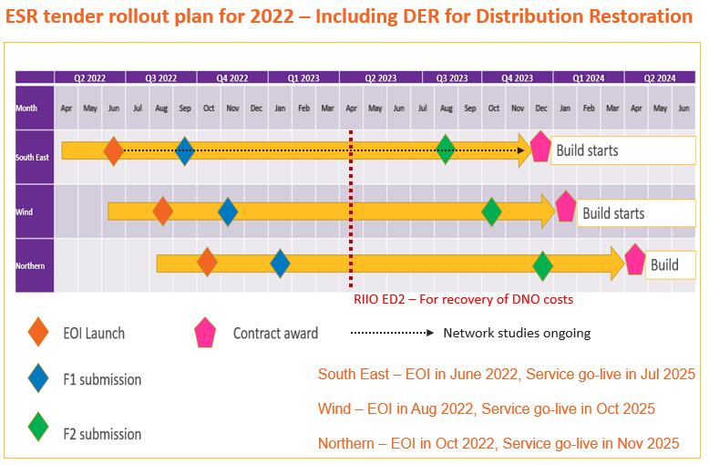
8. 2022 Tenders recap
Alex Unitt
South East Tender launched in July and is currently in the invitation to tender stage.
78 unique offerings received at EOI
48 offerings across four service categories through to ITT part 1
Wind Tender was launched in August and we are currently evaluating the EOI submissions.
High level of interest
Full service only to provide additional resilience to existing contracted services
ITT 3rd October
Dates | Activity - Northern Tender
Aug 22 | Industry Consultation Opens
Oct 22 | Expression of Interest
Dec 22 Jan 23 | Feasibility Stage 1
April - Dec 23 | Feasibility Stage 2 and Commercial Submissions
April 24 | Contract award
Nov 25 | Service commences
Oct 30 | Service expires

Slide 19

9. Q & A
Alex Unitt
Please use the chat function in Teams to submit your questions
Please do not disclose any information that could identify you as a restoration service provider
Questions will be published after the webinar
https://nationalgrid.onbrandcloud.com/login/

Slide 20
Let’s continue this dialogue
Alex Unitt
Please email us with your questions or further feedback:
commercial.operation@nationalgrid.com
To ensure you keep up to date with the Restoration Competitive Procurement Event, sign up for the Future of Balancing Services distribution list at the link below:
https://www.nationalgrideso.com/insights/future-balancing-services

