Slide 1
21 December 2021 – 9am to 2pm
Online Meeting via Teams
CMP381

Slide 2
WELCOME

Slide 3
Modification Process
Paul Mullen – National Grid ESO Code Administrator

Slide 4






Code Modification Process Overview
Talk to us
Raise a mod
Refine solution
Consult
Decision
Implement
Forums
Panels
Workgroups
(Workgroup Consultations)
Ofgem/Panel
Notes:
We are on the “Refine Solution” phase

Slide 5


Refine solution
Workgroups
If the proposed solution requires further input from industry in order to develop the solution, a Workgroup will be set up. ​
The Workgroup will:
  further refine the solution, in their discussions and by holding a Workgroup Consultation
  Consider other solutions, and may raise Alternative Modifications to be considered alongside the Original Modification
  Have a Workgroup Vote so views of the Workgroup members can be expressed in the Workgroup Report which is presented to Panel
Notes:
Workgroup
The proposal has identified an issue to solve and propose a solution to solve this issue.
Panel have decided that the proposed solution requires further input from industry in order to develop the solution and have therefore asked for a Workgroup to be set up and agreed a terms of reference (list of items that need to be considered by the Workgroup to form a robust solution( or solution(s).
We have endeavoured to ensure there is sufficient industry representation at this Workgroup.
The Workgroup will:
further refine the solution(s) and will hold a Workgroup Consultation to gauge industry views on their current thinking and also to provide the Workgroup with additional information/data to help them refine the solution(s).
Consider different solutions to solve the issue and may raise “Alternative Modifications” to be considered alongside the Original Modification. Important to note that no Alternative Modifications can be raised once the Workgroup Report has been signed off by Panel.
Have a Workgroup Vote so views of the Workgroup members can be expressed in the Workgroup Report which is presented to Panel and provides useful intelligence for industry and whoever is making the final decision on what a subset of industry think about the proposed changes
The output of the Workgroup is detailed in a Workgroup Report, which is then presented to the next Panel for Panel to sign off (agree that the Workgroup has met its terms of reference)

Slide 6


Consult
Code Administrator Consultation
The Code Administrator runs a consultation on the final solution(s), to gather final views from industry before a decision is made on the modification.
After this, the modification report is voted on by Panel who also give their views on the solution.
Notes:
Consult – Code Administrator Consultation
Once the Panel has signed off the Workgroup Report (agreed that it has met its terms of reference), the Code Administrator runs a consultation on the final solution(s), to gather final views from industry before a decision is made on the modification.
After this, the modification report (including a summary of responses to this consultation produced by the Code Administrator) is presented to and voted on by Panel who also give their views on the solution or solutions.

Slide 7


Decision
Dependent on the Governance Route that was decided by Panel when the modification was raised
Standard Governance: Ofgem makes the decision on whether or not the modification is implemented
Self-Governance: Panel makes the decision on whether or not the modification is implemented
  an appeals window is opened for 15 days following the Final Self Governance Modification Report being published
Notes:
Decision
Decisions on whether or not to implement a change are made by either:
Ofgem (you will hear the term " Standard Governance") or;
The respective Code Panel (you will hear the term "Self-Governance").
Essentially Self-Governance is followed where making the change is unlikely to have a material impact on parties (i.e. meets the self-governance criteria) and in this case the Code Panel make the decision whether or not to implement a change on a self-governance change but after this decision a 15 working day appeals window is opened for industry to appeal Panel’s decision (to Ofgem) before the change is implemented into the Code.
This change is [Standard / Self Governance]

Slide 8


Implement
The Code Administrator implements the final change which was decided by the Panel / Ofgem on the agreed date.
Notes:
Implement
Each change will include a proposed date for the change to be implemented into the Code – typically if this a change that impacts charges it will come in on a 1 April date.
Otherwise invariably it will be ~ 10 working days after a decision from Ofgem or ~ 5 working days after closure of appeals window (where the Panel rather than Ofgem are the decision body).
If Ofgem are making the decision and approve the change, Ofgem will clearly state on their decision letter what the implementation will be.

Slide 9
Objectives and Timeline
Paul Mullen – National Grid ESO Code Administrator

Slide 10
Timeline for CMP381 at 17 December 2021
Milestone | Date | Milestone | Date
Modification presented to Panel | 17 December 2021 | Code Administrator Consultation (2 working days) | 6 January 2022 (5pm) to 10 January 2022 (5pm)
Workgroup Nominations | 17 December 2021 to 5pm on 20 December 2021 | Draft Final Modification Report (DFMR) issued to Panel | 11 January 2022 (5pm)
Ofgem grant Urgency | 20 December 2021 (5pm) | Panel undertake DFMR recommendation vote | 12 January 2022 (11am)
Workgroup 1 - Understanding process, responsibilities and change, identify possible alternatives, agree Workgroup Consultation questions | 21 December 2021 (9am to 2pm) | Final Modification Report issued to Panel to check votes recorded correctly | 12 January 2022 (1pm)
Workgroup Consultation (3 working days) | 23 December 2021 (9am) to 29 December 2021 (5pm) | Final Modification Report issued to Ofgem | 12 January 2022 (3pm)
Workgroup 2 - Assess Workgroup Consultation Responses and Workgroup Vote | 31 December 2021 (9am to 2pm) | Ofgem decision | 14 January 2022 (5pm)
Workgroup report issued to Panel | 5 January 2022 | Implementation Date | 17 January 2022
Panel sign off that Workgroup Report has met its Terms of Reference | 6 January 2022 (12pm)

Slide 11
Workgroup Responsibilities
Paul Mullen – National Grid ESO Code Administrator

Slide 12
Expectations of a Workgroup Member
Contribute to the discussion
Be respectful of each other’s opinions
Language and Conduct to be consistent with the values of equality and diversity
Do not share commercially sensitive information
Be prepared - Review Papers and Reports ahead of meetings
Complete actions in a timely manner
Keep to agreed scope
Your Roles
Help refine/develop the solution(s)
Bring forward alternatives as early as possible
Vote on whether or not to proceed with requests for Alternatives
Vote on whether the solution(s) better facilitate the Code Objectives

Slide 13
Workgroup Alternatives and Workgroup Vote
Paul Mullen – National Grid ESO Code Administrator

Slide 14
Can I vote? and What is the Alternative Vote?
To participate in any votes, Workgroup members need to have attended at least 50% of meetings
Stage 1 – Alternative Vote
Vote on whether Workgroup Alternative Requests should become Workgroup Alternative CUSC Modifications.
The Alternative vote is carried out to identify the level of Workgroup support there is for any potential alternative options that have been brought forward by either any member of the Workgroup OR an Industry Participant as part of the Workgroup Consultation.
Should the majority of the Workgroup OR the Chair believe that the potential alternative solution may better facilitate the CUSC objectives than the Original then the potential alternative will be fully developed by the Workgroup with legal text to form a Workgroup Alternative CUSC modification (WACM) and submitted to the Panel and Authority alongside the Original solution for the Panel Recommendation vote and the Authority decision.

Slide 15
Can I vote? and What is the Workgroup Vote?
To participate in any votes, Workgroup members need to have attended at least 50% of meetings
Stage 2 – Workgroup Vote
2a) Assess the original and WACMs (if there are any) against the CUSC objectives compared to the baseline (the current CUSC)
2b) Vote on which of the options is best.

Slide 16
Terms of Reference
Paul Mullen – National Grid ESO Code Administrator

Slide 17
CMP381 – Terms of Reference
Consider whether or not a £10/MWh cap on BSUoS is appropriate or justify if another £/MWh cap is more appropriate
Consider if the £10/MWh cap on BSUoS should be in place from 1 January 2022 to 31 March 2022 or a different time period
Consider the impacts on Generators, Suppliers and Consumers of deferring the additional BSUoS costs above the cap to the 2022/23 Charging year
Consider the limit on the total BSUoS costs that would be deferred
Confirm there is no interaction with other in-flight Modifications
Consider invoicing / billing timeline in the context of the Implementation Date

Slide 18
Proposer Slides
Simon Vicary – EDF Energy

Slide 19
Defect and Urgency
BSUoS costs are significantly higher than the ESO forecasts so far this winter, as a result of exceptional market conditions, therefore much higher than consumers and industry parties could reasonably have expected or will have budgeted for.
Our analysis suggests that the ESO BSUoS forecast will be inaccurate to a similar degree in Q1 2022. As a result both industry and consumers will not be prepared or able to tolerate the actual extreme prices that may outturn.
It is absolutely critical to protect consumers, and prevent further insolvency contagion to suppliers and generators.
We believe this proposal will have a positive impact on consumers as it spreads the recovery of a portion of the exceptional BSUoS costs over a longer period, providing time for consumers to budget for these exceptional costs at a time of already extreme power prices.

Slide 20
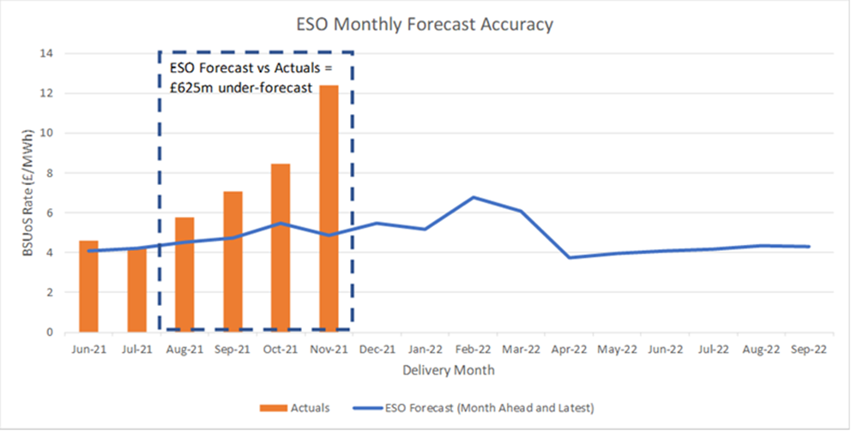
BSUoS variance to ESO forecast
The chart below shows the recent variance to the ESO BSUoS forecast, with the outturn being £625m higher across the last 4 months.

Slide 21
Proposed Solution
To protect consumers, and prevent further insolvency contagion to suppliers and generators in Q1 2022:
  a half-hourly £10/MWh cap should be put in place (as for CMP350)
  additional BSUoS costs above the cap would be deferred to the 2022/23 charging year
  the total costs which can be deferred are to be limited to £300m (which effectively means the impact of the inaccuracy of forecast is being shared across ESO and industry)
  we are seeking implementation with effect from 1st January 2022
This is consistent with the mechanism approved under CMP345 and CMP350 to protect against extreme BSUoS costs in 2020 due to COVID.
  This means minimal, if any, system impact as the change can use the existing processes.
  The legal text required is also established.

Slide 22
ESO thoughts and analysis
Jenny Doherty – National Grid ESO

Slide 23
CMP381 – ESO overview

Slide 24
Overview of approach in CMP345 / 350
Each settlement period between x and y date will be capped at £10/MWh. Anything above this, will be deferred until the following charging year.
We will continue to issue invoices as normal, with credits issued for the difference once a month (shown in calendar in next slides)
Costs for implementing the scheme are as agreed between the ESO and Ofgem
Reporting:
  The ESO will publish a weekly update on the costs which have been deferred to date
  Should 80% of the total support limit be reached, then this will be updated each working day
At least 2 business days’ notice from the ESO as to when the CMP381 BSUoS Support Scheme is to end.
Costs are recovered equally through FY22/23 (note discuss approach on next slide)

Slide 25
Questions for CMP381 implementation
How the costs are recovered in each day
      Across the settlement day – proposal
      - In this option, the costs recovered in each settlement day are the same
      - The costs are volume weighted across the day through each settlement period i.e. when volume is highest in the day, the largest proportion of costs are paid
      - This is how the majority of BSUoS charges work in BAU and is how the CMP373 is being recovered
      b) Evenly across the settlement periods
      - In this option, the costs recovered in each settlement period are fixed i.e. if the volumes to spread the costs over or high / low it does not change the amount to be recovered
      - This is how the recovery of CMP345 / 350 is occurring
    2) When / how recovery commences
    This scheme is slightly different to CMP345/350 as the end date of the scheme, is the day before recovery commences. We will therefore not have all finalised data before recovery commences. The proposed option is:
- On 8th April we will publish the recovery costs per day, which will commence as of 1st April 2022. This will be made up of SF and II data
- On 28th April, we will publish an updated figure to recover per day following all SF data being available

Slide 26
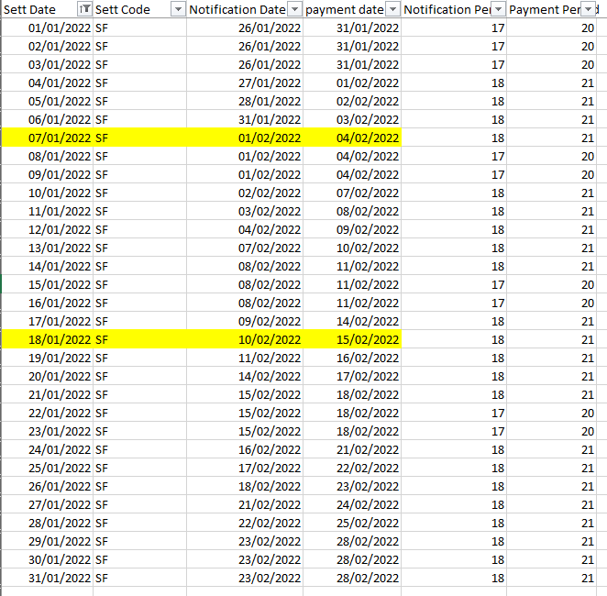
Calendar of dates
Invoicing calendar
Credit note calendar
Scheme Month | Last Day of Settlement Month | II Processing Date for last Settlement day of Month | SF Billing Date for Last Settlement day of Month | Credit Note Issue Date | Payment Date
Jan-2022 | 31/01/2022 | 08/02/2022 | 23/02/2022 | 04/03/2022 | 09/03/2022
Feb-2022 | 28/02/2022 | 08/03/2022 | 23/03/2022 | 01/04/2022 | 06/04/2022
Mar-2022 | 31/03/2022 | 08/04/2022 | 27/04/2022 | 06/05/2022 | 11/05/2022
Full calendar of invoicing dates can be found here: https://www.nationalgrideso.com/document/47391/download

Slide 27
ESO available support
The proposal sets out £300m of support from the ESO. Whilst this is in line with the support noted in CMP361, that number is an indicative value and will depend on financing in future periods from FY23/24 onwards and not in the short-term.
We are open to providing support to industry, however currently the ESO has other financial commitments, which makes this level of support, at short notice, very challenging for a legally separate company with a RAV of £200m.
This includes £100m of TNUoS funding - predominately the "k" factor demand under recovery from FY21, which the ESO will only recover in FY23.
There are additional risks such as significant bad debt with the high number of suppliers that have ceased in FY22.
Understandably, there are internal governance processes needed in regard to providing support which are likely to conclude on Wednesday.

Slide 28
Analysis of how much would have been deferred in 2021 under different price caps
2021 BSUoS Charges by Month |  | Amounts that would have been deferred under different cap values (£/MWh)
Month | Billed Total | £5 Cap | £10 Cap | £15 Cap | £20 Cap | £25 Cap | £30 Cap | £35 Cap
April | £155,614,544 | £23,540,569 | £11,461,548 | £8,530,180 | £5,950,753 | £3,815,762 | £2,005,890 | £999,786
May | £177,780,449 | £26,485,069 | £3,621,659 | £115,300 | £0 | £0 | £0 | £0
June | £161,772,879 | £18,219,921 | £1,953,893 | £33,678 | £0 | £0 | £0 | £0
July | £156,731,953 | £12,907,044 | £942,707 | £0 | £0 | £0 | £0 | £0
August | £213,257,976 | £51,837,998 | £14,714,037 | £5,016,987 | £1,251,172 | £227,277 | £0 | £0
September | £264,544,266 | £126,411,853 | £89,125,348 | £70,273,103 | £57,111,226 | £46,275,422 | £37,081,042 | £29,249,520
October | £352,043,857 | £163,844,809 | £70,917,604 | £32,957,154 | £15,031,674 | £5,357,959 | £1,271,244 | £94,453
November | £571,767,208 | £366,001,819 | £245,754,573 | £177,040,515 | £135,623,471 | £109,982,798 | £91,415,209 | £78,116,020
December (up to 8th) | £122,066,280 | £62,256,630 | £32,173,442 | £20,247,243 | £16,118,340 | £14,306,166 | £12,645,606 | £11,078,950
Total | £2,175,579,410 | £851,505,711 | £470,664,810 | £314,214,160 | £231,086,636 | £179,965,384 | £144,418,990 | £119,538,729

Slide 29
Analysis on different price caps
*Data up to 24th November (latest SF data)
Table on the left indicates % of Settlement Periods affected by different price caps
Prior to September 2021, a price cap of £10/MWh would typically have affected between 5-10% of Settlement Periods
This indicates that such SPs are not unforeseen, as based on the historical average more than one SP reaches £10/MWh per day
In Autumn 2021 a £10/MWh cap would have affected around 26% of SPs
That means it is no longer affecting “exceptional” settlement periods, since 1 in 4 would be capped
Where previously a £10/MWh was used for COVID, that affected around 7% of SPs in that period
To affect an equivalent amount of SPs in Autumn 2021, a cap in the range of £20-£25MWh would have been needed
 | £10/MWh cap | £15/MWh cap | £20/MWh cap | £25/MWh cap
Sep-21 | 12% | 7% | 5% | 5%
Oct-21 | 30% | 15% | 8% | 3%
Nov-21* | 39% | 23% | 14% | 9%
Autumn 2021 | 26% | 15% | 9% | 6%
2021 | 11% | 5% | 3% | 2%
2017-2021 | 5% | 2% | 1% | 0%
High BSUoS costs are driven by a relatively small number of particularly high cost Settlement Periods
Since April 2017, only 70 SPs have had a BSUoS cost above £50/MWh - all of these have occurred since September 2021
If a £50/MWh cap had been put in place from 1st Sep – 24th Nov 2021, £58.3m of BSUoS costs would have been deferred over those 70 SPs
  Therefore, a £50/MWh cap could be reasonable if focussing on cost extremities

Slide 30
Next Steps
Paul Mullen - National Grid ESO Code Administrator

