Slide 1
Friday 30 October 2020
Online Meeting via Teams
CUSC Panel
Join Microsoft Teams Meeting
+44 20 3443 6278 United Kingdom, London (Toll)
Conference ID: 269 946 332#

Slide 2
WELCOME

Slide 3
Approval of Panel Minutes
Approval of Panel Minutes from the Meetings held 16 September 2020, 25 September 2020 and 1 October 2020

Slide 4
Actions Log
Review of the actions log

Slide 5
Chair’s Update
An update from the Chair about ongoing relevant work, discussions etc.

Slide 6

Authority Decisions
Decisions Received since last Panel meeting
CMP280 Update 2 October 2020
CMP342 Appeal received 2 October 2020
Decisions Pending
CMP280, CMP292, CMP317/327, CMP339, CMP324/325, CMP334, CMP333
Received Final Modification Reports since last Panel Meeting
CMP335/336 and CMP343/340 (6 October 2020)
.

Slide 7

New modifications submitted
CMP352: Correction to ‘Revised Indicative Annual TNUoS charge’ formulas in Appendix 2 of CUSC Section 3
Grahame Neale, National Grid ESO

Slide 8
Critical Friend Feedback – CMP352
Code Administrator comments | Amendments made by the Proposer
Justification on the Fast Track Self- Governance route Amendments to implementation date/approach | Proposer accepted all amendments made by the Code Administrator

Slide 9
What’s the issue
CUSC allows Suppliers to revise their Demand Forecast (that’s used for TNUoS charging) in response to significant changes in Demand. This is so these changes in Demand do not affect the Supplier’s Forecasting Performance. This is described in CUSC Section 3.23.7 and 3.23.8
Point 5 and 8 in Appendix 2 of CUSC Section 3 states the formula under which the above changes are made
These formulas do not function mathematically and therefore do not deliver the intent of CUSC.
NGESO believe this error has existing since the introduction of CUSC. These provisions are very rarely used however NGESO have had some enquiries recently about these provisions.
CMP352 looks to correct these formulas so they can function as intended

Slide 10
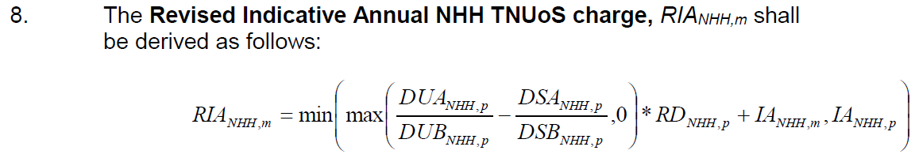
An Example (1)
Using NHH Demand as an example, there are 2 issues
DUA = average metered User demand 20 business days prior to increase in demand
DUB = average metered User demand 20 business days after increase in demand
DSA = average metered System demand 20 business days prior to increase in demand
DSB = average metered System demand 20 business days after increase in demand
RD = forecast proportion of HH Charges remaining for the previous Financial Year
IA = Indicative Annual HH TNUoS charge

Slide 11
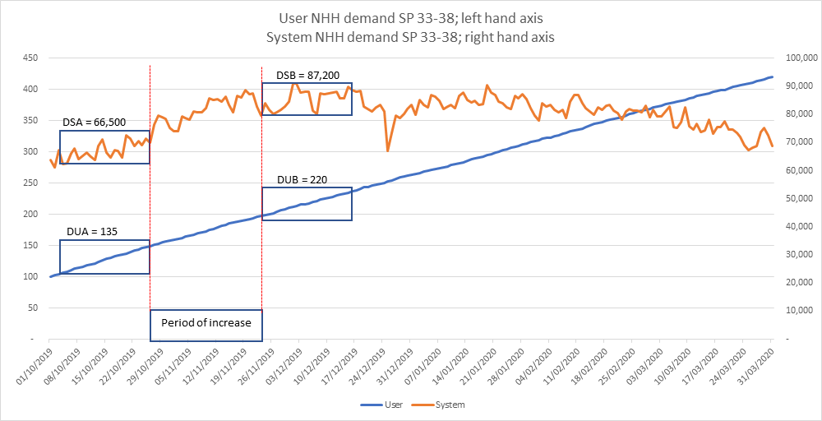
An Example (2)
1 - Comparing User Demand to System Demand
The intention is to compare the Users demand either side of the Reported Period of Increase, and compare to System demand over the same period
From the chart, we can see both User and System demand have increased
User = 220/135 = 1.63
System = 87,200/66,500 = 1.31
The nominator and denominator variables in CUSC are the wrong way round i.e. CUSC states
Demand increases do not feed through as max of (0.61-0.76 = -0.15) vs 0
User Demand = 135/220 = 0.61
System Demand = 66,500/87,200 = 0.76

Slide 12

An Example (3)
2 – Adding (rather than multiplying) percentages to a value
The variable RD is a percentage, whilst IA is a £ value. Assume RD = 59%, IA = £1m and the blue box is corrected as per the previous slide.
This results in;
0.32 x 0.59 + £1,000,000 = £1,000,000.19
We believe the intent is multiplicative so that;
(1 + (0.32 x 0.59)) x £1,000,000 = £1,188,800
$$max\left(\frac{220}{135}− \frac{87,200}{66,500}, 0\right)=max\left(1.63− 1.31, 0\right)=0.32$$

Slide 13
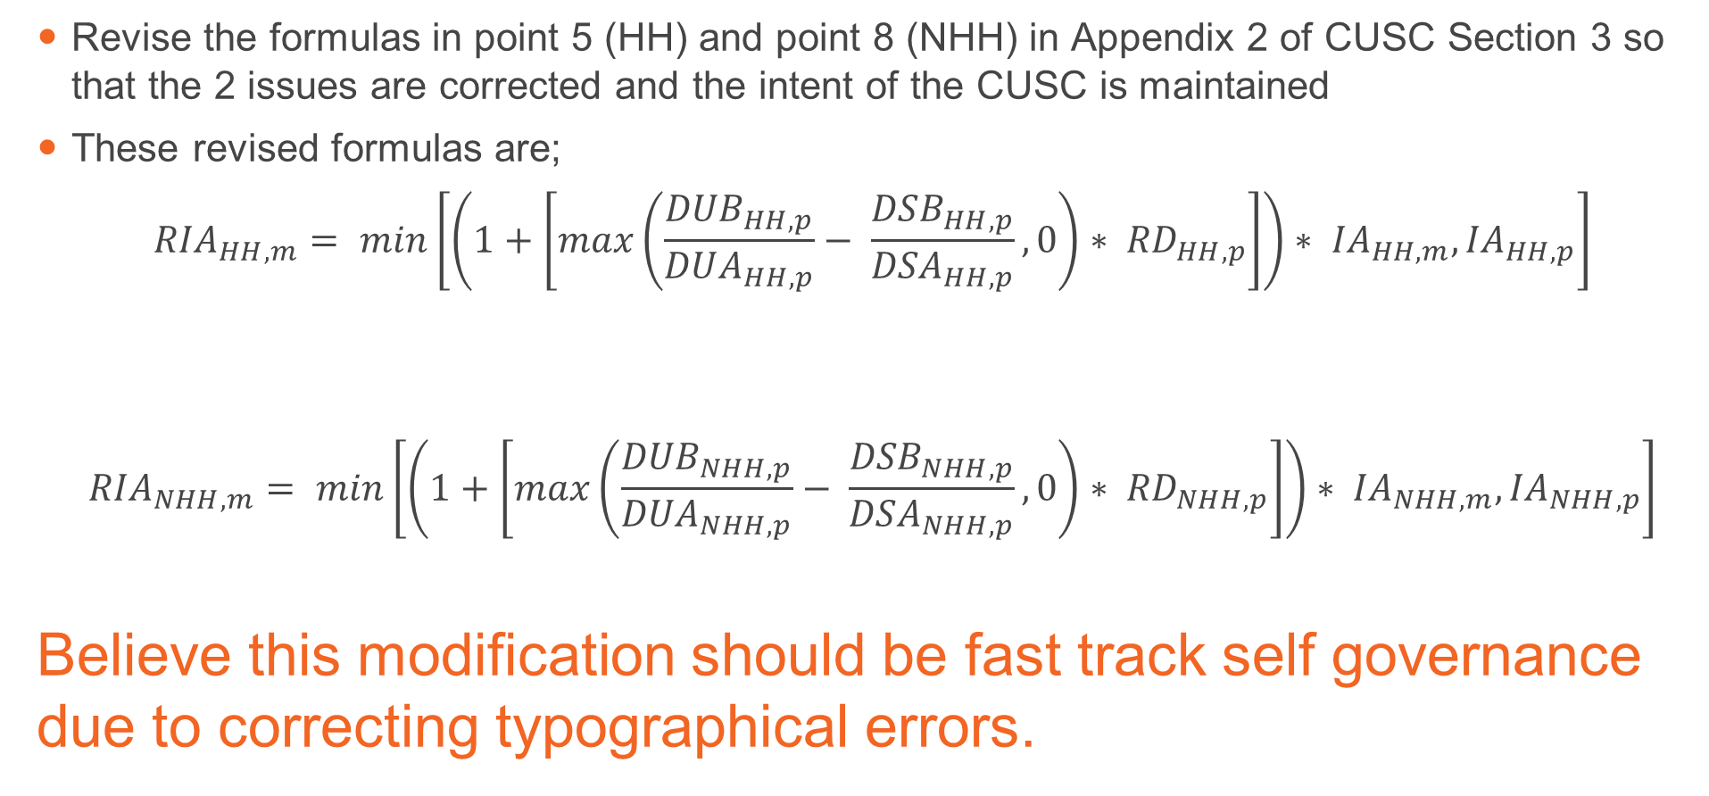
What’s the proposed solution
Revise the formulas in point 5 (HH) and point 8 (NHH) in Appendix 2 of CUSC Section 3 so that the 2 issues are corrected and the intent of the CUSC is maintained
These revised formulas are;
$${RIA}_{HH, m}= min\left[\left(1+\left[max\left(\frac{{DUB}_{HH,p}}{{DUA}_{HH,p}}− \frac{{DSB}_{HH,p}}{{DSA}_{HH,p}}, 0\right)∗ {RD}_{HH,p}\right]\right)∗ {IA}_{HH,m}, {IA}_{HH,p}\right]$$
$${RIA}_{NHH, m}= min\left[\left(1+\left[max\left(\frac{{DUB}_{NHH,p}}{{DUA}_{NHH,p}}− \frac{{DSB}_{NHH,p}}{{DSA}_{NHH,p}}, 0\right)∗ {RD}_{NHH,p}\right]\right)∗ {IA}_{NHH,m}, {IA}_{NHH,p}\right]$$
Believe this modification should be fast track self governance due to correcting typographical errors.

Slide 14
Justification for Fast Track Self-Governance
The Proposer recommends that this Modification follows the Fast Track Self-Governance procedure as the changes meet the required criteria as the Modification is required as a result of factual change, including but not limited to:
iv) Updating out of date references to other documents or paragraphs.
The Self-Governance criteria is met as the modification is unlikely to discriminate between different classes of CUSC Parties and is unlikely to have a material effect on:
-Existing or future electricity customers;
-Competition in the generation, distribution, or supply of electricity or any commercial activities connected with the generation, distribution or supply of electricity,
-The operation of the National Electricity Transmission System
-Matters relating to sustainable development, safety or security of supply, or the management of market or network emergencies
The CUSC’s governance procedures or the CUSC’s modification procedures
For information, Fast Track Self-Governance – Guidance
-Rectify internal inconsistences
-Remove outdated (or redundant) information;
-Correct typographical errors in the CUSC; or
-Further development / detail existing processes or code arrangements (without introducing new requirements upon code parties which significantly impact business practices or systems).

Slide 15
Next steps
Panel to unanimously approve that this can be implemented after the appeals window closes, providing no objections are raised.
Stage Gate | Date
Draft Fast Track Self- Governance Report issued to Panel | 22 October 2020
Draft Fast Track Self-Governance Report presented to Panel | 30 October 2020
Modification Panel decision | 30 October 2020
Appeals Window (15 Working Days) | 16 November 2020 to 7 December 2020
Decision implemented in CUSC | 14 December 2020

Slide 16
New modifications submitted
CMP353: Stabilising the Expansion Constant and non-specific Onshore Expansion Factors from 1st April 2021
Grahame Neale and Matt Wootton, National Grid ESO

Slide 17
Critical Friend Feedback – CMP353
Code Administrator comments | Amendments made by the Proposer
Additional commentary on which of Ofgem’s Urgency Criteria this meets Definition on acronyms and cosmetic changes | Proposer accepted all amendments made by the Code Administrator

Slide 18
Proposer Recommended Governance Route
The Proposer recommends that this modification should be treated as an Urgent Modification proposal and proceed directly to Code Administrator Consultation.

Slide 19
Ofgem’s Urgency Criteria
Ofgem’s current view is that an urgent modification should be linked to an imminent issue or a current issue that if not urgently addressed may cause:
A significant commercial impact on parties, consumers or other stakeholder(s); or
A significant impact on the safety and security of the electricity and/or gas systems; or
A party to be in breach of any relevant legal requirements.
More information can be found at:
https://www.ofgem.gov.uk/system/files/docs/2016/02/urgency_criteria.pdf

Slide 20
Proposer’s Justification vs Ofgem’s Urgency Criteria
Ofgem’s Urgency Criteria | Proposer’s Justification
a) A significant commercial impact on parties, consumers or other stakeholder(s). | The Proposer considers that this is an imminent issue or a current issue that if not urgently addressed may cause a significant commercial impact on parties, consumers or other stakeholder(s) and therefore meets Ofgem’s Urgency Criteria (a). The Proposer considers that without Urgent change there would be a significant commercial impact on market participants due to the large changes in locational tariffs that would otherwise take effect on the 1 April 2021 and so without sufficient notice for them to understand and prepare for the effects. If the proposal was not treated as Urgent it would not have time to complete and be approved prior to the tariff setting process in December and January.
b) A significant impact on the safety and security of the electricity and/or gas systems. | n/a
c) A party to be in breach of any relevant legal requirements | n/a

Slide 21
Timeline for CMP353 – Proposed Urgent Timeline (Code Administrator Consultation)
Milestone | Date | Milestone | Date
Modification presented to Panel | 30 October 2020 | Final Modification Report issued to Panel to check votes recorded correctly | 24 November 2020 (3pm)
Ofgem grant Urgency | By 3 November 2020 (5pm) | Final Modification Report issued to Ofgem | 25 November 2020 (3pm)
Code Administrator Consultation (10 working days) | 4 November 2020 (9am) to 18 November 2020 (5pm) | Ofgem decision (5 working days) | 2 December 2020
Draft Final Modification Report (DFMR) issued to Panel | 20 November 2020 | Implementation Date | 1 April 2021
Panel undertake DFMR recommendation vote (2 working days) | 24 November 2020

Slide 22
Timeline for CMP353 – Proposed Urgent Timeline (Workgroup)
Milestone | Date | Milestone | Date
Modification presented to Panel | 30 October 2020 | Code Administrator Consultation (2 working days) | 18 November 2020 (9am) to 19 November 2020 (5pm)
Workgroup Nominations (2 Working Days) | 30 October 2020 (3pm) to 3 November 2020 (5pm) | Draft Final Modification Report (DFMR) issued to Panel | 20 November 2020
Ofgem grant Urgency | By 3 November 2020 (5pm) | Panel undertake DFMR recommendation vote (2 working days) | 24 November 2020
Workgroups 1 and 2 (assuming Ofgem have granted Urgency) | 4 November 2020 and 6 November 2020 | Final Modification Report issued to Panel to check votes recorded correctly | 24 November 2020 (3pm)
Workgroup Consultation (2 working days) | 9 November 2020 (9am) to 5pm 10 November 2020 | Final Modification Report issued to Ofgem | 25 November 2020 (3pm)
Workgroups 3 and 4 - Assess Workgroup Consultation Responses and Workgroup Vote | 12 and 13 November 2020 | Ofgem decision (5 working days) | 2 December 2020
Workgroup report issued to Panel (1 working day) | 16 November 2020 | Implementation Date | 1 April 2021
Panel sign off that Workgroup Report has met its Terms of Reference | 17 November 2020

Slide 23
Panel Decision and Next Steps
Does the Panel agree that:
This modification should proceed directly to Code Administrator Consultation
Panel will now be asked to:
Carry out recommendation vote on the request for Urgency
Agree timetable
Next Steps
Under CUSC Section 8.24.4, we will now consult the Authority as to whether this Modification is an Urgent CUSC Modification Proposal
Letter to be sent to Ofgem 1st thing 2 November 2020
Ofgem approval of Urgent treatment sought by 5pm on 3 November 2020

Slide 24
In Flight Modification Updates
Review of all CUSC Modifications with current status, next steps and any Panel recommendations

Slide 25
Dashboard – CUSC (as at 27 October 2020)
Category | May | Jun | Jul | Aug | Sep | Oct
New Modifications | 4 | 2 | 3 | 0 | 1 | 1
In-flight Modifications (includes those on hold but not New Modifications) | 46 | 46 | 45 | 47 | 47 | 48
Modifications issued for Workgroup consultation | 2 (CMP335/336CMP339) | 1 (CMP345) | 2 (CMP343/340 and CMP350) | 0 | 0 | 0
Modifications issued for Code Administrator Consultation | 1 (CMP337/338) | 7 (CMP324/325, CMP345, CMP334, CMP333, CMP342, CMP317/327 and CMP339) | 1 (CMP350) | 3 (CMP346, CMP347, CMP333 ) | 2 (CMP343/340, CMP335/336 ) | 1 (CMP351)
Workgroups held | 9 | 6 | 8 | 6 | 2 | 2
Authority Decisions | 3 (CMP281, CMP319, CMP306) | 2 (CMP345 and CMP323) | 3 (CMP303, CMP337/338, CMP320) | 1 (CMP350) | 0 | 0
Implementations | 0 | 2 (CMP345 and CMP323) | 0 | 1 (CMP350) | 1 (CMP348) | 0
Modifications on Hold | 5 | 4 | 4 | 4 | 4 | 4
Workgroups postponed | 2 (CMP311, CMP326) | 2 (CMP343/340, CMP335/336) | 0 | 0 | 0 | 0

Slide 26
CUSC Workgroups for next 3 months (as at 27 October 2020)
October (total = 2)
November (total = 4)
CMP328 – 19 Nov
CMP344 – 22 Oct
CMP326
CMP328 – 15 Oct
December (total = 2)
January (total = 4)
CMP326
CMP328 x 2
CMP326
CMP344
CMP330
CMP330
CMP330 – 9 Nov
See Notes explaining what each Modification is seeking to achieve
Notes:
CMP328 - Put in place an appropriate process to be utilised when any connection triggers a Distribution impact assessment.
CMP344 - Clarifies that the allowed revenue for Transmission Owners recovered from Transmission Users under the Charging Methodologies is fixed for each onshore price control period for onshore transmission licensees and at the point of asset transfer for OFTOs.
CMP311 – Reassessment of CUSC credit requirements for Suppliers, specifically for “User Allowed Credit “
CMP326 - Introducing a 'Turbine Availability Factor' for use in Frequency Response
Capacity Calculation for Power Park Modules (PPMs)
CMP330 - Allowing new Transmission Connected parties to build Connection Assets greater than 2km in length

Slide 27
Grid Code Workgroups for next 3 months (as at 27 October 2020)
October (total = 4)
GC0138/141 - 8 Oct
GC0139 – 14 Oct
GC0147 – 16 Oct and 30 Oct
November (total = 7)
GC0109 x 2 – 12 Nov and 24 Nov
December (total = 5)
GC0139 – 17 Nov
GC0147
GC0145 – 8 Dec
GC0144
GC0137
GC0134
GC0145 x 2 – 3 Nov and 24 Nov
GC0134
January (total = 2)
GC0109 x 2 – w/c 11 Jan and w/c 25 Jan
GC0144 – w/c 2 Nov
See Notes explaining what each Modification is seeking to achieve
Notes:
GC0145 – Updating the Grid Code to include the Manually Activated Reserve Initiative (MARI)
GC0147 – Enduring Modification to GC0143
GC0139 - Seeks to increase the scope and detail of planning - data exchange between DNO's and National Grid ESO to help facilitate the transition to a smart, flexible energy system.
GC0141 - User Compliance Processes and Modelling following 9th August Power Disruption
GC0138 – Compliance process technical improvements (EU and GB User)
GC0134 - Remove the need for 24/7 contact and telephony for small embedded generators forming part of an aggregator or participating in the Balancing Market as part of wider access.
GC0109 - Set out within the Grid Code the obligation on Network Operators to make available to market participants, in real time, all the types of system warnings issued
GC0144 – Set out what criteria would constitute an emergency condition under Article 18(3) of the System Operation Guideline and under what conditions National Grid ESO would suspend the market. In addition, the modification also seeks to clarify under what conditions the TERRE market would be suspended and to align these provisions.
GC0137 - Proposes to add a non-mandatory technical specification to the Grid Code, relating to what is referred to as Virtual Synchronous Machine (“VSM”) capability

Slide 28
STC and SQSS Workgroups for next 3 months (as at 27 October 2020)
October
GSR027 – 6 and 8 Oct
November
December
January
GSR027 - To address the specific actions from the Energy Emergency Executive Committee (E3C) and Ofgem final reports into the power outage of 9th August 2019 for the ESO to review, in consultation with industry, the NETS SQSS requirements that drive reserve, response and inertia holding on the GB electricity system.

Slide 29
Asks of Panel (as at 27 October 2020)
CMP300 – Agree that the Workgroup has met its Terms of Reference and can proceed to Code Administrator Consultation
CMP344 – Agree timeline - specifically i) Workgroup Report will be a late paper but presented to November 2020 Panel, ii) we will hold Special Panel in early January for Panel recommendation vote and iii) Panel will only have 1 working day to check that recommendation votes have been recorded correctly
CMP330 - Agree proposed amendments to the Terms of Reference proposed by the Workgroup
CMP328 – Agree proposed amendments to the Terms of Reference proposed by the Workgroup
CMP342 – Note that a Self-Governance Appeal was raised 2 October 2020 and won’t be implemented 9 October 2020
CMP309/310 – Note the changes between now and when the last Code Administrator Consultation was issued and agree that this can be issues for a 2nd Code Administrator Consultation

Slide 30
Timeline for CMP344 V2
Milestone | Date | Milestone | Date
Workgroups 1 and 2 | 3 September 2020 and 22 October 2020 | Draft Final Modification Report (DFMR) issued to Panel | 29 December 2020
Workgroup Consultation (15 Working Days) | 2 November 2020 – 5pm on 23 November 2020 | Panel undertake DFMR recommendation vote | 8 January 2021
Workgroup 3 - Assess Workgroup Consultation Responses and Workgroup Vote | 24 November 2020 | Final Modification Report issued to Panel to check votes recorded correctly (1 working day) | 8 January 2021
Workgroup report issued to Panel (2 working days) | 25 November 2020 | Final Modification Report issued to Ofgem | 12 January 2021
Panel sign off that Workgroup Report has met its Terms of Reference | 27 November 2020 | Ofgem decision | 31 January 2021
Code Administrator Consultation (15 Working Days) | 30 November 2020 to 5pm on 21 December 2020 | Implementation Date | 1 April 2021

Slide 31

Brexit CUSC Changes Katharina Birkner

Slide 32

Brexit situation and possible outcomes
The European Union Withdrawal Act (2018) was approved by the house of Lords on the 22nd January 2020. This initiated 11 months negotiation for a post Brexit EU relationship.
The withdrawal agreement states that all EU network codes in place or approved by ACER ahead of exit day will be copied into GB law except for elements that aren’t operable.
As the negotiations are slowly drawing to and end there’s 2 possible options:
Deal
No Deal
This option currently looks less likely. Due to the UK negotiation team having expressed a preference to be outside of the internal energy market, there is a chance that an agreement, a “deal” situation could look similar to the “no deal” scenario initially. A “deal” scenario may require further negotiations to identify alternative options for the ongoing relationship on energy.
If an agreement is reached we will withdraw our
CUSC Brexit mods and raise new ones.
This option currently appears more likely due to the outstanding sticking points.
BEIS have a series of SIs that have been laid in place to copy EU network codes into GB law.
Code modifications have been raised previously to account for a “no deal” Brexit to ensure the CUSC remains accurate. These mods have been reviewed to include relevant updates since last year

Slide 33
CUSC Impact
In 2019 we raised 2 CUSC mods to ensure the CUSC remains accurate in the event the UK leaves the EU without an agreement. The Panel voted that the mod met the self-governance criteria and should proceed straight to CAC, which was run. Once it became clear that the European Union Withdrawal Act (2018) had been agreed the mods were put on hold.
CMP309: CUSC changes in the event the UK leaves the EU without an agreement
CMP309 seeks to ensure any retained EU law functions effectively in the CUSC in a “no deal” scenario taking into consideration the provisions of relevant statutory instruments under the Withdrawal Act. Legal text changes impact section 8 in the CUSC (CUSC modification) and section 11 in the CUSC (definitions)
CMP310: CUSC section 14 changes in the event the UK leaves the EU without an agreement
CMP310, is the equivalent to CMP309 for CUSC section 14 changes (charging methodologies)
We are bringing CMP309 and CMP310 back at October CUSC panel including additional legal text changes that are required due to the implementation of CMP322 and CMP323 (EBGL Art 18 T&Cs implementation) to initiate a new Code Administrator Consultation. The defect has not changed.
Our recommendation to Panel is to now proceed to a second CAC.

Slide 34
Legal Text highlights
SI 2019 No. 532 – Exiting the European Union (Electricity) laid 15th June 2019 copied the ITC agreement and Electricity Balancing Regulation into GB law
CUSC Section 11 (Definitions)
Adding definition for Electricity Balancing Regulation (in place of previous definition as Electricity Balancing Guidelines) and subsequent EBR definitions
Adding definitions for Retained EU law and Legally Binding Decisions from the EU Commission and ACER
CUSC Section 4 (Balancing Services)
Updating EBGL Art 18 (T&Cs) provisions ensuring they contain updated definitions from Section 11
Updating exhibit Y reference from EU law to retained SOGL
CUSC Section 8 (CUSC Modification)
Ensuring Section 8 contains updated definitions from Section 11
CUSC Section 14 (Charging Methodologies)
Updating reference from EU law reference to Retained EU law

Slide 35
Discussions on Prioritisation

Slide 36
Prioritisation Principles
Section 8: 8.19.1.(e) makes the following provision for the Panel and states “Having regard to the complexity, importance and urgency of particular CUSC Modification Proposals, the CUSC Modifications Panel may determine the priority of CUSC Modification Proposals and may (subject to any objection from the Authority taking into account all those issues) adjust the priority of the relevant CUSC Modification Proposal accordingly”
Complexity | The modification is viewed as being resource intensive and will most likely require a higher than average number of workgroups to conclude the process. Additionally the modification defect is viewed to have implications for many different areas of the energy market which need to be taken into consideration throughout the process.
Importance | The perceived value & risk associated with the proposed modification. The value / risk could be considered from a number of different perspectives i.e. financial / regulatory / licence obligations both directly for customer and end consumers more generally.
Urgency | A modification which requires speedy consideration within the code governance process, both complexity and importance should be factors considered in evaluating urgency as well as the timescales for implementation within the respective code.

Slide 37

BREAK

Slide 38
Workgroup Reports
CMP300 - Cost reflective Response Energy Payment for Generators with low or negative marginal costs
Paul Mullen

Slide 39
CMP300 Background
CMP300 was raised by Drax Power Ltd. and was submitted to the CUSC Panel for their consideration in February 2019.
The CUSC Panel decided that this modification should be assessed by a Workgroup and submitted to the Authority for decision.
CMP300 seeks to improve the cost reflectivity of the Response Energy Payment (REP) as the current construction of the REP is not reflective of the costs or avoided cost of energy production for generators. It will achieve this by ensuring all BM Units with low or negative marginal costs, as a consequence of having a CfD FiT, are subject to the same REP methodology.
4 Workgroup Meetings held
3 Workgroup Consultation Responses received
2 respondents believed that the proposed change better facilitates the CUSC objectives than the Baseline. However, 1 of these respondents favours an optional pricing approach as it allows market participants to provide their own approach in terms of cost reflective pricing. This has subsequently been raised as a Workgroup Alternative Code Modification (WACM1).
Workgroup Vote held 31 October 2019
5 of the 6 Workgroup Members voted that the Original and WACM1 were better than the current CUSC arrangements; and
3 voted that WACM1 was best, with 2 votes for the Original and 1 vote for no change.
Workgroup Report presented to November 2019 Panel; however Panel raised concerns that the Workgroup Report didn’t really explain to what extent a CfD plant loses out at the moment under the current arrangements, as it doesn’t set out the payments that the affected generator receives/pays/forgoes when it provides response. This has been addressed in the Benefits/Costs section of the Workgroup Report.

Slide 40
CMP300 Solutions
Proposers solution:
Currently, the Reference Price which feeds into the calculation of the Response Energy Payment (REP) is set to £0/MWh for “non-fuel” cost BM Units only. Proposer suggests that this is set at £0/MWh for CfD BM Units as well.
WACM1:
Market Participants will have an one-off choice for the REP to be set at £0/MWh (as per Proposer’s Solution) or at the prevailing Market Index Price. This must be exercised within 28 calendar days of ESO’s letter asking them to indicate their choice. Where no choice has been made within 28 calendar days, the REP will be set at £0/MWh.
Implementation:
10 working days after Ofgem decision for Proposers solution and WACM1.
National Grid ESO Workgroup Member expressed a preference for April 2022 implementation to align with delivery of a new Settlements system.

Slide 41
CMP300 Terms of Reference
The Workgroup conclude that they have met their Terms of Reference and the references can be located below:
Workgroup Term of Reference | Location in Workgroup Report
Scope of Cross Code Impacts to be considered as early as possible | Workgroup Considerations
b) Workgroup is to be mindful of SOGL | Workgroup Considerations
c) Ensuring any workgroup consultation goes to CFD BMU parties | Workgroup Considerations
d) Ensuring there are no unintended consequences in crossovers. between definition of non-fuel BMU and CFD BMU | Workgroup Considerations
e) Consideration to whether any values other than “zero” are appropriate | Workgroup Considerations

Slide 42
CMP300 Next Steps
Panel to agree that Workgroup has met its Terms of Reference and can proceed to Code Administrator Consultation
Milestone | Date
Code Administrator Consultation (1 month as EBGL Implications) | 4 November 2020 to 4 December 2020
Draft Final Modification Report (DFMR) issued to Panel | 10 December 2020
Panel undertake DFMR recommendation vote (5 working days) | 18 December 2020
Final Modification Report issued to Panel to check votes recorded correctly (5 working days) | 18 December 2020
Final Modification Report issued to Ofgem | 5 January 2021
Implementation Date | 10 working days after Ofgem decision

Slide 43
Draft Final Modification Reports
None

Slide 44
Standing Groups - Updates on all standing groups relevant to CUSC panel e.g. potential for future governance changes or modifications
Governance Standing Group – Garth Graham
TCMF – Jon Wisdom

Slide 45
European Updates - Updates on all European developments relevant to CUSC panel e.g. potential for future governance changes or modifications
European Code Development – Nadir Hafeez
Joint European Stakeholder Group – Garth Graham

Slide 46
Update on Other Industry Codes
Grid Code
STC
SQSS
DCUSA
BSC

Slide 47
Relevant Interruptions Claim Report (January, April, July, October)

Slide 48
Governance
None

Slide 49
Horizon Scan (February, May, August, November)

Slide 50
Forward Plan Update/Customer Journey)
(January, March, May, July, September, November)
(Critical Friend Quarterly Update in Panel Pack – January, April, July and October. To be discussed at Panel – January and July)
Critical Friend Quarterly Update (Panel Pack only)

Slide 51
Critical Friend Feedback
2 CUSC Modification Proposals received from 1 August to 15 October inclusive
General areas of feedback (across all CUSC and Grid Code Modifications)
Feedback we will act on to further improve our service:
Any thoughts from Panel so far?
Continue to have discussions with Proposers ahead of Modification Proposal Submission Date so clear on expectations, level of detail and process;
From 1 October 2020, we have introduced new simpler Proposal Forms that remove repetition and include guidance for Proposers.
Both have had critical friend checks undertaken on them;
Are you seeing better quality Modification Proposals?
Any further feedback?
Note there have been 0 Grid Code Modification Proposals raised in the same period.
Will seek and act on feedback from Proposers, who have used the new Proposal Forms.
For both of these, required communications were sent to Independent Chair, Panel and industry within agreed timescales (i.e. on the next working day after Modification Proposal Submission Date); and
Further internal workshops November and December for practical application of our checks (including EBGL) against the new proposal form
Working with the Proposer well ahead of Modification Proposal Submission Date helps ensure the best outcome – following such discussions, the Proposer realised the impact on the ESO could be minimised by amending their original proposed timescales. Positive feedback received from Proposer on this process.

Slide 52
AOB
General discussion on impacts of coronavirus outbreak (ALL)
2021 Panel Dates (Paul Mullen)

Slide 53
CUSC 2021 - Panel dates
CUSC | (TCMF) CUSC Development Forum | Modification Submission Date | Papers Day | Panel Dates
January | 7 | 14 | 21 | 29
February | 4 | 11 | 18 | 26
March | 4 | 11 | 18 | 26
April | 8 | 15 | 22 | 30
May | 6 | 13 | 20 | 28
June | 3 | 10 | 17 | 25
July | 8 | 15 | 22 | 30
August | 5 | 12 | 19 | 27
September | 2 | 9 | 16 | 24
October | 7 | 14 | 21 | 29
November | 4 | 11 | 18 | 26
December | 25/11 | 2 | 9 | 17

Slide 54
Next Panel Meeting
10am on 27 November 2020 via Teams
Papers Day – 19 November 2020
Modification Proposals to be submitted by 12 November 2020
TCMF – 5 November 2020
Next Panel Meeting

Slide 55
Close
Trisha McAuley
Independent Chair, GCRP

