Slide 1

Power Potential
Market Trial – Wave 2 Example
(with speakers notes update from February presentation)
https://nationalgrid.onbrandcloud.com/login/
Notes:
This slide pack covers the logic behind the nomination process during Wave 2 (commercial trials) of the Power Potential project and it is to be read in conjunction with the Power Potential Reactive Power Commercial Procedure document:
https://www.nationalgrideso.com/document/140786/download

Slide 2
Why Wave 2?
Benefits of wave 2 trials:
For DERs
Genuine income opportunity
Testing of the auction and nomination process
Evaluation of real system scenarios
Budget spending indicator
For the project
Price discovery through competition among DERs
Opportunity to determine the real costs of participation
Confirmed phase of Power Potential market trials
Notes:
The benefits and learning aspects during Wave 2 market trials are listed here.

Slide 3
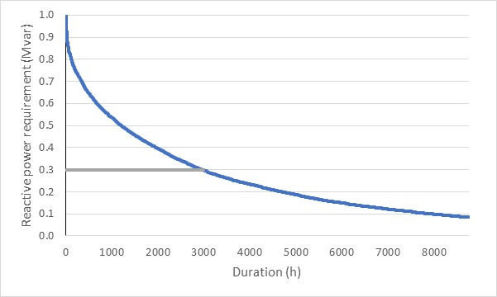
Illustrative Example of System Reactive Power Requirements
Market solution:
Transmission connected generators & DERs
STATCOM/SVC
Notes:
This curve shows an example of the reactive power requirement (Mvar) across time (h) and indicates the different options that are used to meet that requirement.

Slide 4
Trials budget and limitations
    Trial budget in Wave 2 (£350k). Wave 2 is mandatory
    Project commitment to 1800 “market hours”.
    Target Average Cost (TAC) will be used in assessment logic to ensure to remain within the budget limits and deliver market hours
    If on a rolling basis, actual costs incurred are equal to or less than the TAC, then there should be sufficient budget to ensure that the project commitment to 1800 “market hours” is met.
    However, if the rolling average cost is higher than the TAC, then this is an indicator that there may be insufficient budget to deliver 1800 market hours.
Notes:
This slide shows the main considerations and principles during Wave 2 and the need to work around a fixed budget by using a TAC (Target Average Cost) definition.

Slide 5
What is the Target Average Cost (TAC)?
Notes:
The curve on this slide is created from the Reactive Power requirement curve in the previous slide. We sorted the curve based on duration and got this new load-duration curve. On the x-axis we have time/duration and for this example we use 1800 h which correspond to the duration of the Wave 2 trials. On the y-axis we have the reactive power requirements in Mvar.
So, we have a reactive power requirement curve over the duration of the trials but, how do we know we are going to be OK within the budget?
On the y-axis we have the NG ESO reactive power requirement. E.g if the reactive power requirement is 80 Mvar, we can identify overall duration is 80 h over the market trial duration of 1800 h, and similarly for different reactive power requirements. It can be seen that the TAC for each of those requirements will be different, shorter duration means higher is the TAC and vice versa.

Slide 6
Average TAC calculations
TAC₁ x Q₁ + TAC ₂ x Q ₂ + TAC ₃ x Q ₄ + …TAC _{n} x Q _{n} = TOTAL TRIAL BUDGET
    In 1800 market (T) hours we have 300 EFA blocks, which means 300 variables (different TAC per each EFA block)
    In order to resolve that mathematical formula we introduce “reference TAC”
    We assume TAC in each EFA block depends linearly on duration and average TAC, TAC_{i}=(TAC x (T- duration_{i})/T))
    Replacing each variable with “reference TAC” will results in one equation with one unknown variable from which we calculate TAC for each EFA block
Notes:
In order to keep the trials within the budget we need to make sure that the sum of all TACs and reactive power requirements is equal to the total budget.
As we can see, we have a mathematical equation with 300 variables (one TAC for each EFA block). To solve this equation we introduce the reference TAC definition from which all other TACs can be calculated, as described in the slide.
Replacing each variable with the “reference TAC” will result in one equation with one unknown variable. From this, we can calculate the reference TAC and therefore TACs for each EFA blocks.

Slide 7
Example – How it works in trials?
1 week
    Ahead of the trial start we will have a TAC for each EFA period, for each day for all 1800 h market hours
    We will create a lookup table which we will be using during the trials for market assessment
    We will aim to share more information on a week ahead basis on:
        The various network conditions scenarios driving reactive power requirements
        TAC ranges (minimum and maximum and the likelihood of being accepted within that range)
Q 11 TAC1 1 | Q 12 TAC1 2 | Q 13 TAC1 3 | Q 14 TAC1 4 | Q 15 TAC1 5 | Q 16 TAC1 6
Q 21 TAC21 | Q 22 TAC22 | Q 23 TAC23 | Q 24 TAC24 | Q 25 TAC25 | Q 26 TAC26
Q 31 TAC31 | Q 32 TAC32 | Q 33 TAC33 | Q 34 TAC34 | Q 35 TAC35 | Q 36 TAC36
Q 41 TAC41 | Q 42 TAC42 | Q 43 TAC43 | Q 44 TAC44 | Q 45 TAC45 | Q 46 TAC46
Q 51 TAC51 | Q 52 TAC52 | Q 53 TAC53 | Q 54 TAC54 | Q 55 TAC55 | Q 56 TAC56
Q 61 TAC61 | Q62 TAC62 | Q 63 TAC63 | Q 64 TAC64 | Q 65 TAC65 | Q 66 TAC66
Q71 TAC71 | Q 72 TAC72 | Q 73 TAC73 | Q 74 TAC74 | Q 75 TAC75 | Q76 TAC76
Notes:
How this calculations will look in trials?
For each week ahead we will create a look up table (as shown in the slide). Based on system scenarios and duration of reactive power requirements, we will calculate the expected TAC for each EFA block for each week.
In practice, ahead of each week, we will know from this look up table what would be the TAC range (min-max) that we are willing to accept while being confident that we will stay within the trial budget. We will publish the TAC range only, ahead of the DER bidding process for the reactive power service.
The various network conditions scenarios driving reactive power requirements is likely to give providers informed position on estimate of reactive power requirements.
At the end of each week, we will publish the remaining budget, which will inform TACs limit for the next weeks.

Slide 8
Example – Week 1, EFA block 11:00-15:00, April 2021
    Via DERMS DERs will submit their bids day ahead for EFA block between 11:00-15:00
    From lookup table we read the reactive power requirements (e.g. 80MVAr) and corresponding TAC for that EFA block
    The total VPP offered from DERs is e.g. 120 MVAr
    How we determine which bids from VPP will be accepted?
DER A
30 Mvar
Bid £3/Mvar
DER B
40 Mvar
Bid £5/Mvar
DER C
50 Mvar
Bid £7/Mvar
Notes:
This is an example of the process in practice, considering three DERs: A, B and C who have offered different Mvar ranges at different £/Mvarh prices.
Knowing the requirement and the TAC for one EFA block, which bids would be accepted from the DER offered values? Note that NG ESO receives the DER bids as an aggregated virtual power plant (VPP) at the GSP.

Slide 9
Example – Week 1, EFA block 11:00-15:00, April 2020
              Calculation of actual costs for VPP :
            (30 Mvar x £3/Mvarh + 40 Mvar x £5/Mvarh +10 Mvar x £7/Mvarh)
            /Q requirements = £4.5/MVar/h
If actual costs for VPP is consistently > than “TAC” this means we will run out of the budget and NGESO needs to readjust the requirements or agree to accept the bids but monitor budget in the following rounds
The actual procurement levels will be driven by budget
If actual costs incurred are consistently equal to or less than the TAC, then there should be sufficient budget to ensure that the project commitment to 1800 “market hours” is met
This restriction does not exist in the established reactive market
Notes:
The generators in the previous slide are ranked by their bids (A < B< C). To meet the system requirements, we are taking everything from generators A and B and 10 Mvar remaining from generator C.
Based on that assumption, we will calculate actual costs for VPP. In this case, it is £4.5/Mvar/h.
By comparing the actual costs for the VPP with the TAC we will have an indication on the health of the budget.

Slide 10
Cost Curves for Q service
    Commercial information presented to NGESO as 10 VPPs (or bands) per GSP (.cvs file with 10 rows). Band 10 contains all the DER in a GSP, it is constructed first and then broken into smaller bands.
    VPP contains effective GSP reactive power volumes (lead/lag), maximum volumes and associated costs
    Procurement decision for one VPP in line with system requirements
Parameters of each VPP:
Band ID
Band lead Mvar (and associated lag)
Band lag Mvar (and associated lead)
Band Maximum lead Mvar
Band Maximum lag Mvar
Band availability cost £/h
Band utilisation cost £/h
Band maximum utilisation cost £/h
GSP
…
…
VPP 1
DER 1
…
VPP 5
DER 1, …, j
…
VPP 10
DER 1,…,N
Notes:
This slides covers the details of how the VPP is characterised, defining the Mvar capabilities and the associated costs.
NG ESO receives 10 VPP options per GSP of increasing size and cost. Band 10 (VPP 10) will contain all the DERs in a GSP. Only one of the VPPs received will be nominated, following the approach with TAC assessment explained in the previous slides.

Slide 11
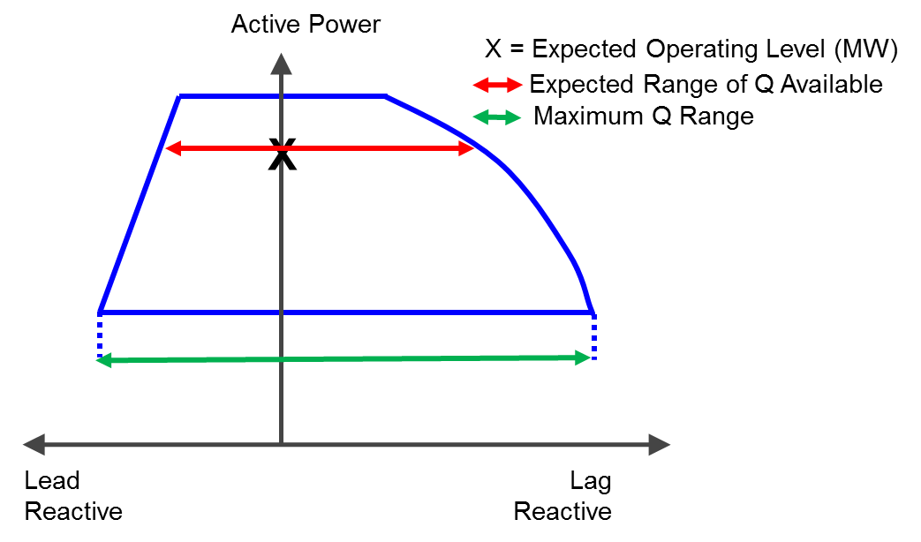
Cost Curves for Q service
      Cost curve construction:
      Availability cost (£/h) is evaluated for the Maximum Q range of the DER in the band.
      Expected utilisation cost (£/h) is evaluated for the band volume within the Expected Range of Q available of the DER in that band and using an expected utilization % .
      NGESO does not receive information on the provider’s technical capabilities or individual prices.
Notes:
This slide highlights some important aspects in the VPP construction and how the availability and utilisation costs are evaluated, respectively, on the maximum Q range and on the expected reactive range of each DER.

Slide 12
Example: Cost curve for GSP with 3 DER (lead req.)
Band ID | Band lead Mvar | DER rank by expected cost | DER procured
1 | 4 | A < C < B | A
… | … | … | …
5 | 20 | A < C < B | A, C
6 | 24 | A < B < C | A, B
7 | 28 | A < B < C | A, B
8 | 30 | A < B < C | A, B
9 | 36 | A < B < C | A, B, C
10 | 40 | A < B < C | A, B, C
DER A
16 Mvar lead
(expected range)
DER B
18 Mvar lead
(expected range)
DER C
10 Mvar lead
(expected range)
DER A has cheap availability and utilisation costs. DER B has high availability and cheap utilisation costs. DER C has cheap availability and high utilisation costs.
Notes:
The DER bids availability and utilisation costs for the unit. NG ESO will determine by system conditions how much time of available reactive power will be utilised (i.e. expected utilisation factor). Depending on that, we will create a blended availability an utilisation unit costs on which DERs will be ranked (i.e. forecasted cost). For different bands (or VPP) the ranking order might be different depending on how the volume of the band is met by the cheapest DER combination.

Slide 13
    Examples of Reactive Power Requirements Scenarios
 | Scenario | Factors | Pre-fault capability (%) | Post fault capability (%)
1 | High Voltage | Demand/ generation High import/ export from IC | 100 | 100
2 | High Voltage | Demand/ generation Low import/ export from IC | 100 | 0
3 | Medium Voltage | High import/ export from IC | 50 | 100
4 | Medium Voltage | Low import/ export from IC | 50 | 0
5 | Low voltage | High import/ export from IC | 0 | 100
6 | Low voltage | Low import/ export from IC | 0 | 0
Notes:
Those examples show the potential system requirements that could be expected on the system and the amount of reactive power that NG ESO would like to buy pre fault and post fault depending on system conditions. E.g. for high demand and generation and high import from interconnectors the requirement is for full lead and lag capability. This examples form a basis for our trial scenario cases, which will allow us to drive the procurement requirement.

Slide 14
Assessment Process
Start Assessment
(lead and lag requirements)
Start with max band
Calculate forecast cost, procured volume and forecast price
No
Band exhausted?
Yes
Zero Solution found
Forecast price <= Max Acceptable Price (TAC)
Move to lower band
No
Yes
Solution found
Return :
Forecast cost
Sanction cost
Procurement band
Notes:
This slide covers the different steps in the assessment process, evaluating the requirement starting from the largest band (VPP). From this, there is an iterative process to meet the requirement while keeping within the TAC.

Slide 15
Example of Assessment process
STEP 1: NG ESO Lead requirement = 50, Lag requirement = 0
STEP 2: Consider Band 10
Step 3: Forecast Cost = Availability Cost + Utilization Cost = 100 + 101 = 201
STEP 4: Procured Volume = Q lead+ Q Associated Lag = 50 + 20 = 70
STEP 5: Forecast Price = Forecast Cost / Procured Volume = 201/70= 2.87
STEP 6: TAC = 2.5
STEP 7: If (Forecast Price > TAC ) then consider band 9 and repeat from STEP 3
STEP 3_1: Forecast Cost = Availability Cost + Utilization Cost = 100 + 87 = 187
STEP 4_1: Procured Volume = Q lead+ Q Associated Lag = 45 + 36 = 81
STEP 5_1: Forecast Price = Forecast Cost / Procured Volume = 187/81= 2.31
STEP 6_1: TAC = 2.5
STEP 7_1: If (Forecast Price < TAC go to step 8
STEP 8_1: Solution found:
  Procurement Band 9
  Sanction Cost = Availability Cost + Max Utilisation Cost =100 + 175 = 275
Notes:
Finally, this slide shows the step by step calculation of an illustrative example with some test values.

