Slide 1
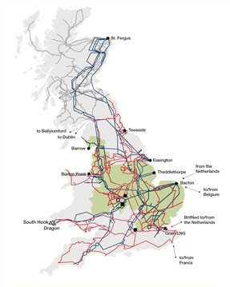
GSR022: Review of Security and Economy Planned Transfer Conditions
Scope and Terms of Reference
1

Slide 2
Contents
Background
Scope of the Workgroup
Review of Security Planned Transfer Conditions
Review of Security Economy Transfer Conditions
Timescales
Discussion
2

Slide 3
Background
3

Slide 4
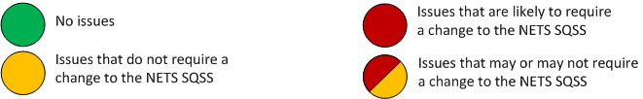
Background
1
4

Slide 5
Background
Under the defined background assumptions, there is not enough/ a lot more generation which leads to unreasonable assumptions to be made.
Not familiar with the operational regimes of some new generation technologies.
The assumptions made on contributions from different types of generation maybe out of date. Some are not modelled at all.
The inclusion of Small and Medium Embedded Power Stations in the Security and Economy background is subject to interpretation.
Lack of BM participants make certain boundaries inoperable.
1
5

Slide 6
Background
Three groups with almost the same workgroup members
Issues 1 and 3
GSR022: Review of Security and Economy Planned Transfer Conditions
Issues 4 and 5
GSR016
Small and Medium Embedded Generation Assumptions
Issues 2
The SO/TOs need to keep their assumptions up to date.
Provisionally internal workgroup within NGET.
Seeking input from /collaboration with Scottish TOs via the JPC as required.
Updates to the JPC and NETS SQSS Review Panel as necessary.
1
6

Slide 7
Scope
Workgroup to address issues related to
security background
economy background
arising from
Generation Technology
Availability of Generation
These issues are
Under the defined background assumptions, there is not enough/ a lot more generation which leads to unreasonable assumptions to be made.
The assumptions made on contributions from different types of generation maybe out of date. Some are not modelled at all..
7

Slide 8
Scope of the Workgroup
Two separate work streams
Security Planned Transfer
  Decision driven by availability of generation, their operational regimes, and the risk of not being able to supply demand due to network constraints.
  Some analysis is required
Economy Planned Transfer
  Decision mainly economic
  Required understanding of the operating regimes for different types of plants
  Comprehensive statistical analysis and Cost Benefit Analysis studies are necessary
  The introduction of an additional background should not be ruled out at this stage
It is proposed that the Workgroup reports on each work stream separately.
1
8

Slide 9
GSR022- WS1:
Security Planned Transfer Conditions
What is it that we are trying to achieve, and what are the expectations of our stakeholders?
Providing transmission capacity to ensure that the peak demand can be supplied by generation that might be available in a different part of the network
vs.
Providing transmission capacity to ensure that the peak demand can be supplied by generation that we are 100% certain is available
Potentially a criteria that applies differently for different areas could be used (large vs small area or importing vs exporting area)
9

Slide 10
GSR022- WS1:
Security Planned Transfer Conditions
Review of the Straight Scaling Technique (Could be an interim position)
Review of assumptions on Interconnectors
Review of assumptions on other generation types
A view on Demand Side Management
10

Slide 11
GSR022- WS2:
Economy Planned Transfer Conditions
  Is a need to change existing scaling factors?
  What is the most suitable way to model new technologies (solar, storage, …etc.)?
  What is the level to which all types of generation should be dispatched at?
  How to address scenarios with generation being in excess of demand?
Has there been any change to assumptions that were used to specify the current scaling factors?
To what extent did the CPA conducted by the GSR009 workgroup consider different boundaries.
Is there any discrepancy between the methodology used by GSR009 workgroup and that used by different TOs to support the need case for their investment?
Is there any discrepancy between the methodology used by GSR009 workgroup and NOA?
Do we need a new set of Planned Transfer Conditions or is it sufficient to modify the Economy Planned Transfer Conditions?
What methodology should we use for CPA?
What scenarios should be covered by the CPA?
What are the “new” scaling factors?
What data do we have regarding all different types of generation
What are the advantages/disadvantages of a locational criteria (large vs small area or importing vs exporting area)
11

Slide 12
Timescales
  WS-1: 12 Months
  WS-1: 24Months
  First meeting: Early to mid December
12

Slide 13
Discussion

