Slide 1
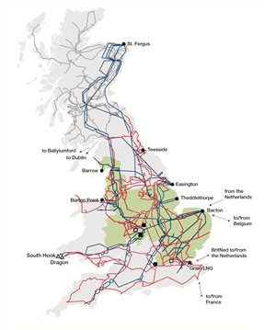
GSR022: Review of Security and Economy Required Transfer Conditions
WS1 Security Background
1

Slide 2
WS1- Contents
The methodology
  Ranking Order technique
  Direct Scaling technique
  Interconnection Allowance
Generation assumptions:
  Interconnectors
  Renewables
  Battery storage
Demand Side Management assumptions
  Contracted DSM resources
  Emergency DSM resources OC6
2

Slide 3
GSR022: Review of Security and Economy Backgrounds
WS1- Security Background: The Methodology
3

Slide 4
WS1- Ranking Order Technique
Today
Power Stations ranked according to the likelihood of them running at the time of the ACS Peak Demand
A total capacity of just below 120% of demand is assumed to be contributory
The rest of the plants are assumed non-contributory
Moving Forward
Continue with the same assumptions unless any other change in Appendix C dictates a change to this methodology
4

Slide 5
WS1- Direct Scaling Technique
Today
Use the availability factors to decide which power stations would be available
Scale the capacity of this generation to meet the demand
No issues when
MW Available is > MW Required
Demand may be at risk when
MW Available is < MW Required
Moving Forward
Need to ensure the network does not unduly restrict generation from meeting the demand.
5

Slide 6
WS1- Direct Scaling Technique
How to Balance Generation and Demand when there is not enough generation?
Option 1
Scale Generation up to meet demand.
Option 2
Scale demand down to match generation.
Where to apply the change?
Where existing generation is
Where demand is
In the smaller zone
In the larger zone
In the importing zone
In the exporting zone
6

Slide 7
WS1- Direct Scaling Technique
Factors that need to be considered
What would be the maximum unserved demand (MW and MWh)?
How long would this last for (how many minutes in the day)?
How much additional capacity would need to be provided?
How does this interact with the Interconnection Allowance?
Does the increase in CapEx balances the value of lost load?
Implementation of the change
No change required;
Change the direct scaling technique; or
Change the Interconnection Allowance
7

Slide 8
WS1- Interconnection Allowance
Today
Calculate the sum of Generation and Demand in the Smaller Area
Use this sum to calculate an Interconnection Allowance using the “Circle Diagram”
Moving Forward
There are no clear issues with the current method to calculate the Interconnection Allowance.
However, there may be a need to modify it to fit in one of the solutions proposed to resolve issues with the “Direct Scaling Technique”
8

Slide 9
GSR022: Review of Security and Economy Backgrounds
WS1- Security Background: Generation Assumptions
9

Slide 10
WS1- Security Background: Interconnectors
Today
GSR009 Workgroup could not establish a consistent pattern in historic interconnector flows.
The workgroup recommended that all interconnectors be set to zero.
Moving Forward
Assuming there is enough generation, does this “0” assumption impose any risk to demand security?
Are there any better assumptions?
10

Slide 11
WS1- Interconnectors
Does this “0” assumption impose any risk to demand security?
Studies
Peak Y Analysis looking at sensitivities with permutations on interconnector flows.
Analysis
Does the “planned transfer” and/or the “required transfer” resulting from any of the sensitivities exceed the capacity that should be delivered by the existing dual criteria
11

Slide 12
WS1- Interconnectors
Are there any better assumptions?
What is the most likely flow on a specific interconnector at ACS Peak Demand under security background assumptions?
What factors drive/affect this flow
How confident are we that this flow will take place?
Are there any “non-commercial” factors, e.g. potential failures, that need to be taken into account?
12

Slide 13
WS1- Interconnectors
Are there any better assumptions?
What are the main characteristics distinguishing both markets?
Peak Demand
Geographical spread (km²)
Generation mix
  Base load generation
  Peak lopping generation
  Renewables (What is the minimum expected level of renewable generation?)
  Generation that sets the marginal price (if any)
What are the factors that drive the marginal price down/up in each market?
13

Slide 14
WS1- Interconnectors
Are there any better assumptions?
Under the Security Planned Transfer Conditions, what would be the marginal price in GB?
What factors could push the marginal price in the “Other Market” to a value higher than that in GB?
What is the likelihood of these conditions happening at times when the Security Planned Transfer Conditions take place in GB?
14

Slide 15
WS1- Interconnectors
Are there any better assumptions?
How likely is it that interconnector flows could equalise the marginal price in the two markets?
How likely would there be a technical restriction on the interconnector capacity (e.g. RoCoF constraint, cable/converter failure, outage on the other side , etc.)
15

Slide 16
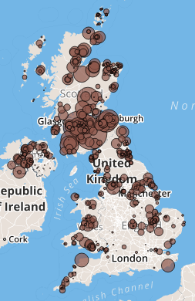
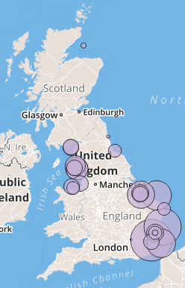
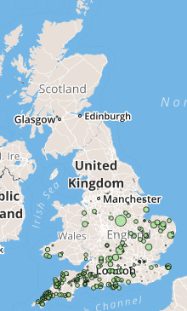
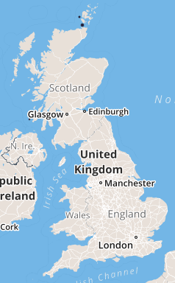
WS1- Renewables
Today
Zero output
Moving Forward
Have we reached enough level of wind (both in capacity and geographical spread) to allow us to model it at an output level higher than 0%?
Wave/Tidal have not reached enough capacity/spread yet!
It is unreasonable to assume that solar generation will be contributing towards meeting the ACS Peak Demand.
Map of wind, solar, and wave/tidal
Onshore Wind
Offshore Wind
Solar
Wave
16

Slide 17
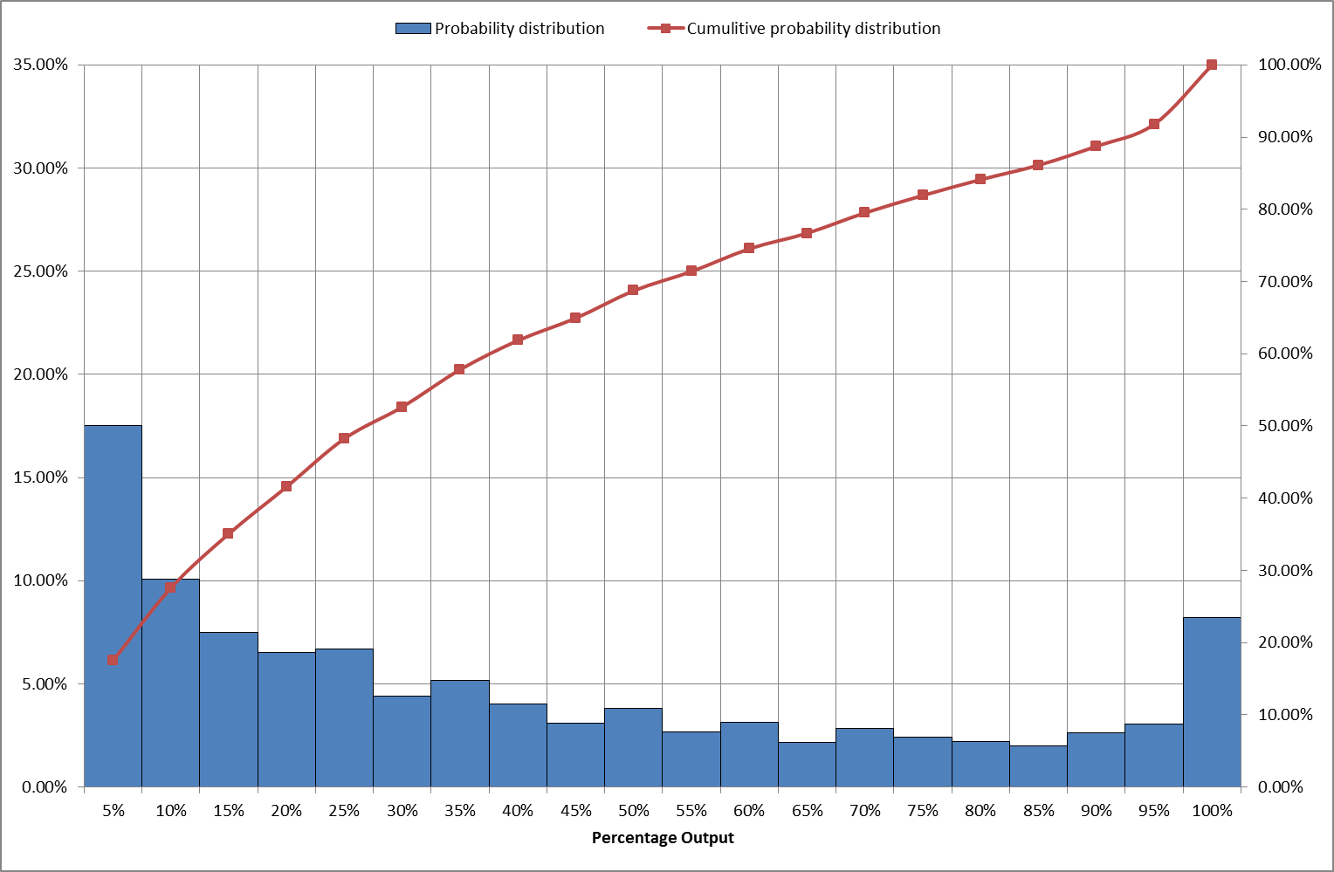
WS1- Renewables (Wind)
Have we reached enough level of wind (both in capacity and geographical spread) to allow us to model it at an output level higher than 0%?
Can we produce the probability distribution on the right for the following?
1 turbine
Several turbines spread over 1km² area
Several turbines spread over 10km² area
Several turbines spread over 100km² area
Several turbines spread over GB
Probability distribution for the percentage output of a windfarm
Winter
17

Slide 18
WS1- Renewables (Wind)
Have we reached enough level of wind (both in capacity and geographical spread) to allow us to model it at an output level higher than 0%?
Based on the previous plots, can we find what the “minimum guaranteed wind output” in GB is going to be?
If we use this value, would we put high wind generation/low demand areas, e.g. North of Scotland, under risk?
Would we be willing to use two different levels of wind output (large zone vs small zone – importing zone vs exporting zone)
Probability distribution for the percentage output of a windfarm
Winter
18

Slide 19
WS1- Security Background: Storage
Today
Pumped storage are considered contributory
Other storage is not explicitly modelled
Moving Forward
We need better assumptions on all types of storage that are likely to contribute towards demand security.
How likely is it that storage would run under the Security Background conditions?
At what output level would storage be running?
19

Slide 20
WS1- Security Background: Storage
How likely is it that storage would run under the Security Background conditions?
What are the revenue drivers for storage?
How can we identify which storage providers will trade in the energy market?
Based on the energy prices expected under the Security Background conditions, would these storage providers be willing to sell electricity?
At any time, what percentage of these would be available?
Is there any technical/or commercial reason that would prevent them from selling the total capacity stored in them?
20

Slide 21
GSR022: Review of Security and Economy Backgrounds
WS1- Security Background: DSM Assumptions
21

Slide 22
WS1- Security Background: Demand Side
Demand Side Contracts
OC6 Instructions
Fulfilled by means of standby generation that and storage devices.
Should already be included in FES backgrounds and W24 submissions.
No need to model these separately as they are already accounted for.
These are a form of emergency instructions that should be enacted when there is not enough generation (rather than not enough network capacity)
Initial proposal is not to take these into account when designing the system.
22

Slide 23
WS1- Security Background: Discussion
23

