Slide 1

Data for GC0096
Ultra capacitors -002
Eric A Lewis Enstore director
Issued 03-04-2017 Electricity storage Ultra Capacitors – Issue 002 Slide

Slide 2
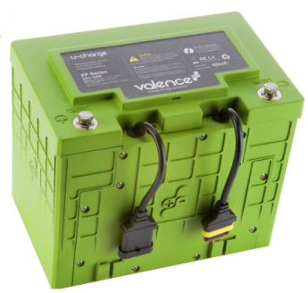
Electricity storage using DC batteries
AC bus
Inverter’s DC bus
DC batteries
Diodes
AC
inductors
CB
Transformer
Fast switching devices
AC supply inverter
Interface parts
Typical data :
The DC batteries can not be directly connected to the AC bus.
The circuits shown, in a simplified form, is based on using a standard low voltage inverter.
The inverter’s DC bus voltage is varied to control the battery’s power flow.
This is now a widely used design especially with higher voltage batteries.
Batteries are used in series and parallel depends on the required power and energy.
Issued 03-04-2017 Electricity storage Ultra Capacitors – Issue 002 Slide

Slide 3
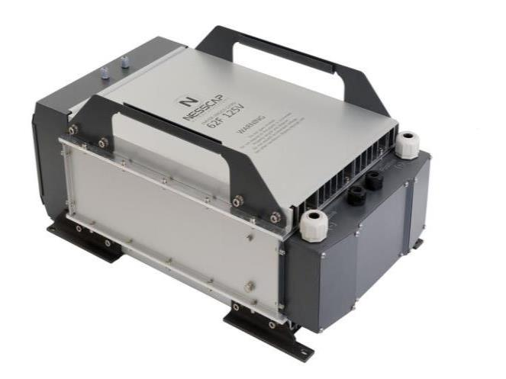
Electricity storage using Ultra capacitors
AC bus
Inverter’s DC bus
Ultra capacitors
Diodes
AC
inductors
CB
Transformer
Fast switching devices
AC supply inverter
Interface parts
Typical data :
The Ultra Capacitors are only DC rated and can not be directly connected to the AC bus.
The circuits shown is the same as used for DC batteries.
Ultra capacitors do not need a special class in the Grid Code.
Issued 03-04-2017 Electricity storage Ultra Capacitors – Issue 002 Slide

Slide 4

Thank you
Issued 03-04-2017 Electricity storage Ultra Capacitors – Issue 002 Slide

