Slide 1

Data for GC0096
Flywheels - 002
Eric A Lewis Enstore director
Issued 03-04-2017 Electricity storage flywheels – Issue 002 Slide

Slide 2
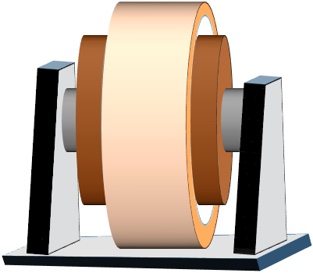
Basic Flywheel option -1
Onshore Transmission System
Grid Entry
Points
Has zero power at df/dt = 0.
This is not compatible with Grid Code Electricity Storage.
Power Station
Bus bar
Flywheel
Stator
Power Station
Issued 03-04-2017 Electricity storage flywheels – Issue 002 Slide
2

Slide 3
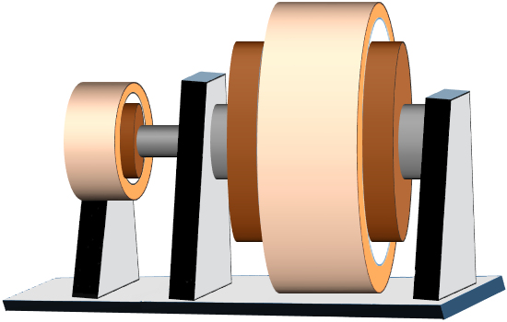
Basic Flywheel option - 2
Onshore Transmission System
Grid Entry
Points
Power Station
Bus bar
Has a power at df/dt = 0.
This is compatible with Grid Code Electricity Storage.
Flywheel
Motor
Stator
ESU
Power Station
Issued 03-04-2017 Electricity storage flywheels – Issue 002 Slide

Slide 4
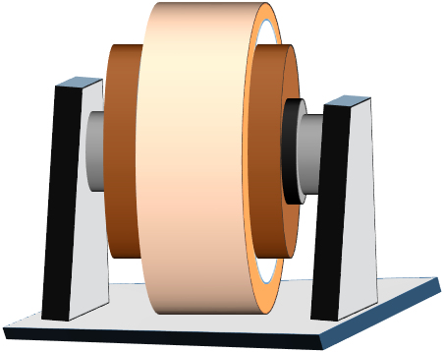
Advanced Flywheels - 1
Compatible with Grid Code Electricity Storage.
Onshore Transmission System
Onshore Transmission System
Grid Entry Point
Power Station
Bus bar
Power Station
Power Station
Bus bar
Power Station
Main Power
Converter
Main Power
Converter
Flywheel
Flywheel
Stator
Stator
Field Power
Converter
Synchronous motor + flywheel
Induction motor + flywheel
Issued 03-04-2017 Electricity storage flywheels – Issue 002 Slide
4

Slide 5
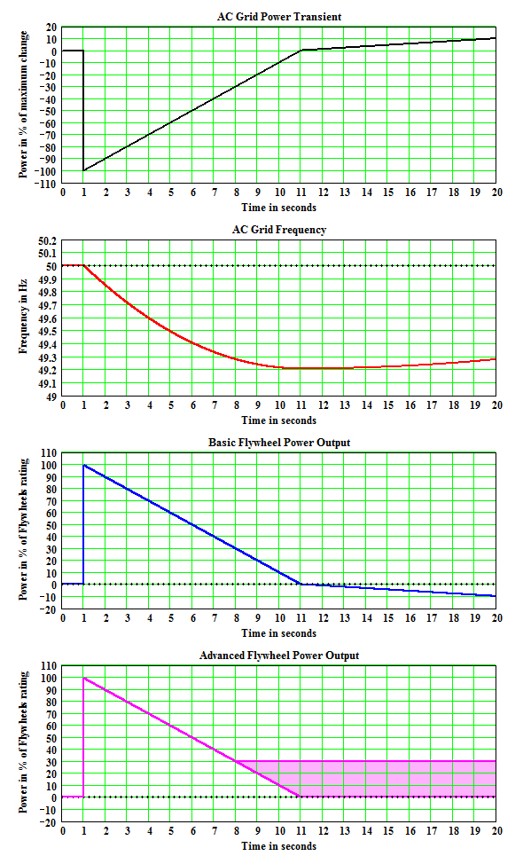
Advanced Flywheels - 2
Onshore Transmission System
Grid Entry Point
Power Station
Bus bar
Power Station
Flywheel
Stator
Field Power
Converter
Adjustable in this range
Synchronous Flywheel Type 2
Has zero power at df/dt = 0.
This is not compatible with Grid Code Electricity Storage.
Synchronous with inertia
Choice
Asynchronous with power to aid recovery
Issued 03-04-2017 Electricity storage flywheels – Issue 002 Slide

Slide 6

Thank you
Issued 03-04-2017 Electricity storage flywheels – Issue 002 Slide
6

