Slide 1
Agenda TSOG 8th November
10.00-10.20 TSOG Legal Interpretation
10.20-10.40 Ofgem Update
10.40-11.10 GC0095: Issues Tracker – Review by Exception
11.10-11.15 Comfort break
11.15-12.00 TSOG Entry into Force requirements
12.00-12.20 Scope Data Exchange and Operational Planning
12.20-12.30 AOB/next meeting
12.30 Lunch

Slide 2
Data Exchange

Slide 3
Structure of TSOG & Data Exchange
TSOG is structured as follows:
Parts (II: Operational Security)
Titles (2: Data Exchange)
Chapters (1-6 based on which party)
Articles (40 – 53)
Data exchange Title is grouped by whom data exchanged is with, which customer

Slide 4
Categories of data exchange in TSOG
Structural
Topology
Technical data on plant
Scheduled (SGUs)
Forecasted active power output & reserves
Availability or scheduled unavailability
Forecasted restriction in reactive power control capability
Real-time
Frequency
Active & reactive power
Voltages
Aggregated generation

Slide 5
TSO-SGU Data Exchange
Structural
Scheduled
Real-Time
Type B, C, D
Type B, C, D
General data – installed capacity & primary energy source
Cold & warm start times
Short-circuit calculation data
Transformer data
FCR, FRR or RR data
Restoration data
Dynamic simulation data
Protection data
Voltage & reactive power control capability
Position of Circuit Breakers at connection point
Active and reactive power at connection point
Net active and reactive power*
* In the case of power generating facility with consumption other than auxiliary consumption
Active power output & reserves amount and availability*
Scheduled unavailability or active power capability restriction
Forecast restriction in the reactive power control capability
* Day-ahead & Intraday
Type B, C, D

Slide 6
TSO-HVDC Data Exchange
Structural
Scheduled
Real-Time
Name plate data
Transformer data
Filters & filter bank data
Reactive compensation data
Active power control capability
Reactive power & voltage control capability
Active or reactive operational mode prioritization
Frequency response capability
Dynamic model data
Protection data
Fault ride-through capability
Active power schedule & availability*
Scheduled unavailability or active power capability restriction
Forecast restriction in the reactive power or voltage control capability
* Day-ahead & Intraday
Position of Circuit Breakers
Operational status
Active & reactive power

Slide 7
Demand Facilities - Tx
Structural
Scheduled
Real-Time
Electrical data of transformers
Load characteristics of the demand facility
Reactive power control characteristics
Active & forecast reactive power consumption*
Schedule of its structural minimum and maximum power to be curtailed**
Forecast restriction in the reactive power or voltage control capability
* Day-ahead & Intraday
** In the case of DSR participation
Active & reactive power at the connection point
Minimum and maximum power range to be curtailed.
Behaviour at the voltage ranges specified by the TSO

Slide 8
Demand Facilities - Dx
Scheduled
Real-Time
Structural minimum and maximum active power available for DSR
Maximum and minimum duration of any potential usage of this power for DSR
Forecast of unrestricted active power available for DSR
Real-time active and reactive power at the connection point
Confirmation that the estimations of the actual values of DSR are applied

Slide 9
TSO-TSO Data Exchange
Structural
Real-Time
Substation topologies
Transmission line technical data
Transformer data
Max and min active & reactive power
Phase-shifting transformer data
HVDC data
Reactors, Capacitors & static VAR compensators
Operational security limits
Synchronous Area
Frequency
FRCE
Aggregated generation infeed
System state
Power exchange via virtual tie-lines
Substation topologies
Bay active & reactive power
Regulating positions of transformers
Busbar voltage
Restrictions on active & reactive power supply
Reactive power from Capacitor, Inductor or static VAR compensator
Observability Area

Slide 10
TSO-DSO Data Exchange
Structural
Real-Time
Substations
Lines connecting substations
Transformers from substations
SGUs
Reactors & Capacitors in substations
Total aggregated generation capacity & related frequency data
* Provide update on data at least every 6 Months.
Substation topologies
Bay active & reactive power
Tap positions of transformers
Busbar voltage
Restrictions on active & reactive power supply
Reactive power from Capacitor, Inductor or static VAR compensator
Aggregated generation in DSO area
Aggregated consumption in DSO area

Slide 11
Data Exchange timelines
Entry into Force (EIF) is expected ~Jan 17
Whole of data exchange Title applies 18 months after EIF
BUT that includes time needed for NRA approval, which is 6 months so
Data exchange requirements must be decided by Jan 18*
*That date includes consultation with industry
However certain details must be decided with ‘All TSOs’ within 6 months after EIF; see article 40.6

Slide 12
Relevant concepts
SGUs
Flexibility
Reserve types
Significant Grid Users: scope of who this code applies to
Article 40.5 gives wide ‘wiggle room’ to apply the data requirements appropriately
Makes reference to other part of TSOG which details different types of reserves

Slide 13
Relevant concepts – cont’d
Observability area
Multiple TSOs
In UK there are multiple ‘certified’ TSOs to whom this code could apply to.
Concept of ‘how far’ into other peoples networks you need sight of

Slide 14
SGUs
Article 2.1 sets the scope for the whole code
existing and new power generating modules classified as type B, C and D in accordance with the criteria set out in RfG
existing and new transmission-connected demand facilities;
existing and new transmission-connected closed distribution systems;
existing and new demand facilities, closed distribution systems and third parties if they provide demand response directly to the TSO in accordance with the criteria in DCC
providers of redispatching of power generating modules or demand facilities by means of aggregation and providers of active power reserve in accordance with Title 8 of Part IV of this Regulation; and
existing and new high voltage direct current ('HVDC') systems in accordance with the criteria in HVDC

Slide 15
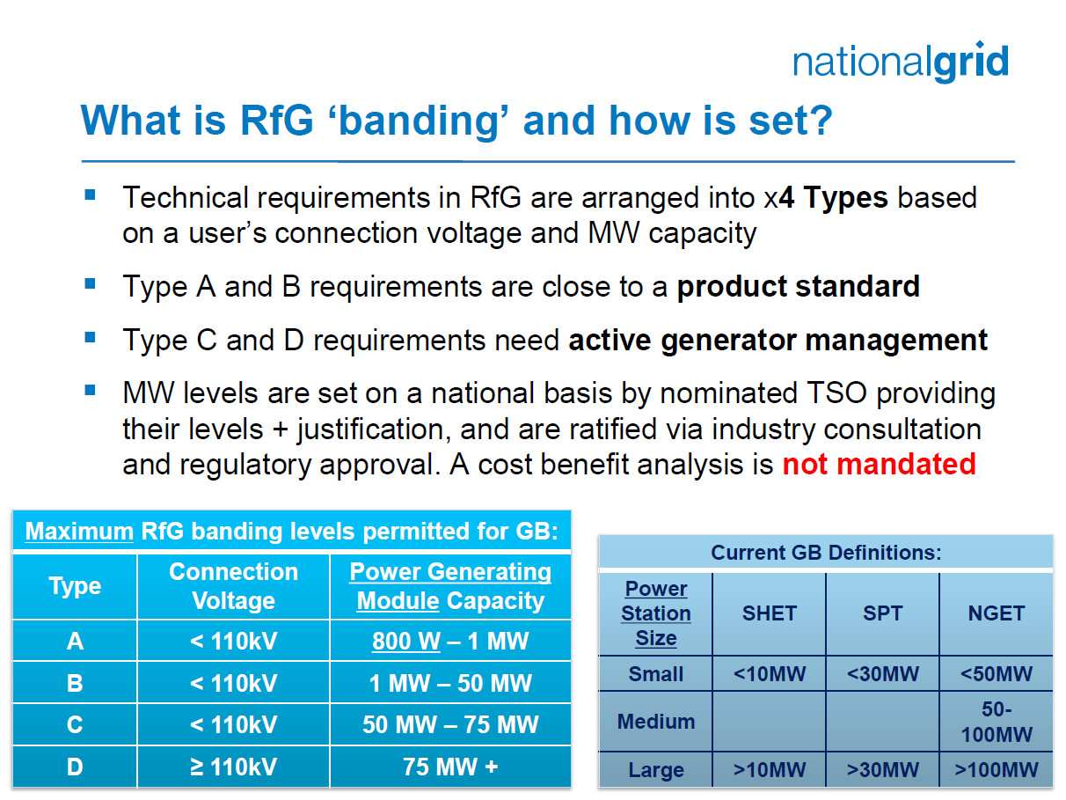
SGUs

Slide 16
Article 40.5 - flexibility
In coordination with the DSOs and SGUs, each TSO shall determine the applicability and scope of the data exchange based on the following categories:
  structural data in accordance with Article 48;
  scheduling and forecast data in accordance with Article 49;
  real-time data in accordance with Article 44 and Article 50; and
  provisions in accordance with Article 47, 51, Article 52 and Article 53.

Slide 17
Operational Planning

Slide 18
Operational Planning
Relevant Assets
A part of the network or SGU connected to the TSOs network that has a large enough degree of influence to be considered for Cross Boarder Outage Coordination. Note – the level of influence is not yet defined.
Article 75
Methodology for coordinating operational security analysis
Article 84
Methodology for assessing the relevance of assets for outage coordination

