Slide 1




Welcome to
Introduction to CfD Allocation Round 8

Slide 2
Introduction to the day

Slide 3


CfD delivery partners
Registration
Qualification
Reviews
Allocation
Minor and Necessary modifications
CfD Counterparty
Appeals
DB Regulation
Policy
Regulations

Slide 4
Agenda
10:00​ | Welcome and today’s agenda​ | DESNZ
10:05​ | Policy context, changes for AR8, forward look, key dates | DESNZ​
10:25 | NESO overview (CfD process, registration, application, allocation)​ | NESO​
11:10 | ***Break***
11:20 | Key CfD terms and signing process (M&N, pre-bidding, post-allocation) | ​LCCC
11:50 | Disputes | Ofgem
12:00 | *** Break *** | ​
12:05 | Q&A panel | All
12:30 | Wrap-up, key takeaways and close | ​DESNZ

Slide 5


Context
Main Changes for AR8
Supply Chain Requirements
Timings

Slide 6

Context
We have an ambition to achieve Clean Power by 2030
We have Carbon Budget 6 commitments​
We are guided by our statutory objective to deliver for consumers
Price is as central a focus for us as it was in AR7.

Slide 7
Main CfD Changes for AR8
Hybrid metering
Hybrid metering for single technology/multiple commercial arrangements will be enabled
Eligibility requirements
Applications with Gate 1 connection offers will be excluded from participating in AR8
Setting budgets
Visibility of bids will be extended to solar PV and onshore wind (including remote island wind), alongside offshore wind.
As with AR7, we will publish a budget in advance of the sealed bid window for all technologies.
The Secretary of State may increase this budget following sight of bids, if it presents good value for money for consumers.
This will allow CfD and merchant assets of the same technology to share metering infrastructure.
Legislative changes to allow NESO to correct errors, or consider new documentary evidence during the Tier 1 review
New technology category for Other Deepwater Offshore Wind (ODOW) will be introduced.

Slide 8
Timings
6 July 2026
Statutory notices published
20 July 2026
Allocation Round Application Window opens
7 August 2026
Closure of Allocation Round Application Window
17 September 2026
Qualification Assessment Window
Earliest possible Budget Notice publication
19 November 2026
Latest possible Budget Notice publication
27 November – 1 December 2026
Earliest possible notification of results
15 – 17 February 2027
Latest possible notification of results
10 August – 16 September 2026
6 – 10 July 2026
Minor & Necessary Modification request window

Slide 9
Supply chain requirements
For onshore wind and solar CfD units equal to and above 300MW in capacity, applicants must present a Supply Chain Plan Statement to enter the CfD auction.
For fixed offshore wind and floating offshore wind units, regardless of capacity, applicants must present a Clean Industry Bonus Statement to enter the CfD auction.

Slide 10
Contracts for Difference
CfD Team
Allocation Round 8

Slide 11
Contents:
Introduction
Contracts for difference Process Overview
Registration/Single Sign On
Application & Qualification
AR8 Policy Changes / Updates
Allocation / Auction
Future Engagement

Slide 12
Introduction
Richard Griffiths

Slide 13
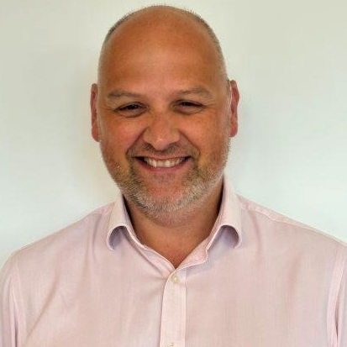
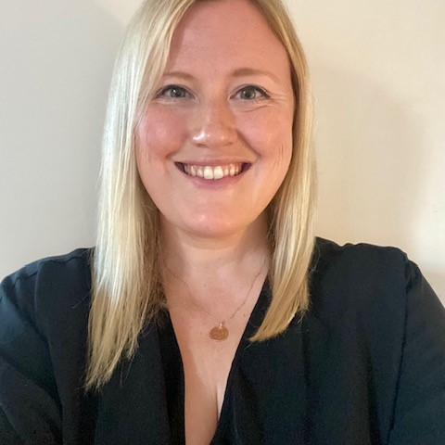






The Contracts for Difference (CfD) team
NESO runs the Electricity Market Reform (EMR) Delivery Body. We are responsible for the operational delivery of the CfD scheme.
Richard Griffiths
Becky Thomas
Helen Cox
You can contact our team via phone or email at any stage excluding the below windows, details of which you can find on the timeline:
Assessment window
Tier One Dispute Assessment Window
Allocation and Independent audit
Telephone – 01926 655 300 – Open 9am to 4pm
E-mail – box.emr.cfd@neso.energy
Mike Royle
George Hunt
Jatinder Sembi
Marina Kranyez
Helen Mukkara

Slide 14
CfD Delivery Body Responsibilities
The Delivery Body manages the Allocation round using the CfD Portal
We will assess and qualify/disqualify applications, notifying applicants of the decision of qualification​
  We use the policy (Allocation Framework) written by DESNZ to carry out this activity
We will determine the outcomes of Tier 1 Disputes
  Again, using the same policy to come to a decision on whether we can overturn our initial assessment
Throughout the Allocation round the Delivery Body provide DESNZ & the Secretary of State with valuations of all applications​
We will coordinate the CfD Allocation process​ and produce reports as required by Delivery Partners (DESNZ, OFGEM & LCCC)​
Finally, we provide LCCC with the information necessary to offer a CfD contract to successful Applicants

Slide 15

Single Sign On (SSO) from 2nd July
What does it mean for AR8?
From 2nd July, all Users (existing and new) will need to register for a NESO account to gain access to the EMR CfD Portal
The CfD login page has been modified to reflect the new process
Modification of the User login process via SSO, a customer's email address is their User ID (no more password and Pin)
Once in the Portal, introduction of a Switch Profile feature to help Users manage multiple IDs associated with the same email address
The Managing Login Credentials function has been removed from the User Management section in the Portal as this is no longer applicable under CIAM
Changes with regards to certain email notifications triggered at Company Registration and User Management levels prompting registration for a NESO account. For instance, when creating users and amending email addresses
We are introducing SSO, following customer feedback and aligning with wider NESO Single Sign On solutions.

Slide 16
Key Messages from the CfD Team
The Portal opens for registrations on 2nd July. The introduction of Single Sign On (SSO) will make your first login a longer process, don’t leave this to the last minute and contact us with any issues
You must register your company within the CfD Portal before being able to submit an Application (unless previously registered) – don’t leave this too late
For those previously registered, please ensure your contact details are updated before the application window opens
Read the CfD guidance and Schedule 5 eligibility requirements before applying
  Ensure all necessary documents are available
  Take note of the common failure reasons within the slide pack
Having read the guidance and supporting material, if outstanding questions remain, contact the CfD team as early as possible to clarify understanding. The application window can become busy with queries so you may have to wait longer for a response in this window.
We endeavour to respond to all queries as quickly as we can, but we are a small team so please don’t leave your queries to the last minute
Don’t leave your application to the last minute

Slide 17
The CfD Process
Notes:
Thank you Richard,
So good morning everyone, I’m Helen Cox and I’m the Senior Analyst for the CfD Team. I’m going to walk you through a few process steps, some key messages, and then hand over to my colleague Stuart for a change summary, and then Jat for an Auction walk through.

Slide 18

AR8 Application Process
This section will cover:
New: User Group
Company Registration
What the CfD Application process looks like and key dates;
Key information sources;
How the Delivery Body can help you;
Main eligibility checks;
Common reasons Applications fail;
What good looks like;
What happens after submission
What Applicants need to know

Slide 19

CfD User Group
A new structured forum bringing together a representative group of CfD Applicants.
Designed to provide direct, ongoing feedback on the Application process, guidance, and tools.
Focused on capturing real user experience across different technologies and project types.
What are the goals:
Improve complex customer journeys
Enhance guidance and usability
Inform future improvements to the portal and processes
Support more inclusive design
Strengthen feedback loops
What it is not:
It is not: a place to discuss Applications or specific projects
It is not: a place to influence policy
It is not: a substitute for formal guidance or rules
How do I join?
Register your interest through the CfD mailbox: box.emr.cfd@neso.energy

Slide 20





Company Registration
Company Registration Process
Registration opens 2nd July.
Any company or organisation that wishes to submit an application in a CfD Allocation Round must first register on CfD Portal. The deadline for company registrations ahead of AR8 is midday on Friday 7th August.
Registration Deadline
Midday, 7th August
Registration
Stage 1
Review the CfD registration and user management guidance
Registration
Stage 2
Complete the registration form and submit to the Delivery Body
Registration
Stage 3
The Delivery Body will validate the form and approve or reject
Registration
Stage 4
Company will have Approved status, now able to submit applications

Slide 21
CfD Allocation Process
Application Window
Applicant Led
Assessment Window
NESO Led
Reviews and Appeals
Reviews Window:
17 September – 23 September
Sealed Bids and Auction
Contract Budget Notice publication
15 Working Days
Opens: 20 July
Closes: 16 September
27 Working Days
Opens: 10 August
Appeals Window:
8 October – 14 October
Auction and Audit
Release Results
Closes: 7 August 5pm
Results: 16 September
Sealed Bid Window
Review of Key Allocation Round Activities
AR8 Timeline
https://www.cfdallocationround.uk/ar8-timeline

Slide 22


Key Information Sources
Rules & Requirements
CfD Regulations
Guidance
NESO website - Delivery Body Guidance
LCCC website - LCCC Guidance and Publications
Help during the Round
Delivery Body (NESO) mailbox and phoneline
Contract Allocation Framework (CAF)
CfD Agreement Terms and Conditions
Allocation Round Notices and directions
Microsite – Timeline & CfD FAQs
Process and eligibility clarification
Portal and submission queries.
Ofgem website - Appeals Guidance

Slide 23
How we can help:
What we can help with:
Clarifying process, guidance, and requirements;
Answering eligibility-related queries;
Supporting portal & submission issues.
What makes a helpful query:
Review the Guidance first;
Relevant project and Application identifiers;
Clear and specific questions;
Any context that may impact answers.
Important Limitations:
We cannot provide legal advice;
We cannot pre-assess applications or evidence;
We cannot advise on commercial or strategic decisions;
We cannot advise on CfD Contract queries or DESNZ policy decisions.
How to contact us:
Email: box.emr.cfd@neso.energy
Phone: 01926 655300 Option 3,
9:00-16:00 Mon-Fri.

Slide 24
Assessment Checks
Eligibility Requirements
Company information provided
Project eligibility and classification
Planning Consent
Application Quality
Complete and correctly submitted
Clear and consistent across all documents
Evidence directly supports each requirement
Required declarations provided
Downstream Readiness
Key project and contract information provided to enable LCCC
/
Company information provided
Unit location
Project eligibility and classification
Planning Consent
Grid Connection
Land/Seabed rights
Supply Chain/CIB
Non-receipt of other funds
Technology specific criteria
Private Network CfD Agreements
The DB must validate that the Application meets the Regulations and Contract Allocation Framework requirements.
At a high level, the DB checks:
Key project and contract information provided to enable LCCC processes

Slide 25
Common stumbling blocks
Connection Agreements
Missing original agreements or Agreements to Vary,
Unsigned documents,
Omitted appendices,
Submission of acceptance pages only,
Using anticipated rather than contractual connection dates.
Coordinates & Site Mapping
Coordinates not aligning with submitted maps
Errors such as swapped latitude/longitude, missing negative signs, or incorrect coordinate format
Incorrect extreme boundary points
Planning Evidence
Evidence must be the formal consent, not supporting materials (e.g. committee minutes),
For Development Consent Orders, the DCO itself is required, not the decision letter,
Extensions or commencement acknowledgement must come from the issuing authority.
VAT Certificates
Must clearly show the applicant name – not just a group certificate.

Slide 26


What does good look like?
Complete
Clear
Consistent
Considered
Check all mandatory fields are complete
Make sure you’ve attached all documents
Use the Validate Mandatory Fields button
Consider a cover letter
Explain complex document packs
Use the optional explanatory fields
Check coordinates, dates, locations
Confirm uploaded documents are for the correct unit
Start early
Allow time for a colleague to review.
Use the guidance as a checklist

Slide 27
What happens after submission
Results
Reviews
Appeals
16 Sept
17 - 23 Sept
8 – 14 Oct
View via the Portal
Raise via the DB
Non-Material corrections
Raise via Ofgem
X No corrections
Outcome:
Qualified
Non-Qualified
Outcome:
Qualified
Non-Qualified
Outcome:
Qualified
Non-Qualified

Slide 28

Final Reminders
Registration:
opens 2nd July
Applications:
opens 20th July
closes 5pm 7th August
Ensure you have appropriate internal cover / deputies in place and registered in the portal
Start early — give yourself time to prepare and review
Keep the rules and guidance to hand as you complete your application
Raise clear, specific queries to help us support you effectively
Build in time for a thorough internal review before submission

Slide 29
Changes for AR8

Slide 30

Where to find more
To fully understand the changes introduced in AR8 please review the updated Regulations, the draft Framework (which shows tracked changes) and the Delivery Body Guidance. This presentation is based on the draft Allocation Framework.
This webinar is an introduction, we’re not going to cover all of the nuance!
Contracts for Difference (Allocation) (Amendment) Regulations 2026
View Here
Draft and Final CFD Allocation Framework
View here
NESO guidance
View here

Slide 31
AR8: Changes on a page
Other Deepwater Offshore Wind (ODOW) | Hybrid Metering | Crown Estate Lease
Connection Requirements (Connections Reform) | Connection Requirements (Clarification on the full Connection Agreement) | Connection Requirements (expired Offers)
Unconsented Planning | Map Changes (removal of OS Reference) | Company Registration Evidence
Permitting Corrections and New Documentary Evidence at Disputes | Addressing DB Human Error in Assessments | ‘Pending’ Changes
Separate Clearing Rules (technology, locational, repowering and project size) | Removal of default bids | Bid Stack Visibility
To be talked about in more detail in the following slides.

Slide 32
Connection Requirements
These must be uploaded alongside your full Connection Agreement and our assessment will continue to be based on the Connection Date in the existing Connection Agreement.
If you’ve received a Connection Offer* the Delivery Body will not be able to take that Offer into account.
There are specific rules for those projects who have been Accelerated from Phase 2 to Phase 1, for more detail please see our Application guidance.
Connections Reform Evidence & Gate 1 Exclusion
Only projects with a Gate 2, or Gate 1 Connection Point and Capacity Reservation (CPCR), will be eligible in AR8.
This is evidenced either through
a post-reform Connection Agreement or
the G2tWQ Notification
*This relates to a Connection Offer that has not yet been accepted by both parties, i.e. signed and countersigned​

Slide 33
Connections Requirements
Documentation Clarification
We will be continuing to require the full suite of relevant documents that together form your Connection Agreement, this includes:
The original Connection Agreement; and
Any subsequent related documentation, such as Agreements to Vary.
Any document which is not fully executed (i.e. signed and countersigned) will not be accepted and will lead to a rejection.
Expired Connection Offers
In AR7 we saw a number of Connection Offers had been signed by the applicant after a clear deadline, suggesting the offer had expired. In this case we require some positive confirmation from the counterparty that the deadline was extended or signed offer was accepted.
Clarification on documentation and expiry

Slide 34
New Documentary Evidence at Disputes
We can now accept in support of a Non-Qualification Review (Tier 1 dispute) “Additional information or Documentary Evidence”, meaning if you have failed to upload the correct version of a document it can be considered in the Non-Qualification Review
This power is still narrow and limited to cases of “Non-Material Error or Omission”, please don’t aim to rely upon it.
Each dispute will be judged on its own facts and merits, but there are some illustrative examples in our Non-Qualification Review Submission guidance.
“Additional Information or Documentary Evidence” means information or documentary evidence which-
  was not provided by the Applicant to the Delivery Body with the Applicant’s Application;
  existed at the time that the Applicant submitted its Application; and
  was in the Applicant’s possession at the time that the Applicant submitted its Application.

Slide 35

Removal of default bids
If an applicant fails to make a bid during the Sealed Bid Window their application will be treated as withdrawn and no Contract will be awarded.
This is a significant change to previous years and we strongly recommend ensuring multiple users are registered on the portal with coverage throughout the Sealed Bid Windows.* This also applies to any application that is Pending at the time of the Sealed Bid Window.
* Note DESNZ will issue an update of the timeline by 15th October if there are appeals to Ofgem which may move the Sealed Bid Window.

Slide 36
Separate Clearing Rules
Secretary of State (SoS) can determine specific separate clearing prices to apply for a particular group:
Technology Specific
Locational Specific
Repowering Specific
Project Size Specific
If one or multiple of these rules are triggered that group will have a separate clearing price to mitigate the risk of overcompensation where costs significantly diverge.
You will see a new question in the application form to enable the Locational Clearing Prices which is mandatory for all Offshore Wind Applications.

Slide 37
Allocation / Auction
Jat Sembi

Slide 38
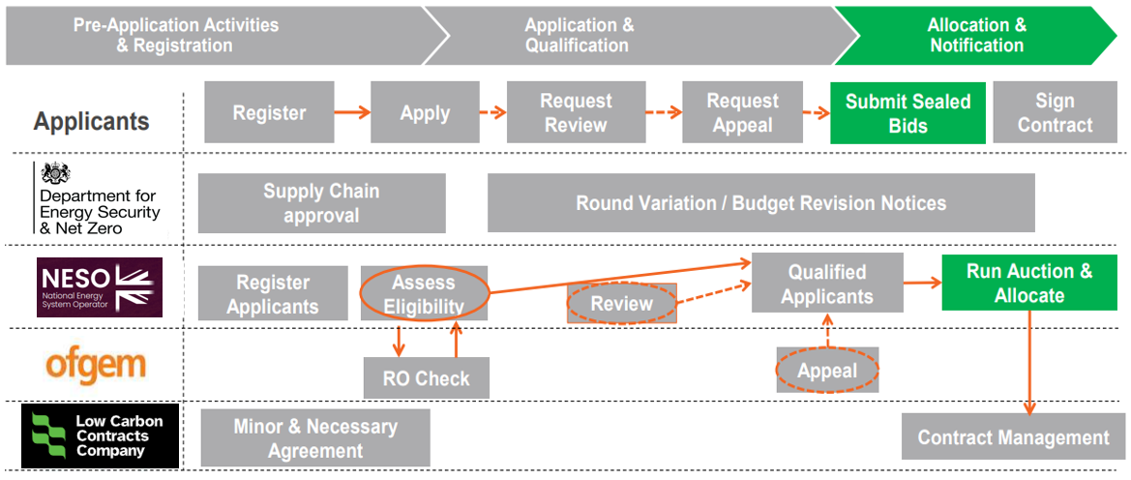
Allocation & Notification Process

Slide 39
Valuation of Applications
All qualifying applications must be valued by the Delivery Body in respect of each of the years specified in the Budget Notice.
The method of calculation will be set out in Schedule 2 (“Valuation Formula”) of the Final Allocation Framework. The Valuation Formula combines the following four components to calculate the overall budget impact.
Administrative Strike Price minus the Reference Price
ASP: Maximum Strike Price (£/MWh) that applies to an Application.
Reference Price: Market Electricity Price (£/MWh) in a given time period.
Capacity
MW Capacity value is the Initial Installed Capacity Estimate to 2 decimal places.
Technology Specific Factors
Load Factor specific to the technology
Additional Conversion Factors
i.e. Transmission Loss Multiplier (TLM), Days per Year, hours to days
This should be provided in MWAC Capacity for Solar PV Applicants
Year 1 Factor (YR1F) applied to each phase to account for partial year generation in the first year of operation of the project or phase
Renewable Qualifying Multiplier (RQM) and CHP Qualifying Multiplier (CHPQM).
Budget Impact
=

Slide 40
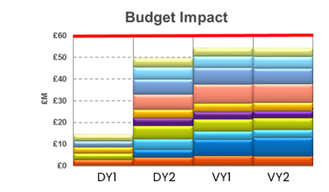
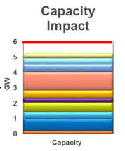
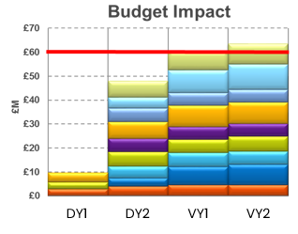
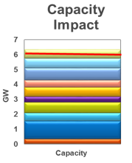
Auction Determination
Unconstrained Allocation
Unconstrained allocation is where all qualifying applications fit within both the budget and capacity constraints.
This would result in no auction and all applications shall be awarded a CfD at their respective Administrative Strike Price.
Budget and/or capacity breach
Constrained Allocation
Constrained allocation is where the Delivery Body determines that qualified applications exceed the relevant constraints, i.e. the pot value and/or the overall capacity limit.
This scenario would trigger the requirement to hold an auction to competitively allocate the budget to Applicants.
Budget and/or capacity breach

Slide 41
Applicant Submission of Sealed Bids
For anonymised Bid Information only one Sealed bid allowed
Valuation determines constrained allocation [Notice of Auction issued to Applicants]
Sealed Bids submitted via the CfD Portal
The sealed bids submission window will be 5 Working Days
Maximum of 4 sealed bids allowed [Max 2 per Delivery Year]
Applicants who do not submit a bid will be withdrawn (New rule 16.3)
Strike Price
Target Commissioning Window Start Date
(TCWSD)
Target Commissioning Date
(TCD)
Capacity
(MW)
Changes that can be made to each Sealed Bid:

Slide 42
Competitive Auction Process
All Sealed Bids compete on a Strike Price basis, operating the applicable order of auctions where necessary.
Sealed Bids are then assessed and allocated from the lowest to highest Strike Price. *
Bids which are tied on the same Strike Price will be handled by the Tiebreaker Rules, as set out in the Round specific Allocation Framework.
Successful applications are awarded a CfD at the pot clearing price set by the highest successful bid. **
*Flexible bids and interleaving will be considered in certain situations when a bid cannot be allocated.
**This is also subject to administrative strike prices and Max specific clearing prices.

Slide 43
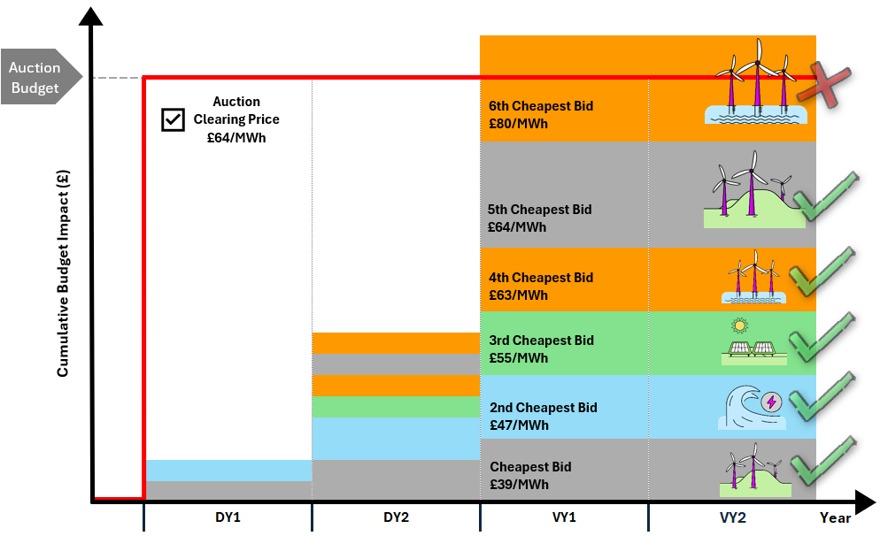
General Auction
The auction uses a ‘pay as clear’ methodology, where all successful bidders are paid the auction clearing price set by the most expensive successful bid – this is the strike price.
Bids are considered in order of bid price
All successful bidders are paid the auction clearing price set by the most expensive successful bid –
the strike price awarded is £64/MWh

Slide 44
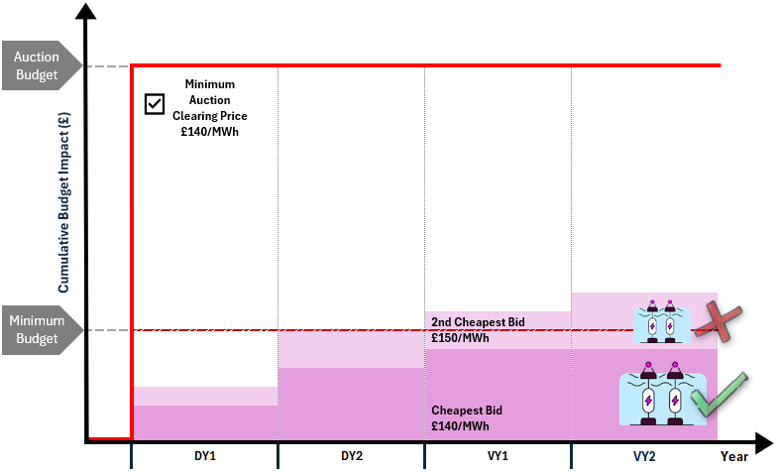
Minimum Auction
Minimum Auction followed by a main pot auction – slide 1 of 2
Bids are accepted in price order until the minimum, total budget, or capacity cap would be breached.
All successful projects receive one clearing price (the highest accepted bid, capped at the Administrative Strike Price).
Any unsuccessful bids carry over to the main pot auction.

Slide 45
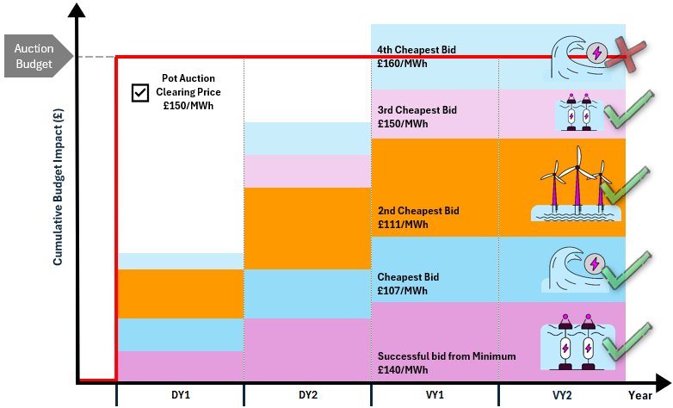
Minimum Auction
Minimum Auction followed by a main pot auction – slide 2 of 2
Unsuccessful Minimum bids re-enter the main auction.
Bids are re‑ranked based on price.
A new clearing price is established based on the highest successful bid in that auction.
A successful bid in the Minimum auction can have its strike price uplifted to the main auction clearing price, provided it does not exceed the Administrative Strike Price.

Slide 46
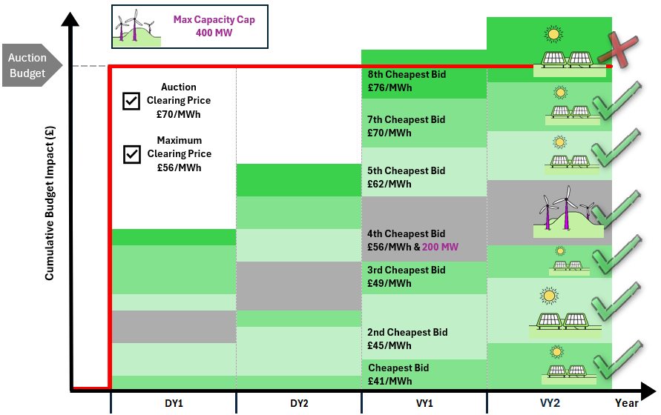
Maxima Auction
Pot Auction with a Capacity Maxima applied
Bids are accepted in price order until the maximum, total budget, or capacity cap would be breached.
A new clearing price is established based on the highest successful bid, whilst also maintaining the separate maximum only clearing price.

Slide 47
CfD auction – Separate Clearing Prices
Applicants should be aware that there are four technology specific separate clearing price rules that could be applied in the Allocation Round 8 CfD auction. The categories for Specific Separate Clearing Prices are:
Technology specific separate clearing rules
Technology plus Locational specific separate clearing rules
Technology plus Repowering specific separate clearing rules
Technology plus Project size specific separate clearing rules
If no Specific Separate Clearing Prices are set out in the Pot and Price Notice or the Contract Budget Notice, then the clearing rules set out in Rules 19-22 that do not apply with respect to Specific Separate Clearing Prices shall be followed. We may refer to this a default clearing rules in this presentation.

Slide 48
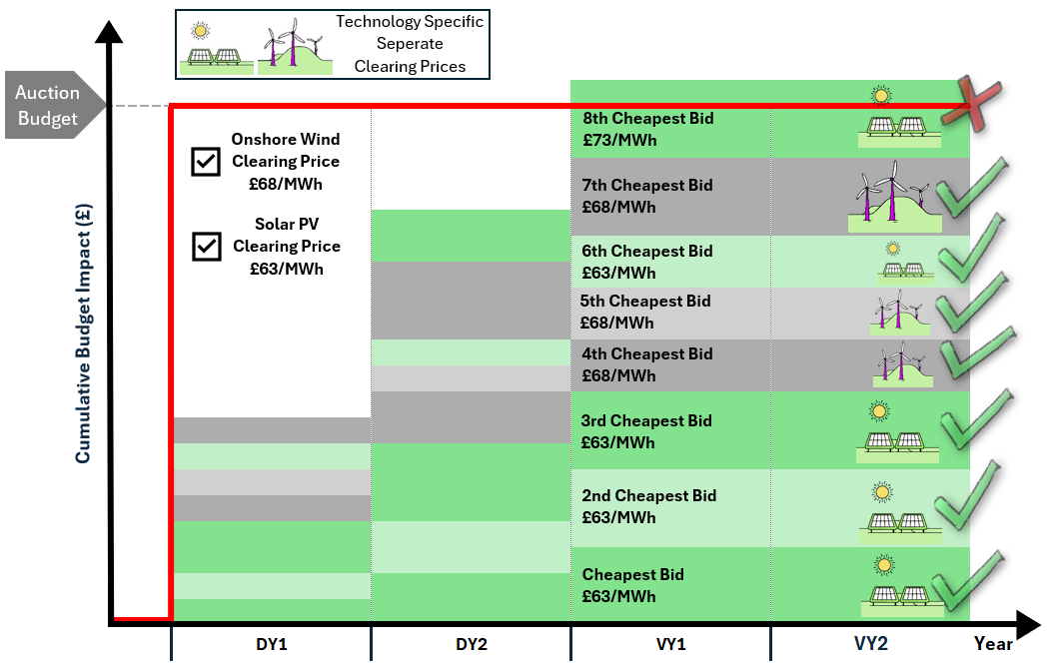
CfD auction – Separate Clearing Prices
Pot Auction with Technology Specific Clearing Price Rules
In this example, ‘Technology Specific Clearing Rules’ have been applied to Solar PV and Onshore Wind applications.
The auction still uses a ‘pay as clear’ methodology, where all successful bidders are paid the auction clearing price set by the most expensive successful bid from each technology group where applicable.
Technology Specific bids are cleared to a separate technology only clearing price for each technology.
Onshore Wind & Solar PV will clear to a separate strike price.

Slide 49
CfD Notification – Post Competitive Auction or Allocation Process
Independent Auditor carries out an assessment of the Delivery Body’s Allocation Result, along with a controls audit of the whole Allocation Round.
Secretary of State undertakes a review of the Auditors report and Delivery Body’s Results, and will decide whether to Proceed, Re-run or Cancel the Allocation Process.
Delivery Body releases the results to the Applicants and the necessary notifications to the Low Carbon Contracts Company, which include:
All Applicants
All Applicants will be notified via an allocation results letter as to whether the application has been Successful or Unsuccessful in securing a CfD contract.
Successful Qualifying Applicants/LCCC
The awarded CfD Strike Price
Successful Allocation Capacity
Target Dates (TCWSD, TCD, TCW)
Company Details and relevant contacts for the contract issuing process
Letter is accessible via the CfD Portal.

Slide 50
NESO Wrap Up
Richard Griffiths

Slide 51
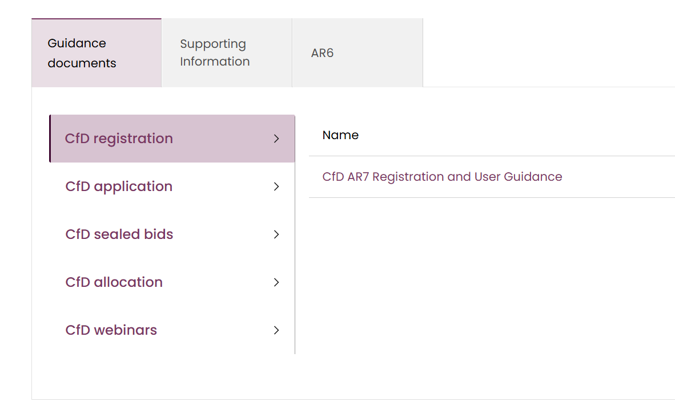
Ongoing Support
Registration:
opens 2nd July
Applications:
opens 20th July
closes 5pm 7th August
The CfD Portal can be found here
The CfD team have prepared guidance documents to help applicants prepare for their application
The Joint Delivery Partner Microsite also holds all key documentation
You can contact us via phone or e-mail Monday to Friday:
  Telephone – 01926 655 300 – Open 9am to 4pm
  E-mail – box.emr.cfd@neso.energy
During key milestones, such as the Assessment period, the team are unavailable for queries

Slide 52

Coffee break
10 mins

Slide 53
AR8 Contracts for Difference (CfD)
LCCC Key CfD terms and signing process (M&N, pre-bidding, post-allocation)
LCCC June-26

Slide 54

Agenda
Disclaimer
LCCC does not speak on behalf of government and we do not make policy.
These slides are for educational purposes only.
When we refer to the CfD, we are referring to the standard power sector CfD to which we are the counterparty.
The content of slides and any statements made by LCCC in the presentations are provided in good faith, however, neither the content of the slides nor any statements made are (or are intended to be) any form of representation, undertaking, warranty or legal advice and do not (and are not intended to) take precedence over the provisions of the CfD, the terms of which shall always prevail.
01
About LCCC - Alba Mullen, Policy & Commercial Development Manager
Minor & Necessary, Engagement with LCCC during Allocation Window & Contract Production / Signing – Oana Barbuta & Slavi Stoencheva, Legal Team, Madison Webb, Communications Team.
02
03​
CfD Milestones - Serena Pook, Lead Contract Manager

Slide 55
LCCC Overview
Alba Mullen – Policy & Commercial Development Manager
LCCC at a glance
Enabled achievements

Slide 56


LCCC at a glance
Our Technologies
Our Mission
Our Vision
Offshore wind
Onshore wind
Dedicated
Biomass
with CHP
Remote
Island wind
To accelerate the delivery of Net Zero
To shape and implement schemes which enable
low-carbon investment at least cost to the consumer
Floating
Offshore
wind
Energy from
Waste with CHP
Advanced
Conversion
Technologies
Biomass
Conversion
Solar
Tidal
Nuclear
Geothermal
Hydrogen
Carbon Capture, Usage and Storage
Our Guiding Principles
Our Values
Maintain investor confidence
Minimise cost to the consumer
Powered by Curiosity
Better Together
Own Every Outcome

Slide 57
LCCC at a glance
01
02
03
04
DESNZ
Low Carbon
Contracts Company
Generating power
without CfD
NESO
Contract signing
Project delivery & CfD obligations
Scheme design and delivery expertise
Policy definition
Auction parameters
Budget setting
Auction application process
The Auction
End of CfD term & project tail end
Decommissioning

Slide 58
Achievements – Supporting Regional Delivery
£77 billion
13*
520
Private Investment
leveraged
Technologies
Capacity providers from a
diverse range of technologies
We have facilitated
investment in new low carbon
projects (up to AR6 projects)
Technologies supported by the CfD, enabling both nascent and mature technologies *including H2
Capacity providers help ensure
security of supply
~37%
562*
10*
GB
energy demand
Renewable
electricity contracts
Hydrogen
production projects
By 2031, CfDs are expected to generate approximately 138 TWh of electricity from projects up to and including AR7/7a. This equates to about 37% of GB’s forecasted energy demand for 2031
CfD contracts under
management including HPC,
excluding H2
CfDs to account for 125MW from
Hydrogen allocation round 1
*Contracts yet to be signed

Slide 59
Pre Application Window & Contract Award
Slavi Stoencheva
What considerations need to be made before application window?
How does Contract Award happen?

Slide 60
Minor and Necessary Requests
The process:
Engage early with us
Apply during the M&N Modification Request Window
Opens after publication of Allocation Round Notice
Closes no less than 20 working days before the application closing date specified in the Allocation Round Notice
Information to be provided must include:
  Short description of change
  Proposed amendment in tracked changes to the CfD wording
  Explanation of why it is both minor AND necessary
  Determination before application closing date ensures applicants can submit, amend or withdraw their applications based on this determination
  You can find the recording of the M&N webinar which takes you through the process on the CfD Allocation Round Portal here as well as our guidance on making a M&N application here. Please send any M&N requests by email to cfdmandn@lowcarboncontracts.uk

Slide 61


Day 0 to 10 following successful auction
Contract Production
BD 0: NESO sends CfD Notification to successful Generators and LCCC
BD 0 - 3: LCCC makes contact with Generators and welcome letters sent
BD 3 – 10: LCCC sends out contracts in batches

Slide 62
Day 3 to 50 following successful auction
Contract Signing
BD 3 - 10: Generators receive electronic copy of the Contract signed by LCCC
BD 4 - 20: By no later than 5:00pm 10 Business Days after the contract was issued countersigned CfD must be received by LCCC from the Generator
BD 5 - 40: Generator must meet Initial Conditions Precedent within 20 Business Days of contract being signed and returned to LCCC
To note: LCCC will only offer the contract to the party named in the CfD Notification.

Slide 63
Engagement with LCCC during Allocation Window
During application phase:
During the application window and assessment phase, applicants are expected to seek guidance from published documentation and notices.
Queries may be submitted to info@lowcarboncontracts.uk
Responses are limited to general, non-site-specific queries
Engagement begins once contracts have been awarded and LCCC has been notified, at which point a Contract Manager is allocated
  Please note that, until a CfD has been awarded, we are limited in the guidance we can provide. NESO remains the appropriate point of contact for application and assessment queries during the window, with escalation routes used where issues cut across delivery bodies. We are committed to ensuring all applicants have equal access to information, with updates shared on the CfD Allocation Round Portal to support a fair and transparent process.
  You can access our guidance on the query process here and send any non-site-specific requests by email to info@lowcarboncontracts.uk

Slide 64
CfD Key Terms & Milestones
Serena Pook – Lead Contract Manager

Slide 65
CfD Milestone Overview
Initial Conditions Precedents (ICP)
Conditions must be fulfilled before the contract is in effect
Milestone Delivery Date (MDD)
To demonstrate commitment to the project, Generators must achieve the Milestone Requirement via one of two methods: 10% spend or Project Commitment route.
Operational Conditions Precedent (OCP)
Conditions must be fulfilled prior to the Start Date
Target Commissioning Window (TCW)
A Start Date after the TCW End Date results in contract erosion (i.e. reduced subsidy payments)
Long Stop Date
Date by which Generator must produce declared amount of electricity
Final Installed Capacity
The capacity set for the CfD term on which the CfD payments will be based upon
MDD
Milestone Requirement must be met
TCD
Target Commissioning Date
LSD
Last date by which the CfD must start
Agreement Date
Contract signature
ICP Deadline
Initial Conditions Precedent must be met
TCW Start
Earliest the CfD can start
TCW End
Last date to start CfD to maintain full term
FIC
Final Installed Capacity set
Notes:
65

Slide 66
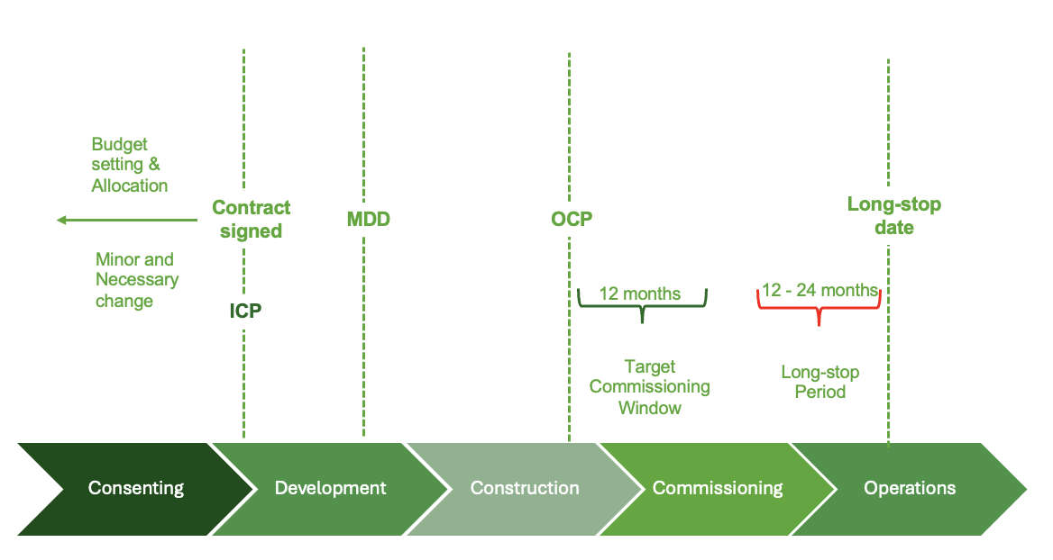
Initial Condition Precedent (ICP)
First contractual milestone, requires Generators to provide specific information to demonstrate they can legally enter into a CfD and perform their obligations
Within 20 Business Days of signing the CfD, Generators must provide:
  Legal Opinion – Confirming the Generator’s legal capacity and authority to enter into / perform the CfD
  Know Your Customer (KYC) information - LCCC must be satisfied of the legal identity, ownership and control of the Generator
  Facility Description - Details of the assets comprising the Facility and a map or plan of the Facility
  Failure to fulfil the Initial Conditions Precedents provides LCCC with a right to terminate the CfD.

Slide 67
Milestone Delivery Date (MDD)
Milestone Requirement (MR) confirms progress of Projects and intends to deter speculative bids and mitigate risk of CfD budget blocking
Within 18 months of the CfD being granted, the Generator must provide evidence via:
the “10% spend” route - demonstrating that it and its direct shareholders have spent 10% or more of a project’s pre-commissioning costs; or
18-months
Agreement Date
Contract signature
MDD
Milestone Requirement must be met
the “Project Commitments” route - including
    A board resolution to progress the project
    Evidence of sufficient financial resources to meet
    the Total Project Spend
    Site Leases and Necessary Consents
    Executed Material Equipment contracts
    A Directors' Certificate is required to affirm information accuracy.
Failure to meet the MR by the MDD provides LCCC with a right to terminate the CfD.

Slide 68
Operational Condition Precedents (OCPs)
Generator must complete the OCPs before issuing a Start Date Notice
TCW Start
TCW End
LSD
Evidence that 80% of the Installed Capacity Estimate has been commissioned
Metering
Evidence that all Communications Equipment is commissioned and compliant with BSC
CHP/FMS
3 months notice of intended start date if Embedded Generator (distribution)
Notification and detail of a Market Supply Agreement
Compliance with transmission grid code or distribution code for connection and export
Settlement
CfD settlement information – with correct systems and processes in place
Installed Capacity
Evidence that the generator is complying with Metering Compliance Obligations
Time stamped electrical schematic diagram showing location of metering equipment
Communications Equipment
Combined Heat and Power Quality Assurance (CHPQA) procedures available
Embedded Generator specific
Grid connection
Fuel Measuring Sampling (FMS) procedures available
12 months
Longstop Period
12 – 24 months
Key message: This is beyond evidence usually required for project commissioning

Slide 69
Target Commissioning Window and Longstop Date
TCW Start
TCW End
LSD
Reporting requirements are expected Start Date and the Installed Capacity on the :
  Agreement Date
  monthly basis for the 6 months prior to the Expected Start Date
  upon request and
  when a generator becomes aware there is a change
12 months
Longstop Period
12 – 24 months
Please note:
The Start Date cannot occur before commencement of the Target Commissioning Window (TCW)
The CfD’s term will begin to erode after the last day of the TCW regardless of whether the Start Date has occurred
The CfD may be terminated where the Generator does not achieve the Start Date and / or commission at least the Required Installed Capacity (RIC) before the Longstop Date
Required Installed Capacities are 85% for offshore wind and 95% for all other technologies

Slide 70
Final Installed Capacity (FIC)
Generator must declare Final Installed Capacity (FIC) no later than 10 working days after the Longstop Date
FIC can be no higher than Installed Capacity Estimate (ICE) and no lower than Required Installed Capacity (RIC)
Level of difference payment is capped at the declared FIC – this is the Maximum Contract Capacity (MCC)
Any generation in excess of the MCC may be sold as merchant capacity but LCCC must be consulted
FIC is the last of the CfD milestones but equally important as failure to comply confers a right of contract termination
TCW Start
TCW End
LSD
FIC
12 months
Longstop Period
10 days
12 – 24 months

Slide 71
Installed Capacity Journey
“Installed Capacity” is the capacity of the Facility (expressed in MW) were it to be operated at optimal conditions on a continual basis at the maximum capacity possible without causing damage to it, net of any loads due to operating the Facility and any losses incurred between the generators and the meter
Initial
ICE
MW
Revised
ICE
ICE
FIC
OCP
RIC
IICE – Initial Installed Capacity Estimate
ICE = Installed Capacity Estimate
MDD = Milestone Delivery Date
RIC = Required Installed Capacity
FIC = Final installed Capacity
MCC = Maximum Contract Capacity
Allocation
CFD Signed
MDD
Start Date
Longstop Date
Time
Permitted Reduction of 25%
OCP requires 80% of ICE to be commissioned to issue Start Date Notice
MCC = ICE until FIC declared, then MCC = FIC. Payments can never go above MCC
* IICE or ICE may also be reduced for a Relevant Construction Event at any time prior to the Longstop Date.
85%+ of ICE for offshore wind or 95%+ for all other technologies

Slide 73
www.ofgem.gov.uk
Ofgem is the Office of Gas and Electricity Markets. We are a non-ministerial government department and an independent National Regulatory Authority, recognised by EU Directives. Our role is to protect consumers now and in the future by working to deliver a greener, fairer energy system.
We do this by:
working with Government, industry and consumer groups to deliver
a net zero economy at the lowest cost to consumers.
stamping out sharp and bad practice, ensuring fair treatment for all consumers, especially the vulnerable.
enabling competition and innovation, which drives down prices and
results in new products and services for consumers.

Slide 74
Ofgem’s Role in the CfD Appeals Process
IF
AND
THEN
AND
IF | an applicant’s prequalification submission is rejected
AND | the DB has undertaken a non-qualification (“Tier 1”) review and upheld the rejection
THEN | the CfD applicant can submit a (“Tier 2”) appeal to Ofgem under Reg 43 of the CfD Regulations
THEN | Ofgem must assess and resolve this appeal between the NESO Delivery Body (“the DB”) and the applicant

Slide 75
How to request resolution of a dispute
If the DB has issued a non-qualification notice after a Tier 1 review, the applicant can apply to Ofgem for a Tier 2 review
The appeal notice to submit to Ofgem can be found in Appendix 2 of our Disputes Guidance
This is submitted to EMR_DR@ofgem.gov.uk within 5 working days of the DB Tier 1 decision
Ofgem will confirm receipt
Ofgem will consider the appeal and will then uphold or overturn the DB decision
This decision will then be published on our website

Slide 76
Indicative Appeal Timeline
NESO Issues Decision Notice
5 Days
Appeal Submitted to NESO
10 Days
NESO Issues Reconsidered Decision Notice
5 Days
Appeal Submitted to Ofgem
Appellant can request that the NESO review the decision
Appellant may request that Ofgem reviews the decision
NGESO reconsiders the application
Appeal Submitted to Ofgem
20 Days
Ofgem Issues Decision
28 Days
Appeal Submitted to the Court
Court Issues Its Decision
Appellant may appeal to the Court for a review of the Ofgem decision
Ofgem will consider the decision and seek to respond
Court will consider and make decision
Ofgem may exceed the 20-day target if this is necessary, e.g. to reach a robust, rational and procedurally fair decision, or due to a high volume of applications. If this is the case, Ofgem will inform parties to the dispute how much additional time will be required.

Slide 77
Appeal: Required Information
Appeal
Notice
Statement identifying disputed part of DB decision and setting out key facts
Summary of grounds for dispute.
Succinct arguments supporting each of the grounds
Schedule listing further documents submitted
Non-qualification determination
Tier 1 decision notice
Evidence submitted to DB for Tier 1 Review
Indication of what evidence DB had at Tier 1 review
Other relevant evidence
Accompanying Documents

Slide 78
Ofgem Review Process
Upon receiving the appeal notice:
Ofgem will notify the DB that an appeal has been submitted
Ofgem will only review the decision made by the DB - applicants should only provide information submitted with their original application or information that clarifies a believed DB misunderstanding
Ofgem will consider whether the DB correctly applied the CfD Regulations and CfD Allocation framework correctly, based on the evidence they had before them at the time of the decision
Ofgem will send a copy of our decision to the applicant and the DB, and will publish a copy on our website

Slide 79
Outcome of an appeal
Successful Tier 2
Appeal
Ofgem may determine that an appellant does qualify
Regulations 51 and 52 of the CfD Regulations explain how this affects participation in the allocation process if the round has already commenced
Unsuccessful Tier 2
Appeal
Once we have issued a decision notice, we will not consider the dispute further
If we decide not to overturn the DB’s decision, the appellant can appeal to the Court to reconsider out decision

Slide 80
Coffee break
5 mins

Slide 81

Q&A panel
Chair: Jamie Balbes, DESNZ
Panellists:
Theo Kaloudiotis
Stuart Wells
Jatinder Sembi
Helen Cox
Richard Griffiths
Serena Pook
Oana Barbuta
Alba Mullen
Slavi Stoencheva
Madison Webb
Nick Allen
Myra Fazal
Burhan Ali
Usama Malik

Slide 82


Thank you
Contracts for Difference
AR8 Launch Event 24 June 2026

